Slide 1

Artificial Intelligence
Machine learning
Fall 2008
professor: Luigi Ceccaroni

Slide 2
Knowledge acquisition
Reference frame: construction of a knowledge-based system:
  Knowledge acquisition
  Knowledge representation
  Definition of a resolution method
  Construction of an inference engine
2

Slide 3
Knowledge acquisition
Adquisició del coneixement ≡ Traspàs del coneixement d’un o més experts (o fonts de coneixement) en un domini determinat, cap a un formalisme de representació computable del coneixement
FC₁ ≡ Expert₁
. . . .
FC_{n} ≡ Expert_{n}
Enginyer
del
coneixement
Base
de
coneixement
Domini (fets, relacions, associacions)
Coneixement
Procés de resolució (heurístiques, mètodes)
3

Slide 4
Methodologies to acquire knowledge
Interviews with experts
Techniques based on inductive machine learning
  Construction of decision trees:
    Nodes represent descriptors
    Branches represent possible values of the descriptor
4

Slide 5
Inductive machine learning
Techniques oriented to analysis problems (classification/interpretation)
The expert expresses his knowledge in a familiar form:
  observations/examples
5

Slide 6
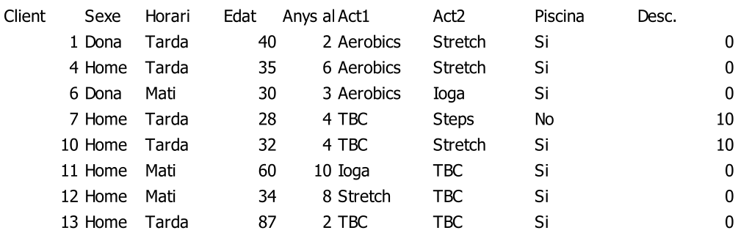
Inductive machine learning
Sample data:
6

Slide 7
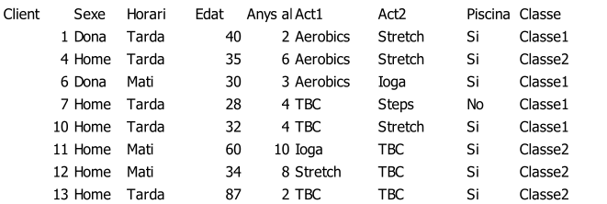
Inductive machine learning
First objective: Grouping similar objects via clustering methods
7

Slide 8
Inductive machine learning
Second objective: Classifying new objects
The starting point is more informed, given that groups have been already defined.
Specific characteristics of each group/class are determined, to be able to assign a new object to a class.
8

Slide 9
Inductive machine learning
Methods:
  Decision trees:
    CART, ID3, ASSISTANT, C4.5, C5.1
  Classification rules
    If Act1 is steps
    Then
    Act2 is ioga
    Rule's probability: 0.9
    The rule exists in 52 records.
9

Slide 10
Decision trees
Té tos
No
A lot
A little
Té febre
Pols alterat
Té mucositat
Yes
No
Yes
No
No
Yes
Decisión 1
Decisión 2
Decisión 3
Decisión 4
Decisión 5
Decisión 6

Slide 11
ID3
ID3 ≡ Induction of Decision Trees [Quinlan, 1979, 1986]
Top-down strategy
Starting from a set of examples/instances and their classes, it creates the tree which best explains them.
11

Slide 12
ID3
It’s a greedy algorithm for the automatic construction of decision trees, which selects at each step the best descriptor.
→
The best one is the most discriminant (potentially more useful).
It lets reduce the size of the decision tree.
The selection is done maximizing a function G(X,A), which represents the information gain.
12

Slide 13
ID3
The construction process is iterative:
  A subset of instances (window) is selected from the training set.
  The decision tree is built, which allows to discriminate the instances of the window.
  If the decision tree explains the rest of instances of the training set
  then it is the final tree,
  else the instances wrongly classified (exceptions) are added to the window and the process go back to (2)
  endIf

Slide 14
Information gain
Information (X = instances, C = classification):
Entropy (A = attribute, [A(x) = v_{i} ] represents instances with value v_{i} ):
Information gain:

Slide 15
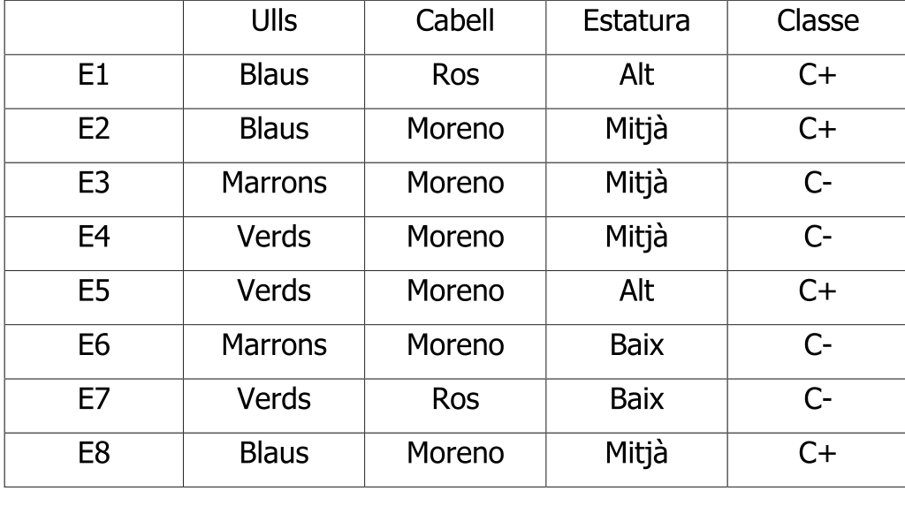
ID3: example

Slide 16
ID3: example
I (X, C) = -1/2 log₂ 1/2 -1/2 log₂ 1/2 = 1
(1,2,5,8) (3,4,5,7)
C+ C-
E (X, Ulls) = 3/8 (-1 log₂ 1 - 0 log₂ 0) +
2/8 (-0 log₂ 0 - 1 log₂ 1) +
3/8 (-1/3 log₂ 1/3 - 2/3 log₂ 2/3) = 0.344
E (X, Cabell) = 2/8 (-1/2 log₂ 1/2 - 1/2 log₂ 1/2) +
6/8 (-3/6 log₂ 3/6 - 3/6 log₂ 3/6) = 1
E(X, Estatura) = 2/8 (-1 log₂ 1 - 0 log₂ 0) +
4/8 (-1/2 log₂ 1/2 - 1/2 log₂ 1/2) +
2/8 (-0 log₂ 0 - 1 log₂ 1) = 0.5
16

Slide 17
ID3: example
G (X, Ulls) = 1 - 0.344 = 0.656
G (X, Cabell) = 1 - 1 = 0
G (X, Estatura) = 1- 0.5 = 0.5
Ulls
Blaus
Verds
Marrons
1,2,8 3,6 4,7, 5
+ - - +
Cabell Estatura Classe
E4 Moreno Mitjà C-
E5 Moreno Alt C+
E7 Ros Baix C-

Slide 18
ID3: example
I (X, C) = -1/3 log₂ 1/3 -2/3 log₂ 1/3 = 0,918
(5) (4,7)
E (X, Cabell) = 1/3 (- 0 log₂ 0 - 1 log₂ 1) +
2/3 (-1/2 log₂ 1/2 - 1/2 log₂ 1/2) = 2/3
E (X, Estatura) = 1/3 (-0 log₂ 0 - 1 log₂ 1) +
1/3 (-1 log₂ 1 - 0 log₂ 0) +
1/3 (-0 log₂ 0 - 1 log₂ 1) = 0
G (X, Cabell) = 0,918 - 0,666 = 0,252
G (X, Estatura) = 0,918 - 0 = 0,918
Ros

Slide 19
ID3: example
Ulls
Blaus
Verds
Marrons
1,2,8 3,6 4,7, 5
+ - - +
Estatura
Alt
baix
Mitjà
5 4 7
+ - -

Slide 20
ID3: example
Ulls = Blaus → C+
Ulls = Marrons → C-
Ulls = Verds ∧ Estatura = Alt → C+
Ulls = Verds ∧ Estatura = Mitjà → C-
Ulls = Verds ∧ Estatura = Baix → C-

Slide 21
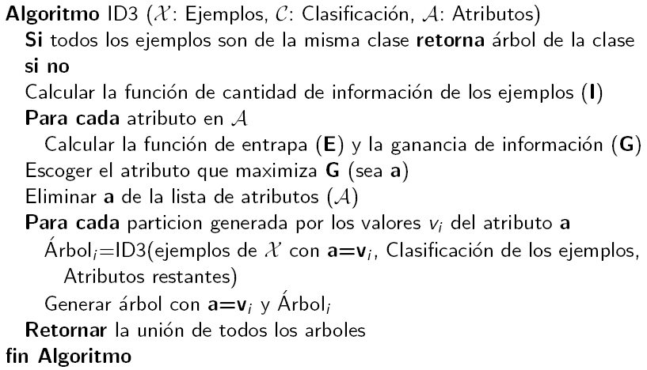
ID3: algorithm

Slide 22
Tipos de aprendizaje
Aprendizaje inductivo: Creamos modelos de conceptos a partir de generalizar ejemplos simples. Buscamos patrones comunes que expliquen los ejemplos.
Aprendizaje analítico o deductivo: Aplicamos la deducción para obtener descripciones generales a partir de un ejemplo de concepto y su explicación.

Slide 23
Tipos de aprendizaje
Aprendizaje genético: Aplica algoritmos inspirados en la teoría de la evolución para encontrar descripciones generales a conjuntos de ejemplos.
Aprendizaje conexionista: Busca descripciones generales mediante el uso de la capacidad de adaptación de redes de neuronas artificiales.

