Slide 1
Artificial Intelligence Knowledge-based systems
Fall 2008
professor: Luigi Ceccaroni

Slide 2
Introduction
The picture of problem solving that had arisen during the 1960’s was of a general-purpose search mechanism trying to string together elementary reasoning steps to find complete solutions.
Such approaches have been called weak methods, because, although general, they do not scale up to large or difficult problem instances.
In the methods we have seen so far exploration is based on just one heuristic function.

Slide 3
Introduction
Expressive capacity of heuristic functions is limited.
The alternative to weak methods is to use more powerful, domain-specific knowledge that allows larger reasoning steps and can more easily handle typically occurring cases in narrow areas of expertise.
One might say that to solve a hard problem you have to almost know the answer already.

Slide 4
The history of knowledge-based systems (KBS)
The history of KBSs starts in 1958, a historical year.
John McCarthy and Marvin Minsky moved to MIT and made crucial contributions:
Definition of the high-level language Lisp
Publication of the Advice Taker
Microworlds (limited domains)
4

Slide 5
The Advice Taker
In 1958, McCarthy published a paper (Programs with Common Sense), in which he described the Advice Taker, a hypothetical program that can be seen as the first complete AI system.
McCarthy’s program was designed to use knowledge to search for solutions to problems.
Unlike others, it embodied general knowledge of the world.
For example, he showed how some simple axioms would enable the program to generate a plan to drive to the airport to catch a plane.
The program was also designed so that it could accept new axioms in the normal course of operation, thereby allowing it to achieve competence in new areas without being reprogrammed.

Slide 6
The Advice Taker
The Advice Taker thus embodied the central principles of knowledge representation and reasoning:
to have a formal, explicit representation of:
the world
the way an agent’s actions affect the world
to be able to manipulate these representations with deductive processes
It is remarkable how much of the 1958 paper remains relevant after 50 years.
Later systems incorporated the main theme of McCarthy’s Advice Taker approach:
Clean separation of the knowledge (in the form of rules) and the reasoning component

Slide 7
The DENDRAL program
The DENDRAL program was an early example of this approach.
It was developed at Stanford by:
Ed Feigenbaum (a former student of Herbert Simon)
Bruce Buchanan (a philosopher turned computer scientist)
Joshua Lederberg (a Nobel laureate geneticist)
Problem to be solved: inferring molecular structure from the information provided by a mass spectrometer.
The input to the program consists of:
the elementary formula of the molecule (e.g., C₆H₁₃NO₂)
the mass spectrum giving the masses of the various fragments of the molecule generated when it is bombarded by an electron beam
For example, the mass spectrum might contain a peak at m = 77 corresponding to the mass of a phenyl cation fragment.

Slide 8
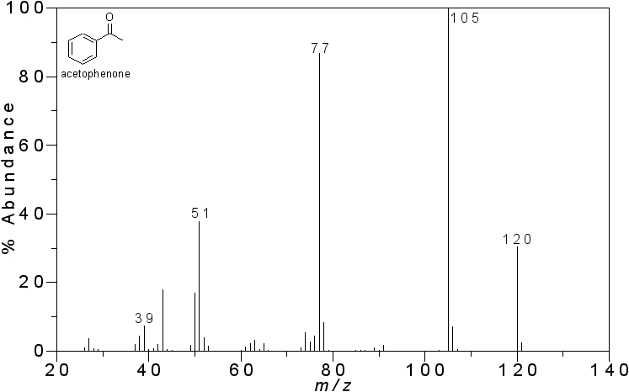
The DENDRAL program

Slide 9
The DENDRAL program
The naive version of the program:
generated all possible structures consistent with the formula
then predicted what mass spectrum would be observed for each
then compared this with the actual spectrum
As one might expect, this rapidly became intractable for decent-sized molecules.

Slide 10
The DENDRAL program
The DENDRAL researchers consulted analytical chemists and found that they worked by looking for well-known patterns of peaks in the spectrum that suggested common substructures in the molecule.
For example, the following rule is used to recognize a ketone (C=O) subgroup:
if there are two peaks at x1 and x2 such that:
(a) x1 + x2 = M + 28 (M is the mass of the whole molecule)
(b) x1 - 28 is a high peak
(c) x2 - 28 is a high peak
(d) at least one of x1 and x2 is high
then there is a ketone subgroup

Slide 11
The DENDRAL program
Having recognized that the molecule contains a particular substructure, the number of possible candidates is enormously reduced.
The system was powerful because all the relevant theoretical knowledge to solve these problems has been mapped over from its general form (“first principles”) to efficient special forms (“cookbook recipes”).

Slide 12
The DENDRAL program
The significance of DENDRAL was that it was arguably the first successful knowledge-intensive system:
Expertise derived from large numbers of special-purpose rules

Slide 13
From HPP to MYCIN
Feigenbaum and others at Stanford began the Heuristic Programming Project (HPP):
to investigate the extent to which the new methodology of expert systems could be applied to other areas of human expertise.
The next major effort was in the area of medical diagnosis.
Feigenbaum, Buchanan and Edward Shortliffe developed MYCIN to diagnose blood infections.

Slide 14
MYCIN
With about 450 rules, MYCIN was able to perform as well as some experts, and considerably better than junior doctors.
It contained major differences from DENDRAL:
Unlike the DENDRAL rules, no general theoretical model existed from which the MYCIN rules could be deduced.
Rules had to be acquired from extensive interviewing of experts, who in turn acquired them from direct experience of cases.
Rules had to reflect the uncertainty associated with medical knowledge.
MYCIN incorporated a calculus of uncertainty called certainty factors, which seemed to fit well with how doctors assessed the impact of evidence on the diagnosis.

Slide 15
Natural language
The importance of domain knowledge was also apparent in the area of understanding natural language.
Although Winograd’s SHRDLU system for understanding natural language had engendered a good deal of excitement, its dependence on syntactic analysis caused some of the same problems as occurred in the early machine translation work.
It was able to overcome ambiguity and understand pronoun references, but this was mainly because it was designed specifically for one area—the blocks world.

Slide 16
Natural language
Several researchers, including Eugene Charniak, a fellow graduate student of Winograd’s at MIT, suggested that robust language understanding would require general knowledge about the world and a general method for using that knowledge.
Schank and his students built a series of programs that all had the task of understanding natural language.
The emphasis, however, was less on language per se and more on the problems of representing and reasoning with the knowledge required for language understanding.
The problems included representing stereotypical situations, describing human memory organization, and understanding plans and goals.

Slide 17
The LUNAR system
William Woods (1973) built the LUNAR system, which allowed geologists to ask questions in English about the rock samples brought back by the Apollo moon mission.
LUNAR was the first natural language program that was used by people other than the system’s author to get real work done.
Since then, many natural language programs have been used as interfaces to databases.

Slide 18
Characteristics of problems solvable with ESs
High complexity
Need of an expert solution
Well defined problem
No need of common-sense reasoning
Difficult solution through traditional methods
Existence of cooperative experts (for the development)

Slide 19
From ESs to KBSs (1980’s)
From emulation of human expertise to use of domain knowledge to solve problems
Inclusion of automatic knowledge acquisition into the knowledge engineering process
From just production rules to cases, qualitative models, intelligent agents
From closed systems to open systems able to learn

Slide 20
Modern knowledge based systems (KBSs)
Evolution of expert systems
Modular and formal knowledge bases (ontologies)
Auto-explanation component
Meta-knowledge
Conflict-resolution strategies
Learning

Slide 21
Recent applications of KBSs
Gulf war (1990-91)
Cargo management of transport planes
Planning and coordination of operation Desert Storm
Pilot's Associate project
Battle Management System project
New Millennium Remote Agent (1999)
The New Millennium Remote Agent (NMRA) is an autonomous spacecraft control system developed jointly by NASA Ames and JPL.
It integrates constraint-based planning and scheduling, robust multi-threaded execution, model-based diagnosis and reconfiguration, and real-time monitoring and control.
NMRA controlled Deep Space One (DS-1), the first flight of NASA's New Millennium Program (NMP).
As the first AI system to autonomously control an actual spacecraft, NMRA will enable the establishment of a "virtual presence" in space through an armada of intelligent space probes that autonomously explore the solar system.

Slide 22
Recent applications of KBSs
Genetic engineering (1990’s)
Manipulation of very large knowledge bases to map human DNA (bioinformatics)
NEPTUNE program (2007)
NEPTUNE will deploy a regional cabled ocean observatory on the Juan de Fuca tectonic plate off the coasts of Washington, Oregon, and British Columbia.
Extensive networks of instruments will enable studies of a wide range of oceanographic, geological, and ecological processes.
Mini observatories at nodes will be equipped with multitudes of instruments, sensors, and robots that extend from the sea surface to below the seafloor.
The system will provide real-time data and imagery to shore-based laboratories and classrooms and interactive control over robotic vehicles and instruments.
NEPTUNE may also serve as a unique testbed for sensor and robotic systems designed to explore other oceans in the solar system.

Slide 23
Recent applications of KBSs
Programs for continuous speech recognition, which exactly transform speech to text
Programs to automatically search and summarize documents
Face-recognition systems
Washing machines that automatically adjust to different conditions to wash clothes
Automatic mortgage underwriting systems

Slide 24
Recent applications of KBSs
Automatic investment decision makers
Credit fraud detection systems
Shopping bots on the web
E-mail filters
Automated advice systems that personalize their responses

Slide 25
Recent applications of KBSs
Programs using case-based reasoning to support health and safety compliance in the chemical industry
Expert systems for the long-term scheduling of drivers and guards of railways systems
Case-based and constraint-based apartment construction planning systems
Expert systems designed to troubleshoot computer hardware failures by diagnosing the cause of server failure
Speech recognition software bundled with operating systems (e.g., Windows Vista)

Slide 26
Architecture of KBSs
Knowledge storage subsystem (ontology)
Learning subsystem
State storage subsystem
Knowledge use and interpretation subsystem (inference engine)
User communication subsystem
Justification and inspection subsystem
Reasoning
subsystem

Slide 27
Architecture of a rule-based system (RBS)
U
S
E
R
E
X
P
E
R
T
S
K
N
O
W
L
E
D
G
E
E
N
G
I
N
E
E
R
User
interface
Knowledge
acquisition
K
N
O
W
L
E
D
G
E
E
N
G
I
N
E
E
R
I
N
T
E
R
F
A
C
E
Explanation
module
Facts
base
Rules
base
Inference engine
M
E
T
A
-
R
E
A
S
O
N
I
N
G
S
E
N
S
O
R
S
/
S
T
R
A
T
E
G
A
C
T
U
A
T
O
R
S
I
E
S
I
N
T
E
R
F
A
C
E
S
E
N
S
O
R
S
/
E
X
E
C
U
T
I
O
N
C
O
N
T
R
O
L
U
N
I
T
A
C
T
U
A
T
O
R
S

Slide 28
RBS: Knowledge storage subsystem
Facts base
Description of the current state of the system
Domain model
facts, classes, concepts
slots
facets
Rules base
Knowledge about the domain and the resolution process
Inference rules:
IF <conditions> THEN <actions>
28

Slide 29
RBS: Modular knowledge bases
Module: set of related rules
similar conclusions
similar conditions
same sub-domain
Each module can include:
identifier
rules
meta-rules
29

Slide 30
RBS: Meta-knowledge
Control over how to apply the rules (meta-rules separated from knowledge)
Strategies of conflict resolution
Processing order for strategies
Rule inhibition/disinhibition
Kind of reasoning (forward/backward chaining)
Certainty threshold for rule activation
Module assignation for rules
Processing order for modules
Exceptions
Rules and meta-rules share the same inference engine.

Slide 31
RBS: State storage subsystem
It stores the initial data of the problem and the facts obtained during the resolution process.
It can store other necessary information for the control of the resolution and the other subsystems:
Deduction order of facts
Preferences about facts’ use
Rules which generated the facts
Recently activated rules

Slide 32
RBS: User communication subsystem
To input problem data
To ask questions to the user
on facts
to get confirmations
To ask question to the system
on the resolution (Why?)
on alternative scenarios (What if?)
on the state of the facts base
32

Slide 33
RBS: Justification and inspection subsystem
Credibility of the system
Why: related to the goal of the system
How: trace of reasoning (rules applied and facts deduced)
Output:
Predefined text
Dynamically generated text depending on the context
33

Slide 34
RBS: Learning subsystem
Via error correction
The KBS gets feedback about its errors
It creates new rules or meta-rules
It modifies the rules
Via observation
The KBS monitors or control a process
It expands the KB with new experiences (inductive learning)
Integration with CBR systems
Forgetting process
34

Slide 35
Case-based reasoning (CBR)
The resolution of a problem is obtained identifying a previous, similar solution.
Advantages:
The problem of knowledge extraction is reduced.
The maintenance/correction/extension of the system is facilitated.
Explanations are closer to the user experience.

Slide 36
CBR: Use and interpretation of knowledge
The execution cycle is made of four phases:
Retrieval: search for stored, most similar cases
Reuse: the solution of the retrieved case is considered
Revision: the retrieved solution is analyzed and adapted
Learning: if interesting, the new case is stored, together with the new solution

Slide 37
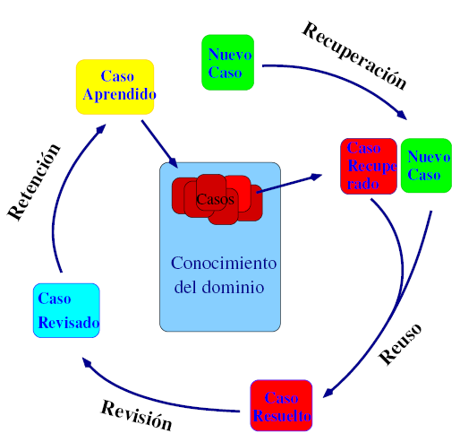
CBR: Execution cycle

Slide 38
CBR: Knowledge storage
Knowledge is basically made of cases
A case is a complex structure, including descriptors and solution
Cases are stored in a case library, with some structure and indexing system
Some knowledge is also about:
Evaluating similarity among cases
Combining and adapt retrieved solutions
Evaluating solutions

Slide 39
CBR: Learning
Addition of new cases (simpler than in RBSs)
A new case is learned if the solution is sufficiently different from previous ones (evaluation).
Cases can be forgotten (if not used or very similar to other ones)

Slide 40
Neural networks
The neuron is the basic computational element:
Input
Output
State
Functions to
Combine input
Calculate the state
Calculate the output

Slide 41
Neural networks
Neurons are organized in a network with various layers, which associate input (problem data) with output (problem solution)
The network needs to be trained (with solved examples), for it to learn to solve new problems (association).

Slide 42
Model-based reasoning
A model is defined about the behavior of a system, based on qualitative information.
Consequences of actions are predicted using common-sense reasoning
In a model-based reasoning system knowledge is represented using causal rules.

Slide 43
Intelligent agents and multi-agent systems
From a monolithic vision of intelligent systems to agents solving simple tasks.
The global problem is solved via:
Cooperation
Coordination
Organization
Negotiation
Work allocation
Communication
Reasoning about others

Slide 44
Intelligent agents and multi-agent systems
Advantages:
More flexible systems
Reconfiguration/reorganization for other tasks or components
Solving more problems
Related to grid computing and Web services.

