Slide 1
Ring Oscillator Clocks and Margins
Jordi Cortadella, Marc Lupon, Alberto Moreno, Antoni Roca and Sachin S. Sapatnekar
Universitat Politècnica de Catalunya University of Minnesota

Slide 2
Matched delay: is it long enough?
Combinational logic
?
req
delay
req
C
?
C
ack
ack

Slide 3
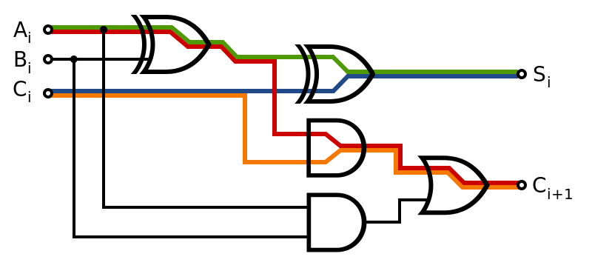
Static Timing Analysis

Slide 4
Static Timing Analysis
Flip Flops
Combinational Logic
Flip Flops
PLL

Slide 5
Static Timing Analysis: setup constraint
Comb. Logic
PVT variability
Two competing paths:
Launching path
Capturing path
Launching path < Capturing path + Period
No variability (or very little)
1
2
PLL
2
1
1
2
+ Margins

Slide 6
Ring Oscillator
Comb. Logic
PVT variability
Correlated!
Launching path < Capturing path + Period
PLL
+ Margins

Slide 7
Matched delays: setup constraint
Launching Path
Capturing Path
Delay
delay
C
C
Launching path < Capturing path + Delay
(Margins?)

Slide 8
Handshaking Ring Oscillators
Combinational Logic
delay
C
C

Slide 9
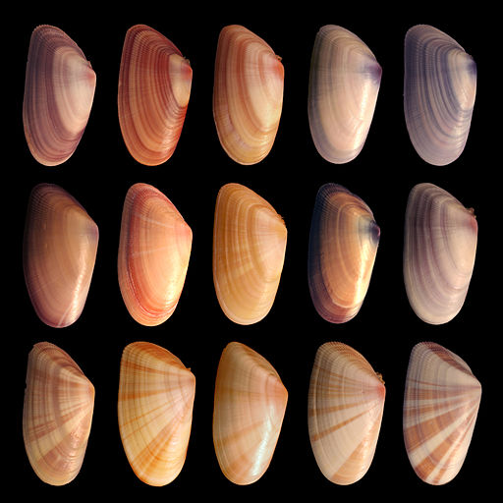
Understanding variability

Slide 10
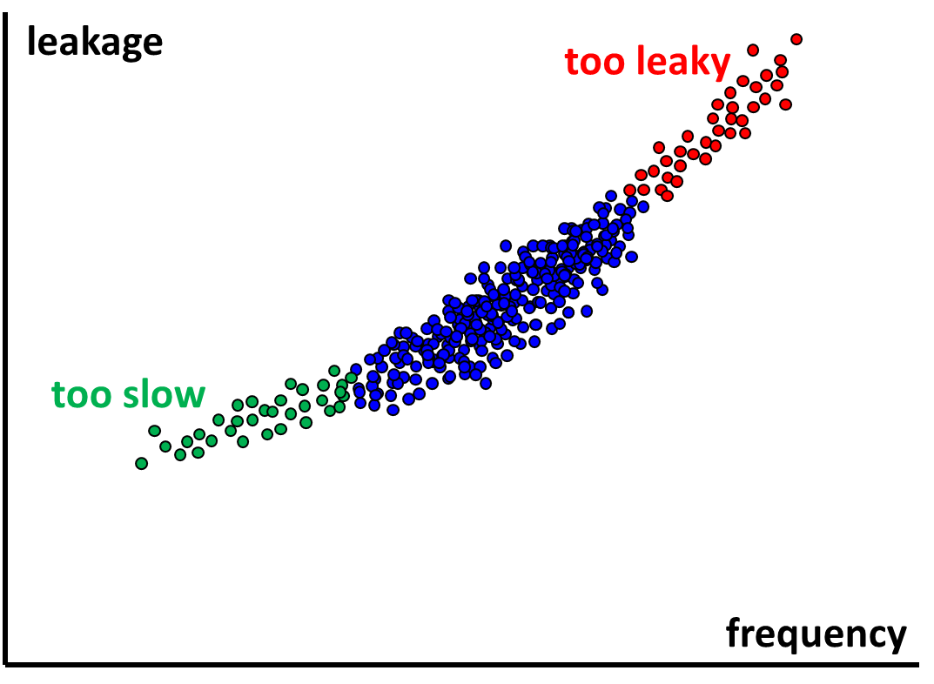
Process variability
Fast
Typical
Slow

Slide 11
Dynamic variability
Δ(Vdd-Vss)
Raj Nair (Anasim Corp.), IC floorplanning and Power Integrity, SOCcentral, Aug 2, 2010.
http://www.soccentral.com/results.asp?entryID=31901. From SOCcentral.com, Copyright 2002 - 2014 Tech Pro Communications

Slide 12
Variability during STA
Within-die (local)
Derating factors (OCV)
Die-to-die (global)
Library corners
Source: H. Masuda et al. (ICICC 2005)

Slide 13
Timing sign-off

Slide 14
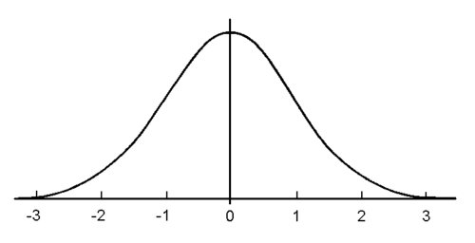
Timing sign-off
Global variability
Corner: Best
…
Local (OCV) variability
Corner: Typical
…
Corner: Worst
Jitter
3σ
Clock Period
(1+δ) ⋅ PathDelay < Period - Jitter
OCV derating factor
typical δ ≈ 0.05 … 0.15

Slide 15
Timing sign-off with ROs
Best
Critical Path
Ring Oscillator
Typical
Critical Path
Ring Oscillator
Worst
Critical Path
Ring Oscillator

Slide 16
Timing sign-off with ROs
Goal: doing classical timing sign-off using
conventional STA tools
designer’s library corners and OCV derating factors
In the paper you will find
A more sophisticated statistical delay model (1st-order Taylor expansions for variability)
This presentation:
A simpler and complementary variability model
Similar conclusions as the ones in the paper

Slide 17
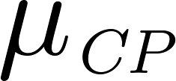
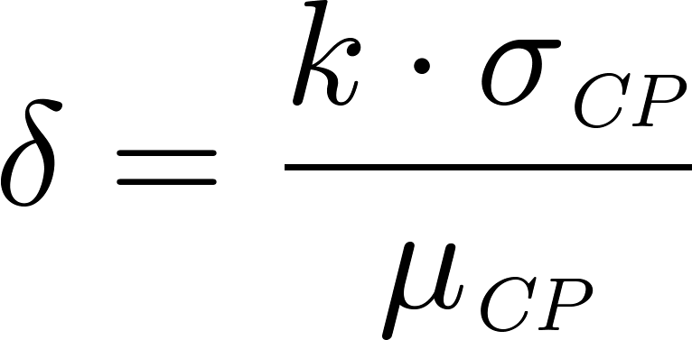
Timing sign-off delay model
Critical Path
yield
3σ
derating factor (OCV)

Slide 18
Timing sign-off delay model with ROs
Critical Path
Same corner
Ring Oscillator

Slide 19
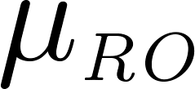
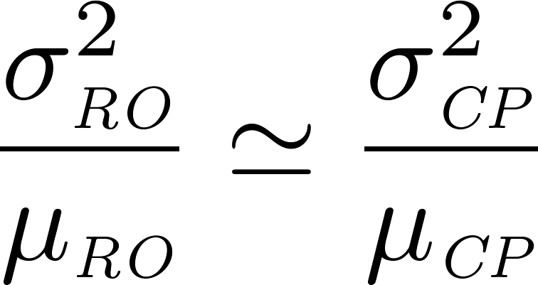
Timing sign-off model with ROs
Critical Path
Ring Oscillator
Assumption: similar index of dispersion (variance-to-mean ratio)
new derating factor

Slide 20
Timing sign-off model with ROs
Critical Path
Ring Oscillator
Assumption: similar index of dispersion (variance-to-mean ratio)
new derating factor
For small values of δ →

Slide 21
Apple-to-apple comparison
Clock domain
Ring oscillator
PLL

Slide 22
Apple-to-apple comparison
Clock domain
Ring oscillator
Fixed
PLL
1.15
1.21
Adaptive !!!

Slide 23
Variability: PLL vs. Ring Oscillator
D
time
clock tree
Q
critical path
D
Q
launching path
clock tree
PLL period
capturing path

Slide 24
Variability: PLL vs. Ring Oscillator
D
time
clock tree
Q
critical path
D
Q
launching path
clock tree
PLL period
capturing path
Voltage droop
D
Q
D
Q
clock-data compensation
PLL period
margin
D
Q
D
Q
Ring Oscillator
only margins for OCV

Slide 25
PLL vs. Ring Oscillator
Ring Osc. Clk (1.2V)
Adaptive frequency
PLL (1.2V)
30%
Fixed frequency
Ring Osc. Clk (0.85V)
Vdd = 1.2V ± 30%

Slide 26
PLL vs. Ring Oscillator
PLL
wasted time
computation time
Cycle period (just in case)
Ring oscillator
Avg period
computation time
Cycle period (just-in-time)

Slide 27
Synthesis of the Ring Oscillator
PLL period
Delay
jitter
OCV (1+δ)
Benefits
$$1+δ\sqrt{2}$$
Critical paths
Corners
FF Vdd+10% 0ºC
TT Vdd 25ºC
SS Vdd-10% 125ºC

Slide 28
Experiment

Slide 29
10 AES modules (65nm)
1.75 mm
0.7 mm
350x350
μm²
Every AES module can be activated/deactivated by clock gating
Switching activity generated by VCS
IR drop (static and dynamic) estimated by PrimeRail

Slide 30
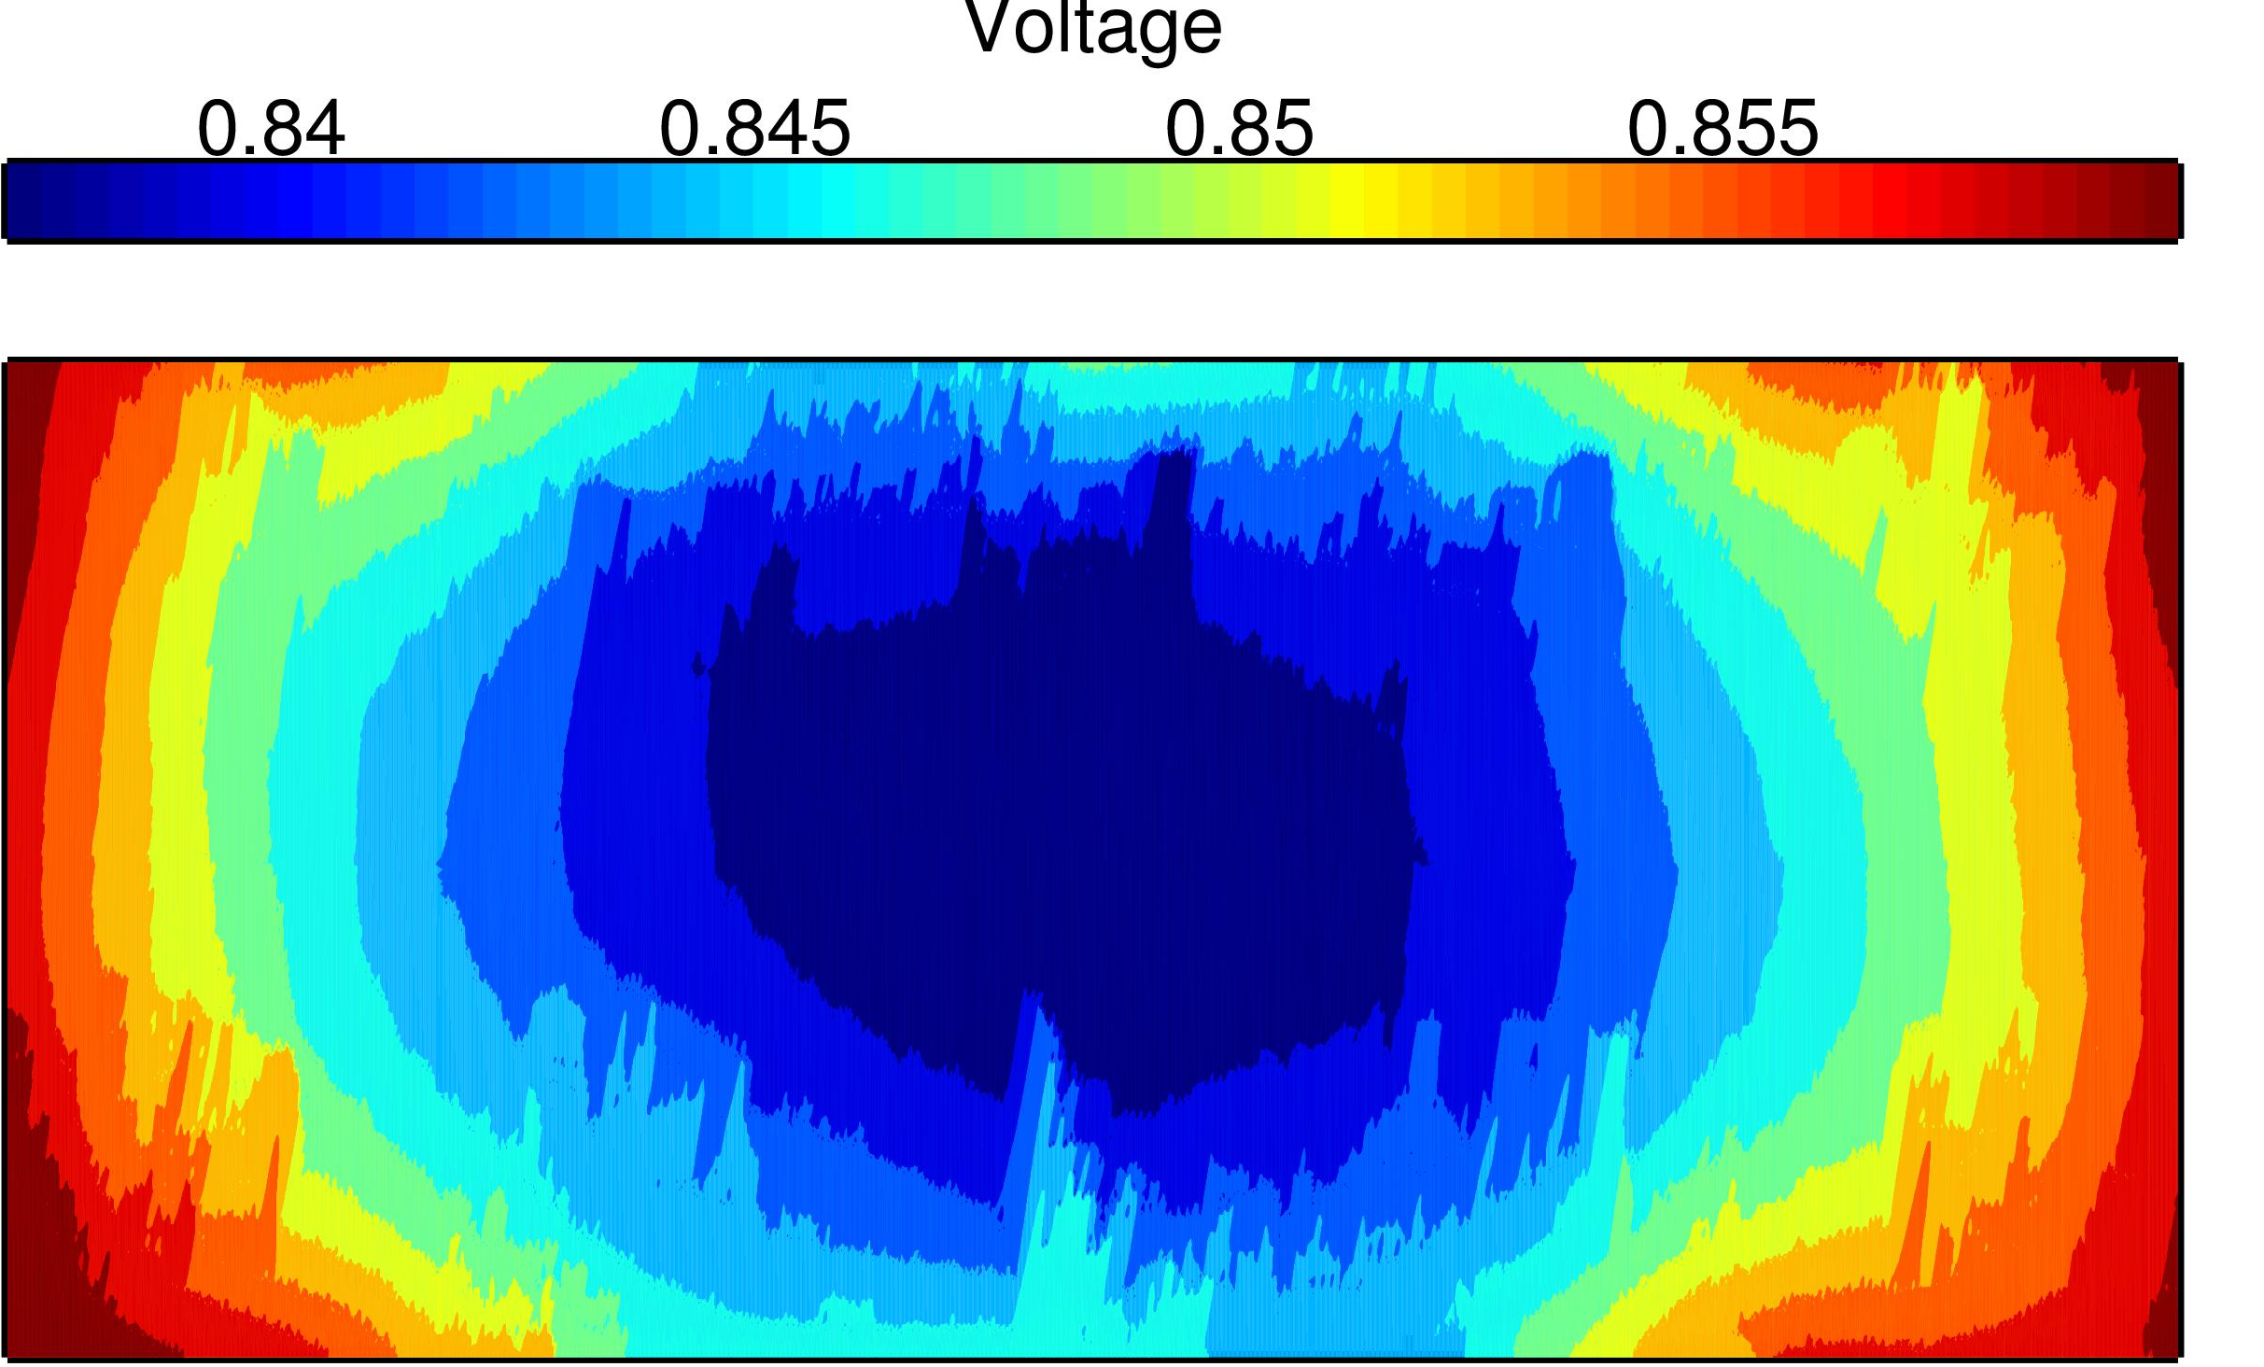
Voltage droop analysis
All modules active
Nominal voltage: 1V Max voltage droop: 168mV Max voltage difference: 25mV

Slide 31
Max voltage difference

Slide 32
Performance & Energy benefits
Sign-off (WC)
0.9V, 125ºC
voltage scaling
Perfect binning
1.6x
-40% Energy
Ring oscillator
1.2x
0.9V, 125ºC
1.0V, 75ºC

Slide 33
Reactive Clocks
J. Cortadella, L. Lavagno, P. López, M. Lupon, A. Moreno, A. Roca and S.S. Sapatnekar Reactive Clocks with variability-tracking jitter ICCD 2015.
Algorithms and EDA scripts for timing analysis:
Automatic synthesis of Ring Oscillators
Technology independent (any .lib file)
Adaptable to different STA and P&R tools
Ring Oscillators + monitors for post-silicon calibration:
Non-intrusive monitors automatically synthesized
Patented technology

Slide 34
Conclusions
Moore’s law is (economically) over. It’s time to exploit what is left in established nodes.
Ring Oscillators: a zero-risk scheme to
boost performance (1.6x speedup) or
reduce energy (40%)
Margins for Ring Oscillators (or matched delays)
Use the same library corners
Derating factor: $\left(1+δ\right) → (1+δ\sqrt{2})$

