Slide 1

Cryptography
Jordi Cortadella and Jordi Petit
Department of Computer Science

Slide 2
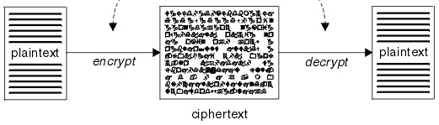
Where do we need cryptography?
Communication (e.g., sending private emails).
Digital signatures, i.e., guarantee that digital documents are authentic.
Network services over unsecure networks (e.g., secure shell (ssh) for remote login, file transfers, remote command execution, etc.).
HyperText Transfer Protocol Secure (HTTPS): secure communication on Internet.
Cryptocurrencies (e.g., bitcoin)

Slide 3
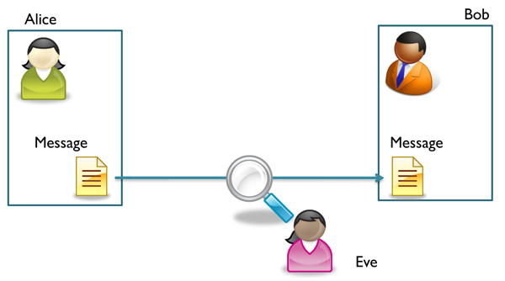
Cryptography
How can we avoid an eavesdropper (Eve) to overhear a message sent from Alice to Bob?
Solution: encrypt the message!

Slide 4

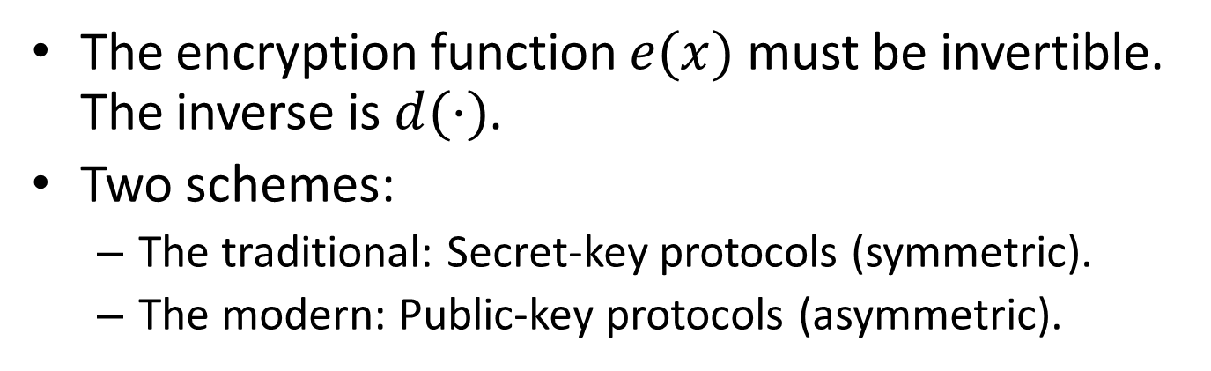


Cryptosystem
Alice
$$e(x)$$
Bob
Encoder
KZ0kVey8l1c=
Decoder
$$x$$
$$x=d(e\left(x\right))$$
?
Hello
Hello
Eve
The encryption function $e(x)$ must be invertible. The inverse is $d(⋅)$.
Two schemes:
  The traditional: Secret-key protocols (symmetric).
  The modern: Public-key protocols (asymmetric).

Slide 5
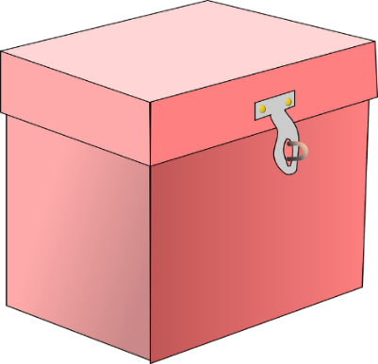



Secret-key protocols
Alice and Bob have to meet privately and chose a secret key.
They can use the secret key to mutually exchange messages.
There are many secret-key protocols. We will explain two of them:
  XOR encoding.
  Advanced Encryption Standard (AES).

Slide 6

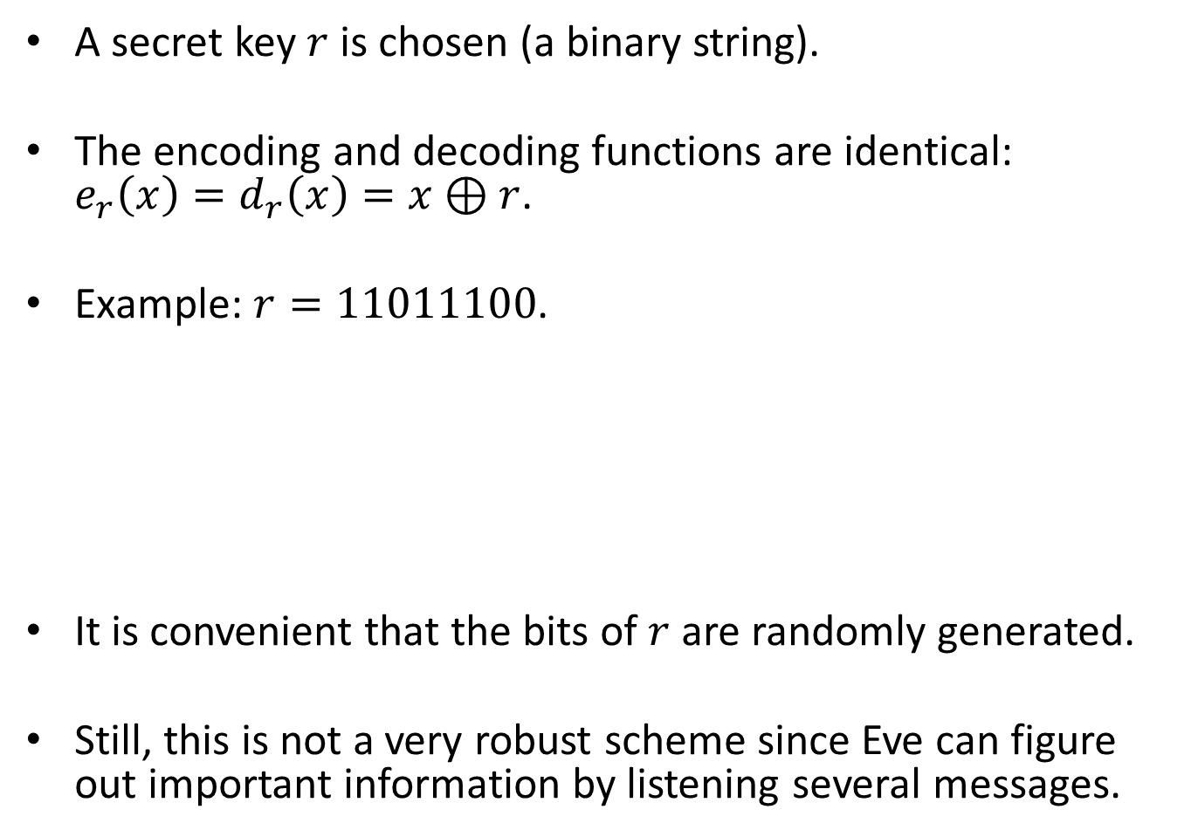


Secret-key protocol: XOR encoding
A secret key $r$ is chosen (a binary string).
The encoding and decoding functions are identical:
$e_{r}\left(x\right)=d_{r}\left(x\right)=x⊕r$.
Example: $r=11011100$.
It is convenient that the bits of $r$ are randomly generated.
Still, this is not a very robust scheme since Eve can figure out important information by listening several messages.
x: 00111010
r: 11011100 m: 11100110
m: 11100110
r: 11011100 x: 00111010
$$x=00111010$$
$$m$$
$$x=00111010$$

Slide 7
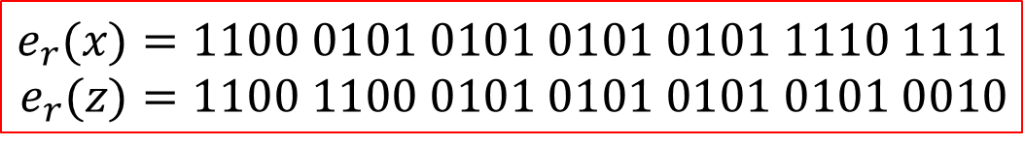
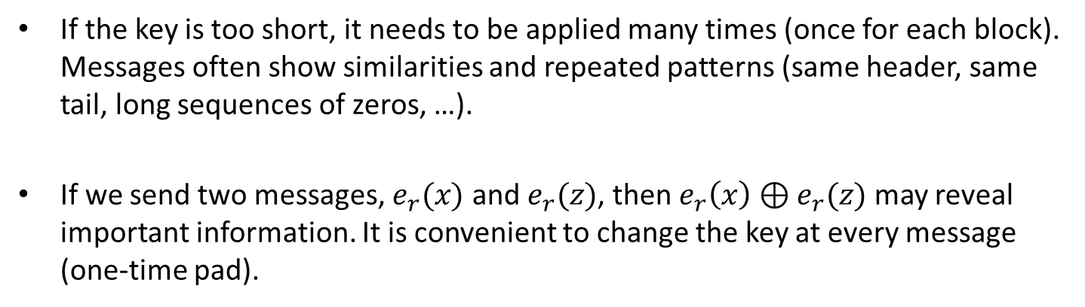

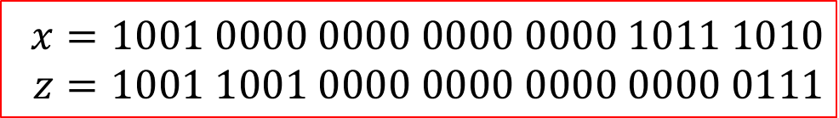
Secret-key protocol: XOR encoding
If the key is too short, it needs to be applied many times (once for each block). Messages often show similarities and repeated patterns (same header, same tail, long sequences of zeros, …).
If we send two messages, $e_{r}(x)$ and $e_{r}(z)$, then $e_{r}\left(x\right)⊕e_{r}(z)$ may reveal important information. It is convenient to change the key at every message (one-time pad).
$$x=1001 0000 0000 0000 0000 1011 1010 \\ z=1001 1001 0000 0000 0000 0000 0111$$
$$r=0101$$
$$e_{r}(x)=1100 0101 0101 0101 0101 1110 1111 \\ e_{r}(z)=1100 1100 0101 0101 0101 0101 0010$$
$$e_{r}\left(x\right)⊕e_{r}(z)=0000 1001 0000 0000 0000 1011 1101$$
Same header.
Same sender?
Long identical sequence.
Maybe zeros?
The key !!!

Slide 8
Secret-key protocol: AES
AES: Advanced Encryption Standard.
Established as a standard by the U.S. National Institute of Standards and Technology (NIST) in 2001.
Very robust and used worldwide.
A family of ciphers with different key and block sizes (key sizes: 128, 196 and 256 bits).

Slide 9
AES scheme
Plain text (128 bits)
Cipher Key
+
Round Key (0)
Key Expansion
SubBytes
N-1
Rounds
ShiftRows
MixColumn
+
Round Key (i)
Final
Round
SubBytes
ShiftRows
+
Round Key
Cipher text (128 bits)

Slide 10
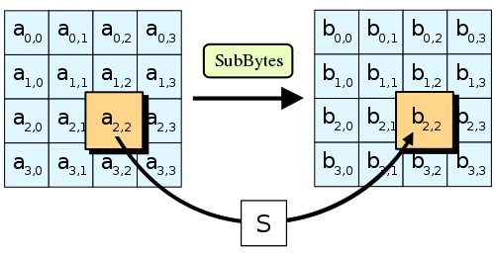
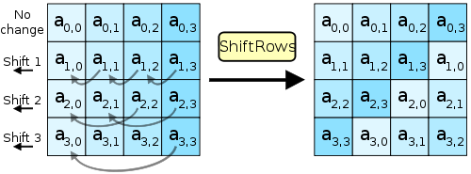
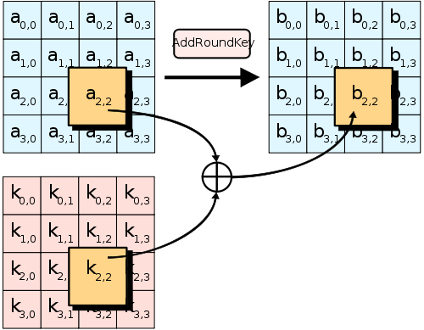
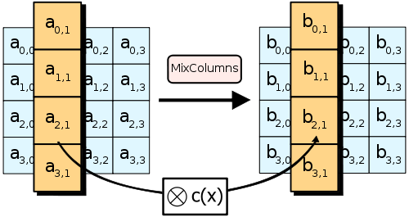
AES steps

Slide 11










Secret-key protocols: problems
Every channel requires
a different key
Bob
$$k_{ab}$$
$$k_{bc}$$
$$k_{be}$$
$$k_{bd}$$
Carol
Alice
$$k_{ac}$$
$$k_{ce}$$
$$k_{ad}$$
$$k_{cd}$$
$$k_{ae}$$
David
Erin
$$k_{de}$$
The key cannot be transmitted
through the communication channel !

Slide 12




Public-key protocols
Private
Public

Slide 13
Public-key protocols
Private
Public

Slide 14
Public-key protocols
Private
Public

Slide 15
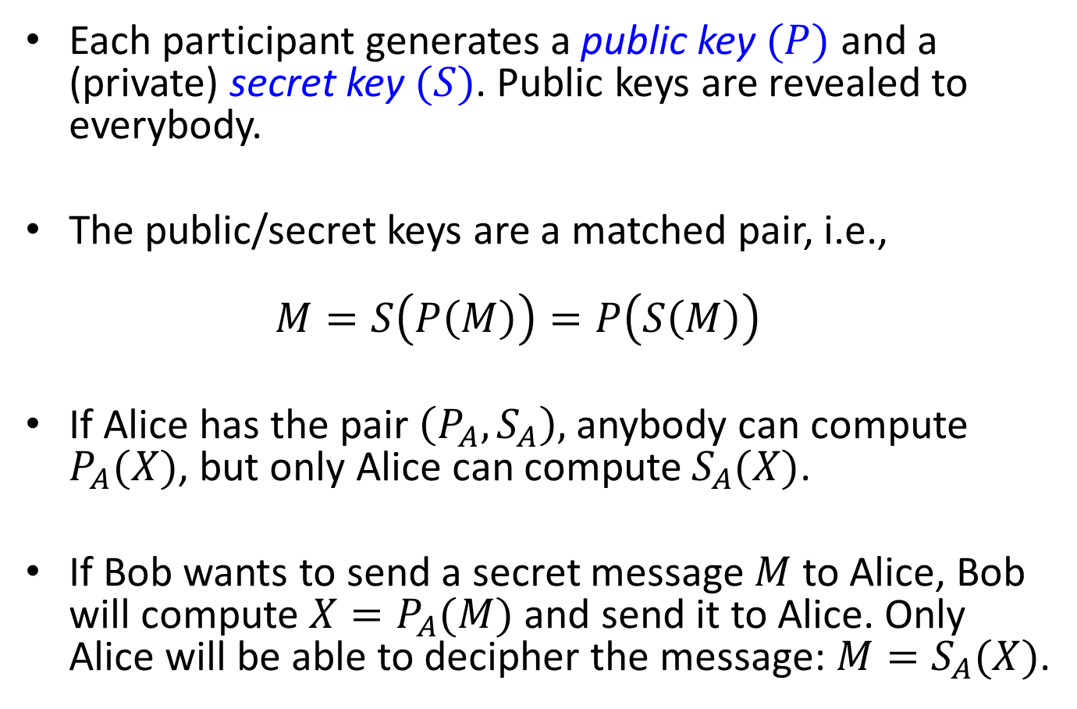
Public-key protocols
Each participant generates a public key $(P)$ and a (private) secret key $(S)$. Public keys are revealed to everybody.
The public/secret keys are a matched pair, i.e.,
$M=S\left(P\left(M\right)\right)=P\left(S\left(M\right)\right)$
If Alice has the pair $\left(P_{A},S_{A}\right),$ anybody can compute $P_{A}(X)$, but only Alice can compute $S_{A}(X)$.
If Bob wants to send a secret message $M$ to Alice, Bob will compute ${X=P}_{A}(M)$ and send it to Alice. Only Alice will be able to decipher the message: ${M=S}_{A}(X)$.

Slide 16












Public-key protocols
Alice
Bob
$$X$$
$$α$$
$$X=S_{B}(α)$$
$$α=P_{B}(X)$$
$$β$$
$$Y$$
$$Y=S_{A}(β)$$
$$β=P_{A}(Y)$$
$$S_{A}$$
$$P_{A}$$
$$P_{B}$$
$$S_{B}$$
Private
Public
Public
Private
But, how to create a cryptosystem like this?
Using number theory.

Slide 17
RSA cryptosystem
Public-key cryptosystem
(Rivest-Shamir-Adleman, 1977).
Based upon number theory: modular arithmetic and prime numbers.
Security: based on the fact that factoring a large number (product of two large primes)
is hard.

Slide 18
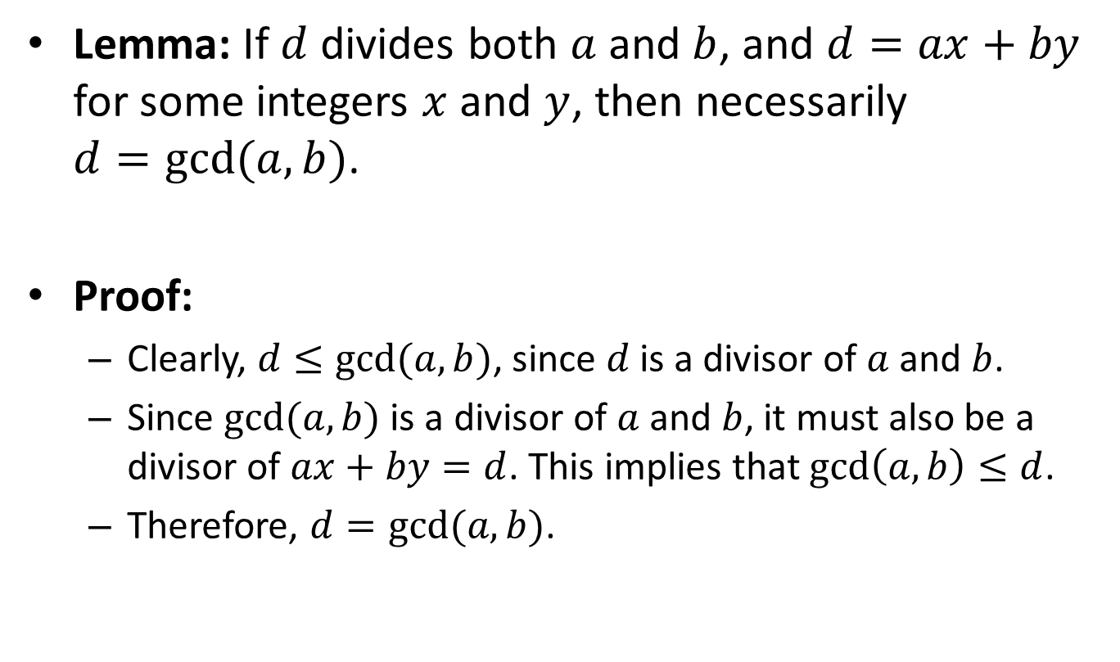
Bézout’s identity
Lemma: If $d$ divides both $a$ and $b$, and $d=ax+by$ for some integers $x$ and $y$, then necessarily
$d=gcd⁡(a,b)$.
Proof:
  Clearly, $d≤gcd⁡(a,b)$, since $d$ is a divisor of $a$ and $b$.
  Since $gcd⁡(a,b)$ is a divisor of $a$ and $b$, it must also be a divisor of $ax+by=d$. This implies that $\gcd\left(a,b\right)≤d$.
  Therefore, $d=gcd⁡(a,b)$.

Slide 19

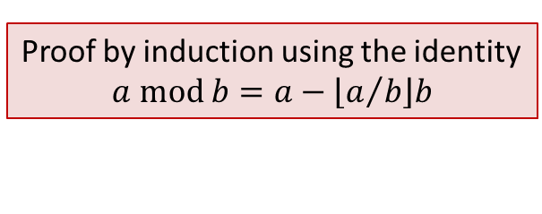

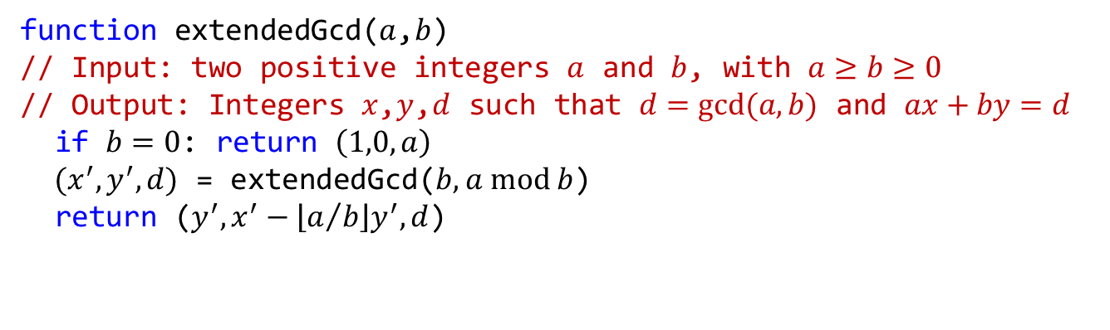



Extended Euclid’s algorithm
function extendedGcd($a$,$b$)
// Input: two positive integers $a$ and $b$, with $a≥b≥0$
// Output: Integers $x$,$y$,$d$ such that $d=gcd⁡(a,b)$ and $ax+by=d$
if $b=0$: return $\left(1,0,a\right)$
$(x^{′},y^{′},d)$ = extendedGcd($b, a \text{mod} b$)
return ($y^{′},x^{′}−\left\lfloor a/b\right\rfloor y^{′},d$)
Proof by induction using the identity
$$a \text{mod} b=a−\left\lfloor a/b\right\rfloor b$$
extgcd(25,11)
(4,-9,1)
$$4⋅25−9⋅11=1$$
extgcd(11,3)
(-1,4,1)
$$−1⋅11+4⋅3=1$$
extgcd(3,2)
(1,-1,1)
$$1⋅3−1⋅2=1$$
extgcd(2,1)
(0,1,1)
$$0⋅2+1⋅1=1$$
extgcd(1,0)
(1,0,1)
$$1⋅1+0⋅0=1$$

Slide 20
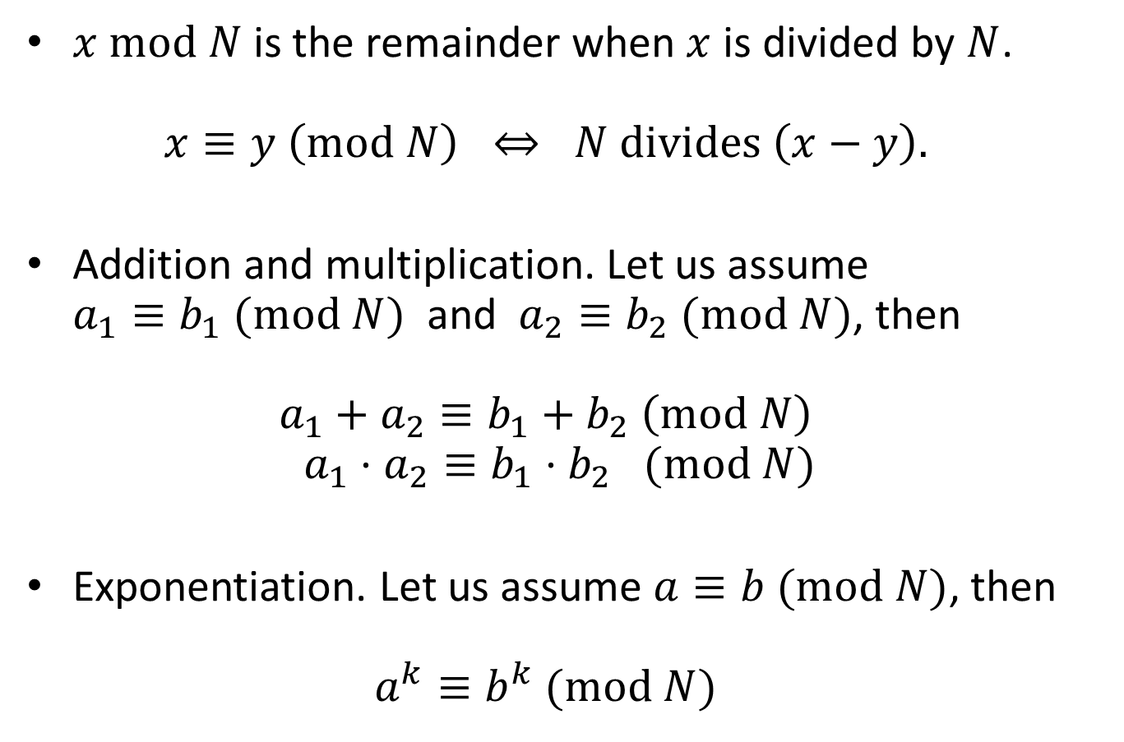
Modular arithmetic: properties
$x \text{mod} N$ is the remainder when $x$ is divided by $N$.
$x≡y \left(\text{mod} N\right) ⇔ N \text{divides} \left(x−y\right).$
Addition and multiplication. Let us assume
$a_{1}≡b_{1} (\text{mod} N)$ and $a_{2}≡b_{2} (\text{mod} N)$, then
$a_{1}+a_{2}≡b_{1}+b_{2} \left(\text{mod} N\right)$
$a_{1}⋅a_{2}≡b_{1}⋅b_{2} (\text{mod} N)$
Exponentiation. Let us assume $a≡b (\text{mod} N)$, then
$a^{k}≡b^{k} (\text{mod} N)$

Slide 21
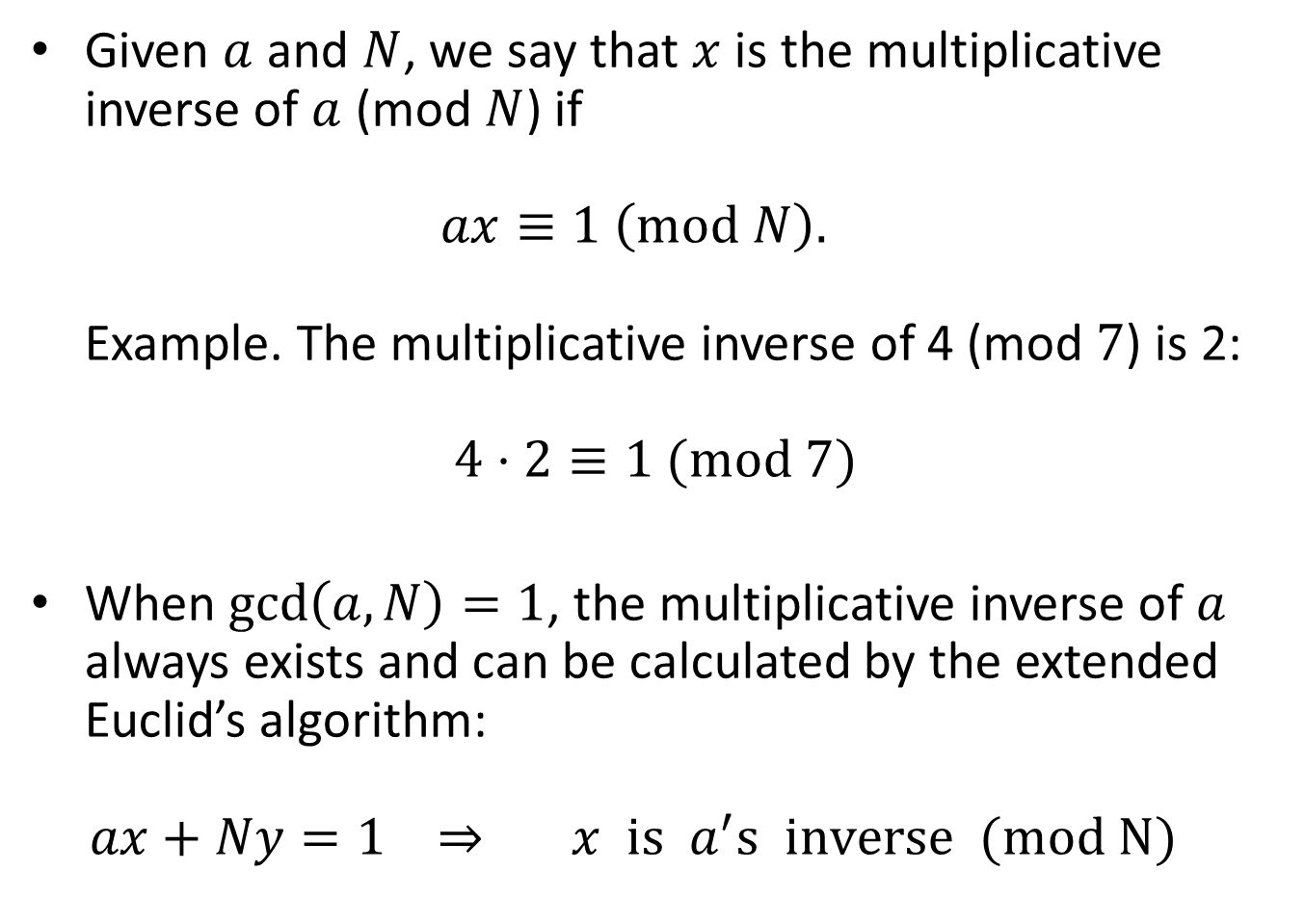
Modular arithmetic: properties
Given $a$ and $N$, we say that $x$ is the multiplicative inverse of $a$ (mod $N$) if
$ax≡1 \left(\text{mod} N\right).$
Example. The multiplicative inverse of 4 (mod $7$) is 2:
$4⋅2≡1 (\text{mod} 7)$
When $\gcd\left(a,N\right)=1$, the multiplicative inverse of $a$ always exists and can be calculated by the extended Euclid’s algorithm:
$ax+Ny=1 ⇒ x is a^{′}s inverse (mod N)$

Slide 22
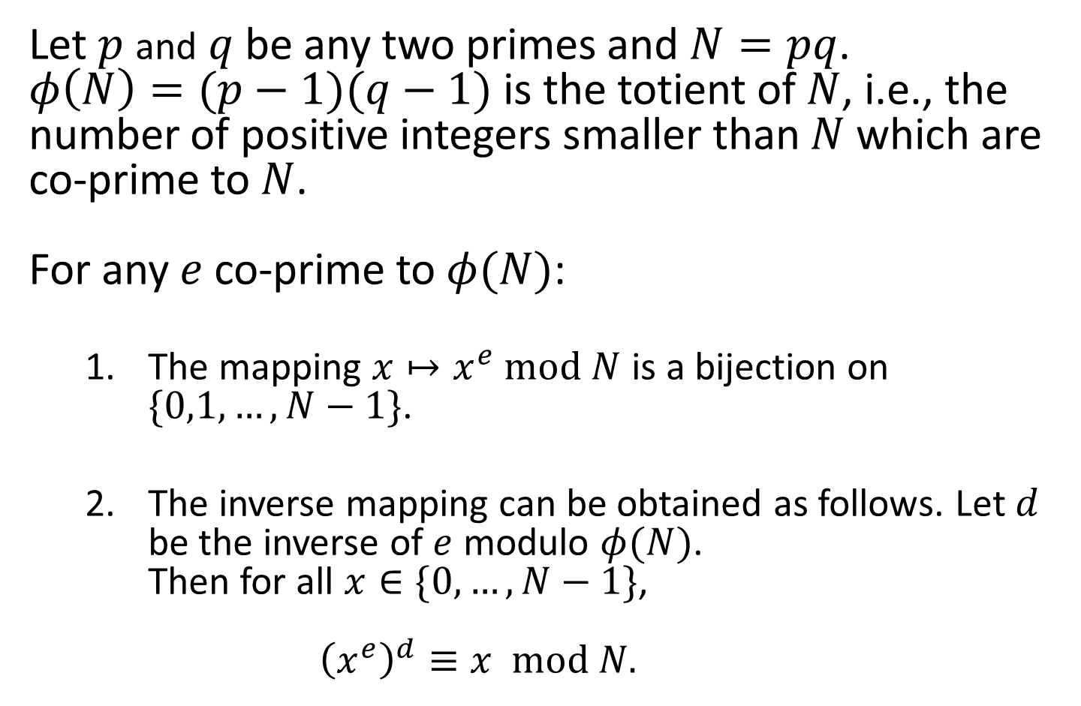
Fundamental property
Let $p$ and $q$ be any two primes and $N=pq$.
$φ\left(N\right)=(p−1)(q−1)$ is the totient of $N$, i.e., the number of positive integers smaller than $N$ which are co-prime to $N$.
For any $e$ co-prime to $φ(N)$:
  The mapping $x↦x^{e} \text{mod} N$ is a bijection on $\{0,1,…,N−1\}$.
  The inverse mapping can be obtained as follows. Let $d$ be the inverse of $e$ modulo $φ(N)$.
  Then for all $x∈\{0,…,N−1\}$,
  ${\left(x^{e}\right)}^{d}≡x \text{mod} N.$

Slide 23


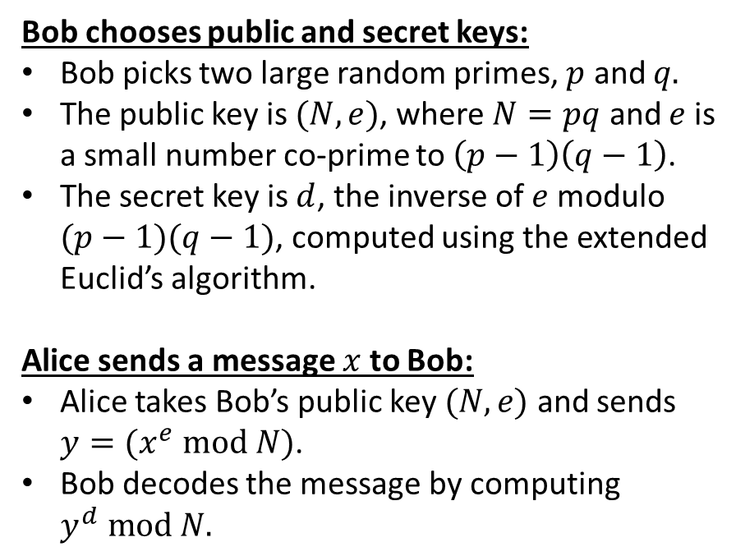


The RSA cryptosystem
mod $N$
$$x$$
$$x^{e}$$
$${\left(x^{e}\right)}^{d}$$
Bob chooses public and secret keys:
Bob picks two large random primes, $p$ and $q.$
The public key is $(N,e)$, where $N=pq$ and $e$ is
a small number co-prime to $\left(p−1\right)\left(q−1\right)$.
The secret key is $d$, the inverse of $e$ modulo
$(p−1)(q−1)$, computed using the extended
Euclid’s algorithm.
Alice sends a message $x$ to Bob:
Alice takes Bob’s public key $(N,e)$ and sends
$y=(x^{e} mod N)$.
Bob decodes the message by computing
$y^{d} \text{mod} N.$
encrypt
decrypt

Slide 24
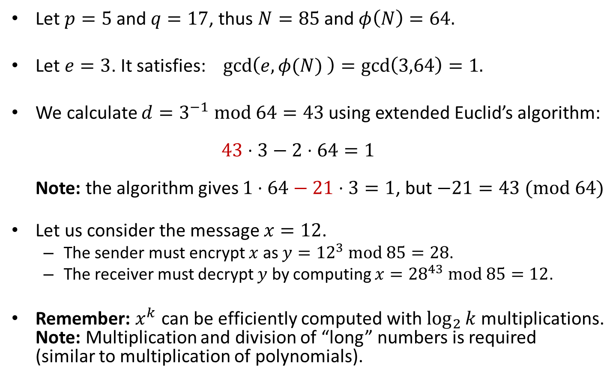
The RSA cryptosystem: example
Let $p=5$ and $q=17$, thus $N=85$and $φ\left(N\right)=64.$
Let $e=3$. It satisfies: $\gcd\left(e,φ(N) \right)=\gcd\left(3,64\right)=1.$
We calculate ${d=3}^{−1} \text{mod} 64=43$ using extended Euclid’s algorithm:
$43⋅3−2⋅64=1$
Note: the algorithm gives $1⋅64−21⋅3=1$, but $−21=43 (\text{mod} 64)$
Let us consider the message $x=12$.
  The sender must encrypt $x$ as $y={12}^{3} \text{mod} 85=28$.
  The receiver must decrypt $y$ by computing $x={28}^{43} \text{mod} 85=12$.
Remember: $x^{k}$ can be efficiently computed with $\log_{2}{k}$ multiplications.
Note: Multiplication and division of “long” numbers is required
(similar to multiplication of polynomials).

Slide 25
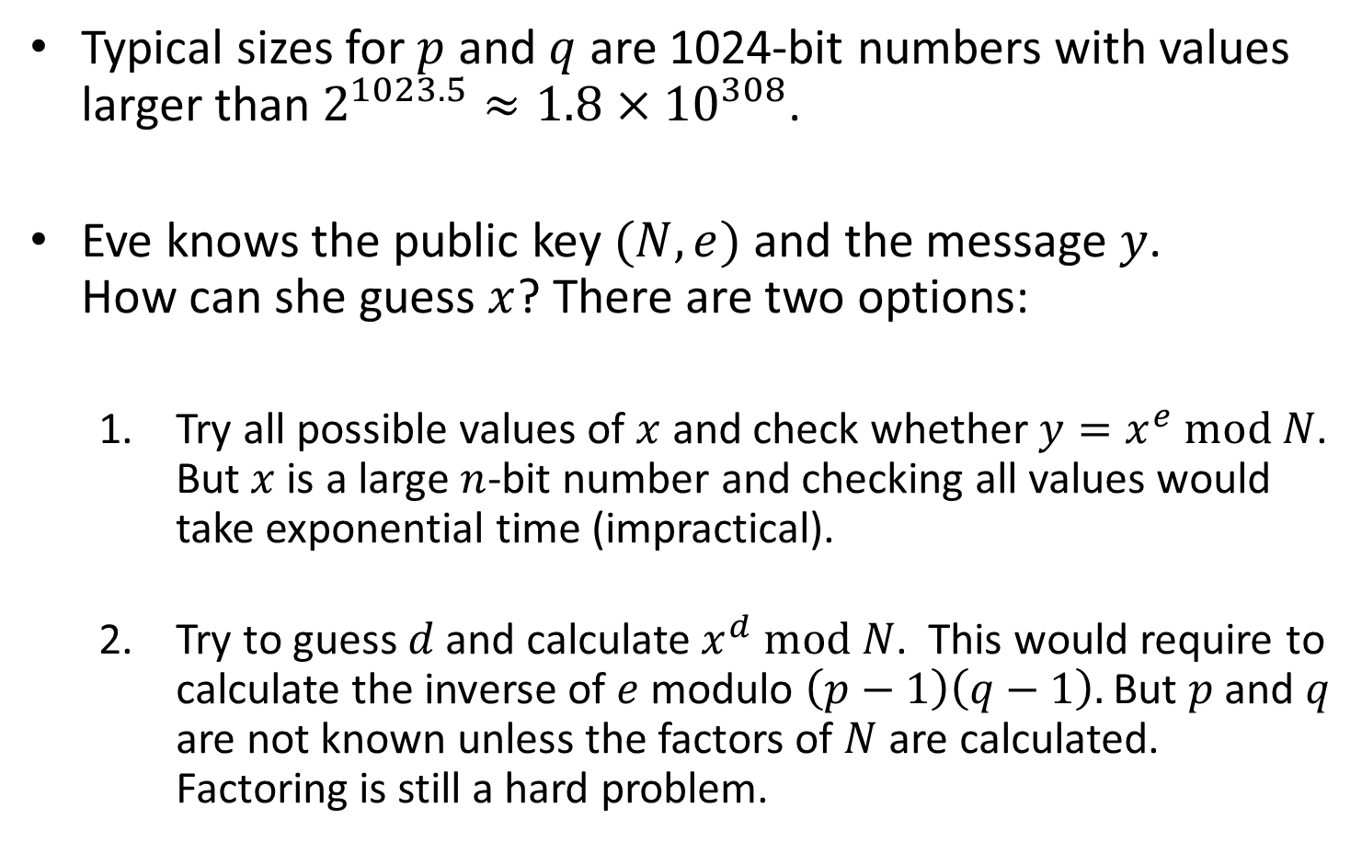
Why is RSA secure?
Typical sizes for $p$ and $q$ are 1024-bit numbers with values larger than $2^{1023.5}≈1.8×{10}^{308}$.
Eve knows the public key $(N,e)$ and the message $y$.
How can she guess $x$? There are two options:
  Try all possible values of $x$ and check whether $y=x^{e} \text{mod} N$.
  But $x$ is a large $n$-bit number and checking all values would take exponential time (impractical).
  Try to guess $d$ and calculate $x^{d} \text{mod} N$. This would require to calculate the inverse of $e$ modulo $\left(p−1\right)\left(q−1\right).$ But $p$ and $q$ are not known unless the factors of $N$ are calculated. Factoring is still a hard problem.

Slide 26
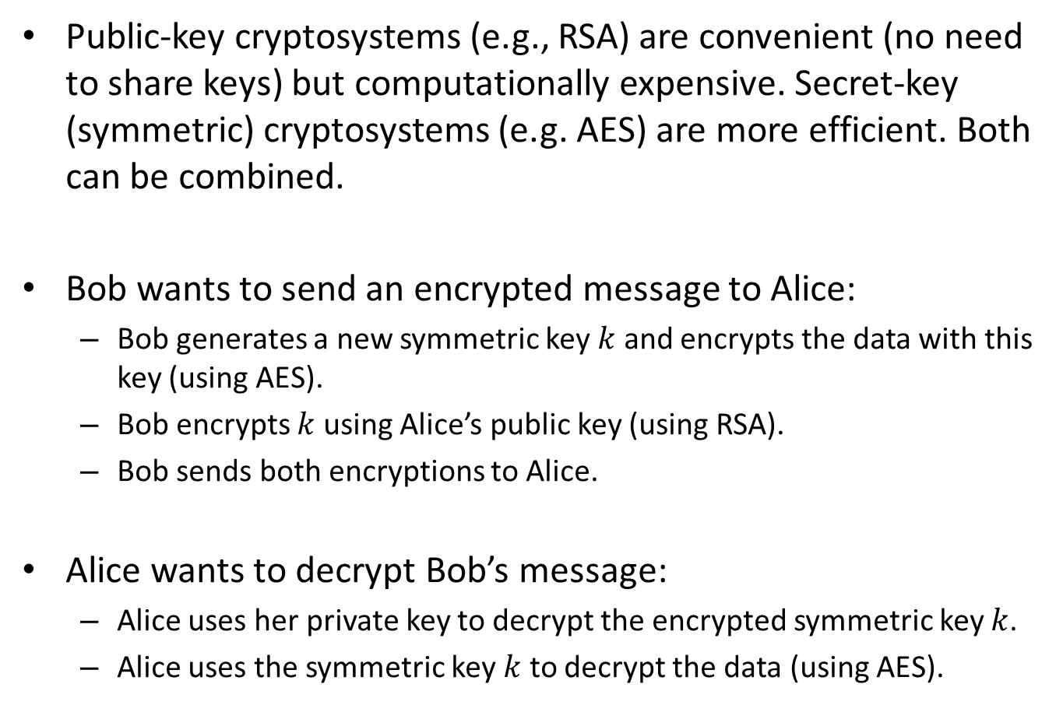
Hybrid cryptosystems
Public-key cryptosystems (e.g., RSA) are convenient (no need to share keys) but computationally expensive. Secret-key (symmetric) cryptosystems (e.g. AES) are more efficient. Both can be combined.
Bob wants to send an encrypted message to Alice:
  Bob generates a new symmetric key $k$ and encrypts the data with this key (using AES).
  Bob encrypts $k$ using Alice’s public key (using RSA).
  Bob sends both encryptions to Alice.
Alice wants to decrypt Bob’s message:
  Alice uses her private key to decrypt the encrypted symmetric key $k$.
  Alice uses the symmetric key $k$ to decrypt the data (using AES).

Slide 27



Cryptographic hash function (CHF)
  A CHF maps data of arbitrary size to a
  fixed-size bit string.
$$x$$
$$h(x)$$
$$y$$

Slide 28
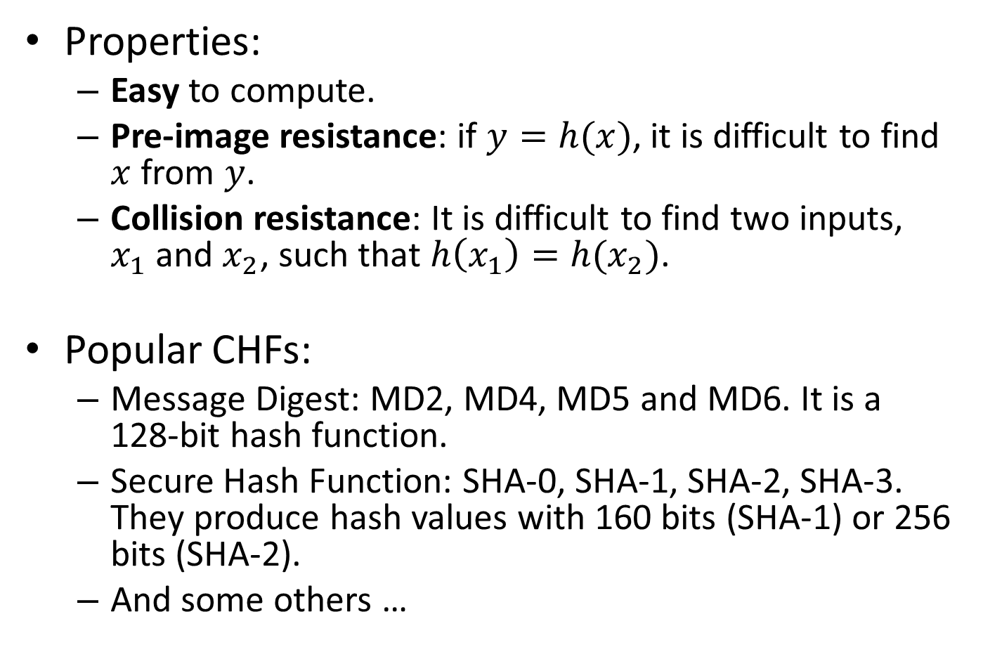
Cryptographic hash function (CHF)
Properties:
  Easy to compute.
  Pre-image resistance: if $y=h(x)$, it is difficult to find $x$ from $y$.
  Collision resistance: It is difficult to find two inputs,
  $x_{1}$ and $x_{2}$, such that $h\left(x_{1}\right)=h(x_{2})$.
Popular CHFs:
  Message Digest: MD2, MD4, MD5 and MD6. It is a 128-bit hash function.
  Secure Hash Function: SHA-0, SHA-1, SHA-2, SHA-3. They produce hash values with 160 bits (SHA-1) or 256 bits (SHA-2).
  And some others …

Slide 29
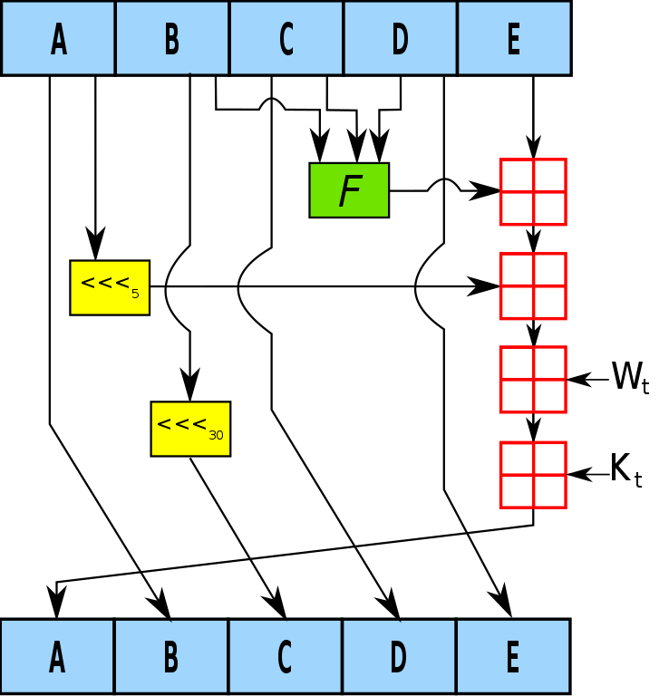
Example: SHA-1
160 bits
The result is “accumulated”
to the result of previous steps.
One step of SHA-1

Slide 30
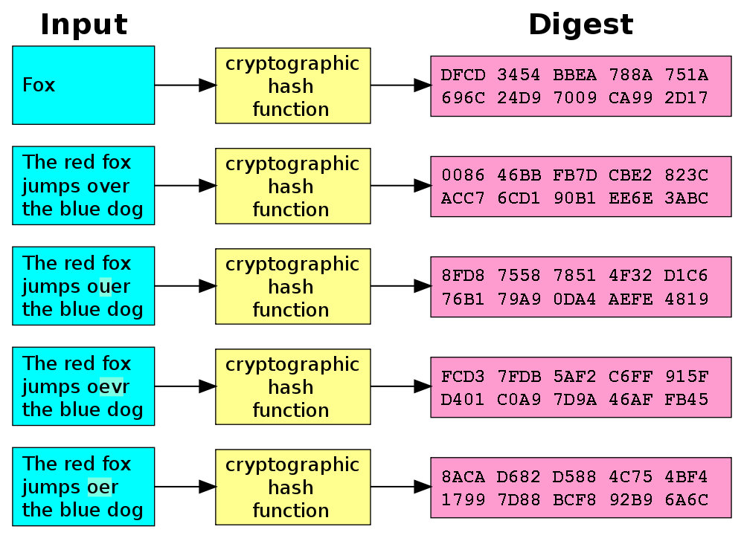
Example: SHA-1
Hash value

Slide 31
Digital signatures
A scheme to guarantee that a message is authentic.
Consider the following case:
  Alice sends a document (possibly unencrypted) to Bob and wants Bob to electronically sign the document.
  Bob “signs” the document and sends it back to Alice.
Questions:
  How does Alice know that the document has not been altered? → integrity.
  How does Alice know that Bob has signed the document (and not somebody else)? → authentication.

Slide 32

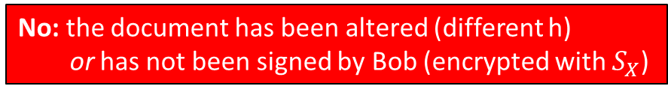
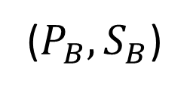
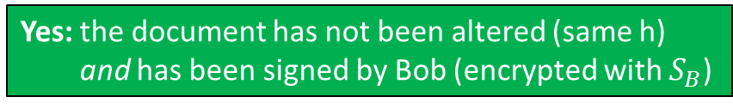



Digital signatures
Alice
Bob
($P_{B},S_{B}$)
SHA-2
SHA-2 (hash)
h
(signature)
$$P_{B}$$
$$S_{B}$$
$$S_{B}$$
h
h
h
Yes: the document has not been altered (same h)
and has been signed by Bob (encrypted with $S_{B}$)
h’
=
No: the document has been altered (different h)
or has not been signed by Bob (encrypted with $S_{X}$)

Slide 33
The pending challenge
How to generate
large prime numbers?
(not explained in this lecture)

Slide 34

Internet + Privacy → Cryptography

Slide 35
Exercises

Slide 36
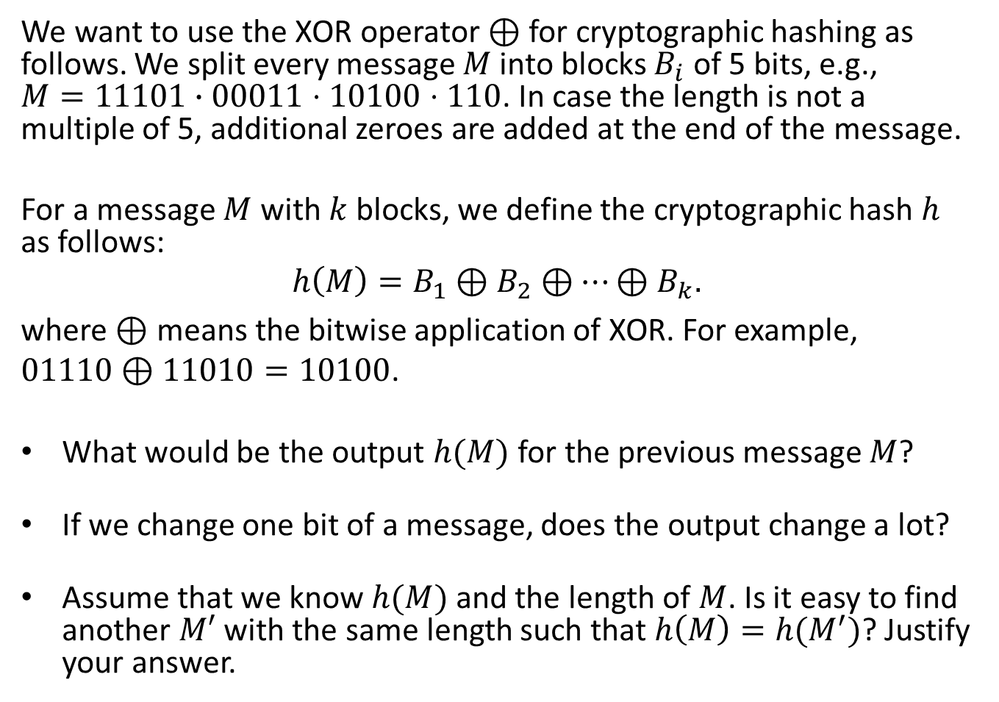
Simple cryptographic hash
We want to use the XOR operator $⊕$ for cryptographic hashing as follows. We split every message $M$ into blocks $B_{i}$ of 5 bits, e.g.,
$M=11101∙00011⋅10100⋅110$. In case the length is not a multiple of 5, additional zeroes are added at the end of the message.
For a message $M$ with $k$ blocks, we define the cryptographic hash $h$ as follows:
$$h\left(M\right)=B_{1}⊕B_{2}⊕⋯⊕B_{k}.$$
where $⊕$ means the bitwise application of XOR. For example, $01110⊕11010=10100$.
What would be the output $h(M)$ for the previous message $M$?
If we change one bit of a message, does the output change a lot?
Assume that we know $h(M)$ and the length of $M$. Is it easy to find another $M′$ with the same length such that $h\left(M\right)=h(M^{′})$? Justify your answer.

Slide 37
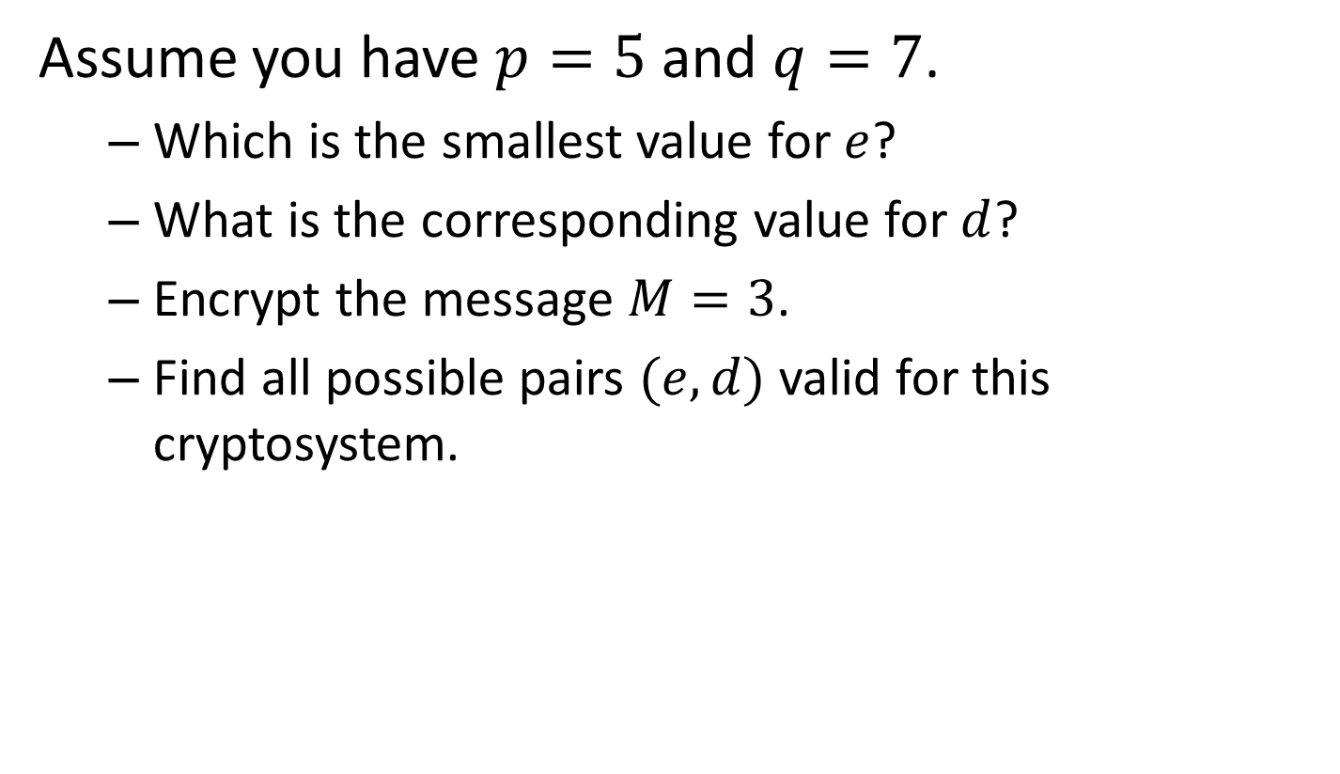
Simple RSA
Assume you have $p=5$ and $q=7$.
  Which is the smallest value for $e$?
  What is the corresponding value for $d$?
  Encrypt the message $M=3$.
  Find all possible pairs $(e,d)$ valid for this cryptosystem.

Slide 38
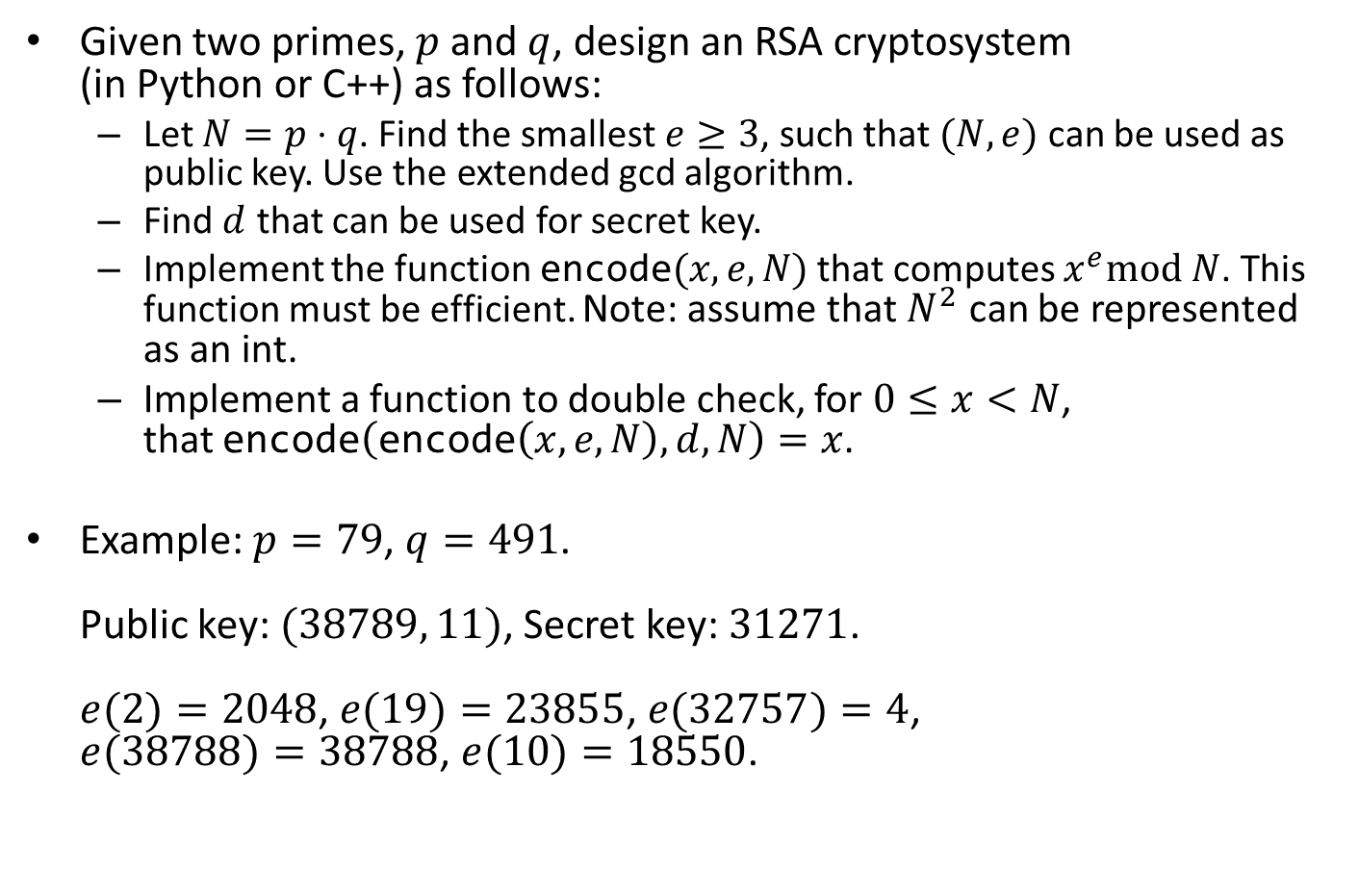
Implement an RSA cryptosystem
Given two primes, $p$ and $q$, design an RSA cryptosystem
(in Python or C++) as follows:
  Let $N=p⋅q$. Find the smallest $e≥3$, such that $(N,e)$ can be used as public key. Use the extended gcd algorithm.
  Find $d$ that can be used for secret key.
  Implement the function $\text{encode}(x,e,N)$that computes $x^{e}\text{mod} N$. This function must be efficient. Note: assume that $N^{2}$ can be represented as an int.
  Implement a function to double check, for $0≤x<N$,
  that $\text{encode}\left(\text{encode}\left(x,e,N\right),d,N\right)=x$.
Example: $p=79$, $q=491$.
Public key: $(38789, 11)$, Secret key: $31271$.
$e(2)=2048$, $e(19)=23855$, $e(32757)=4$,
$e(38788)=38788$, $e(10)=18550$.

