Slide 1

Algorithm Analysis (I)
Jordi Cortadella and Jordi Petit
Department of Computer Science

Slide 2
What do we expect from an algorithm?
Correct
Easy to understand
Easy to implement
Efficient:
  Every algorithm requires a set of resources
    Memory
    CPU time
    Energy

Slide 3
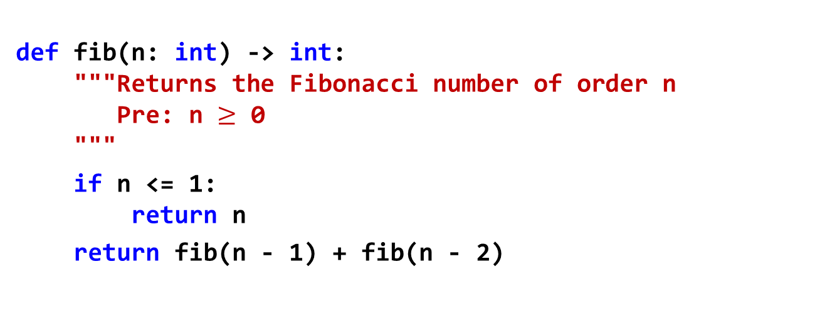
Fibonacci: recursive version
def fib(n: int) -> int:
"""Returns the Fibonacci number of order n
Pre: n $≥$ 0
"""
if n <= 1:
return n
return fib(n - 1) + fib(n - 2)

Slide 4
Fibonacci
8
7
6
5
6
5
4
5
4
4
3
4
3
3
2
4
3
3
2
3
2
2
1
3
2
2
1
2
1
1
0
1
0
1
0
1
0
2
1
1
0
1
0
2
1
1
0
1
0
1
0
2
1
1
0
2
1
1
0
3
2
1
0
2
1
1
0
How many recursive calls?

Slide 5
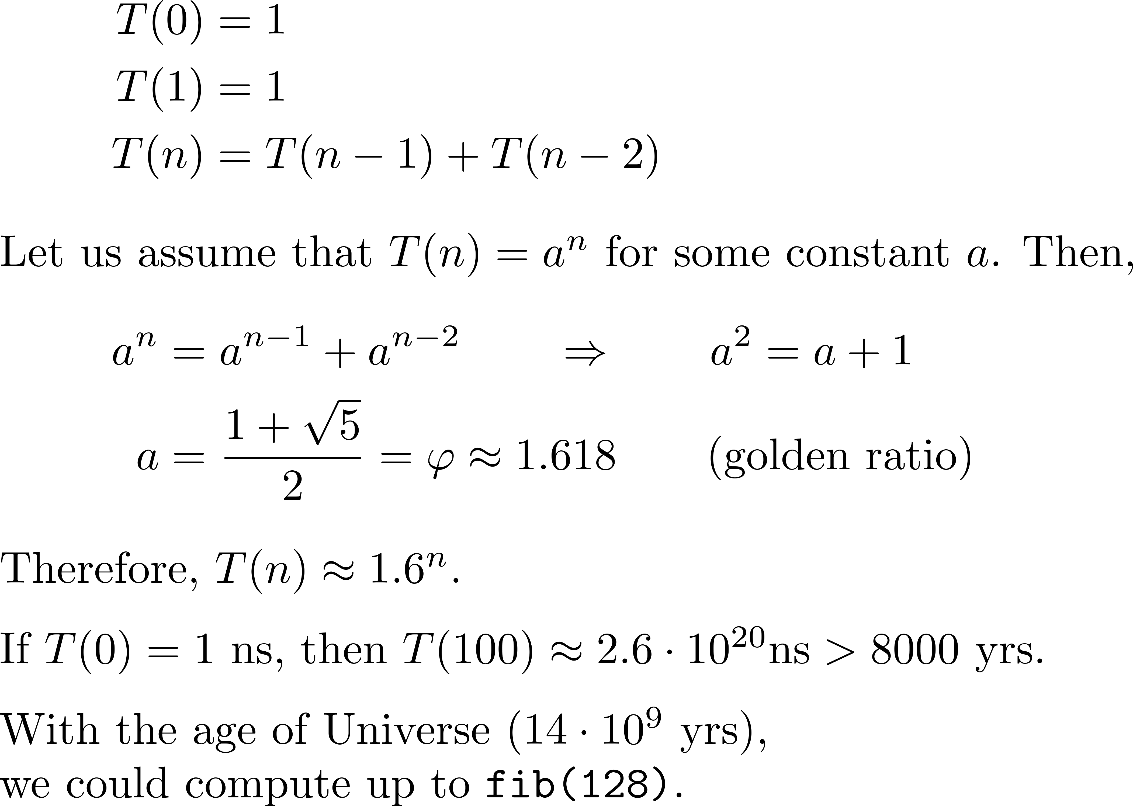
Fibonacci: runtime

Slide 6
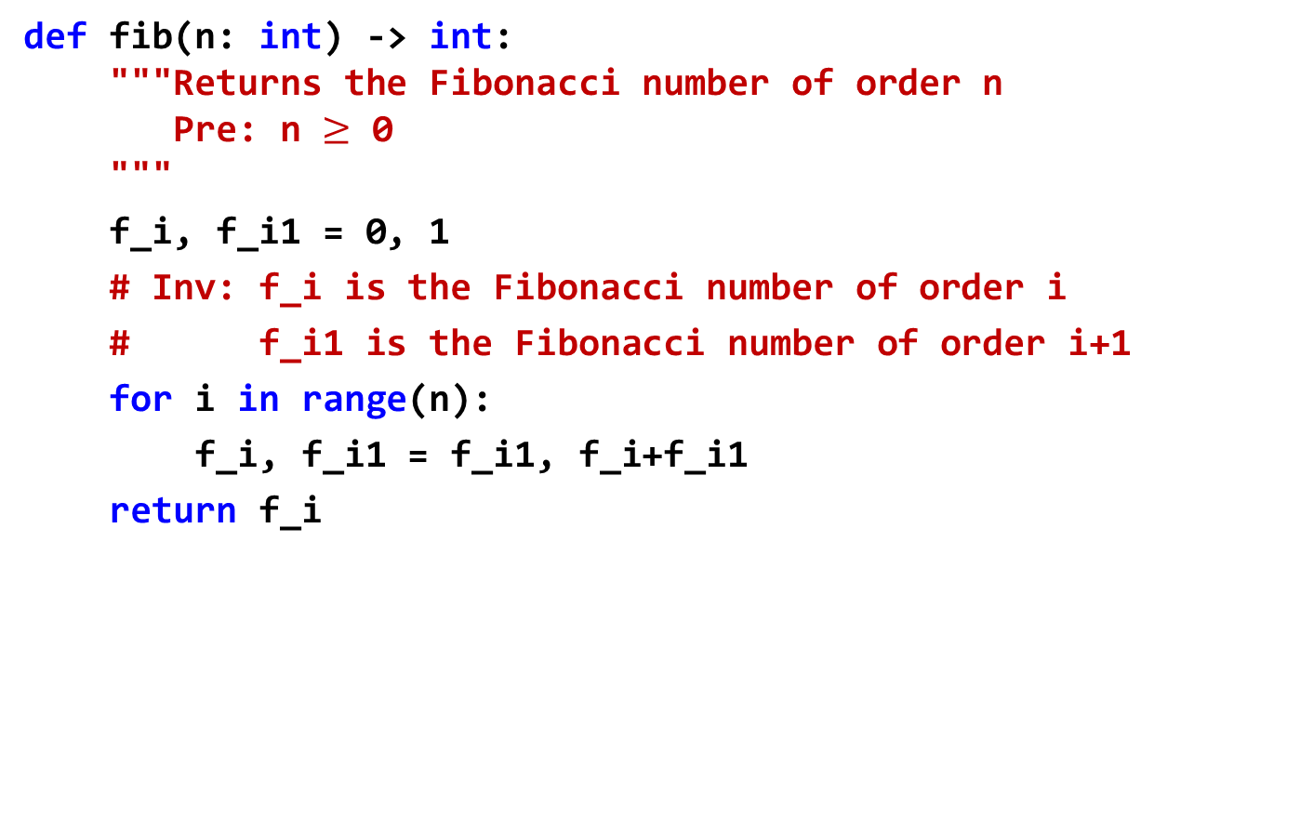
Fibonacci numbers: iterative version
def fib(n: int) -> int:
"""Returns the Fibonacci number of order n
Pre: n $≥$ 0
"""
f_i, f_i1 = 0, 1
# Inv: f_i is the Fibonacci number of order i
# f_i1 is the Fibonacci number of order i+1
for i in range(n):
f_i, f_i1 = f_i1, f_i+f_i1
return f_i
Runtime: n iterations

Slide 7
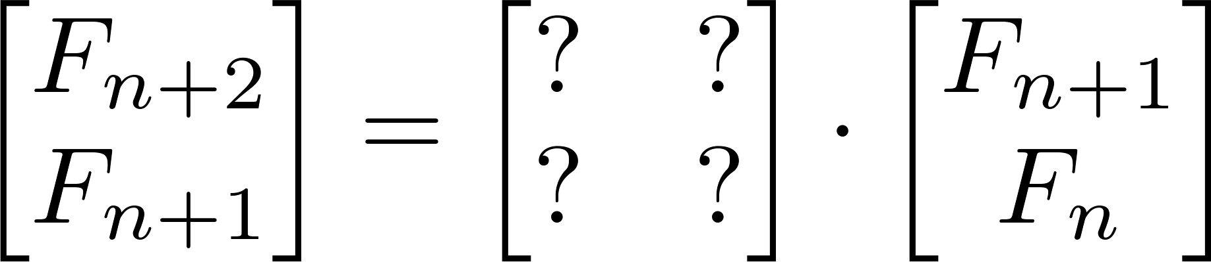
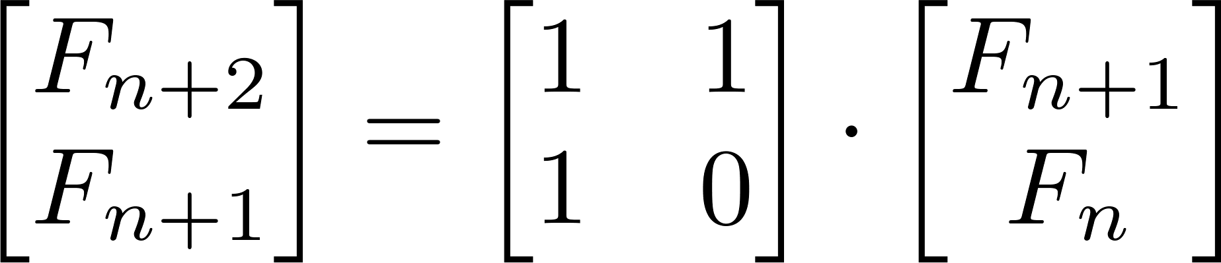
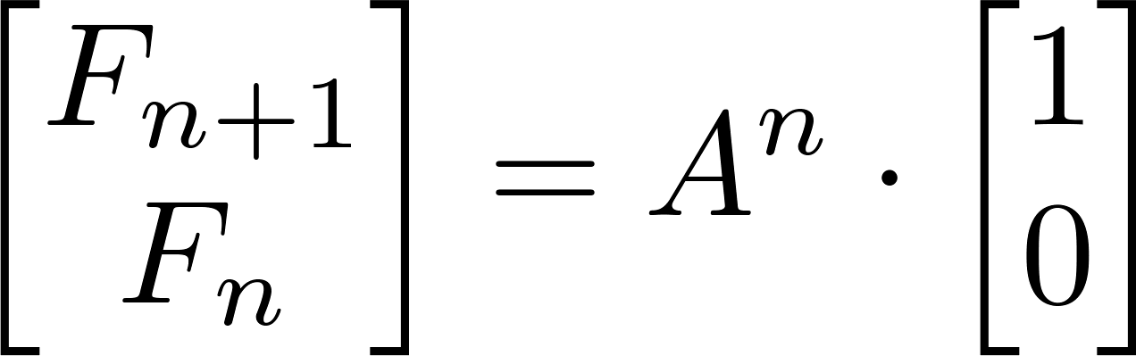
Fibonacci numbers
Algebraic solution: find matrix A such that

Slide 8
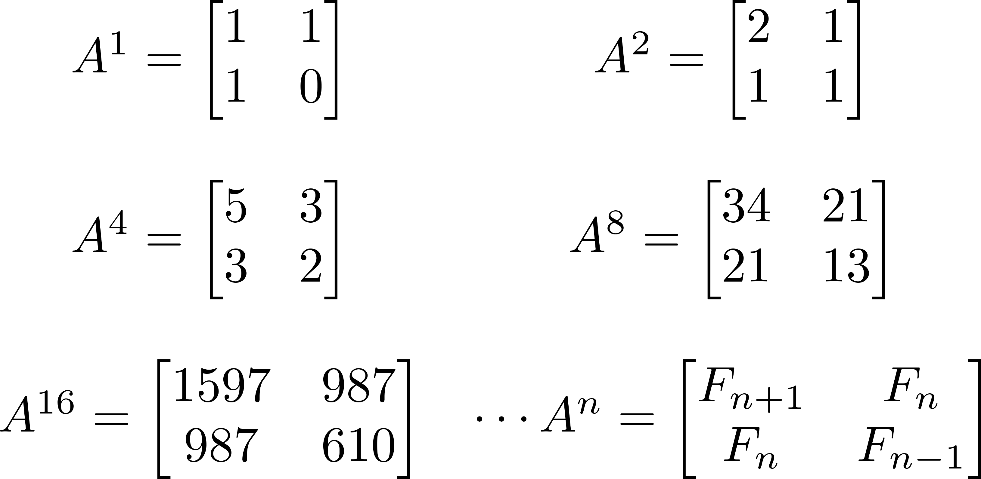
Fibonacci numbers
Runtime ≈ log₂ n 2x2 matrix multiplications

Slide 9
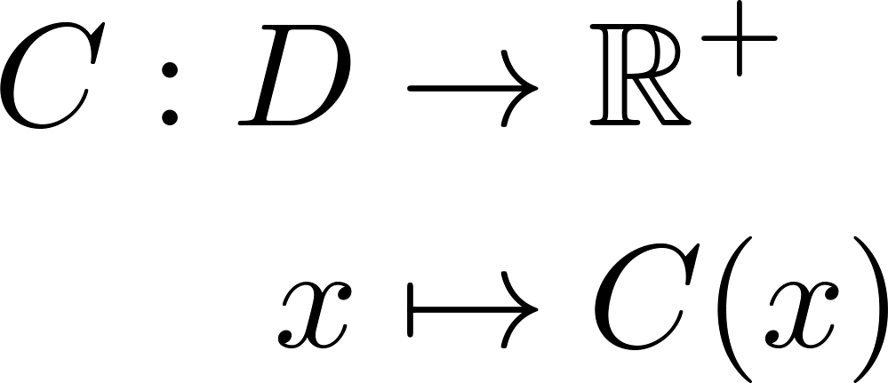
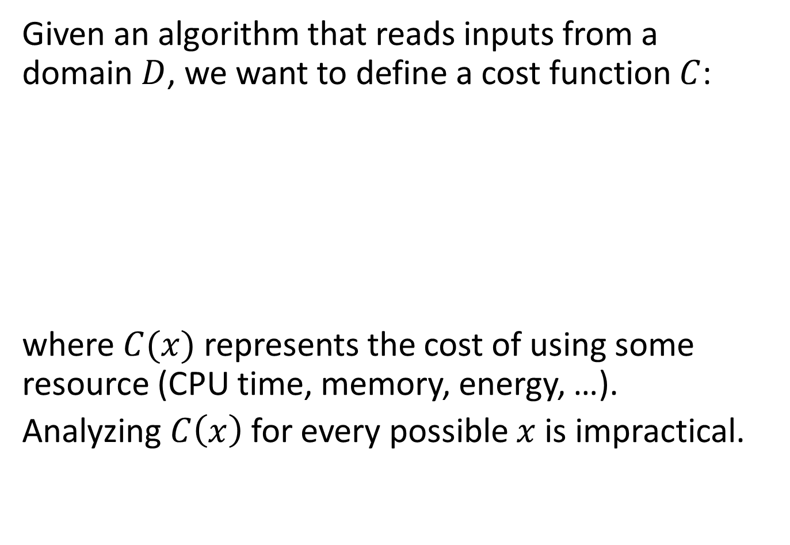
Algorithm analysis
Given an algorithm that reads inputs from a
domain $D$, we want to define a cost function $C$:
where $C(x)$ represents the cost of using some resource (CPU time, memory, energy, …).
Analyzing $C\left(x\right)$ for every possible $x$ is impractical.

Slide 10
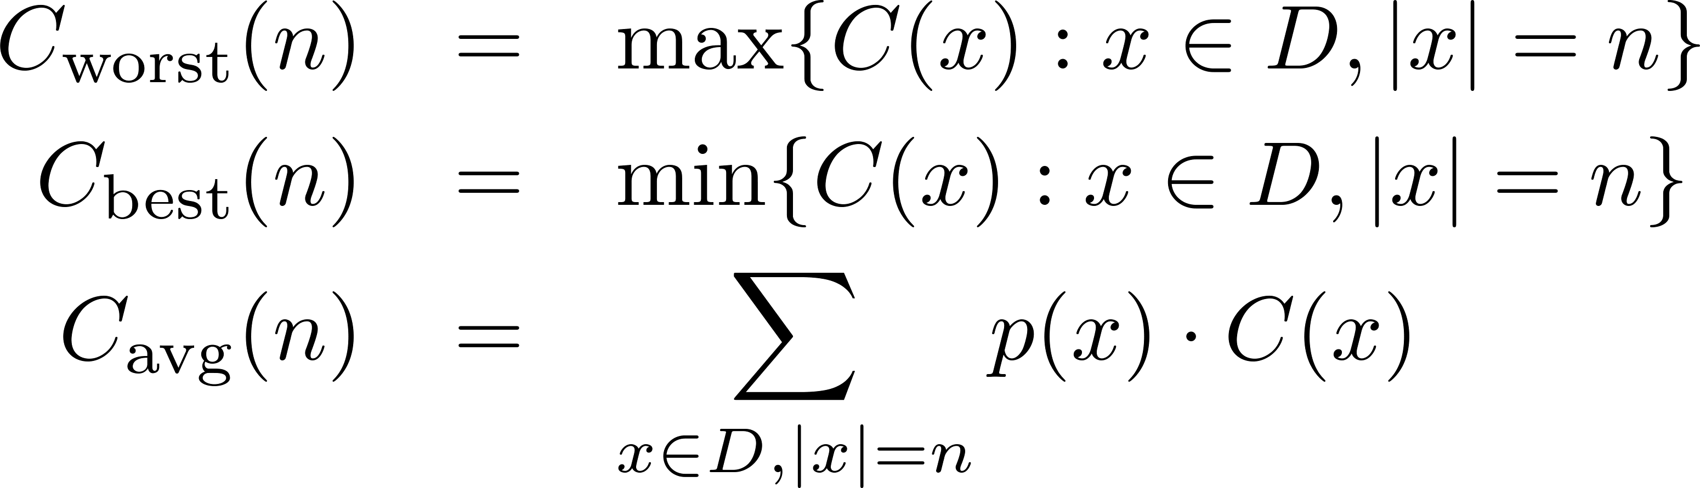
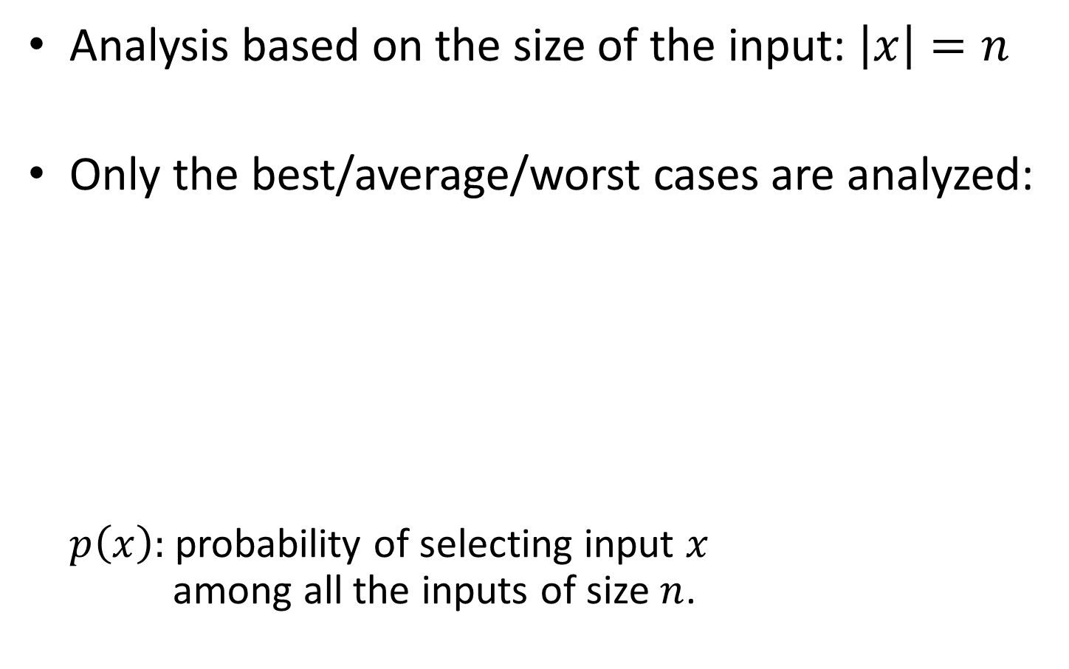
Algorithm analysis: simplifications
Analysis based on the size of the input: $\left|x\right|=n$
Only the best/average/worst cases are analyzed:
$p\left(x\right):$ probability of selecting input $x$
among all the inputs of size $n$.

Slide 11
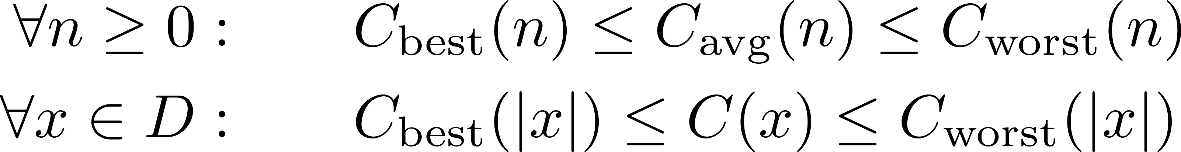
Algorithm analysis
Properties:
We want a notation that characterizes the cost of algorithms independently from the technology (CPU speed, programming language, efficiency of the compiler, etc.).
Runtime is usually the most important resource to analyze.

Slide 12
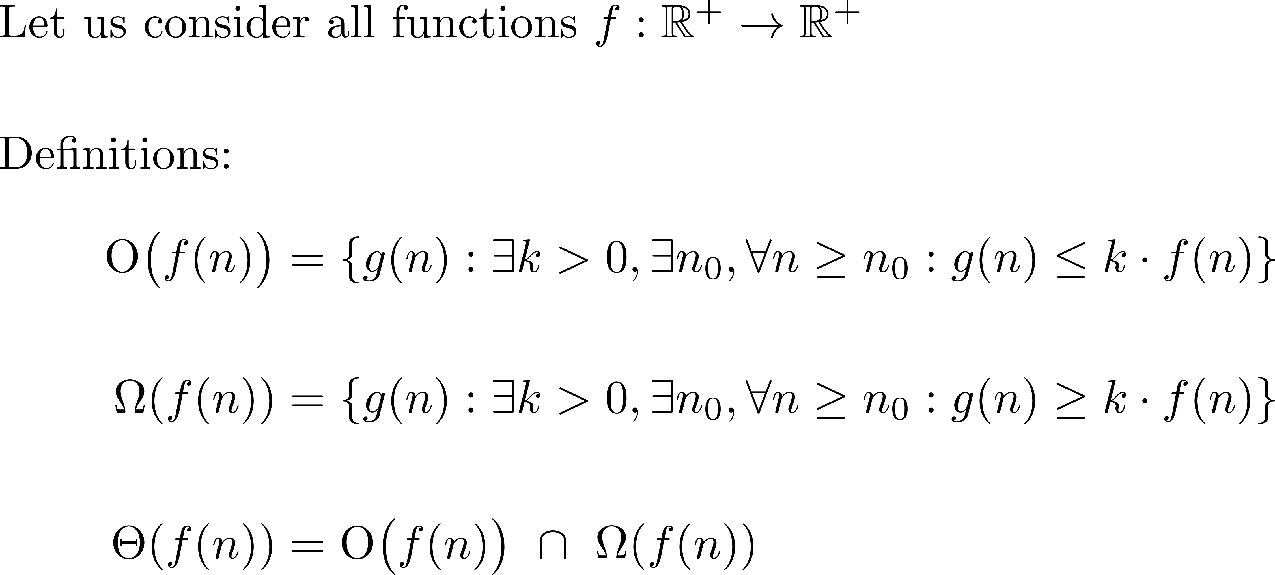
Asymptotic notation

Slide 13
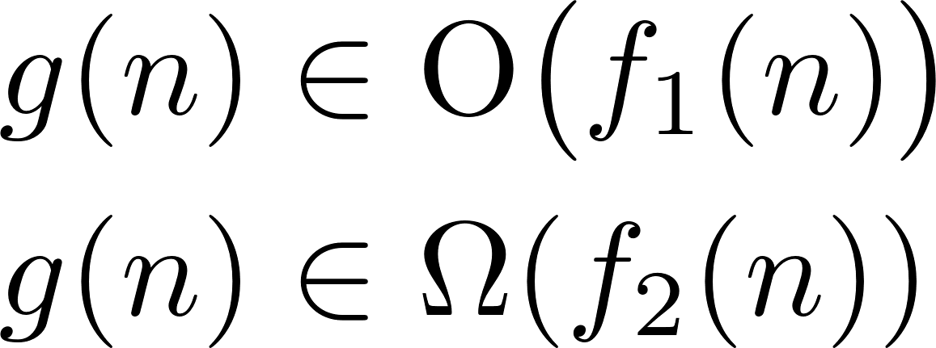





Asymptotic notation
$$k_{1}f_{1}(n)$$
$$g(n)$$
$$k_{2}f_{2}(n)$$
$$n_{0}$$
$$n$$

Slide 14
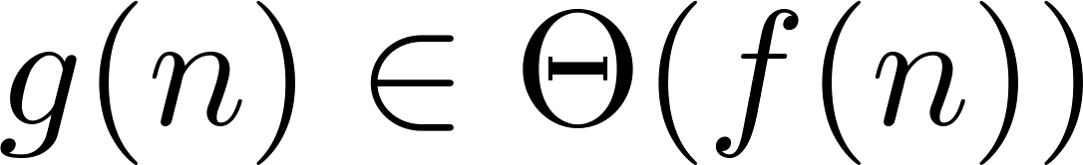


Asymptotic notation
$$k_{1}f(n)$$
$$g(n)$$
$$k_{2}f(n)$$
$$n_{0}$$
$$n$$

Slide 15
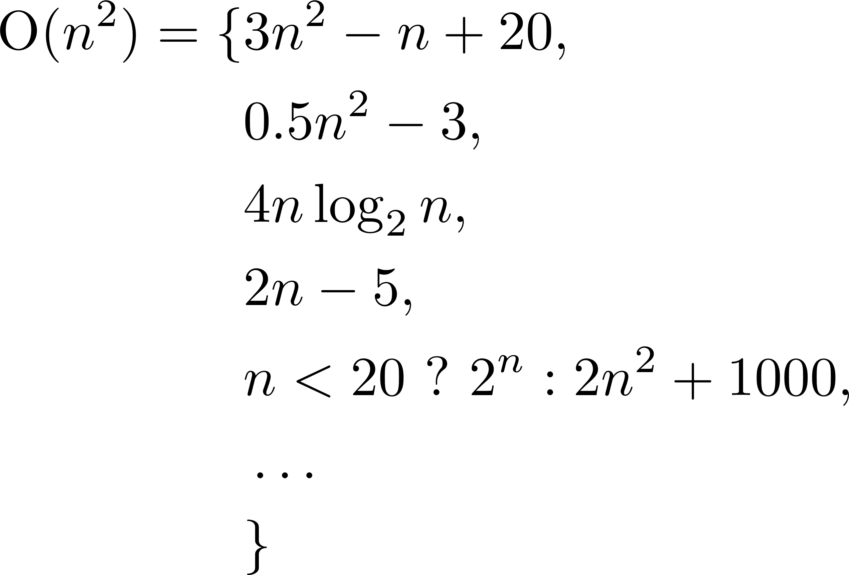
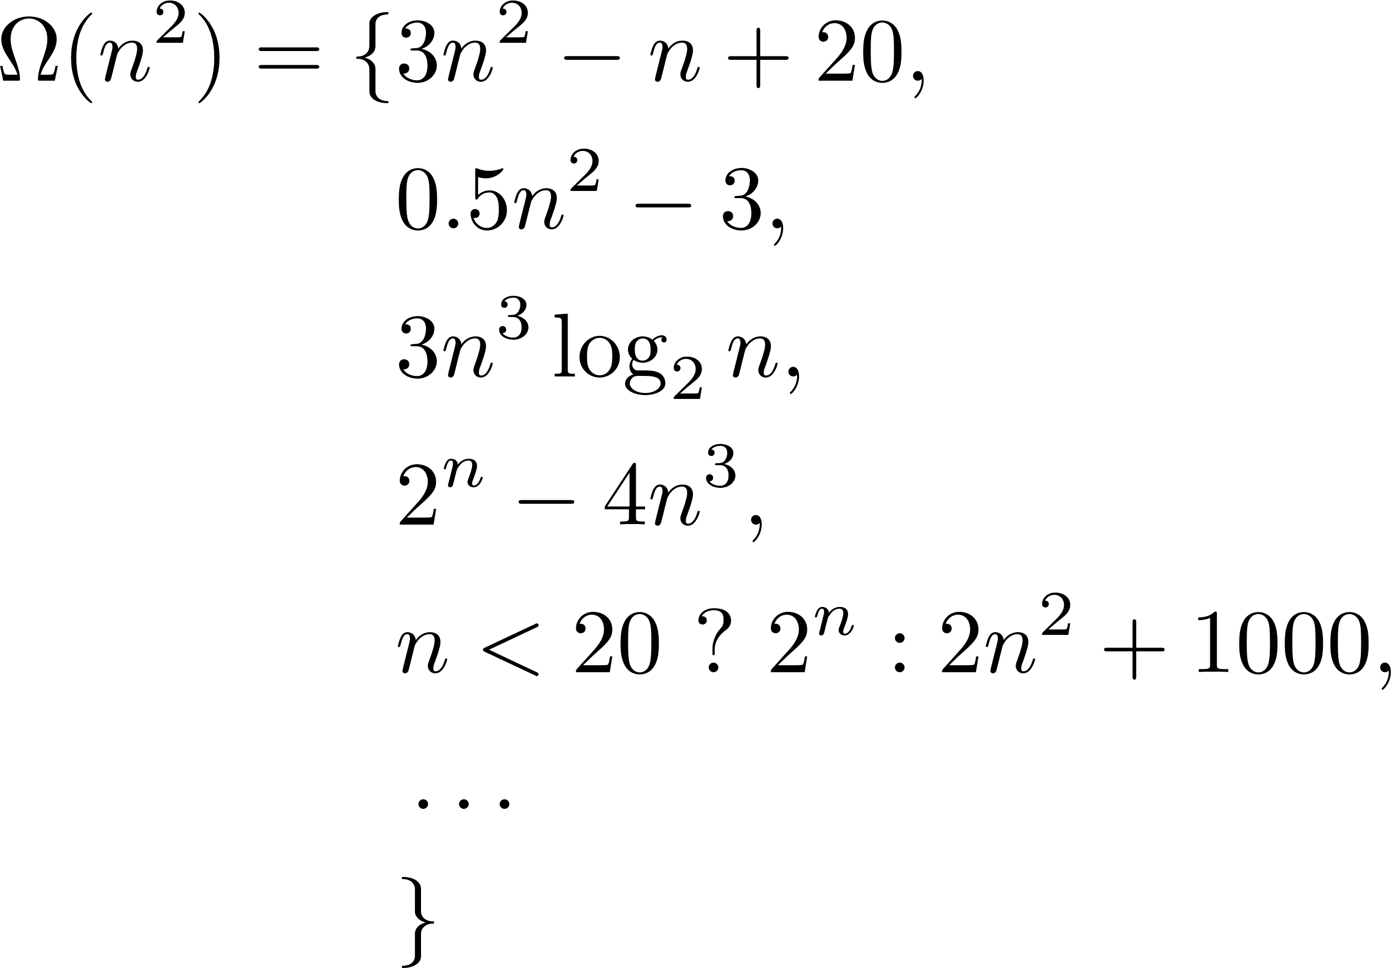
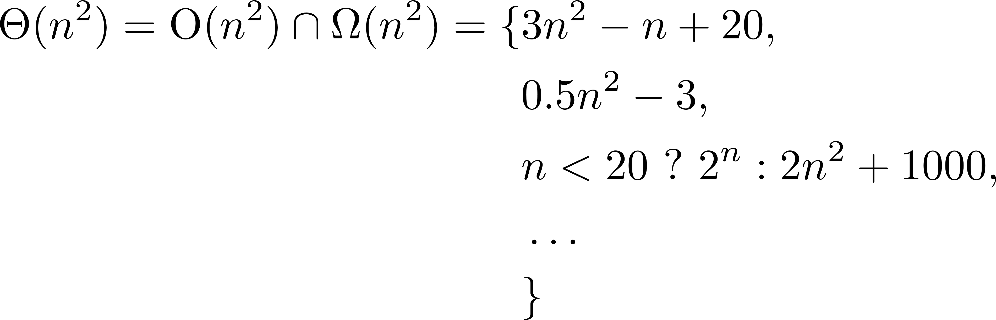
Asymptotic notation: example

Slide 16
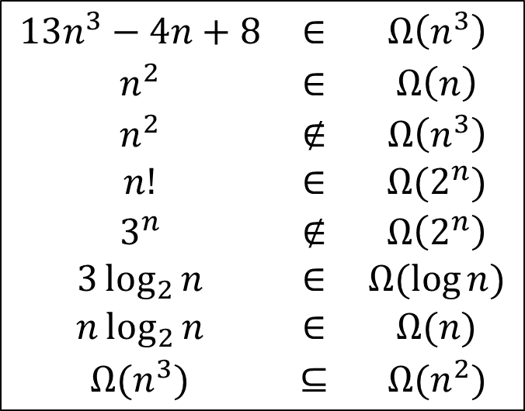
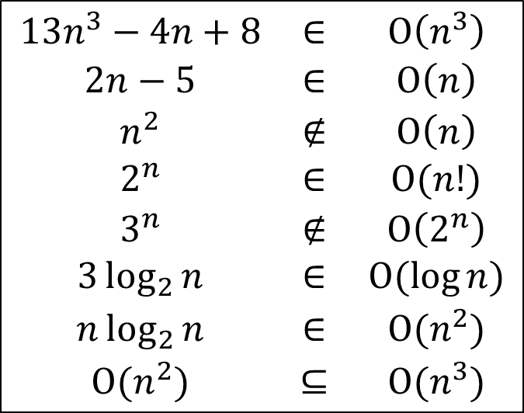
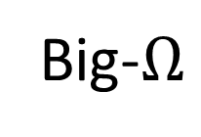
Examples
Big-O
Big-$Ω$
$$\begin{matrix}13n^{3}−4n+8 & ∈ & \text{O}\left(n^{3}\right) \\ 2n−5 & ∈ & \text{O}\left(n\right) \\ n^{2} & ∉ & \text{O}\left(n\right) \\ 2^{n} & ∈ & \text{O}(n!) \\ 3^{n} & ∉ & \text{O}\left(2^{n}\right) \\ 3\log_{2}{n} & ∈ & \text{O}(\log{n)} \\ n\log_{2}{n} & ∈ & \text{O}(n^{2}) \\ \text{O}(n^{2}) & ⊆ & \text{O}(n^{3})\end{matrix}$$
$$\begin{matrix}13n^{3}−4n+8 & ∈ & Ω\left(n^{3}\right) \\ n^{2} & ∈ & Ω\left(n\right) \\ n^{2} & ∉ & Ω\left(n^{3}\right) \\ n! & ∈ & Ω(2^{n}) \\ 3^{n} & ∉ & Ω\left(2^{n}\right) \\ 3\log_{2}{n} & ∈ & Ω(\log{n)} \\ n\log_{2}{n} & ∈ & Ω(n) \\ Ω(n^{3}) & ⊆ & Ω(n^{2})\end{matrix}$$

Slide 17
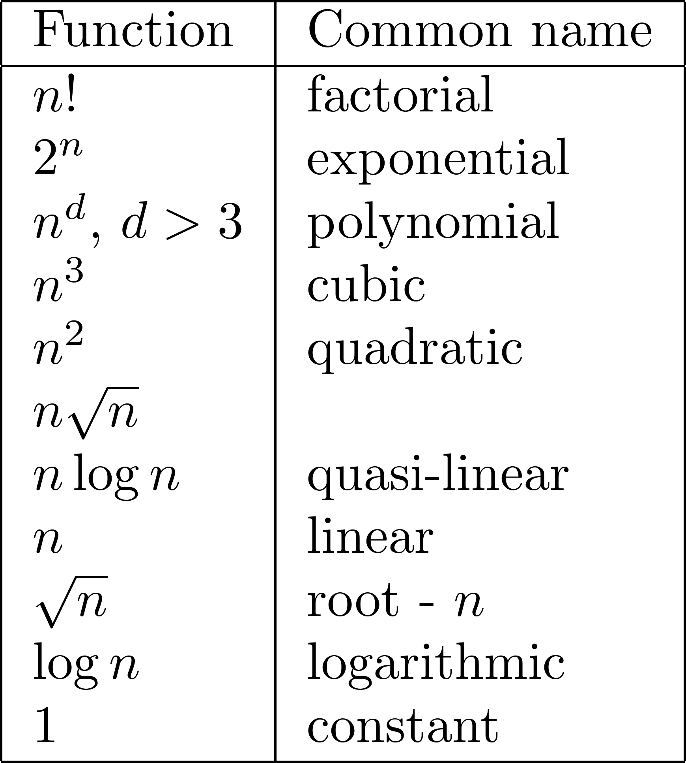
Complexity ranking

Slide 18
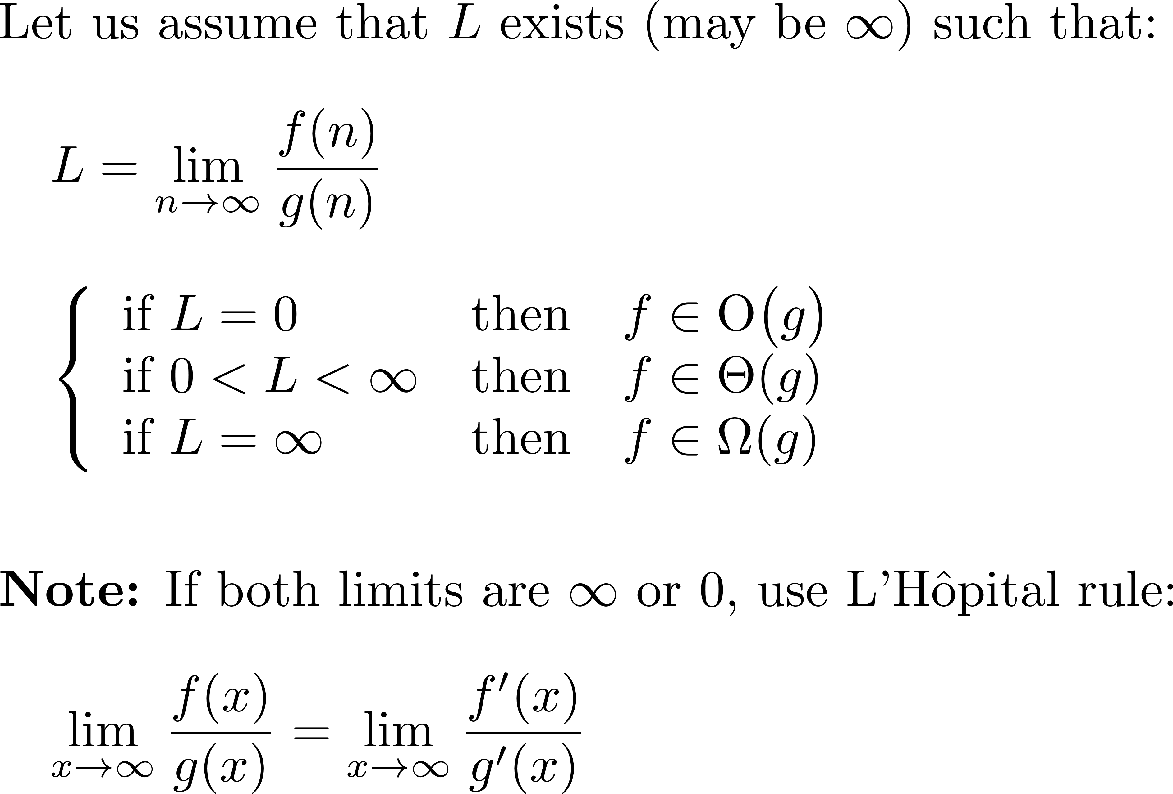
The limit rule

Slide 19
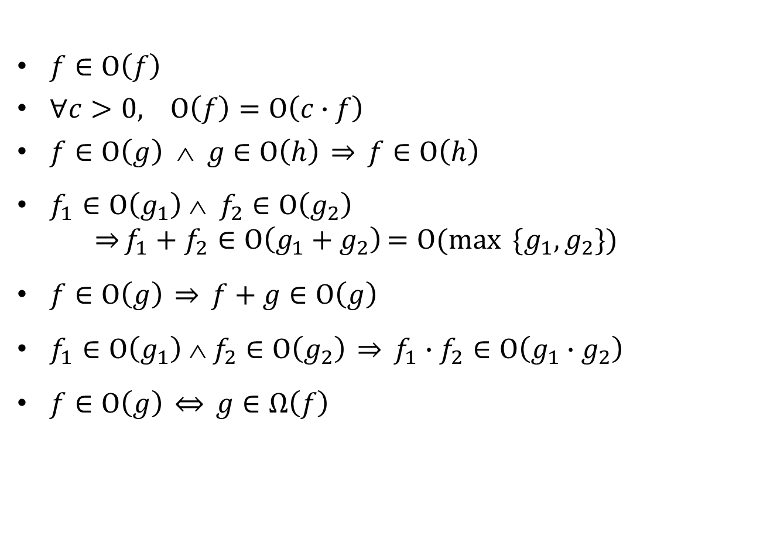
Properties
$f∈\text{O}\left(f\right)$
$∀c>0, \text{O}\left(f\right)=\text{O}\left(c∙f\right)$
$f∈\text{O}\left(g\right) ∧ g∈\text{O}\left(h\right) \overset{⇒}{} f∈\text{O}\left(h\right)$
$f_{1}∈\text{O}\left(g_{1}\right) ∧{ f}_{2}∈\text{O}\left(g_{2}\right)$
$\overset{⇒}{}f_{1}+f_{2}∈\text{O}\left(g_{1}+g_{2}\right)=\text{O}(\max_{ }{ }{\{g_{1},g_{2}\})}$
$f∈\text{O}\left(g\right) \overset{⇒}{} f+g∈\text{O}\left(g\right)$
$f_{1}∈\text{O}\left(g_{1}\right) ∧{ f}_{2}∈\text{O}\left(g_{2}\right) \overset{⇒}{} f_{1}∙f_{2}∈\text{O}\left(g_{1}∙g_{2}\right)$
$f∈\text{O}\left(g\right) \overset{⇔}{} g∈Ω\left(f\right)$

Slide 20
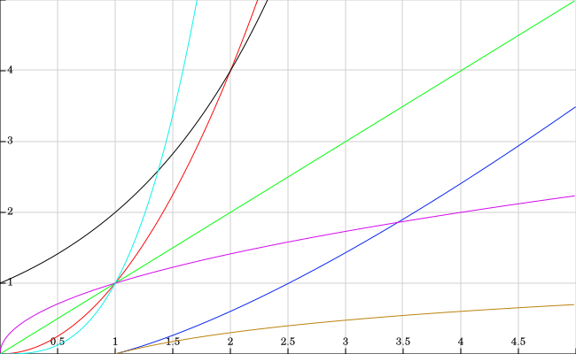
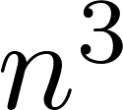

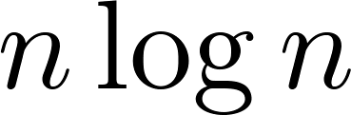
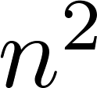
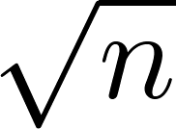

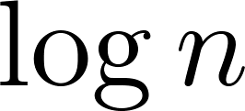
Asymptotic complexity (small values)

Slide 21
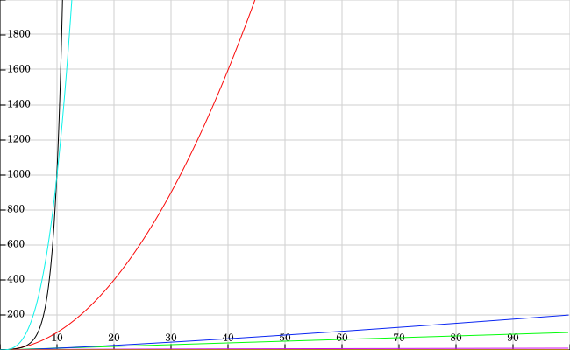
Asymptotic complexity (larger values)

Slide 22
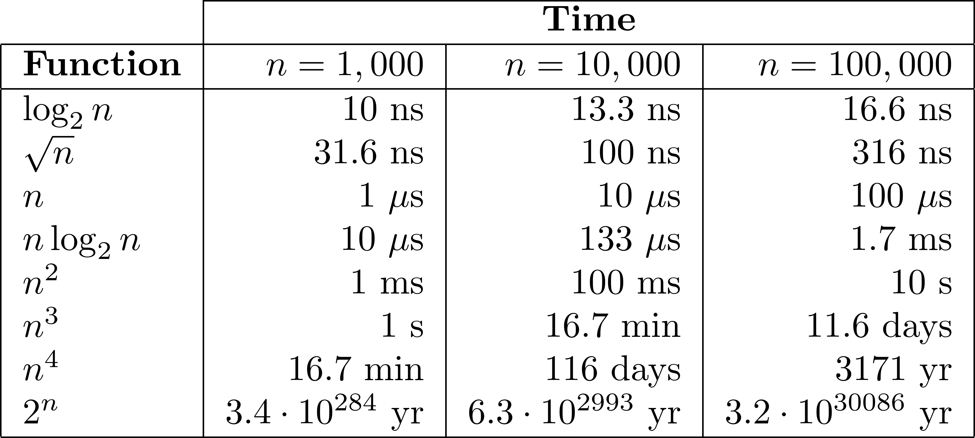
Execution time: example
Let us consider that every operation can be executed in 1 ns (10⁻⁹ s).

Slide 23
How about “big data”?
Source: Jon Kleinberg and Éva Tardos, Algorithm Design, Addison Wesley 2006.
This is often the practical limit for big data

Slide 24

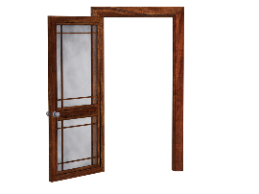

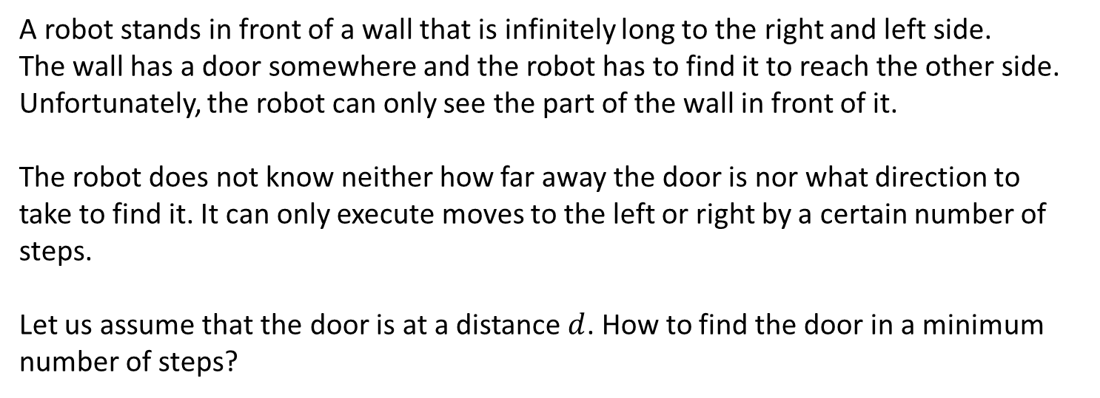
The robot and the door in an infinite wall
$$d$$
A robot stands in front of a wall that is infinitely long to the right and left side.
The wall has a door somewhere and the robot has to find it to reach the other side.
Unfortunately, the robot can only see the part of the wall in front of it.
The robot does not know neither how far away the door is nor what direction to
take to find it. It can only execute moves to the left or right by a certain number of steps.
Let us assume that the door is at a distance $d$. How to find the door in a minimum number of steps?

Slide 25
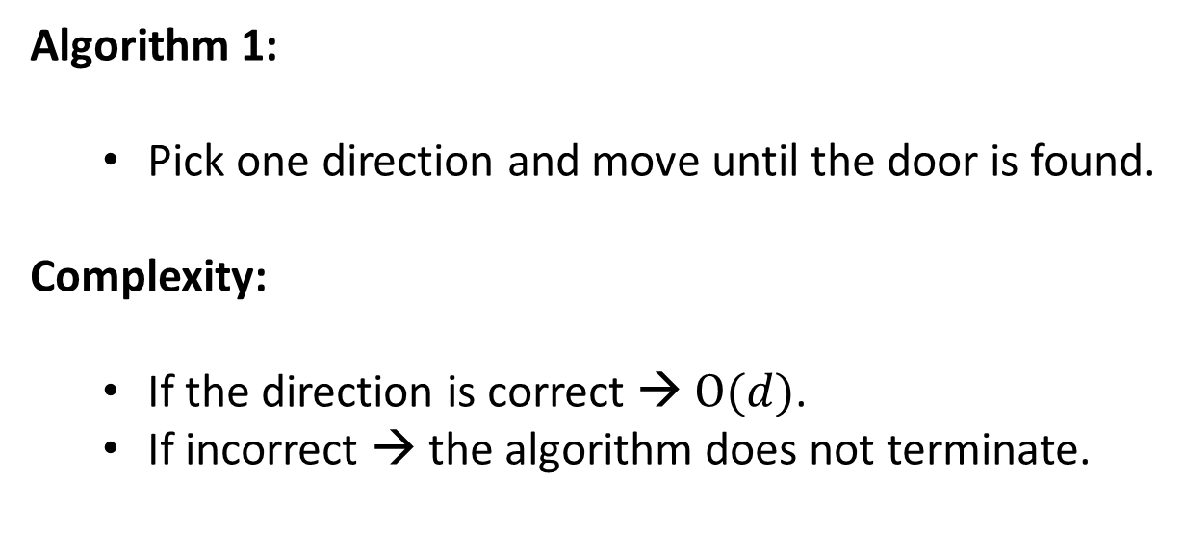
The robot and the door in an infinite wall
$$d$$
Algorithm 1:
  Pick one direction and move until the door is found.
Complexity:
  If the direction is correct → $\text{O}(d)$.
  If incorrect → the algorithm does not terminate.

Slide 26
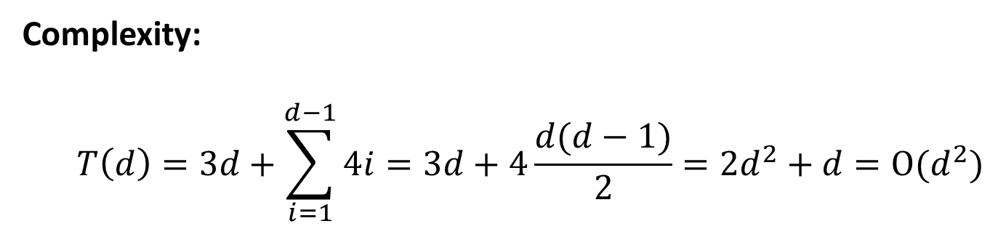
The robot and the door in an infinite wall
$$d$$
Algorithm 2:
  1 step to the left,
  2 steps to the right,
  3 steps to the left, …
  … increasing by one step in the opposite direction.
Complexity:
  $$T\left(d\right)=3d+\sum_{i=1}^{d−1}{4i=3d+4\frac{d(d−1)}{2}=2d^{2}+d=\text{O}(d^{2})}$$

Slide 27
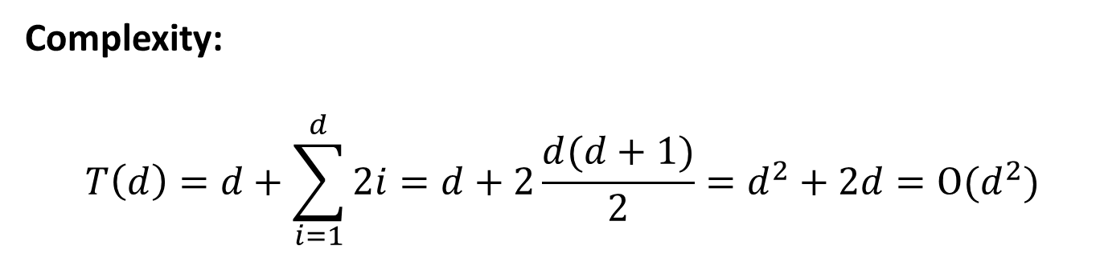
The robot and the door in an infinite wall
$$d$$
Algorithm 3:
  1 step to the left and return to origin,
  2 steps to the right and return to origin,
  3 steps to the left and return to origin,…
  … increasing by one step in the opposite direction.
Complexity:
  $$T\left(d\right)=d+\sum_{i=1}^{d}{2i=d+2\frac{d(d+1)}{2}=d^{2}+2d=\text{O}(d^{2})}$$

Slide 28
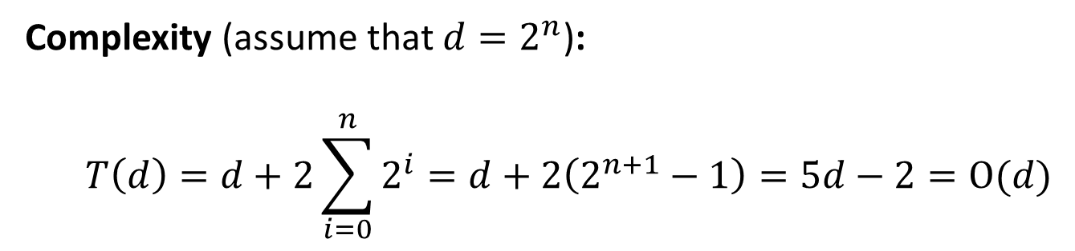
The robot and the door in an infinite wall
$$d$$
Algorithm 4:
  1 step to the left and return to origin,
  2 steps to the right and return to origin,
  4 steps to the left and return to origin,…
  … doubling the number of steps in the opposite direction.
Complexity (assume that $d=2^{n}$):
  $$T\left(d\right)=d+2\sum_{i=0}^{n}{2^{i}=d+2\left(2^{n+1}−1\right)=5d−2=\text{O}(d)}$$

Slide 29
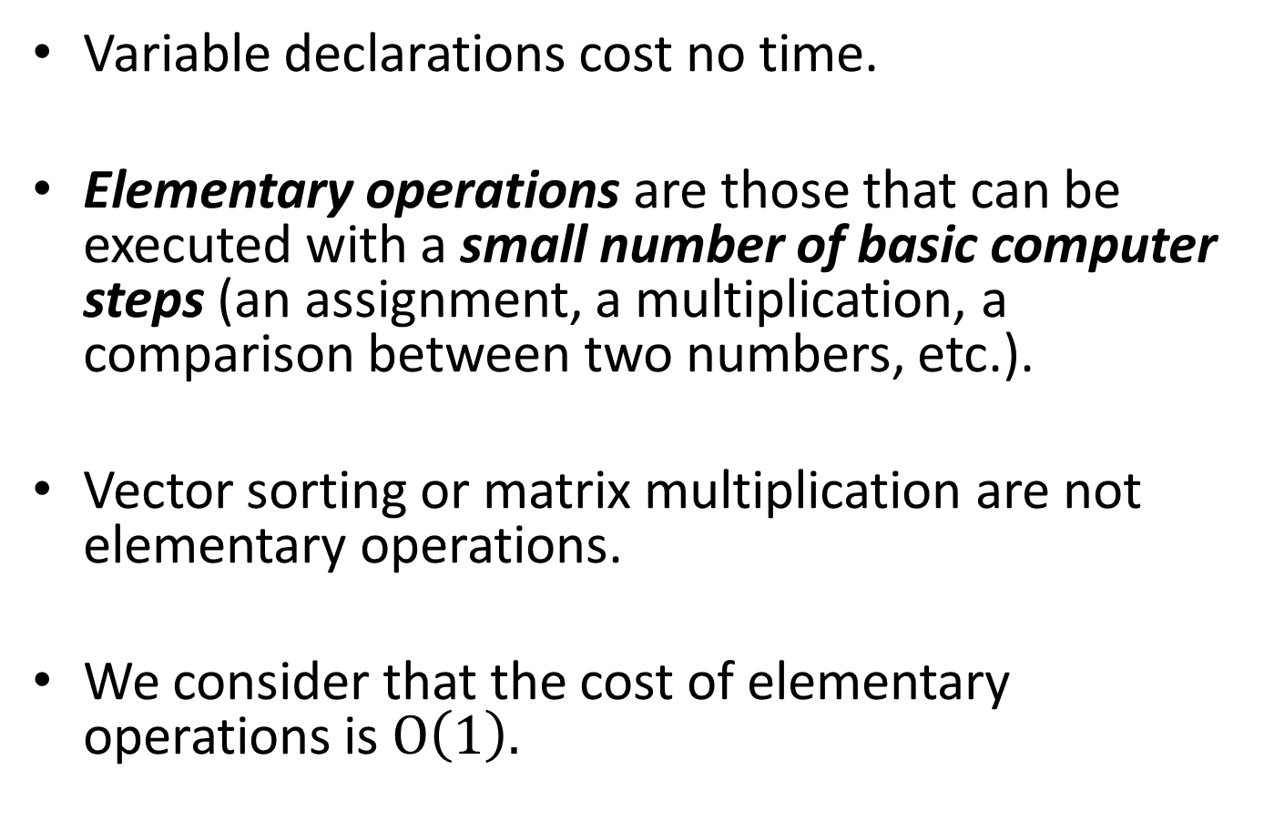
Runtime analysis rules
Variable declarations cost no time.
Elementary operations are those that can be executed with a small number of basic computer steps (an assignment, a multiplication, a comparison between two numbers, etc.).
Vector sorting or matrix multiplication are not elementary operations.
We consider that the cost of elementary operations is $O\left(1\right).$

Slide 30
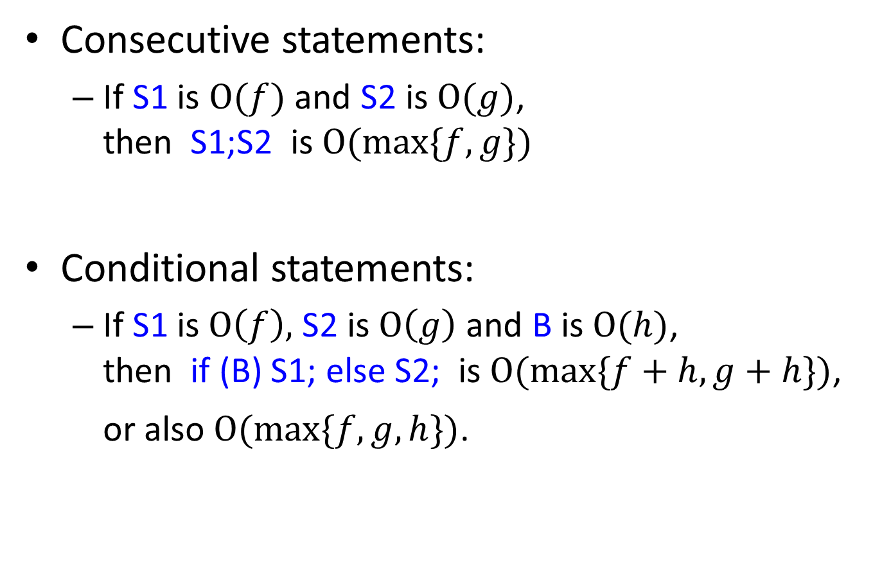
Runtime analysis rules
Consecutive statements:
  If S1 is $\text{O}(f)$ and S2 is$\text{O}(g)$,
  then S1;S2 is$\text{O}(\max_{ }{\{f,g\})}$
Conditional statements:
  If S1 is$\text{O}\left(f\right),$ S2 is$\text{O}\left(g\right)$ and B is$\text{O}(h)$,
  then if (B) S1; else S2; is$\text{O}(\max_{ }{\{f+h,g+h\})}$,
  or also$\text{O}(\max_{ }{\{f,g,h\})}$.

Slide 31
Runtime analysis rules
For/While loops:
  Running time is at most the running time of the statements inside the loop times the number of iterations
Nested loops:
  Analyze inside out: running time of the statements inside the loops multiplied by the product of the sizes of the loops

Slide 32
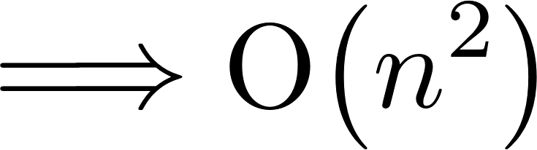
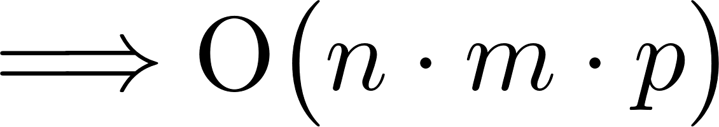
Nested loops: examples
for i in range(n):
for j in range(n):
do_something() # O(1)
for i in range(n):
for j in range(i, n):
do_something() # O(1)
for i in range(n):
for j in range(m):
for k in range(p):
do_something() # O(1)

Slide 33

Linear time: $\text{O}(n)$
Running time proportional to input size
# Compute the maximum of a vector with n numbers
m = a[0]
for i in range(1, len(a)):
m = max(m, a[i])
# Equivalent way in Python (same complexity)
m = max(a)

Slide 34
Linear time: $\text{O}(n)$
Other examples:
  Reversing a vector
  Merging two sorted vectors
  Finding the largest null segment of a sorted vector: a linear-time algorithm exists
  (a null segment is a compact sub-vector in which the sum of all the elements is zero)

Slide 35
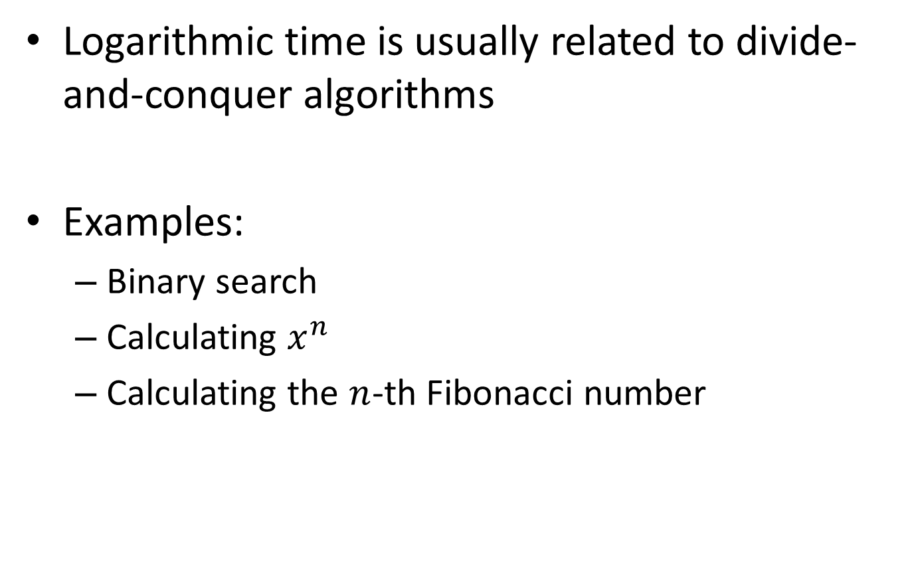

Logarithmic time: $\text{O}(\log{n})$
Logarithmic time is usually related to divide-and-conquer algorithms
Examples:
  Binary search
  Calculating $x^{n}$
  Calculating the $n$-th Fibonacci number

Slide 36
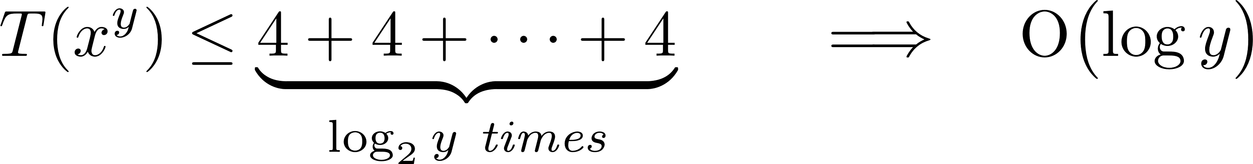
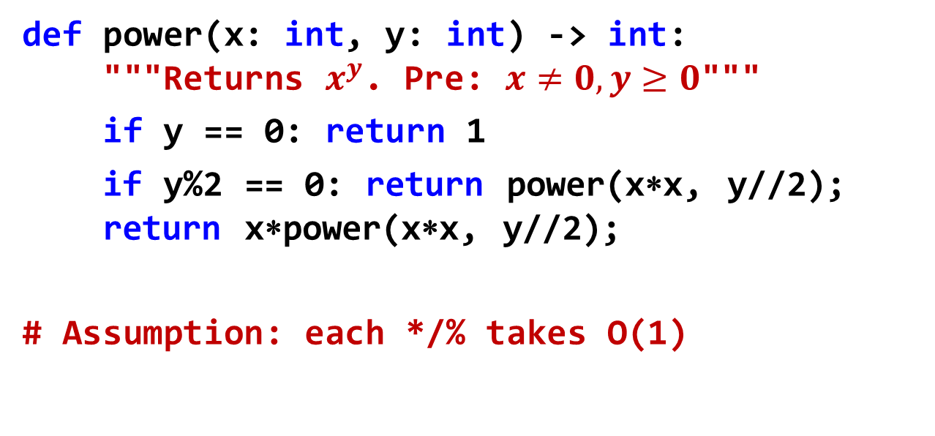

Example: recursive $x^{y}$
def power(x: int, y: int) -> int:
"""Returns $x^{y}$. Pre: $x≠0, y≥0$"""
if y == 0: return 1
if y%2 == 0: return power(x∗x, y//2);
return x∗power(x∗x, y//2);
# Assumption: each */% takes O(1)

Slide 37
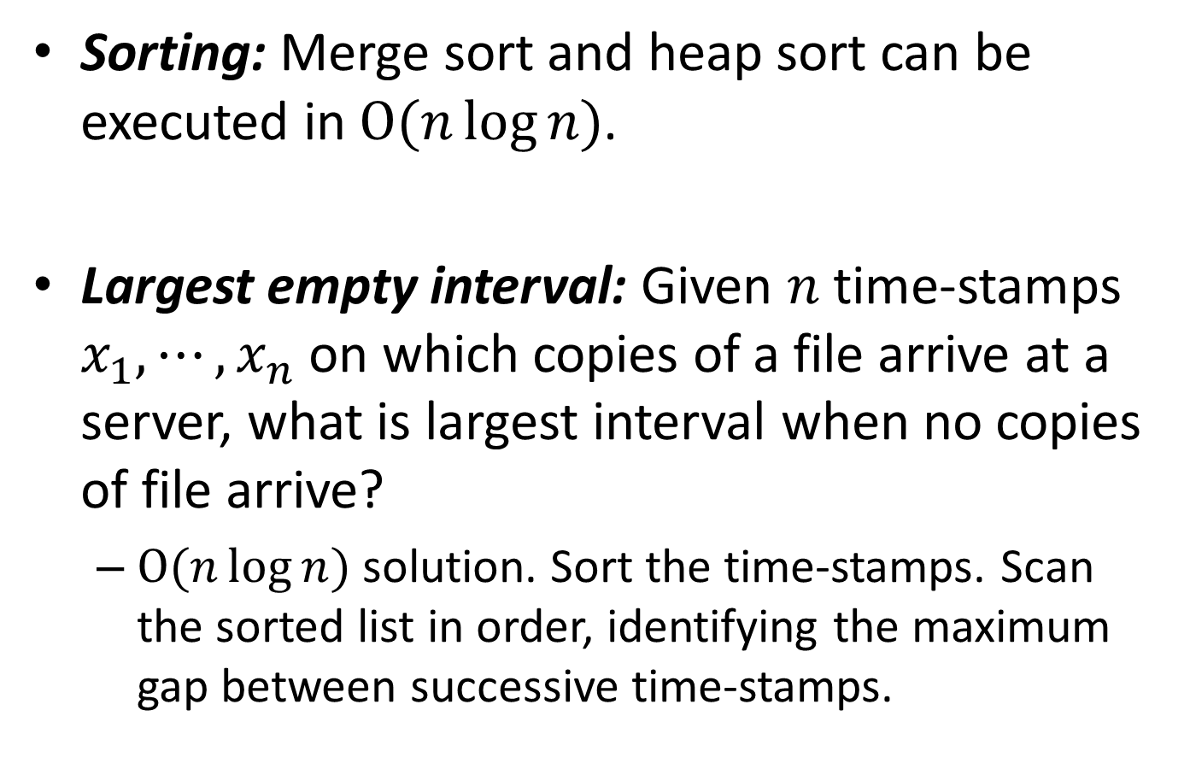

Linearithmic time: $\text{O}(n\log{n)}$
Sorting: Merge sort and heap sort can be executed in $\text{O}(n\log{n)}$.
Largest empty interval: Given $n$ time-stamps $x_{1},⋯,x_{n}$ on which copies of a file arrive at a server, what is largest interval when no copies of file arrive?
  $\text{O}(n\log{n)}$ solution. Sort the time-stamps. Scan the sorted list in order, identifying the maximum gap between successive time-stamps.

