Slide 1
Algorithmics and Programming II: Introduction
Jordi Cortadella and Jordi Petit
Department of Computer Science

Slide 2
Algorithmics and Programming II
Lecturers:
Jordi Cortadella (jordi.cortadella@upc.edu)
Jordi Petit (jordi.petit-silvestre@cs.upc.edu)
Pau Fernández (pau.fernandez@upc.edu)
Teaching Assistant:
Laia Mogas (laia.mogas.pladevall@estudiantat.upc.edu)
Sessions:
Theory (Jordi Cortadella)
Lab (1.1-1.2: Jordi Petit; 1.3: Pau Fernández)

Slide 3
Material
Slides, exercises: https://www.cs.upc.edu/~jordicf/Teaching/AP2
Jutge (for lab sessions): https://jutge.org
Lliçons (by J. Petit and S. Roura): https://lliçons.jutge.org

Slide 4
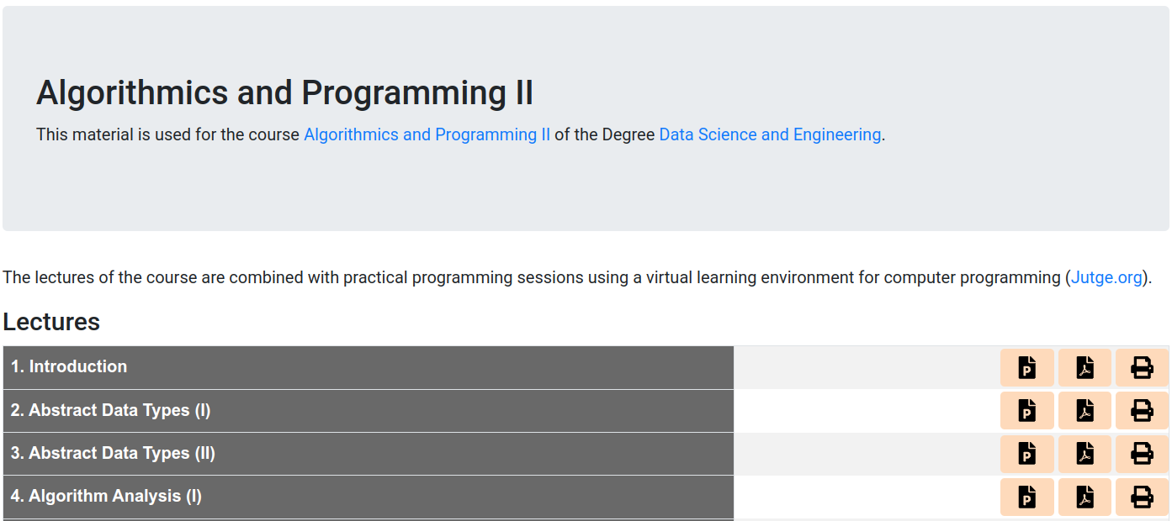
Slides of the lectures

Slide 5
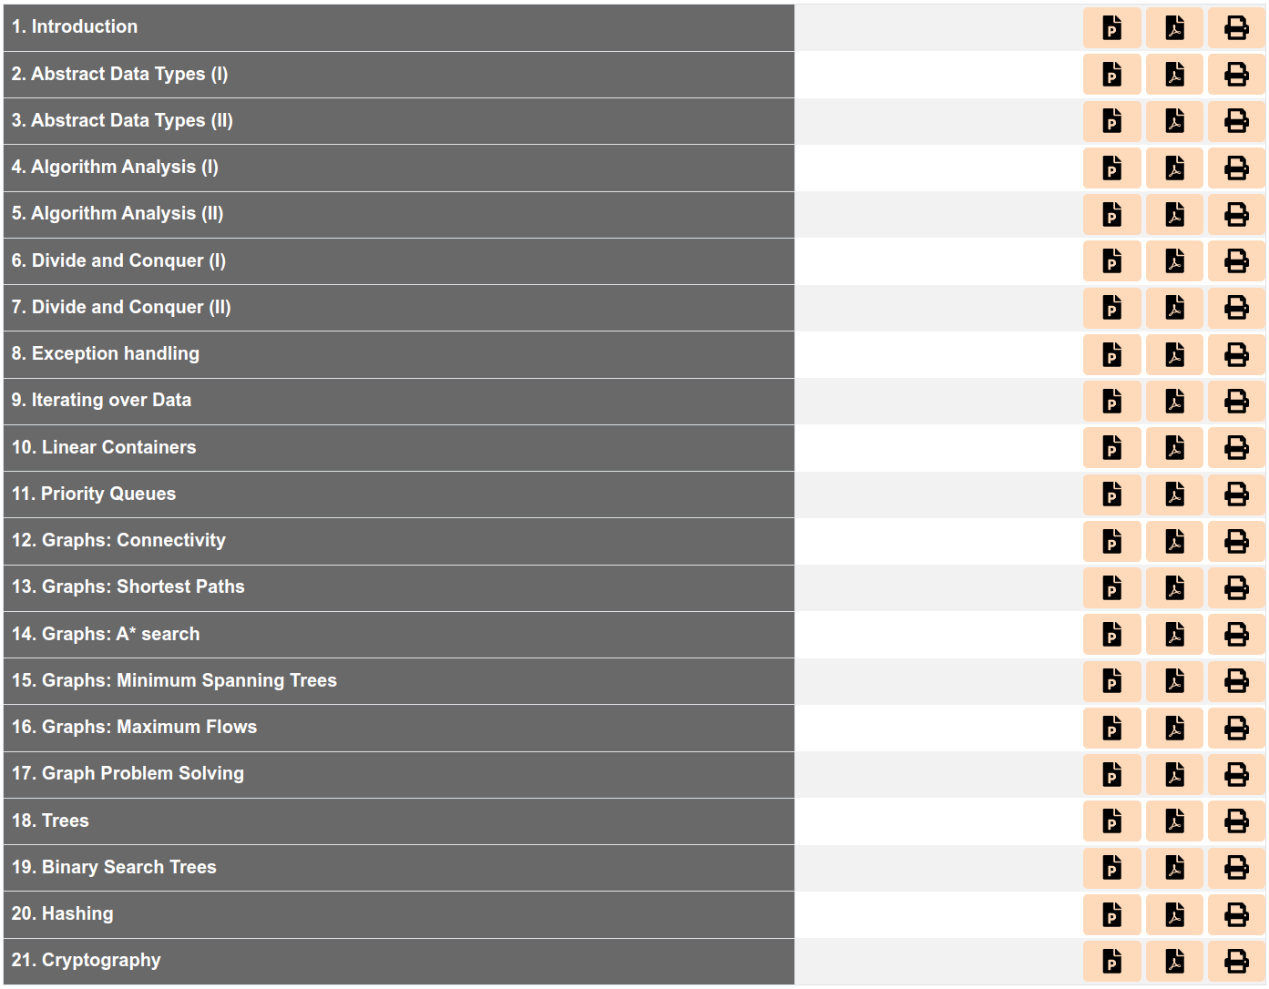

Slide 6
Evaluation
Evaluation items:
Projects: P1, P2
Exams: Partial Lab (PL), Final Theory (FT), Final Lab (FL)
Grading:
Projects: $P=(P1+P2)/2$
Exams: $X=\max_{ }\left\{\begin{matrix}0.3 PL+0.4 FT+0.3 FL \\ 0.5 FT+0.5 FL \end{matrix}\right.$
Final grade: $N=\left\{\begin{matrix}\max_{ }{(0.3 P+0.7 X, 0.15 P+0.85 X)} & \text{if} X≥4 \\ 0.15 P+0.85 X & \text{if} X<4\end{matrix}\right.$

Slide 7
First project: Cities and Roads
Inspired by the game CatanTM.

Slide 8
Peer and self assessment
The project will be evaluated by the students themselves.
Each project will be evaluated by three students. The grade will be calculated as the average grade given by the students.
The evaluation will be completely blind.
Biased evaluations will be detected and penalized.
Each student will have the right to request the evaluation by the professor (who can upgrade or downgrade the evaluation given by the students).

Slide 9
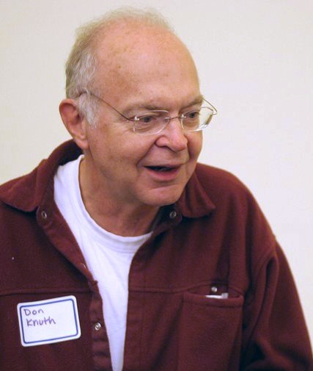
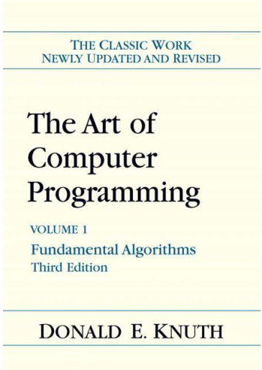
Donald Knuth (Turing award, 1974)
“Programming is an art of telling another human what one wants the computer to do.”
“An algorithm must be seen to be believed.”
“The real problem is that programmers have spent far too much time worrying about efficiency in the wrong places and at the wrong times; premature optimization is the root of all evil (or at least most of it) in programming.”

Slide 10
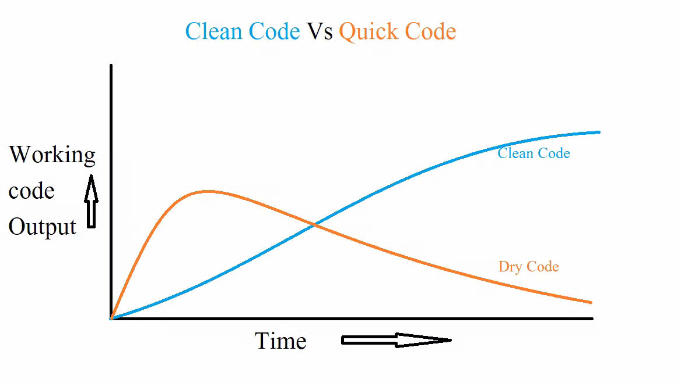

Slide 11
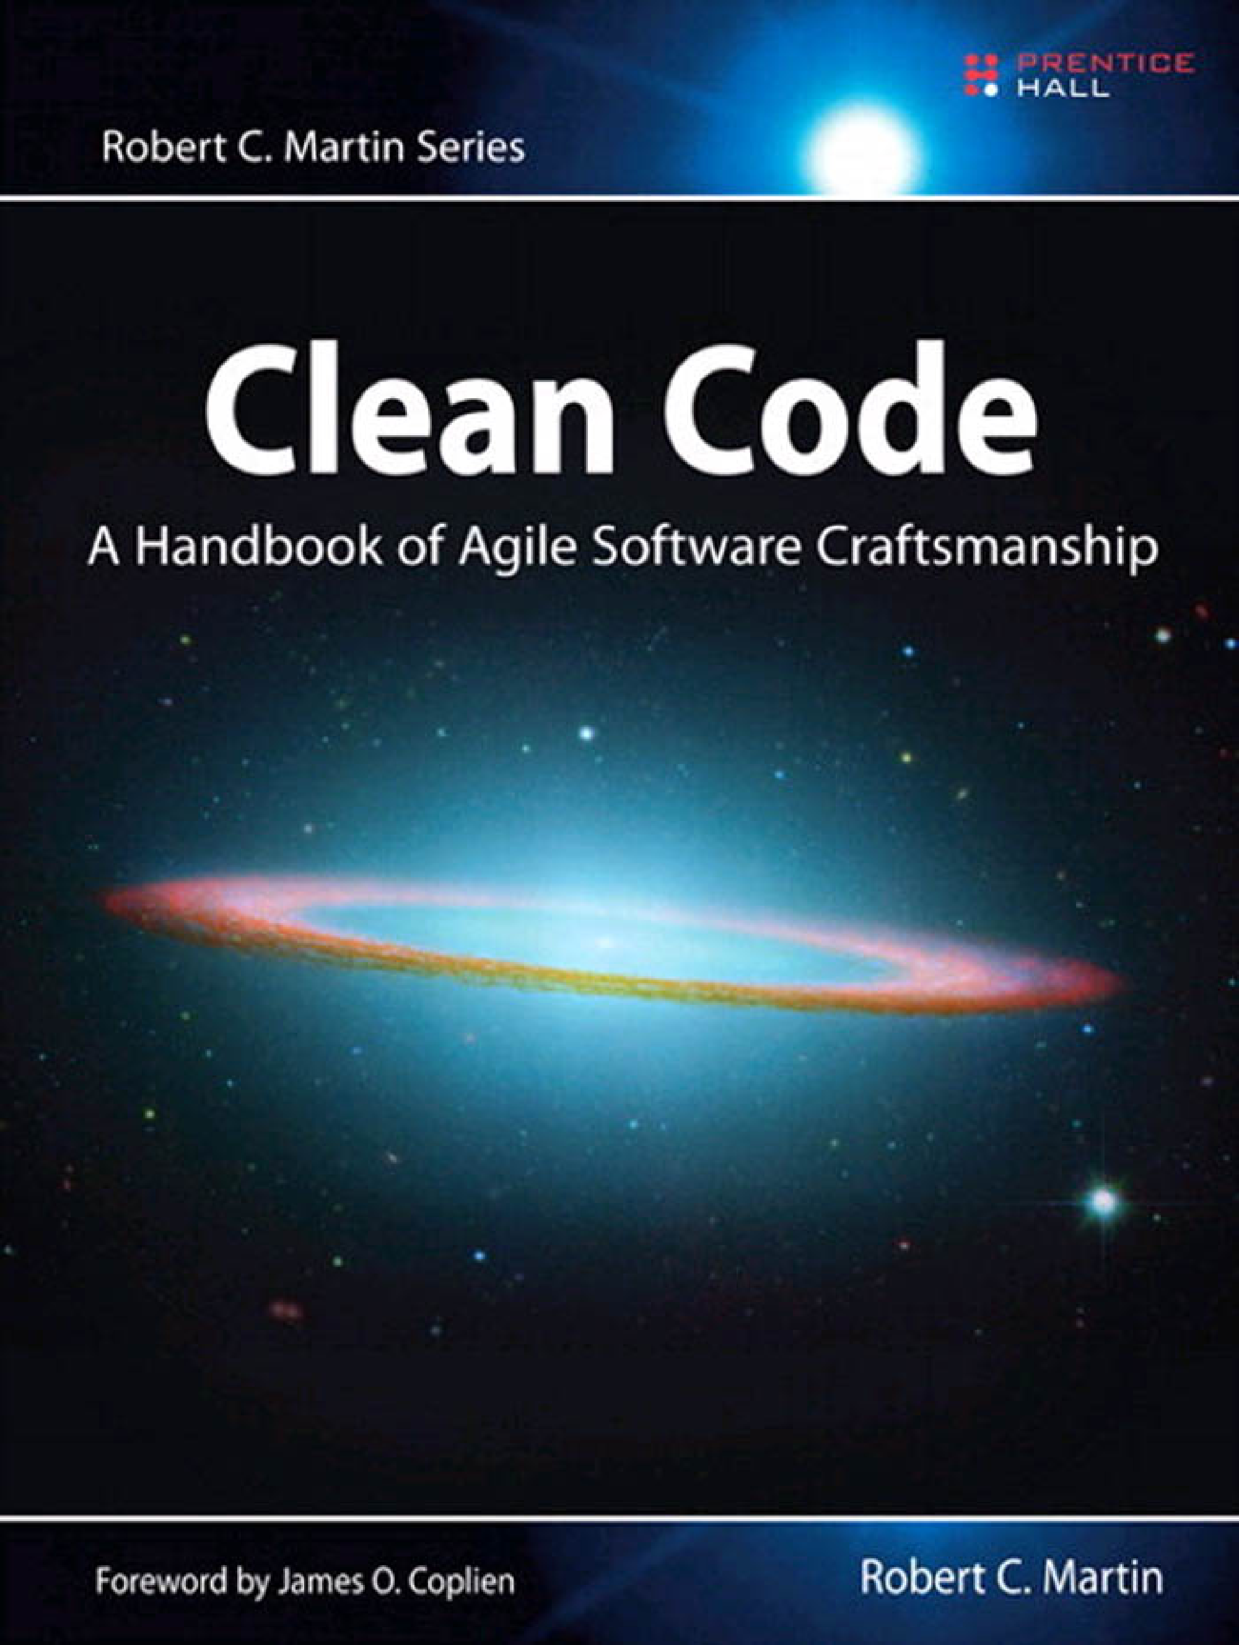
“Truth can only be found in one place: the code.”
“Indeed, the ratio of time spent reading versus writing is well over 10 to 1. We are constantly reading old code as part of the effort to write new code. ...[Therefore,] making it easy to read makes it easier to write.”
“It is not enough for code to work.”
“So if you want to go fast, if you want to get done quickly, if you want your code to be easy to write, make it easy to read.”
“You should name a variable using the same care with which you name a first-born child.”
“Clean code always looks like it was written by someone who cares.”
“Of course bad code can be cleaned up. But it’s very expensive.”

Slide 12
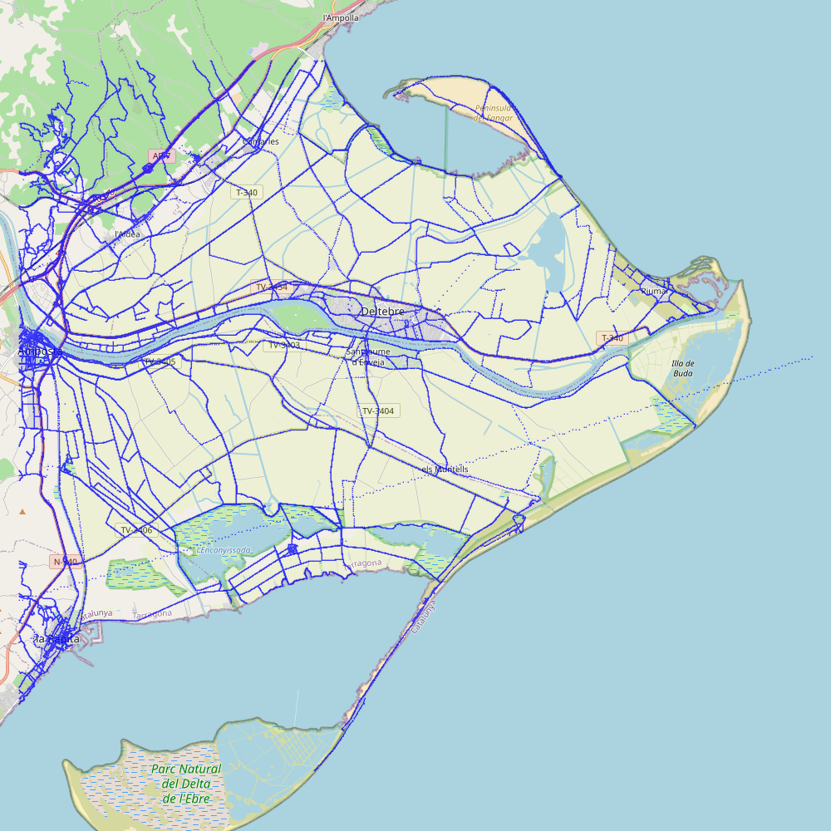
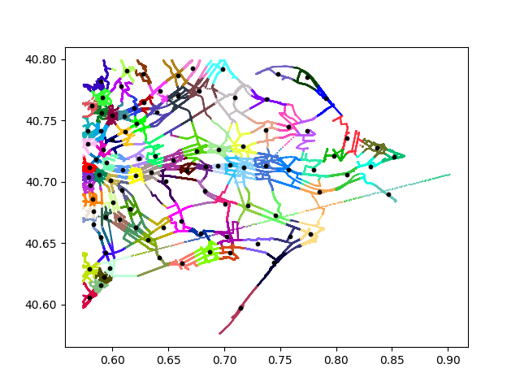
Second project: inferring graphs from GPS routes

Slide 13
Objective of the course
Confronting large and difficult problems. How?
Skills for abstraction and algorithmic reasoning.
Design and use of complex data structures.
Techniques for complexity analysis.
Methodologies for modular programming.
High-quality code.

Slide 14
Problems on polygons
Compute the convex hull of $n$ given points in the plane.

Slide 15
The Closest-Points problem
Input: A list of $n$ points in the plane $\left\{\left(x_{1},y_{1}\right),\left(x_{2},y_{2}\right),…,\left(x_{n},y_{n}\right)\right\}$
Output: The pair of closest points
Simple approach: check all pairs → $\text{O}(n^{2})$
We want an $\text{O}(n\log{n)}$ solution !

Slide 16
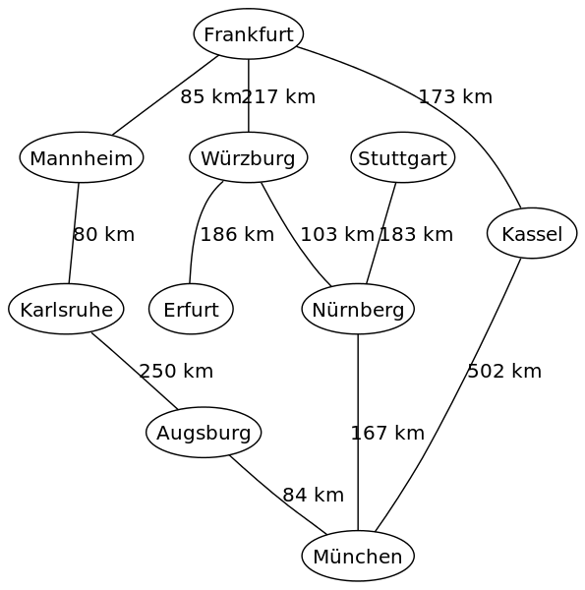
Navigation: find the shortest path

Slide 17
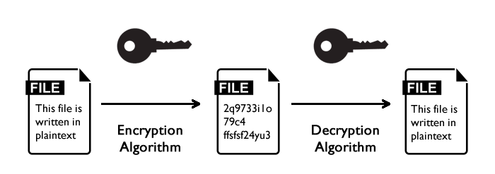
How to encrypt messages?

Slide 18
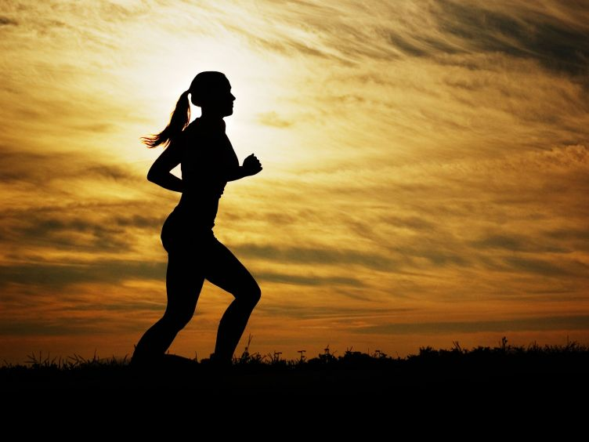
The secret:
training, training, training …

Slide 19
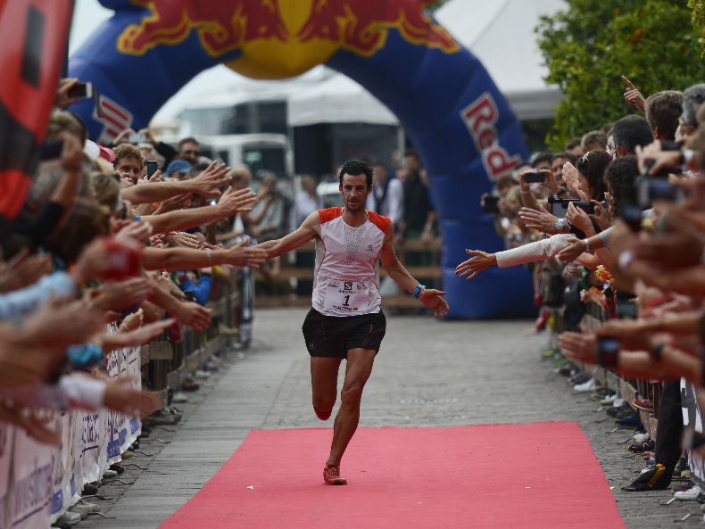
… up to the finish line

