Slide 1
A Hierarchical Mathematical Model for Automatic Pipelining and Allocation using Elastic Systems
Jordi Cortadella and Jordi Petit
Universitat Politècnica de Catalunya, Barcelona

Slide 2
A Hierarchical Mathematical Model for RTL optimizations
Jordi Cortadella and Jordi Petit
Universitat Politècnica de Catalunya, Barcelona

Slide 3
Outline
RTL optimizations: introduction
Elasticity
Basic mathematical model
Hierarchical mathematical model
Two examples

Slide 4
RTL optimizations
F3
F1
F3
F4
F2
Control

Slide 5
RTL optimizations
Mathematical models to find optimal solutions
F1
F4
F2
Control

Slide 6
Synthesis flow
C, C++, SystemC
HLS
Preserve execution order
Retiming
Elasticity (bubbles)
Unit selection
RTL
RTL optimization
RTL Synthesis
throughput
Netlist
architectural exploration
area

Slide 7
Time is elastic …

Slide 8
Elasticity is known from long ago
VME bus
AMBA AHB
Unpredictable timing handled by handshake signals

Slide 9
Rigid vs. Elastic timing
time
time
In
S
Out
9
8
7
6
5
4
3
2
1
9
8
7
6
5
4
3
2
1
CLK
In
6
5
4
3
2
1
S
6
5
4
3
2
1
Out
req
req
ack
ack
bubble
In
5
4
3
2
1
S
5
4
3
2
1
Out
valid
valid
ready
ready
CLK

Slide 10
Incorporating elasticity
Out
In
F1
F3
F2
Modus operandi: compute only when the inputs are valid

Slide 11
Elastic Join
+
Valid
V₁
Cntrl
V
Valid
Ready
R₁
Cntrl
VS
R
Ready
Valid
Cntrl
V₂
Ready
VS
R₂

Slide 12
Variable Latency Units
F
[0 - k] cycles
Data_{in}
Data_{out}
go
done
clear
Valid_{in}
Valid_{out}
Cntrl
Cntrl
Ready_{in}
Ready_{out}

Slide 13
Basic mathematical model

Slide 14
The equations of retiming (registers)
In every cycle, the number of registers is invariant

Slide 15
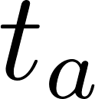
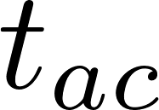
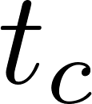
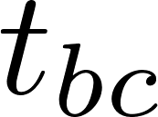
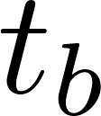
The equations of retiming (delays)

Slide 16
Beyond retiming
Can we do it better?
No!
… unless we use elasticity
Min cycle period: 2
1
1
1
1
In every cycle, the number of registers is invariant

Slide 17
Beyond retiming
Can we do it better?
No!
… unless we use elasticity
1
1
1
Introduce bubbles (registers with invalid data)
tokens
In every cycle, the number of registers is invariant

Slide 18
Performance optimization
Cycle Period: 1 Throughput: 2 tokens / 3 cycles
tokens/cycle
1
$$\max{\frac{\text{Throughput}}{\text{Period}}}$$
tokens/ns
1
1
1
ns/cycle
without bubbles
$$\frac{1 \text{token}}{2 \text{ns}}$$
with bubbles
$$\frac{2 \text{tokens}}{3 \text{ns}}$$
Bubbles contribute to reduce cycle period, … but they also reduce throughput !
better !!!

Slide 19
Performance model
Retiming (fluid) tokens
4/3
4/3
2/3
2/3
2/3
J. Campos, G. Chiola, and M. Silva, “Ergodicity and throughput boundsfor Petri nets with unique consistent firing count vector,” IEEE Transactions on Software Engineering, 1991.

Slide 20
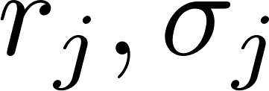
Putting all together
●
Delay & Area equations (same as retiming)
Bufistov, Cortadella, Kishinevsky, and Sapatnekar. A general model for performance optimization of sequential systems. ICCAD, 2007.

Slide 21
Hierarchical mathematical model

Slide 22
Hierarchical model
μP
Arch
Regfile
Exec
FPU
OR
Decode
Memory
FPU1
AND
FPU2
FADD
FMUL
FDIV
cmul
Netlist:
Blocks
Connections
Registers
cadd
xmul
cdiv
carr
cnorm

Slide 23
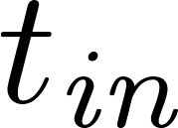
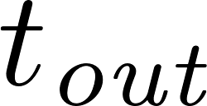
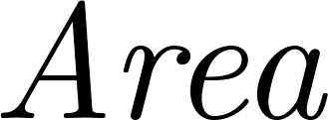
Hierarchical model
F
c
a
b
Each module has an ILP model with interface variables.
The interface variables connect the local ILP models.

Slide 24
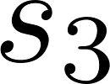
Unit selection
F

Slide 25
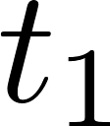
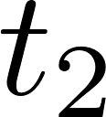
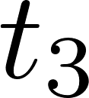
Unit selection
← can be linearized

Slide 26
Block netlist
ILP(F,G)
F ILP(F)
G ILP(G)

Slide 27
Hierarchical model
ILP model (top)
μP
Arch
Regfile
ILP model (FPU)
Exec
FPU
OR
Decode
Memory
ILP model (FPU1)
ILP model (FPU2)
FPU1
AND
FPU2
ILP model
ILP model
ILP model
FADD
FMUL
FDIV
cadd
xmul
cmul
cdiv
carr
cnorm

Slide 28
Example: systolic grid

Slide 29
Area: 10
Delay: 20
Area: 20
Delay: 10
Area: 5
Delay: 0

Slide 30
ILP model:
1766 rows x 1334 columns (578 integer, 66 binary) 4778 nonZeros
Presolved:
857 rows x 809 columns (432 integer, 16 binary) 2752 nonZeros
CPU ≈ 2 mins

Slide 31
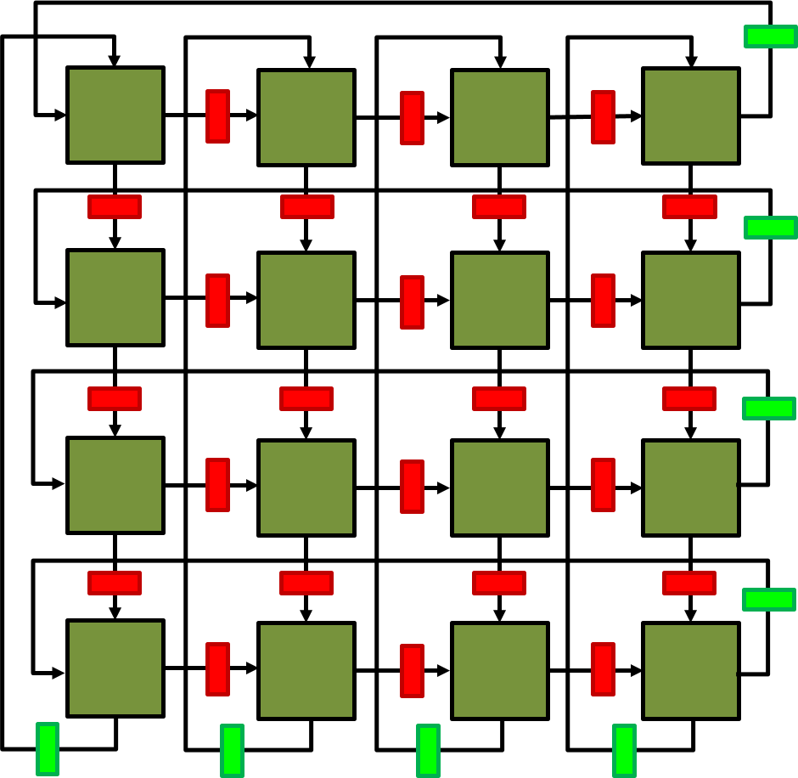
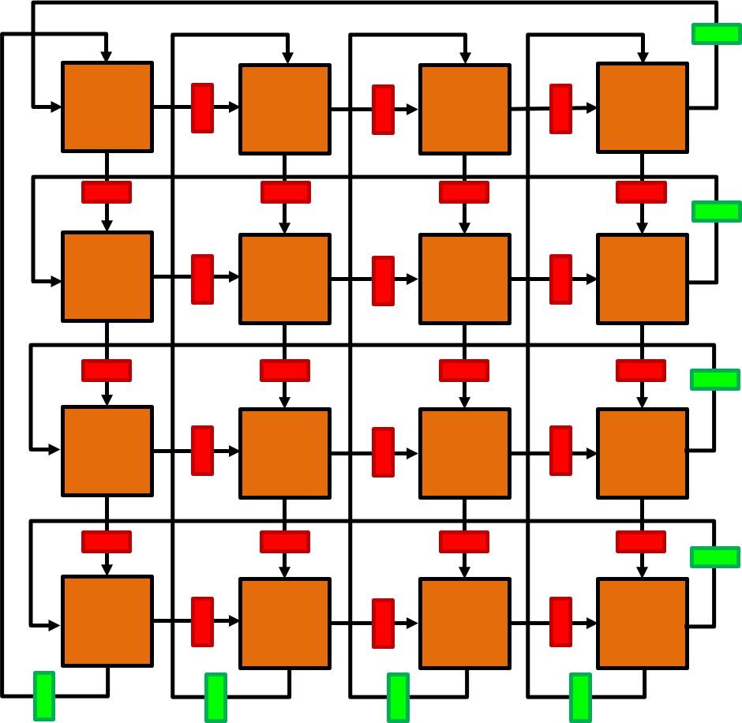
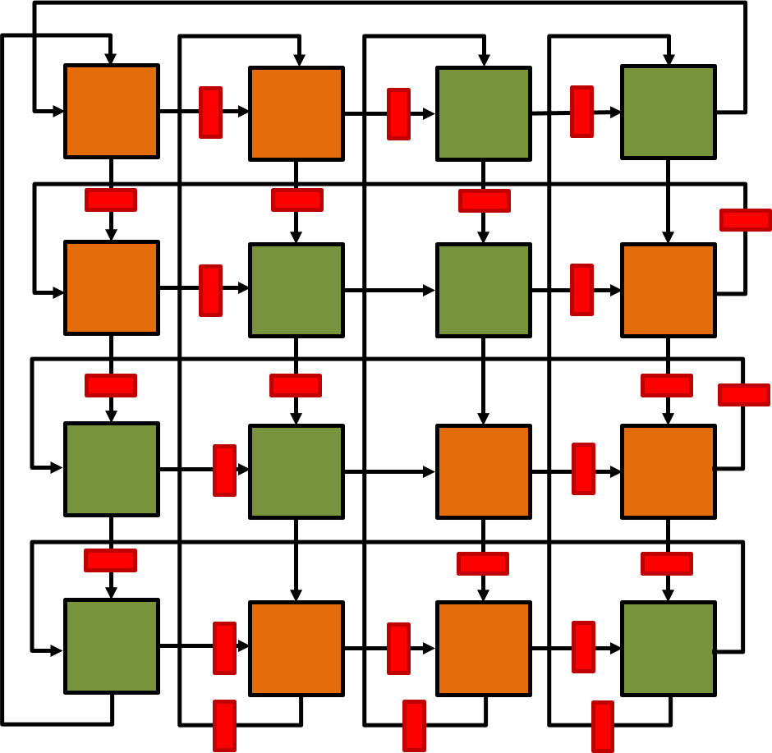
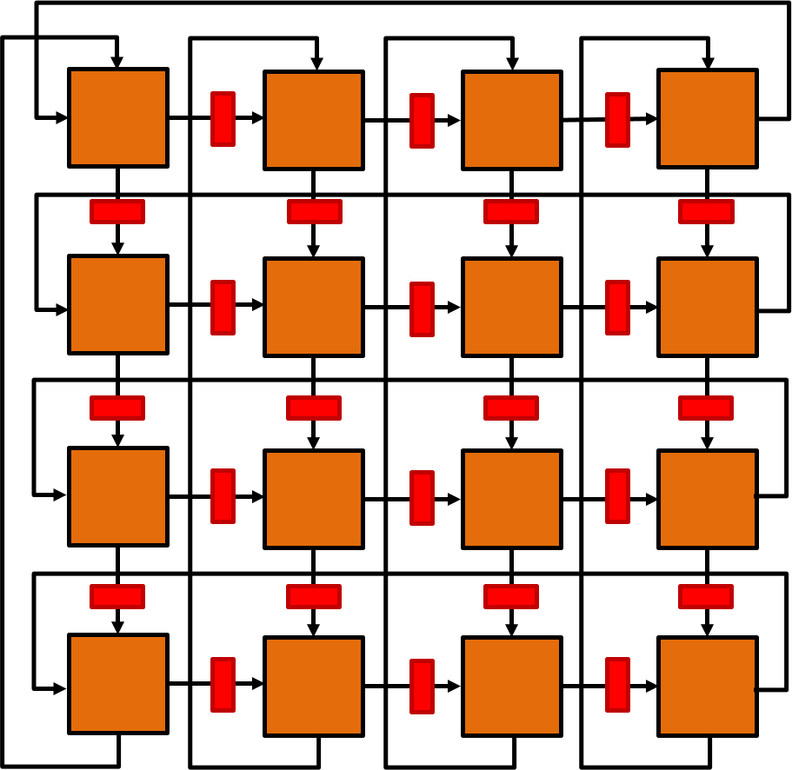
Area-Throughput trade-off

Slide 32
Example: fork/join pipeline

Slide 33
Example
Area: 10 Delay: 40
Area: 10 Delay: 40
Area: 15 Delay: 40
Area: 10 Delay: 20
$$\text{Area}\left(k\right)=k ∙\text{Area}\left(1\right)$$
Area: 30 Delay: 30
$$\text{T}\text{hr}\left(k\right)=k ∙\text{Thr}\left(1\right)$$
Problems:
Max Throughput under Area Constraint
Min Area under Throughput Constraint

Slide 34
Throughput
Area

Slide 35
4
4
4
2
3
1
1
Throughput
1
1
1
3
3
3
2
2
2
2
2
1
1
Area

Slide 36
Conclusions
There is room for architectural exploration at RTL after High-Level Synthesis
Elasticity (adaptive timing) is essential to boost performance
Mathematical optimization models for elasticity and unit selection are possible
Future:
Incorporate models with branch/merge nodes
Scalable (heuristic) optimization methods

