Slide 1
Elastic circuits
Jordi Cortadella
Universitat Politècnica de Catalunya, Barcelona
EMicro 2013

Slide 2
Goals
Convince ourselves that:
designing an asynchronous circuit is easy
synchronous and asynchronous circuits are similar
asynchronous circuits bring new advantages
Not to cover exotic asynchronous schemes
Elasticity can also be synchronous

Slide 3
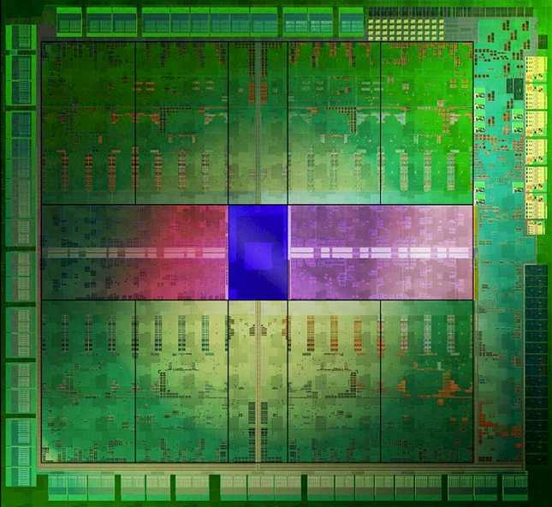
Clocking
How to distribute the clock?
How to determine the clock frequency?
How to implement robust communications?
How to reduce and manage energy?
Nvidia KeplerTM GK110
28nm, 7.1B transistors, 550mm^{2,} 2688 CUDA cores,
Base clock: 836MHz, Memory clock: 6GHz

Slide 4
… time is elastic …

Slide 5
Outline
Synchronous and Source-synchronous circuits
Completion detection
Handshaking
Performance analysis
Why asynchronous?
Design automation
Synchronous elasticity
Globally-asynchronous Locally-synchronous

Slide 6
Synchronous and Source-Synchronous

Slide 7
Synchronous circuit
PLL

Slide 8
Synchronous circuit
CL
Two competing paths:
Launching path
Capturing path
Launching path < Capturing path + Period
CLKtree + CL < CLKtree + Period
1
2
PLL
2
1
1
2
CL < Period
(no clock skew)

Slide 9
Source-synchronous
Launching path
Capturing path
CLK gen
matched delay
matched delay
matched delay
No global clock required
More tolerance to PVT variations
Period > longest combinational path
Good for acyclic pipelines

Slide 10
Source-synchronous with forks and joins
CLK gen
?
How to synchronize incoming events?

Slide 11
C element (Muller 1959)
A | B | C
0 | 0 | 0
0 | 1 | C
1 | 0 | C
1 | 1 | 1
A
C
C
B
A
B
C

Slide 12
C element (Muller 1959)
A | B | C
0 | 0 | 0
0 | 1 | C
1 | 0 | C
1 | 1 | 1
A
MAJ
B
C
(many implementations exist)
A
B
C

Slide 13
Completion detection

Slide 14
Completion detection
CLK
gen
fixed delay
The fixed delay must be longer than the worst-case logic delay (plus variability)
Q: could we detect when a computation has completed ASAP ?

Slide 15
Delay-insensitive codes: Dual Rail
Dual rail: every bit encoded with two signals
A.t | A.f | A
0 | 0 | Spacer
0 | 1 | 0
1 | 0 | 1
1 | 1 | Not used
A.t
A.f
A 1 SP 0 SP 1 SP 1 SP

Slide 16
Dual Rail AND gate
A | B | C
SP | SP | SP
0 | - | 0
- | 0 | 0
SP | 1 | SP
1 | SP | SP
1 | 1 | 1
A.t
A.f
C.t
B.t
C.f
B.f
A
C
B

Slide 17
Dual Rail Inverter
A | Z
SP | SP
0 | 1
1 | 0
A.t
Z.t
A.f
Z.f

Slide 18
Dual Rail AND/OR gate
A.t
A.f
C.t
A
C
B
B.t
C.f
B.f
A
A.f
C
A.t
C.f
B
≡
A
B.f
C.t
C
B.t
B

Slide 19
Dual rail: completion detection
Dual-rail
logic
C
done
•
•
•
•
•
•
Completion detection tree

Slide 20
Multi-input C element
a1
C
a2
C
a3
C
a4
C
c
a5
C
a6
C
a7

Slide 21
Dual rail: completion detection
AND
INV
OR
AND
CLK
gen

Slide 22
Dual rail: completion detection
AND
INV
OR
AND
CLK
gen
C

Slide 23
Dual rail: operation
Compute
Compute
Compute
Compute
Reset
AND
INV
OR
AND
CLK
gen
C
For a correct operation, all internal signals should be reset before the compute phase:
Use a more complex implementation of dual-rail (e.g., DIMS), or
Have internal completion detection, or
Use timing assumptions

Slide 24
Other DI codes
There are many DI codes:
k-out-of n, Berger, Knuth, …
Example: 1-out-of-4
2 bits with 4 wires
Same wire efficiency as DR
Less power consuming
Good for communication
Bad for logic
Wires | Value
0000 | Spacer
0001 | 0
0010 | 1
0100 | 2
1000 | 3
others | not used

Slide 25
Single rail data vs. dual rail
Some back-of-the-envelope estimations:
 | Single rail | Dual Rail
Area | 1 | 2
Delay | 1 | << 1
Static power | 1 | 2
Dynamic power | < 0.2 | 2
Dual rail:
Good for speed
Large area
High power comsumption

Slide 26
Handshaking

Slide 27
Handshaking
CLK
gen
unknown delay
Assume that the source module can provide data at any rate:
When should the CLK generator send an event if the internal delays of the circuit are unknown?
Solution: handshaking

Slide 28
Handshaking
Data
I have data
Request
Acknowledge
I want data

Slide 29
Asynchronous elastic pipeline
ReqIn
ReqOut
C
C
C
C
AckIn
AckOut
David Muller’s pipeline (late 50’s)
Sutherland’s Micropipelines (Turing award, 1989)

Slide 30
Multiple inputs and outputs

Slide 31
Multiple inputs and outputs
delay

Slide 32
Mulitple inputs and outputs
Ack
Req
C
Req
Ack

Slide 33
Channel-based communication
A channel contains data and handshake wires
Single-Rail Data
Req
Ack
Dual-Rail Data
Ack

Slide 34
Push/pull channels
Sender
Receiver
Single-Rail Data
Req (push)
Ack
Single-Rail Data
Ack
Req (pull)
Push: the sender initiates the communication
Pull: the receiver initiates the communication

Slide 35
Four-phase protocol
Data transfer
Data transfer
Req
Ack
Data
Data 1
Data 2
Data 3
Valid data on the active edge of Req
Req/Ack must return to zero before the next transfer
Different variations of the 4-phase protocol exist

Slide 36
Two-phase protocol
Data transfer
Data transfer
Req
Ack
Data
Data 1
Data 2
Data 3
Every edge is active
It may require double-edge triggered flip-flops or pulse generators

Slide 37
How to memorize?
L
Combinational Logic
L
?
?
delay
C
C
2-phase or 4-phase ?

Slide 38
How to memorize?
L
Combinational Logic
L
Pulse generator
delay
C
C
2-phase

Slide 39
How to memorize?
L
Combinational Logic
L
delay
C
C
4-phase

Slide 40
Performance analysis

Slide 41
Ring oscillators
C
6
7
5
1
C
C
C
2
3
C
4
Every ring requires an odd number of inverters
The cycle period is determined by the slowest ring
The cycle period is adapted to the operating conditions (temperature, voltage)

Slide 42
Ring oscillators
C
6
7
5
1
C
C
C
2
3
C
4
Every ring requires an odd number of inverters
The cycle period is determined by the slowest ring
The cycle period is adapted to the operating conditions (temperature, voltage)

Slide 43
Global Rings
C
C
C
C
C
C

Slide 44
Global Rings
Th = 1 / 6
Ramamoorthy and Ho, 1980 Performance evaluation of asynchronous concurrent systems with Petri nets
T. Williams et al., A self-timed chip for division, 1987
Greenstreet and Steiglitz, Bubbles can make self-timed pipelines fast, 1990
Manohar and Martin, Slack elasticity in concurrent computing, 1998.

Slide 45
Global Rings
Th = 2 / 6
Ramamoorthy and Ho, 1980 Performance evaluation of asynchronous concurrent systems with Petri nets
T. Williams et al., A self-timed chip for division, 1987
Greenstreet and Steiglitz, Bubbles can make self-timed pipelines fast, 1990
Manohar and Martin, Slack elasticity in concurrent computing, 1998.

Slide 46
Global Rings
Th = 3 / 6
Ramamoorthy and Ho, 1980 Performance evaluation of asynchronous concurrent systems with Petri nets
T. Williams et al., A self-timed chip for division, 1987
Greenstreet and Steiglitz, Bubbles can make self-timed pipelines fast, 1990
Manohar and Martin, Slack elasticity in concurrent computing, 1998.

Slide 47
Global Rings
Th = 1 / 6
Ramamoorthy and Ho, 1980 Performance evaluation of asynchronous concurrent systems with Petri nets
T. Williams et al., A self-timed chip for division, 1987
Greenstreet and Steiglitz, Bubbles can make self-timed pipelines fast, 1990
Manohar and Martin, Slack elasticity in concurrent computing, 1998.

Slide 48
Global Rings
Th
1/2
Token limited
Bubble limited
0
N/2
N
tokens
Ramamoorthy and Ho, 1980 Performance evaluation of asynchronous concurrent systems with Petri nets
T. Williams et al., A self-timed chip for division, 1987
Greenstreet and Steiglitz, Bubbles can make self-timed pipelines fast, 1990
Manohar and Martin, Slack elasticity in concurrent computing, 1998.

Slide 49
A latch-based view of synchronous circuits
Filp-flop = Master + Slave

Slide 50
Multiple Rings
2 / 4
2 / 5
2 / 4
It’s bubble limited !!!
5 / 7 ?
2 / 7

Slide 51
Slack matching
2 / 4
2 / 5
2 / 4
2 / 7 ?
4 / 9
We can add as many bubbles as we want (but not tokens!)
Slack matching can be solved optimally in polynomial time
Slack matching is conceptually equivalent to buffer (FIFO) sizing or recycling

Slide 52
Performance analysis
C
C
C
C
C
C
(Mean Cycle Ratio)

Slide 53
Latch-based design
L1
L2
L3
L4
Launching path
Capturing path
L1
L2
L3
L4

Slide 54
Matched delays can be adjustable
L1
L2
L3
L4
Delays can be adjusted:
At testing/boot time (to adjust to static variability)
At runtime (to compensate dynamic variability)
delay selection

Slide 55
Why asynchronous?

Slide 56
Exploiting elasticity
CLK
Rigid clock
High performance
Low energy

Slide 57
Exploiting elasticity
Rigid
1 V
High performance
0.9 V
Voltage scaling
Voltage
0.8 V
Low energy
0.7 V
Performance
500 MHz
1 GHz
2 GHz
Rigid clock
High performance
Low energy

Slide 58
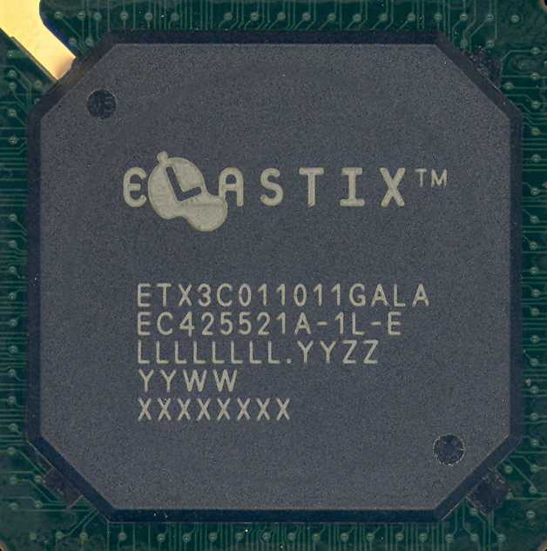
Voltage scaling and power savings
3 ARM926 cores on the same die
-14%
-24%

Slide 59
Tracking variability
matched delay

Slide 60
Tracking variability
delay
Good correlation for:
Process variability (systematic)
Global voltage fluctuations
Temperature
Aging (partially)
multi-corner matched delay
critical paths
best
typ
worst

Slide 61
Margins
Rigid Clocks:
Gate and wire delays (typ)
P
V
T
PLL Jitter
Aging
Skew
Cycle period
Elastic Clocks:
Gate and wire delays (typ)
P
V
T
Aging
Skew
Margin reduction
Speed-up / Power savings
Cycle period

Slide 62
Clock elasticity
Rigid clock
wasted time
computation time
Cycle period
Elastic clock
computation time
Cycle period

Slide 63
Design Automation

Slide 64
Design automation paradigms
Synthesis of asynchronous controllers
Logic synthesis from Petri nets or asynchronous FSMs
Syntax-directed translation
Correct-by-construction composition of handshake components
De-synchronization
Automatic transformation from synchronous to asynchronous

Slide 65
Synthesis of asynchronous controllers
Bus
DSr
Data
Transceiver
LDS
Device
LDTACK
D
DSr
LDS
VME Bus
Controller
D
DSw
LDTACK
DTACK
DTACK
Read Cycle

Slide 66
Synthesis of asynchronous controllers
DSr+
DTACK-
LDS+
LDTACK+
D+
DTACK+
DSr-
D-
LDTACK-
LDS-
Signal Transition Graph
D
DSr
LDS
VME Bus
Controller
LDTACK
DTACK

Slide 67
Synthesis of asynchronous controllers
DSr+
DTACK-
LDS+
LDTACK+
D+
DTACK+
DSr-
D-
LDTACK-
LDS-
D
DTACK
LDS
DSr
LDTACK
Cortadella et al., Petrify

Slide 68
Syntax-directed translation
int = type [0..255] & gcd: main proc (in? chan <<int,int>> & out! chan int) begin x, y: var int | forever do in?<<x,y>> ; do x <> y then if x < y then y:=y-x else x:=x-y fi od ; out!x od end
Sources:
J. Kessels and A. Peeters. DESCALE: A Design Experiment for a Smart Card Application Consuming Low Energy, in Principles of Asynchronous Circuit Design, A Systems Perspective, Eds., J. Sparso and S. Furber, Kluwer Academic Publishers, 2001.
P.A.Beerel, R.O. Ozdag and M. Ferretti. A Designer’s Guide to Asynchronous VLSI, Cambridge University Press, 2010.

Slide 69
De-synchronization
Strategy: substitute the clock tree by local clocks and handshakes
Combinational logic and latches are not modified
More tolerance to variability
Similar area, less power and/or more speed
Cortadella, Kondratyev, Lavagno and Sotiriou. Desynchronization: Synthesis of asynchronous circuits from synchronous specifications. IEEE TCAD, Oct 2006.

Slide 70
Synchronous operation
CLK gen
Transforming a synchronous circuit into asynchronous (automatically)

Slide 71
Synchronous operation
CLK gen
Transforming a synchronous circuit into asynchronous (automatically)

Slide 72
De-synchronization
Transforming a synchronous circuit into asynchronous (automatically)

Slide 73
De-synchronization
Transforming a synchronous circuit into asynchronous (automatically)

Slide 74
System-level de-synchronization
CLK

Slide 75
System-level de-synchronization

Slide 76
System-level de-synchronization

Slide 77
System-level de-synchronization

Slide 78
Synchronous elasticity

Slide 79
Different flavors of elasticity
…
7
4
1
+
…
…
8
4
3
1
0
2
Rigid
…
7
4
1
+
…
e
…
8
4
3
1
0
2
Elastic
7
4
1
+
…
s
…
8
4
3
1
0
2
Synchronous Elastic
Carloni et al., Latency-insensitive systems.

Slide 80
Asynchronous elasticity
req
ack

Slide 81
Synchronous elasticity
valid
stop
CLK
PLL
Ring oscillator

Slide 82
Latch-based elasticity
sender
receiver
Data
Data
En
En
En
En
V
V
V
V
Valid
Valid
Stop
Stop

Slide 83
Elastic netlists
Enable signal
to data latches
EB
Fork
Join
EB
Join / Fork
EB
EB

Slide 84
Variable Latency Units
[0 - k] cycles
go
done
clear
V/S
V/S

Slide 85
Globally-asynchronous Locally-synchronous
GALS

Slide 86
SoC design with GALS
Most IPs are synchronous
Different components may have different operating frequencies
Some components have variable latencies (e.g., cache hit/miss latency)
Multiple clock domains are essential
DSP
μP
CLK3
Bridge
CDC
Fast Bus
CLK1
Bridge
Mem
CDC
Slow Bus
CLK2

Slide 87
Multiple clock domains
Single clock (mesochronous)
Rational clock frequencies
Independent clocks
f1/f0
CLK1
CLK
(f0)
f2/f0
CLK2
CLK0
CLK
f3/f0
CLK3
(controllable skew)

Slide 88
Synchronous handshakes
Sender
Receiver
Data
Valid
Ack
CLK1
CLK2
The arrival of data is unpredictable
Handshakes solve the problem

Slide 89
The problem: metastability
D
Q
D
Q
Ф_{T}
Ф_{R}
setup
hold
Ф_{R}
D
Q
?

Slide 90
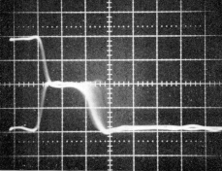
How long does it take to resolve metastability?
Metastability
MTBF: Mean Time Between Failures

Slide 91
Classical synchronous solution
D
Q
D
Q
D
Q
D
Q
Ф_{T}
Ф_{R}
Mean Time Between Failures
f_{Ф}: frequency of the clock
f_{D}: frequency of the data
t_{r}: resolve time available
W: metastability window
τ : resolve time constant
Example
# FFs | MTBF
1 FF | 15 min
2 FF | 9 days
3 FF | 23 years

Slide 92
Handshake with synchronizers
Sender
Receiver
Data
Valid
Ack
CLK1
CLK2
Simple solution
Throughput can be highly degraded: a long round trip for every transaction

Slide 93
Asynchronous FIFOs
Circular buffer
Data
Data
Valid
Valid
Ack
Ack
FIFO control
Clk In
Clk Out
Ack is issued as soon as data has been delivered
No impact on throughput (1 token/cycle)
Min latency determined by the internal synchronizers
Some tricky structures for the FIFO pointers (e.g. Grey encoding)

Slide 94
SoC design with GALS
Bridges for Clock Domain Crossing usually contain asynchronous FIFOs
Latency cost only when interfacing with synchronous domains
No latency penalty between asynchronous domains
DSP
μP
CLK3
Bridge
CDC
Fast Bus
CLK1
Bridge
Mem
CDC
Slow Bus
CLK2

Slide 95
Conclusions
Elasticity offers flexibility in time
Modularity
Dynamic adaptability
Tolerance to variability
Better optimization of power/performance
Why isn’t it an important trend in circuit design?
Lack of commercial EDA support (timing sign-off)
Designers do not feel comfortable with “unpredictable” timing
Other aspects: testing, verification, …
De-synchronization might be a viable solution

Slide 96
Bibliography
Carmona, Cortadella, Kishinevsky and Taubin, Elastic Circuits, IEEE Trans. On CAD, Oct. 2009.
Beerel, Ozdag and Ferreti, A Designer’s Guide to Asynchronous VLSI, Cambridge 2001.
Sparso and Furber, Principles of Asynchronous Circuit Design: A Systems Perspective, Kluwer 2001.
Myers, Asynchronous Circuit Design, John Wiley&Sons, 2001

Slide 97
Be elastic …

