Slide 1
Online Techniques for dealing with Concept Drift in Process mining
J. Carmona
R. Gavaldà
UPC (Barcelona, Spain)

Slide 2
Outline
The Advent of Process Mining (PM)
  The challenge of Concept Drift (CD)
Key ingredients
Online strategy for CD in PM
Experiments
Work in progress

Slide 3
The Advent of Process Mining
Process mining:
BIG DATA in Information Systems
Focus: formal analysis of the processes
Software Engineering challenges:
  Process model alignment with reality
  Automation!
  Formal methods

Slide 4
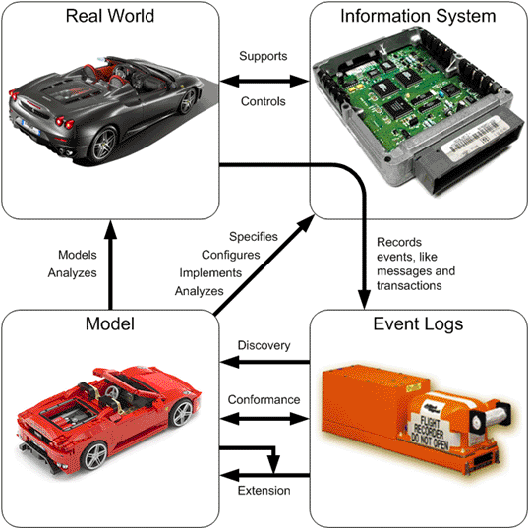
[source: www.processmining.org]

Slide 5
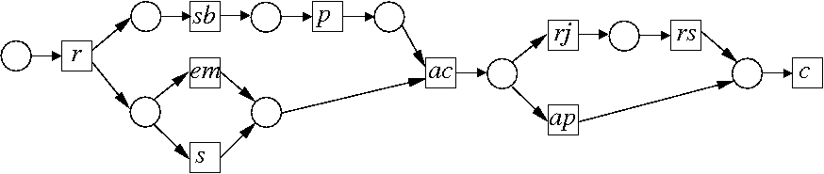
Example: control flow discovery
Information System
Petri Net (PN)
Case | Event | Timestamp
1 | reservation | 21-02-2009 12:20h
1 | arrival | 22-02-2009 21:05h
2 | reservation | 23-02-2009 14:00h
1 | payment | 23-02-2009 14:50h
2 | cancellation | 23-02-2009 16:00h
Event Log

Slide 6
Control Flow Discovery
1: r,s,sb,p,ac,ap,c
2: r,sb,em,p,ac,ap,c
3: r,sb,p,em,ac,rj,rs,c
...
Event Log (EL)
rj
rs
sb
r
p
ac
em
ap
c
s
Petri Net (PN)

Slide 7
The Challenge of Concept Drift
rj
rs
MODEL time ≤ t
1: r,s,sb,p,ac,ap,c
2: r,sb,em,p,ac,ap,c
3: r,sb,p,em,ac,rj,rs,c
4: r, em, sb,p,ac,ap,c
5: r,sb,s,p,ac,rj,rs, c
6: r,sb,p,s,ac,ap,c
7:r,sb,p,em,ac,ap,c
8: r,em,s,sb,p,ac,ap,c
9: r,sb,em,s,p,ac,ap,c
10: r,sb,em,s,p,ac,rj,rs,c
11: r,em,sb,p,s,ac,ap,c
12: r,em,sb,s,p,ac,rj,rs,c
13: r,em,sb,p,s,ac,ap,c
14: r,sb,p,em,s,ac,ap,c
...
sb
r
p
ac
Time
em
ap
c
s
MODEL time ≤ t
Drift !
MODEL time ≥ t+1
rj
rs
sb
r
p
ac
ap
c
em
s
MODEL time ≥ t + 1

Slide 8
The Challenge of Concept Drift [Bose-Aalst 11]
Problem #1: Change Detection!
  “There is a drift in the previous log between
  traces 7 and 8”
Problem #2: Change Localization and
Characterization
  “The activities involved in the drift are em and s,
  for which the causality has changed”
Problem #3: Unravel Process Evolution
  “In the new process, everything is the same but
  em and s, with em now preceding s”
DISCLAIMER: We focus on ABRUPT changes.

Slide 9
Outline
The Advent of Process Mining (PM)
Key ingredients:
  Numerical Abstract Domains
  Concept Drift estimation and change detection
Online strategy for CD in PM
Experiments
Work in progress

Slide 10
From log traces to points in R^{n}
σ = a,a,b,c,b
a
Pref(σ):
λ = (0,0,0)
a = (1,0,0)
a,a = (2,0,0)
b
a,a,b = (2,1,0)
a,a,b,c = (2,1,1)
c
a,a,b,c,b = (2,2,1)

Slide 11
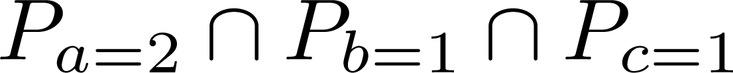
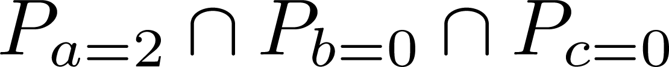
From points to convex polyhedra (Points2CP)
a
Q = Convex Hull of
the set of points
b
c
mass(Q) = Probability of points in the log inside Q

Slide 12
Outline
The Advent of Process Mining (PM)
Key ingredients:
  Numerical Abstract Domains
  Concept Drift estimation and change detection
Online strategy for CD in PM
Experiments
Work in progress

Slide 13
Setting
stream x₁,x₂ ,…,x_{t} ,…
x_{t} drawn from distribution D_{t,} independently
we model change by changes in the D_{t}’s
Two basic problems
Detect change (in the D_{t})
Estimate some statistic (on the D_{t})
  E.g., if x_{t} is a real numer, estimate E[x_{t}]
Only possible if D_{t} do not vary too wildly

Slide 14
Windows & change detection
Sliding window: keep consistent, no explicit change detection
Reference window + Sliding window
Min-error window + growing windows

Slide 15
Windows & change detection
Problem: What size windows?
Large windows: Slow reaction to fast changes
Small windows: Inaccurate estimates, noise sensitive, can’t detect small changes
Optimal size depends on unknown rate of change
User needs to guess
Or else: detect rate from the stream?

Slide 16
ADWIN: Adaptive Window
Time-scale independent, data-adaptive
User does not need to guess window size
Behaves as if “best fixed-window size” known
Keeps largest window consistent with statistical hypothesis “no change”
Keeps window of size N in memory O(log N)
O(1) amortized time per item, O(log N) worst case
C++/JAVA implementation by A. Bifet available
[Bifet-G 07]

Slide 17
Outline
The Advent of Process Mining (PM)
Key ingredients
Online strategy for CD in PM
  Strategy for change detection
Experiments
Work in progress

Slide 18

Online Strategy for CD in PM
LOG
P1 P2 P3 P4 P5 P6 P7 P8 P9 P10 P11 P12 P13 P14 ...
Sequential
Sampling
ONLINE CONCEPT DRIFT DETECTION
Learning
Estimation
Monitoring

Slide 19
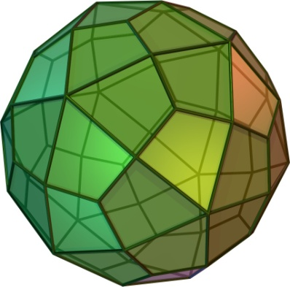
Learning Stage
LOG
P1 ... PN
Log Parikh vectors
Points2CP
Convex Polyhedron Q

Slide 20
Estimation Stage
LOG
P(N+1) ... P(N+K)
Log Parikh vectors
Yes
1
P(N+1) ... inside ?
0
ADWIN
No
Q
Estimate: mass(Q)

Slide 21
Monitoring Stage
LOG
P(N+K+1) ...
Log Parikh vectors
Yes
P(N+K+1) ... inside ?
ADWIN
No
Q
DRIFT!

Slide 22
Algorithm
Input: P1,P2, ... sequence of log points
Select appropriate training size n
S = “Collect a random sample of m points out of the first n”
Q = Points2CP(S)
W = InitADWIN
i = m + 1
repeat
if “Pi included in Q” then W = W U {1}
else W = W U {0}
i = i + 1
until “Convergence criteria on W estimation”
11. while true do
update(Pi,Q,W)
i = i + 1
if “Drift detected on W” then “Emit Drift” and Jump to line 2
endwhile
Learning
update(Pi,Q,W)
Estimating
Monitoring

Slide 23
Experiments: setting
Various models have been used to generate logs
L = {L1,L2}, with L2 being the drifting part
Drift have been created by perturbating the models:
  Flip: ordering between events is reversed
  Rem: one event is removed
  Conc: two ordered events become concurrent
  Conf: two ordered/concurrent events become in conflict

Slide 24
Experiments
bench | events | |L1| | FLIP | REM | CONC | CONF
ShRes(6) | 24 | 4000 | 115 | 54 | 183 | 37
ShRes(8) | 32 | 4000 | 165 | 73 | 381 | 83
PC(8) | 41 | 4000 | 337 | 550 | 262 | 266
PC(9) | 46 | 4000 | 256 | 136 | 323 | 489
WMG(9) | 9 | 4000 | 101 | 16 | 75 | 16
WMG(10) | 10 | 4000 | 147 | 28 | 53 | 18
Cycles(4,2) | 14 | 4000 | 563 | 23 | 664 | 22
Cycles(5,2) | 20 | 4000 | 554 | 22 | 845 | 21
A12F0N00 | 12 | 620 | 83 | 76 | 117 | 15
A22F0N00 | 22 | 2132 | 340 | 56 | 99 | 198
A32F0N00 | 32 | 2483 | 67 | 79 | 258 | 162
A42F0N00 | 42 | 3308 | 178 | 41 | 185 | 37
T32F0N00 | 33 | 3766 | 143 | 28 | 394 | 36

Slide 25
Outline
The Advent of Process Mining (PM)
Key ingredients:
Online strategy for CD in PM
Experiments
Work in progress
  Tackling other problems

Slide 26
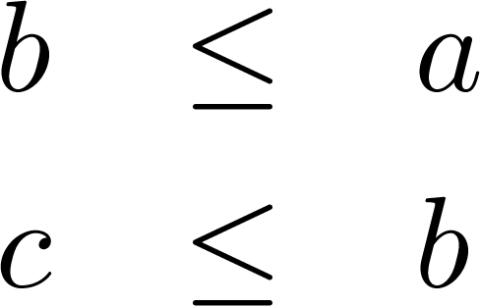
Problem #2: Change Localization
a
b
c
In general:
[Carmona-Cortadella 10]

Slide 27
Problem #2: Change Localization
b
a
c

Slide 28
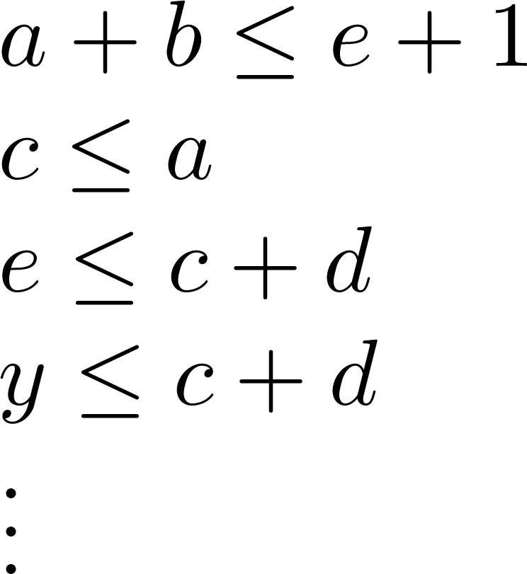
Producer-Consumer example
1: a,c,e,b,d,x,e,a,c,...
2: a,c,e,a,x,c,y,...
3: a,x,c,y,e,b,...
...
EL
(a,b,c,d,e,x,y,z)
(1,0,0,0,0,0,0,0)
(1,0,1,0,0,0,0,0)
(1,0,0,0,0,1,0,0)
(1,0,1,0,1,0,0,0)
(2,0,1,0,1,0,0,0)
...
points in R⁸

Slide 29
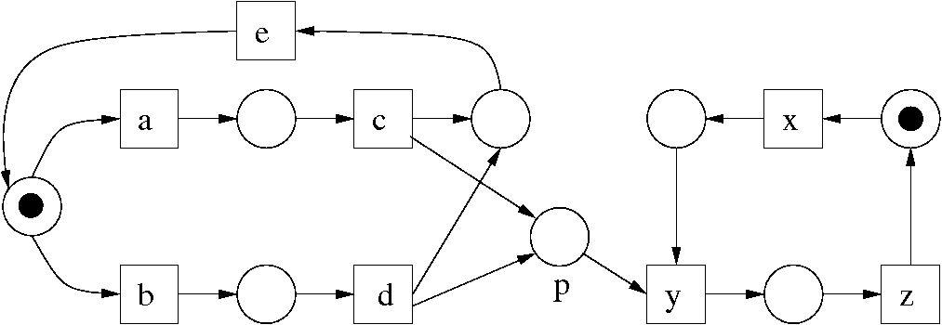
Producer-Consumer example
c ≤ a
e ≤ c + d
y ≤ x
x ≤ z + 1
a + b ≤ e + 1
d ≤ b
y ≤ c + d
z ≤ y

Slide 30
Problem #2: Change Localization
c ≤ a
ADWIN 1
e ≤ c + d
ADWIN 2
y ≤ x
ADWIN 3
a + b ≤ e + 1
ADWIN 4
Learning
Estimation
Monitoring
d ≤ b
ADWIN 5
y ≤ c + d
ADWIN 6
z ≤ y
ADWIN 7
x ≤ z + 1
ADWIN 8

Slide 31
Problem #3: Unravel process evolution
Learning
Estimation
Monitoring
c ≤ a
DRIFT!
e ≤ c + d
y ≤ x
a + b ≤ e + 1
.....

Slide 32
Problem #3: Unravel process evolution
Learning
Estimation
Monitoring
c ≤ a
new model
e ≤ c + d
y ≤ x
a + b ≤ e + 1
y ≤ z
x + b ≤ y + 1
.....

Slide 33
Conclusions & Future Work
First online algorithm for CD in PM
Several uses: segmenting the log for later process discovery, drift detection, …
Able to find the majority of drifts in practice
Ideas to tackle gradual drift
Promising results: fast detection of concept drifts, even with simple abstract numerical domains (octagons)

Slide 34
Thanks!

Slide 35
Backup slides

Slide 36
The Advent of Process Mining
Disciplines involved:
  Formal Methods and Models
  Algorithmics
  AI (e.g., Data Mining/Machine Learning)
  Information Systems
  Software Engineering
  Databases
  Bussiness
  ...

Slide 37
Online Strategy for CD in PM
Change Detection:
  Visual description of the algorithm (1-2 slides)
  Example (1-2 slides, with animation)
  Formal Description of the Algorithm (1 slide)
  Theorem enumeration on guarantees. (1 slide)
  Experiments (3-4 slides)
  More elaborated strategies (1 slide)
Tackling the two other problems:
  Change localization (1-2 slides)
  Unraveling process evolution (1-2 slides)

Slide 38
Outline
The Advent of Process Mining (PM)
  The challenge of Concept Drift (CD)
Key ingredients:
  Process Discovery via Numerical Abstract Domains
  Concept Drift estimation and change detection
Online strategy for CD in PM
  Strategy for change detection
  Experiments
Work in progress
  More elaborated strategies
  Tackling other problems

Slide 39
Process Discovery via Numerical Abstract Domains
From log traces to points in R^{n}
From points in R^{n} to convex polyhedra (Parikh2CP, used in this work)
From convex polyhedra to inequalities
From inequalities to Petri nets
[Carmona & Cortadella, ECML/PKDD’2010]

Slide 40
From points to convex polyhedra
a
Q = Convex Hull of
the set of points
b
c
mass(Q) = Probability of points in the log inside Q

