Slide 1
Specification mining for asynchronous controllers
Javier de San Pedro†
Thomas Bourgeat ‡
Jordi Cortadella†
† Universitat Politecnica de Catalunya
‡ Massachusetts Institute of Technology

Slide 2
Specification mining
FIFO
ctrl
lr
rr
la
ra
lr+
rr+
lr
Synthesis
C
rr
C
Specification
mining
la+
ra+
la
lr-
rr-
Resynthesis
ra
la-
ra-
Notes:
When designing asynchronous circuits controllers, the traditional top-down approach starts from a formal specification and then proceeds to develop a logic circuit implement that specification, often using automatic synthesis tool.
Well, in this work we open the topic of what happens in the opposite direction. When we have already implemented logic circuits and we want to construct speifications for them. We call this “specification mining”

Slide 3
Outline
Overview of specification mining
Modeling behavioral properties
Mining algorithm
Results and conclusions
Notes:
First, I’ll show a brief overview

Slide 4
Background
Synthesis
a+
b+
a+
b+
x+
y-
a
x
x+
b−
y+
x−
y+
y
b
y+
a−
a−
b-
Specification Mining
x−
Signal Transition Graph
State Graph
Netlist
(Petri Net)
(Labeled Transition System - LTS)
y-
Notes:
One of the most well-known formalisms used to describe specifications is the Signal Transition Graph.
Our work will be mostly centered on signal transition graphs because we plan to use Petri Net techniques.
The traditional synthesis procedure constructs a gate-level netlist of the circuit from this specifications. Some approaches construct the netlist directly, some of them internally explore the state graph of the circuit.
However the specification flow that we propose in this talk, starts from the netlist of an already implement circuit and always starts by constructing the state graph of the design.
And then, optionally, the state graph might be converted back into a Signal Transition Graph as in this work or to other specification languages.

Slide 5
Specifications with properties
Environment
Mined specifications must satisfy a set of behavioral properties
  E.g., only show hazard-free behavior
Nothing is known about the environment
  Initially assume free (unrestricted) env.
  Circuit may exhibit hazards under free env.
To ensure the specification satisfies the set of properties…
  Circuit behavior cannot be changed
  Discover constrained environment where the circuit satisfies all properties
a
x
y
b
Input netlist
Free environment
×
×
×
Hazard
×
×
×
×
×
×
×
×
×
×
×
×
×
×
×
×
×
×
×
×
×
×
×
×
×
×
×
×
×
×
×
×
Notes:
However, in this work we are interested in specifications that show circuit behavior which satisfies a set of properties. So for example, specifications that center on the hazard-free behavior of the circuit.
But of course, during specification mining, we don’t know anything about the original specification, and thus we don’t know anything about the environment that goes with the circuit. Initially, we are forced to assume a free environment, without any constraints. But of course, this is chaotic. Most circuits will experience lots of hazards, property violations, under this free environment.
So how can we discover a specification that will satisfy these properties. I mean, we cannot change the circuit. What we can do is to change the environment. Basically we have to discover constrained environments, restrictions on the free environment, that avoid all the hazards. They exercise the circuit only where it satisfies all properties. We have to find these subsets.
Of course, these constrained environments will include the one from the original circuit specification. Or it may be a superset. But also, it might happen that we there is more than one environment than actually satisfies these properties. These additional environments may overlap between them, or not. But they result in specifications that satisfy the properties.

Slide 6










LTS under free environment
×
Free environment
a
a
x
x
y
b
x+
$$\text{ab}=11$$
x+
y+
x+ is not persistent under free environment
y+
b+
b+
b+
b+
b−
y−
x+
b−
y+
b−
$$\text{ab}=10$$
Free environment
b−
x+
×
×
×
×
×
×
×
a−
a+
a−
×
a+
a−
a+
a−
a+
×
×
×
×
×
x−
×
×
×
Select a subset of input transition arcs that satisfy all behavioral properties
×
×
×
x+
a+
a−
$$\text{ab}=01$$
Constrained
env.
×
a−
a−
a−
a−
a+
a+
a+
a+
a−
×
×
a+
y+
×
×
×
x−
b+
×
×
×
y+
b+
b+
b+
×
×
×
×
b−
b−
b−
×
×
x+?
b−
y+
×
×
x−
y−
x−
$$\text{xy}=01$$
$$\text{ab}=00$$
$$\text{xy}=11$$
$$\text{ab}=00$$
$$\text{xy}=00$$
x−
$$\text{xy}=10$$
$$\text{xy}=00$$
Notes:
Let’s use this circuit as a running example. So this is the full state graph of this circuit under a free environment.
As we said, under a free environment, a circuit may show violations of some properties. Let’s focus on this area here, which corresponds only to the buffer part of the circuit. Let’s start from this state with all signals set to zero. If a positive arrives, we move to this state. Now, x positive is enabled and may now fire. However, our free environment may now generate a a negative pulse. We didn’t wait for the acknowledgment via x signal. And of course, in this state, x+ is no longer enabled in this state. So, there is a hazard here, because we might miss this event. Basically, x+ does not satisfy a behavioral property: it is NOT output persistent under this environment.
So our approach tries to find a constrained environment under which these properties are satisfied. What this means, is that we find a subset of the arcs of the state graph so that these violations disappear.
In this case, a valid constrained environment could look like this.

Slide 7
Hazards under free environment
Free environment
×
×
×
Free environment
×
×
×
×
×
×
×
×
×
a
x
×
×
×
×
×
×
×
×
×
×
×
y
×
×
b
×
×
×
×
×
×
×
×
x+
×
×
$$\text{ab}=11$$
x+
×
y+
×
y+
b+
b+
b+
b+
×
y−
×
×
×
$$\text{ab}=10$$
b−
b−
x+
b−
y+
b−
a+
a−
a+
a−
a+
a−
×
a+
a−
×
x−
×
×
x+
a+
a−
$$\text{ab}=01$$
a+
a−
a+
a−
×
a+
a−
y+
b+
y+
b+
x−
b+
×
b+
b−
b−
×
b−
b−
y+
y−
x−
$$\text{xy}=01$$
$$\text{xy}=11$$
$$\text{ab}=00$$
$$\text{xy}=00$$
x−
$$\text{xy}=10$$
Notes:
Going back to the full circuit. This is the state graph under a free environment, and thus as mentioned, it violates lots of properties everywhere. The goal is to find a subset of this state graph that satisfies all the desired properties.
So we apply the same strategy and remove the input transition arcs that lead to violations of properties

Slide 8


Constraining the environment
Free environment
×
×
×
Constrained env.
×
×
×
×
Select a subset of input transition arcs that satisfy all behavioral properties
×
×
×
×
×
a
x
×
×
×
×
×
×
Constrained
env.
×
×
×
×
×
y
×
×
b
×
×
×
×
×
×
×
×
×
×
$$\text{ab}=10$$
x+
y+
$$\text{xy}=10$$
$$\text{ab}=01$$
a+
a−
y+
b+
b−
y−
$$\text{xy}=01$$
$$\text{xy}=11$$
$$\text{ab}=00$$
$$\text{xy}=00$$
x−
Notes:
By doing this, we have created a constrained version of the environment in which the circuit behavior satisfies all the properties.
And thus we have one possible specification that satisfies all the properties.

Slide 9

More than one specification
Free environment
×
×
×
Constrained env. #2
There might more than one environment that satisfies the properties
×
×
×
×
×
×
×
×
×
a
x
×
×
×
×
×
Constrained
env. #2
×
×
×
×
×
×
y
×
×
b
×
×
×
×
×
×
×
×
x+
×
×
$$\text{ab}=11$$
a+
a−
x−
$$\text{ab}=01$$
y+
b+
$$\text{xy}=11$$
b−
y−
$$\text{xy}=01$$
$$\text{ab}=00$$
$$\text{xy}=00$$
Notes:
But this is not the only environment that satisfies these properties. For example we could have this other specification. Which exercises different input sequences.
We cannot create a single specification with the union of the two environments because by combining them we would violate some properties. But they are two correct separate specifications.
In these cases our flow will discover the set of maximal environments.

Slide 10
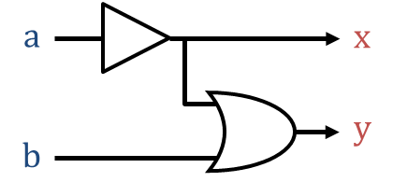
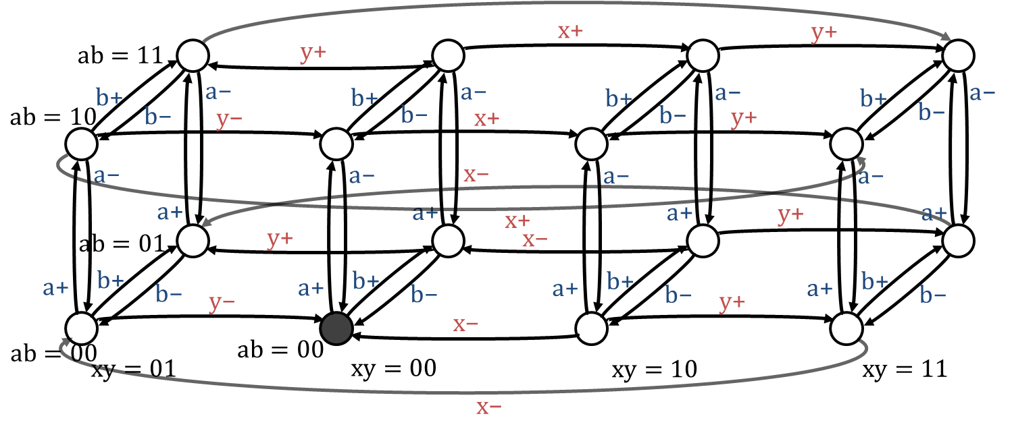
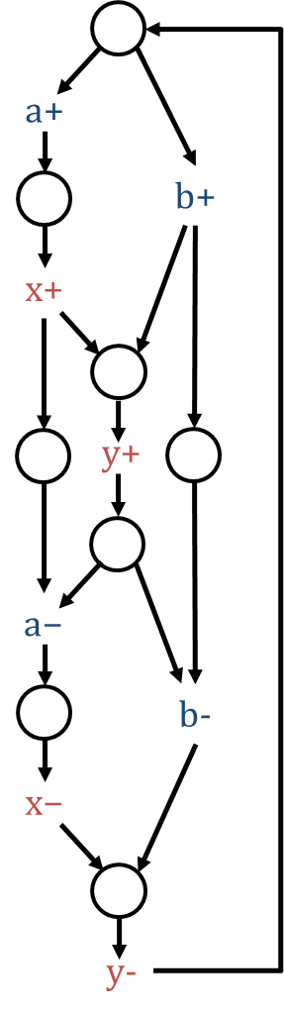
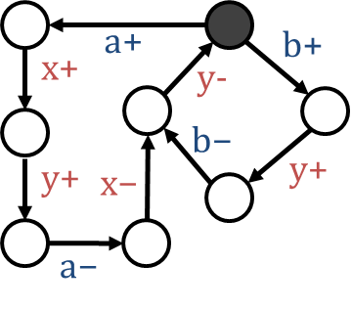
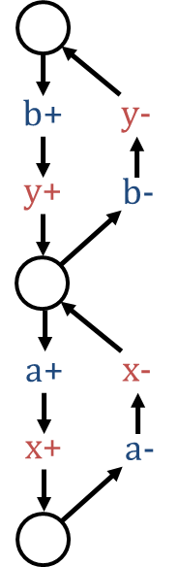
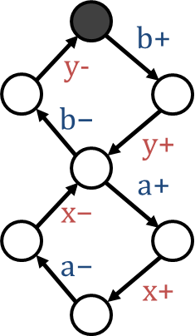
Overview of mining flow
Circuit
LTS
(free env.)
Properties
SI
DI interfacing
  …
LTS snippet 1
(constrained env.)
STG 1
Free environment
×
×
×
×
×
×
×
×
×
×
×
×
×
×
×
×
×
Constrained
env. #2
×
×
×
×
×
×
Constrained
env. #1
×
×
LTS snippet 2
(constrained env.)
STG 2
×
×
×
×
×
×
×
×
×
×
…
Notes:
Here’s an overview of our specification mining flow, summarizing what we’ve seen so far. So, as mentioned, we start from a circuit, construct the full state graph under a unrestricted environment.
We also have a set of properties that we want to ensure are satisfied on the resulting specifications.
So what our mining flow does is to find subsets of the state graph, constraining the environment in different ways in each of them. So that each of them completely satisfyies all of the desired behavioral properties.
Then from these subsets of the state graph, we can apply a synthesis step and for example obtain Signal Transition Graphs.
then proceed to constraint environment to ensure that the LTS satisfies a set of properties, such as speed independence. This is equivalent to finding a subset of the LTS by removing some of the input transitions until it satisfies the set of properties. Then, we construct an STG from the LTS using any of the available tools such as Petrify.
For many types of circuits, however, there will be more than one specification satisfying all the properties. Thus, our flow may produce more than one snippet in these situations.
So the contributions of this work center on this aspect of the flow. Now I will describe our proposal to perform this discovery of constrained environments. Starting by describing some of the properties that we model.

Slide 11
Outline
Overview of specification mining
Modeling behavioral properties
Mining algorithm
Results and conclusions
Notes:
First, I’ll show a brief overview

Slide 12
Properties
Behavioral properties
  Speed-independence
  Delay-insensitive interfacing
  Multiple independent environments
  …
Properties of the specification model
  Marked Graph
  Free Choice
  …
All properties modeled using SAT
Notes:
These are some of the properties that we can enforce in the mined specifications.
We’ll talk about each of these properties with more detail in the following sections.
In addition to classical behavioral timing properties such as speed independence, or delay-insensitive interfacing, we also propose modeling multi-environments, where a circuit has a set of environments that are independent instead of just a single monolithic one.
And also we can enforce properties that are specific to the specification model. For example if we use Signal Transition Graphs, we can enforce specifications that are of specific structural types of Petri nets. Marked graphs or free choice Petri nets. These properties ensure that we get STGs that are easier to visualize, easier to resynthesize back into circuits
In our work, we show how to model all of these properties as a Satisfiability problem. Let’s see an example

Slide 13

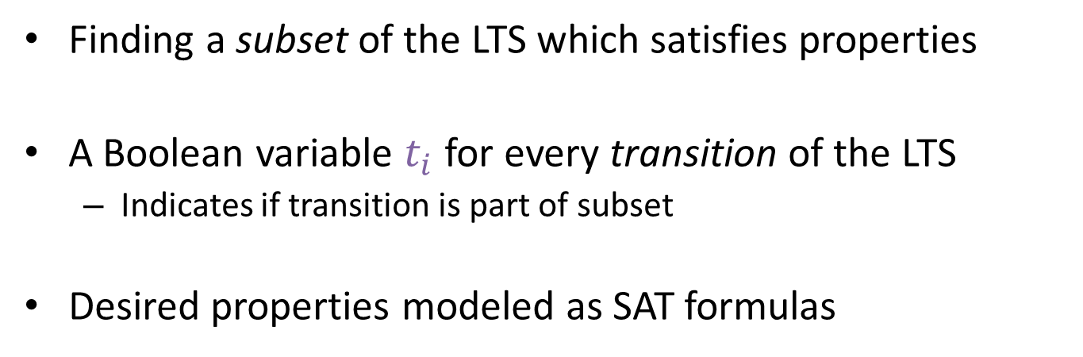



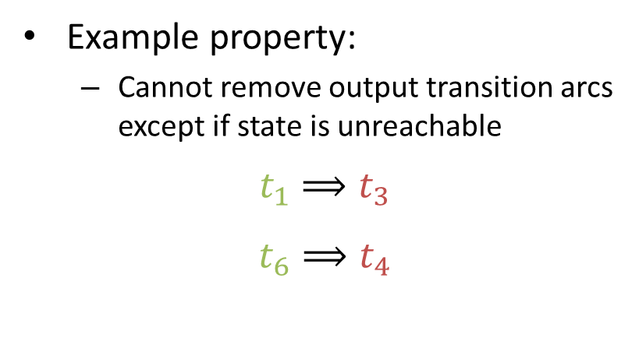


Modeling properties using SAT
Finding a subset of the LTS which satisfies properties
A Boolean variable $t_{i}$ for every transition of the LTS
  Indicates if transition is part of subset
Desired properties modeled as SAT formulas
x+
Example property:
  Cannot remove output transition arcs
  except if state is unreachable
$$t_{1}⟹t_{3}$$
$$t_{6}⟹t_{4}$$
$$t_{3}$$
a+
a−
a+
a−
$$t_{1}$$
$$t_{2}$$
$$t_{5}$$
$$t_{6}$$
x−
$$t_{4}$$
Notes:
So as we said our mining flow starts from a large state graph, and then tries to find a subset of this state graph.
We define a Boolean variable for every transition in the transition system., which indicates whether that property
In addition, we model the desired set of properties as SAT of constraints. For example, as we said, we cannot generally remove an output transition. Instead we have to remove all the input sequences that lead to that state.

Slide 14
Causality patterns in LTS
y
x
y
x
y
x
y
y
y
y is persistent
x triggers y
x disables y
Concurrency
Order
Conflict/choice
Notes:
We model most of the other properties based on exploring the causality relationships between the different signals.
For example. For every transition and every pair of signals x,y we might have three different types of relationships. Depending on whether y is enabled or disabled after firing x.
If firing x enables y, then we say that x triggers y, and this means that there is an order dependency between the two signals. If firing x disables y, then there is a conflict dependency between both signals; you have to chosee between x or y. If firing x does not enable or disable y, then we say that y is persistent, and this means that it may be concurrent with x.
And we can model the behavioral by prohibiting or allowing types of relationships between the different types of signals.

Slide 15
Behavioral properties
Speed-independence (SI)
  Insensitive to gate delays
  Property: Only inputs can disable inputs
Delay insensitive interfacing (DII)
  Insensitive to arrival order of input transitions
  Property: Inputs cannot trigger other inputs
x | y | x triggers y | x disables y
Input | Input | Violates DII
Output | Output |  | Violates SI
Input | Output |  | Violates SI
Output | Input |  | Violates SI
H. Saito, A. Kondratyev, J. Cortadella, L. Lavagno and A. Yakovlev,
What is the cost of delay insensitivity?
ICCAD 1999
Notes:
Going to specific properties. As we said we can model the common properties by prohibiting or allowing different relationships.
One of the properties that we can
For example, if we want to enforce speed-independent specifications, we must ensure that only inputs can disable other inputs.
On the other hand, if we want to enforce delay-insensitive interfacing, our mining flow has to ensure that only inputs can trigger other inputs.
This table shows an analysis of the different allowed relationships between signals depending

Slide 16







Example: speed-independence
x | y | x triggers y | x disables y
Input | Input | Violates DII
Output | Output |  | Violates SI
Input | Output |  | Violates SI
Output | Input |  | Violates SI
For every state, for every pair (x, y) where x input, y output:
y
x
y
x
$$t_{1}$$
$$t_{2}$$
$$t_{1}$$
$$t_{2}$$
y
y
$$t_{3}$$
y is persistent
x disables y
$$t_{1}∧t_{2}⟹t_{3}$$
$${¬t}_{1}∨{¬t}_{2}$$
Notes:
Let me show an example how we map these restrictions into our satisfiability problem. I will center on this constraint here. So, for every pair of signals x y where x is an input, and y is an output. For every existing pattern in the LTS we need to add a constraint that says that if we are keeping these two transitions, then we must also need to keep this one.
Otherwise x would be disabling y. Also, if in the LTS x already disables y, then we must ensure that we prohibit the pattern entirely.
Similarly, we can implement all the other constraints.

Slide 17
Multi-environments
×
×
Environment 2
Environment 1
Circuit
Environment 3
×
x | y | x triggers y | x disables y
Input | Input | Violates DII | Only if same env.
Output | Output |  | Violates SI
Input | Output |  | Violates SI
Output | Input | Only if same env. | Violates SI
lr
FIFO
ctrl
rr
Left environment
Right environment
la
ra
Notes:
Another type of property that we can model is the use of multi-environments, in which the circuit under analysis interfaces with a set of environments instead of a single environment. These environments have the property that they are independent. This means that the only way those environments can influence each other is throught the circuit. Thus, the signals from one environment cannot have any influence on the inputs of another environment.
This is easy enough to model using the relationships that we have seen previously. So if x and y are from different environments then additional constraints apply.
As we will see this is very common on pipeline style circuits in which you have clearly delimited left and right sides.
And helps produce simpler specifications.

Slide 18
Properties of the specification model
Enforce specific structural types of STGs
  Enhances visualization, computational cost, …
Marked graph
  Property: No two signals are in conflict
Free choice
  Property: Signals in conflict must have the same excitation set (see article)
E. Best and R. Devillers,
Characterization of the state spaces of live and bounded marked graph Petri nets,
Language and Automata Theory 2014.
Notes:
So
The other properties that we mention a

Slide 19
Outline
Overview of specification mining
Modeling behavioral properties
Mining algorithm
Results and conclusions
Notes:
First, I’ll show a brief overview

Slide 20

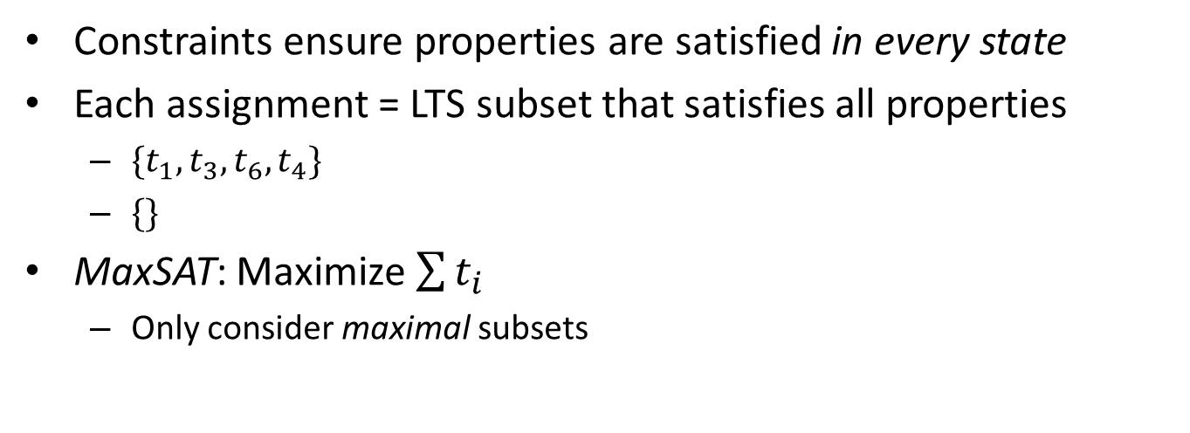



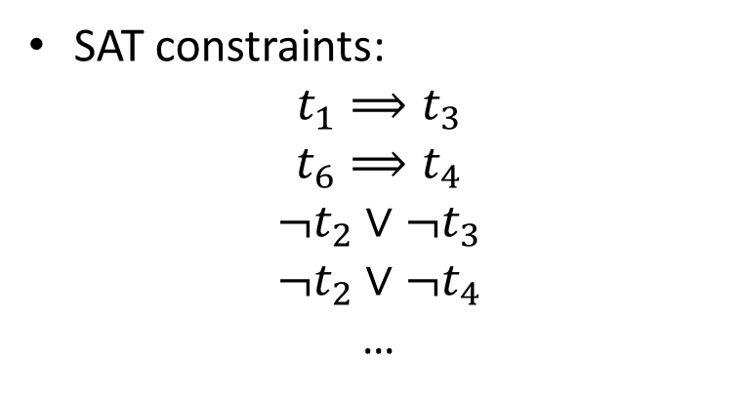


SAT model
x+
SAT constraints:
$$t_{1}⟹t_{3}$$
$$t_{6}⟹t_{4}$$
$$¬t_{2}∨{¬t}_{3}$$
$$¬t_{2}∨{¬t}_{4}$$
…
$$t_{3}$$
a+
a−
a+
a−
$$t_{1}$$
$$t_{2}$$
$$t_{5}$$
$$t_{6}$$
x−
$$t_{4}$$
Constraints ensure properties are satisfied in every state
Each assignment = LTS subset that satisfies all properties
  $\{t_{1},t_{3},t_{6},t_{4}\}$
  $\{\}$
MaxSAT: Maximize $\sum{t_{i}}$
  Only consider maximal subsets
Notes:
So after generated the required constraints for all these properties, for all the states of input LTS, we have a SAT model. These constraints guarantee that every valid solution of this SAT model is a subset of it that guarantees all the desired properties.
But also, the empty set is a valid solution of this model. So this brings us to the actual mining algorithm.

Slide 21
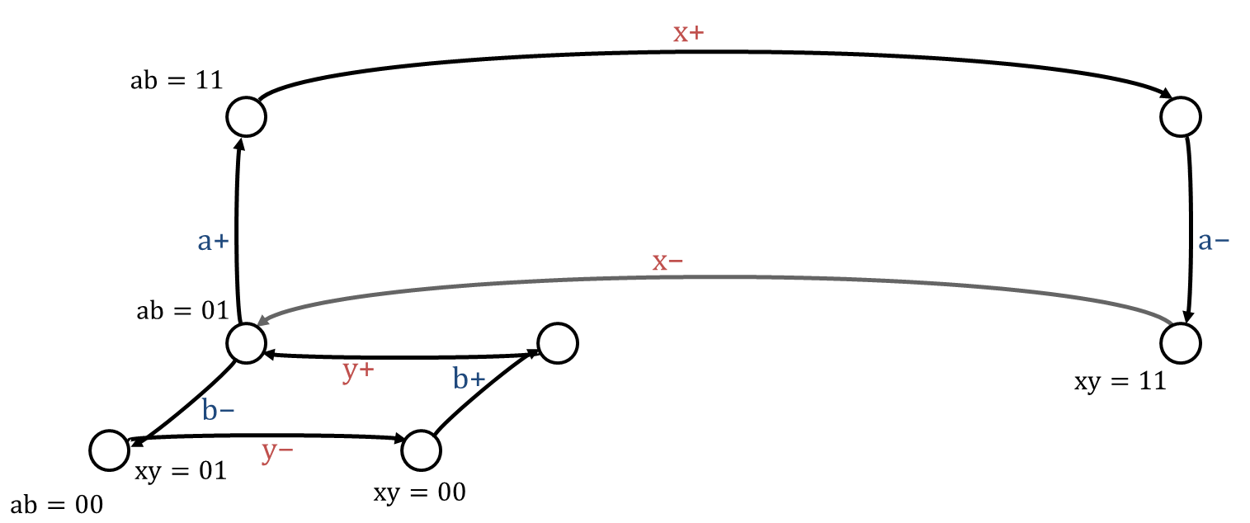
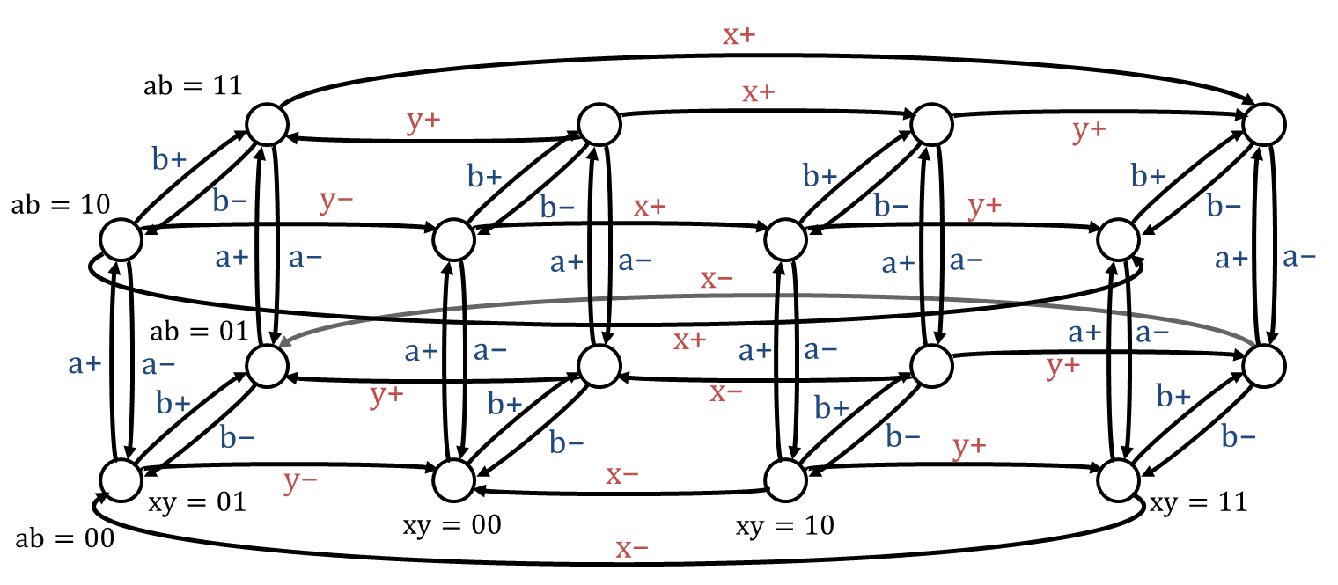
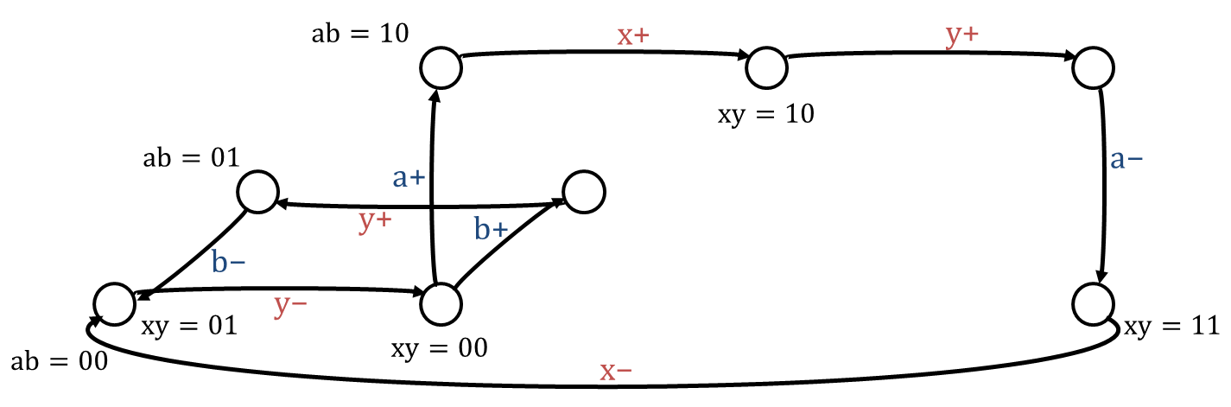
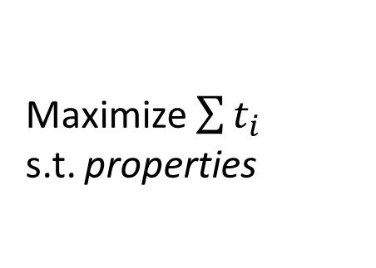
Mining algorithm: MaxSAT
Free environment
No single specification may cover all behavior without violating some property
  E.g., marked graphs
Discover a set of maximal specifications
Constrained
env. #2
Constrained
env. #1
Maximize $\sum{t_{i}}$
s.t. properties
Except those already in previous snippets!
…
Notes:
But independently, those specifications do satisfy the properties

Slide 22
Overview of mining flow
Circuit
LTS
(free env.)
Properties
SI
DI interfacing
  …
LTS snippet 1
(constrained env.)
STG 1
Petrify
LTS snippet 2
(constrained env.)
STG 2
Petrify
…
Notes:
Petrify – region theory

Slide 23
Outline
Overview of specification mining
Modeling behavioral properties
Mining algorithm
Results and conclusions
Notes:
First, I’ll show a brief overview

Slide 24
Case study: 4-phase latch controller
FIFO
ctrl
lr
rr
G. Birtwistle and K. Stevens
Modelling mixed 4-phase pipelines: structures and patterns,
ASYNC 2014.
la
ra
137 possible speed-independent specifications
Synthesized with Petrify, then STGs mined assuming:
  Speed-independence
  Delay insensitive interfacing
  Multi-environment (L, R)
All mined STGs identical to original ones
Notes:
Bisimilar

Slide 25
Some 4-phase examples

Slide 26
Why multi-environment constraint?
Right env. is triggering left env.
FIFO
ctrl
lr
rr
la
ra
Without multi-environments, 2 snippets are obtained

Slide 27
Controllers with choice
Benchmark | Num. of snippets | Gurobi runtime [seconds] | Num. of signals in orig. circuit
SM-latch | 1 | 0.10 | 3
RLM | 4 | 0.14 | 6
1-bit variable | 1 | 0.31 | 6 i/o + 2 internal
alloc-outbound | 3 | 0.73 | 7 i/o + 2 internal
vmebus | 4 | 0.12 | 6 i/o + 1 internal
A/D converter ctrl. | 1 | 0.43 | 7
tsend-csm | - | > 1 hour | 9 i/o + 2 internal
For each benchmark one snippet was identical to the original specification

Slide 28
Example: alloc-outbound

Slide 29
Resynthesis: 1-bit variable
K. v. Berkel. Handshake Circuits: an Asynchronous Architecture for VLSI Programming
Cambridge University Press, 1993.
Spec. mining
Resynthesis
(Petrify)
Notes:
Mining + Resynthesis (use case)

Slide 30
Conclusions
Specifications can be successfully recovered for several types of controllers
Useful for reverse engineering, resynthesis, compositional verification, …
Future work:
  Heuristics to handle large exploration spaces
  Circuits with bounded delays
Notes:
Handling large exploration spaces, perhaps with divide and conquer approaches

Slide 32
BACKUP

Slide 33
OLD

Slide 34
Big LTS template
x+
$$\text{ab}=11$$
x+
y+
y+
b+
b+
b+
b+
$$\text{ab}=10$$
b−
y−
b−
x+
b−
y+
b−
a+
a−
a+
a−
a+
a−
a+
a−
x−
$$\text{ab}=01$$
a+
a−
x+
a+
a−
a+
a−
a+
a−
y+
b+
y+
b+
x−
b+
b+
b−
b−
b−
y+
b−
y−
x−
$$\text{xy}=01$$
$$\text{xy}=11$$
$$\text{ab}=00$$
$$\text{xy}=00$$
x−
$$\text{xy}=10$$

Slide 35
Snippet 2
b+
y-
a+
y+
b-
a+
b+
x+
y-
b+
b−
y+
x−
y+
x+
a+
x-
a−
x+
a-
y+
b+
y-
b−
a−
y+
a+
b-
x−
a−
x−
x+

Slide 36









LTS under free environment
Environment
Nothing is known from the environment
Assume free environment
  All input transitions enabled
a
x
y
b
Original specification
x+
x+
y+
$$\text{ab}=11$$
y+
b+
a−
b+
a−
b+
a−
b+
a−
$$\text{ab}=10$$
b−
y−
b−
x+
b−
y+
b−
a−
a−
x−
a−
a−
a+
a+
x+
a+
y+
a+
$$\text{ab}=01$$
y+
x−
a+
b+
b−
a+
b+
b−
a+
b+
b−
a+
b+
b−
y−
y+
x−
$$\text{ab}=00$$
$$\text{ab}=00$$
$$\text{xy}=01$$
$$\text{xy}=00$$
$$\text{xy}=10$$
$$\text{xy}=11$$
Reset state
x−
Notes:
In our proposed method we start from the circuit netlist only. We initially know nothing about the environment.
We can, however, construct a state graph under a free environment. Which for this example circuit looks something like this.
There are 4 signals, 2 inputs, 2 outputs, thus 16 states. Here is the reset state, with all signals set to zero.
And we can see that if we fire the input transition rising edge b then we enable the output transition y. Because this is a free environment, we assume that in every state all input transitions are possible, and thus enabled, but of course the circuit and its gates dictates which output transitions are enabled at every state.
This state graph here, is actually an specification for this circuit. However, it has several problems. First, it is much more complicated than the original specification. The reason is that it specifies behavior even for inputs that were not shown in the original specification. And thus, this specification evens shows malfunctions or hazards.

Slide 37
Constraining environment
Environment
✓
Speed-independent
Delay-insensitive interfacing
a
x
✓
y
b
Original specification
x+
x+
y+
$$\text{ab}=11$$
y+
b+
a−
b+
a−
b+
a−
b+
a−
$$\text{ab}=10$$
b−
y−
b−
x+
b−
y+
b−
a−
a−
x−
a−
a−
a+
a+
x+
a+
y+
a+
$$\text{ab}=01$$
y+
x−
a+
b+
b−
a+
b+
b−
a+
b+
b−
a+
b+
b−
y−
y+
x−
$$\text{ab}=00$$
$$\text{xy}=00$$
$$\text{xy}=01$$
$$\text{xy}=10$$
$$\text{xy}=11$$
x−
Notes:
So, to visualize this. We know that this circuit satisfies the property of speed independence, but also that the circuit assumes its interface is delay insensitive.
For the first property, we have already shown some states where it is violated, and thus, we constrain the environment to remove those inputs that lead to states where the property was violated.
And now we have an specification of a speed independent circuit.
The second property means that the circuit is robust to wire delay variations but only on the inputs. So we know that for example this scenario neither of these transitions would be allowed, since for example firing this input transition b+ now enables the other input transition a. Note that these violations were introduced when we constrained the environment to be speed-independent.
Similarly fixing these violations may now generate other violations, that we also need to clean up, so it’s an iterative process.
And at the end, we have an state graph that for this example was identical to the original specification, and we were able to discover this with information only from the circuit and these properties.

Slide 38
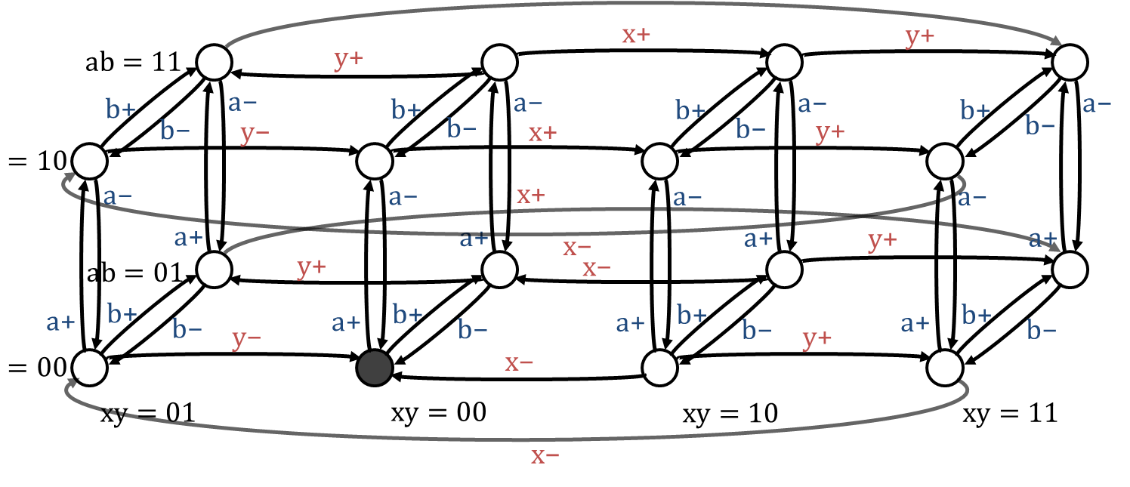
Objectives of this work
Can we discover a specification of the interface that guarantees a speed-independent behavior of the circuit?
Removing input transitions only
a+
b+
x+
b−
y+
x−
y+
a−
Notes:
So this is the approach that we will use in this work.
By knowing certain behavioral properties of the circuit, such as for example that it should be speed independent, can we constraint the interface if the circuit until we get a specification that satisfies these properties? In this case, which is speed-independence.
Can we, by removing input transitions only, eventually find a specification that is speed-independent as in this example?
To actually reduce the specification we not only have to use properties of the circuit, such as speed-independence, but as we will see later we can also assume properties of the interfacing.

