Slide 1



Process Windows
Andrey Mokhov, Jordi Cortadella, Alessandro de Gennaro
June 2017, Zaragoza

Slide 2
Part I:
Motivation and Main Idea

Slide 3
Once upon a
time there was
a transition
system...
…it lacked
persistency, but
had a few nice
diamonds.

Slide 4
Synthesis

Slide 5
Ouch! Can you
understand this Petri net?

Slide 6
Decomposition

Slide 7
Idea: Keep the diamonds,
remove non-persistency

Slide 8
Synthesis

Slide 9
Aha, these are just
marked graphs, but
what do they mean?

Slide 10
These are windows showing parts of the system behaviour.

Slide 11
Each window
covers a part
of the system
behaviour, i.e.
a scenario.
Each transition is covered by
at least one
window.

Slide 12
The initial state is covered by both windows.
Firing c is only possible in the second window, hence the first one becomes inactive.

Slide 13
In s1 the first window is active.
When a and x fire (in any order), the second window wakes up.

Slide 14
In s4 both windows are active and b can be fired in both of them.

Slide 15
Note: when a window wakes up it must be correctly initialised with a wake-up marking.

Slide 16
Window decomposition

Slide 17
Direct synthesis
Window decomposition
Which description do you prefer?

Slide 18
Part II:
Automated Window Decomposition

Slide 19
Windows Decomposition Problem
Given:
A labelled transition system L
A set of desired structural properties, e.g. forward and backward persistence, determinism, connectedness...
Result:
A set of windows W₁…W_{n}, such that L = W₁ ∪ … ∪ W_{n}
Each window W_{k} satisfies the structural properties
Wake-up condition c and marking m for each window

Slide 20
Implementation (sketch)
Discovering windows:
Inspired by Javier de San Pedro and Jordi Cortadella (2016)
SAT formulation: one Boolean variable per transition
Desired structural properties are Boolean constraints
Successively discover largest possible windows
Deriving wake-up conditions and markings:
Build a wake-up truth table: one row per state
Perform Boolean minimisation (see paper for details)

Slide 21
Part III:
Applications

Slide 22
Asynchronous power management controller

Slide 23
Petri net model synthesised from
the underlying transition system

Slide 24
Discovered process windows

Slide 25
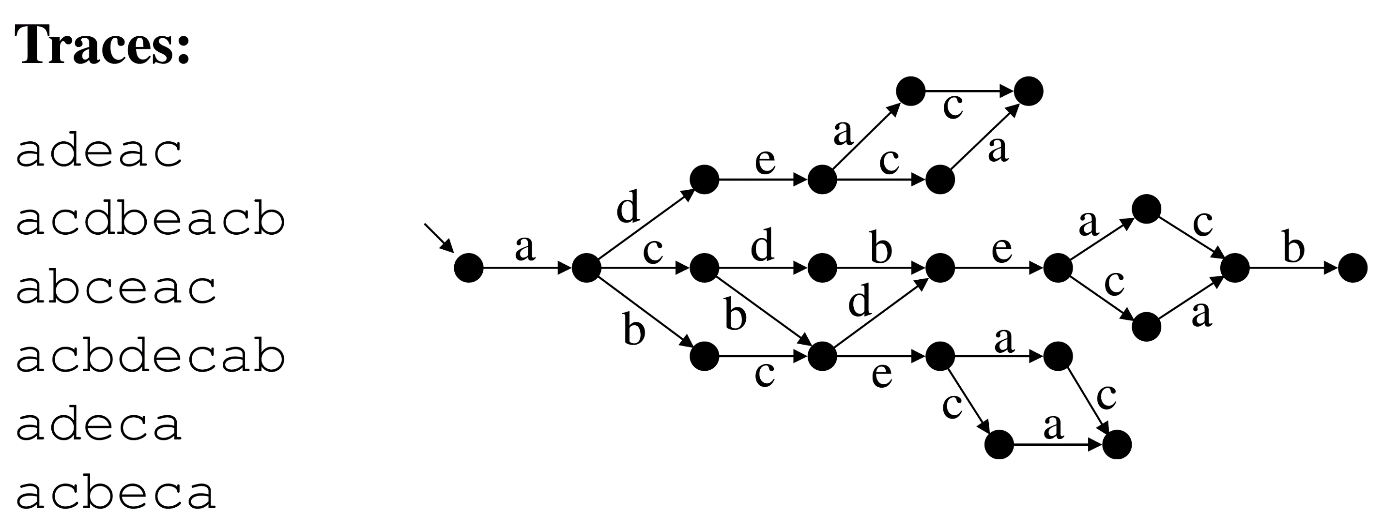

Slide 26
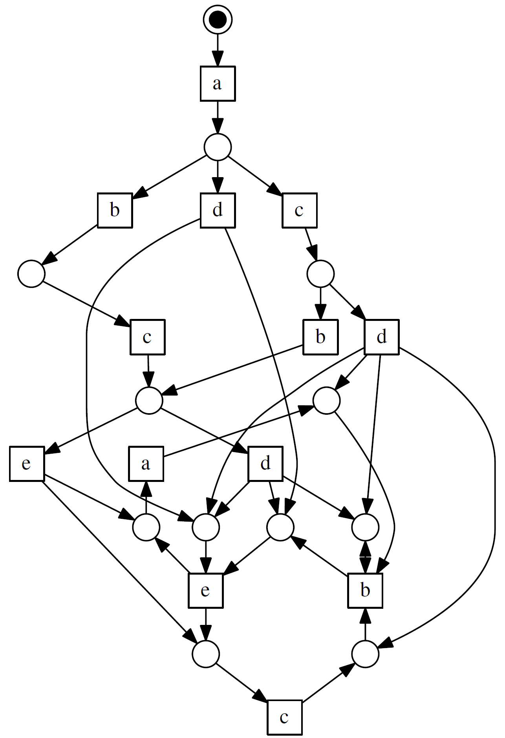
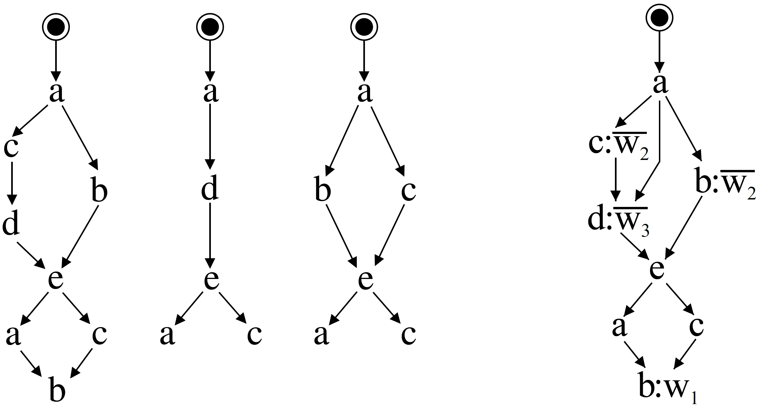
Synthesised
Petri net
Discovered
process windows

Slide 27
Discovering common patterns in scenarios

Slide 28
Summary

Slide 29
Process windows
A new approach to representing complex processes
Automated discovery of windows with desirable structural properties, such as marked graphs
Implemented in Workcraft toolkit (ask for a demo!)
Future research
Beyond choice-free scenarios
Exploit the structure for efficient process analysis
Circuit synthesis

Slide 30

Thank you!

