Slide 1
Making Petri nets friendlier to designers
Jordi Cortadella
(Universitat Politècnica de Catalunya, Barcelona)
STRUCTURE 2017

Slide 2
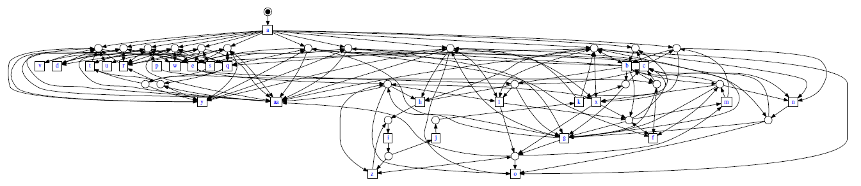
Outline
Friendly specification models for asynchronous circuits
Mining friendly process specifications

Slide 3
Friendly specification models for asynchronous circuits
Jordi Cortadella, Alberto Moreno, Danil Sokolov,
Alex Yakovlev, and David Lloyd.
Waveform transition graphs: a designer-friendly
formalism for asynchronous behaviours.
Int. Symp. on Advanced Research in Asynchronous
Circuits and Systems, May 2017.

Slide 4
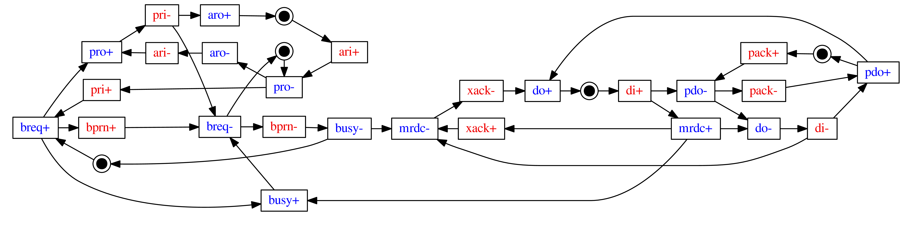
Specification of an asynchronous circuit
Minimalist Petri net (Signal Transition Graph)
Inputs
Outputs

Slide 5
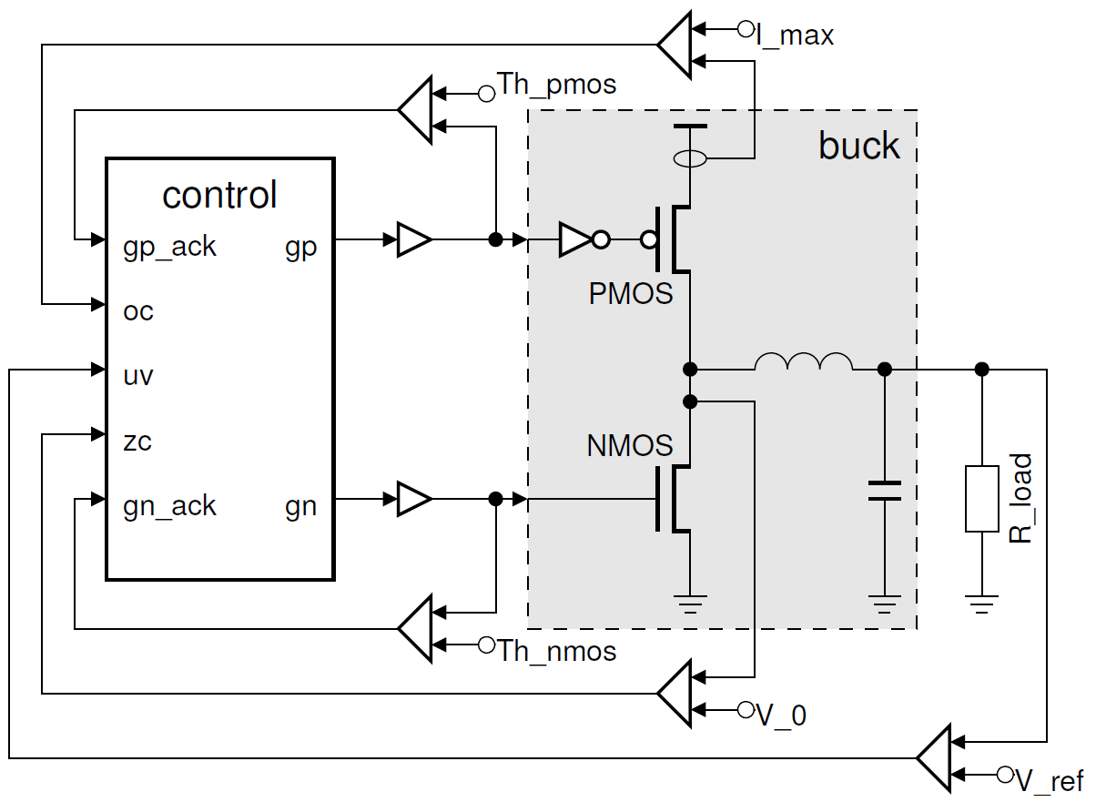
Asynchronous controllers
Source: Sokolov et al., Towards asynchronous power management, FTFC 2014.

Slide 6
Specification formalisms: process algebras
Set Env = { rinp, routp, ainp, aoutp };
agent Env-L = rin.’rinp.Env-Lw;
agent Env-Lw = ainp.(‘ain.Env-L + ainp.Env-Lw);
agent Env-R = routp.(‘rout.aout.’aoutp.Env-R
+ routp.Env-R);
agent Implementation = (Env-L | Circuit | Env-R) \ Env;
CCS:
procedure buffer
(input i: byte;
output o: byte) is
variable x : byte
begin
loop
i -> x ; o <- x
end
end
Balsa:

Slide 7
Specification formalisms: Burst Mode
s1
a+, b-/
x-, y+
s2
No input/output concurrency

Slide 8
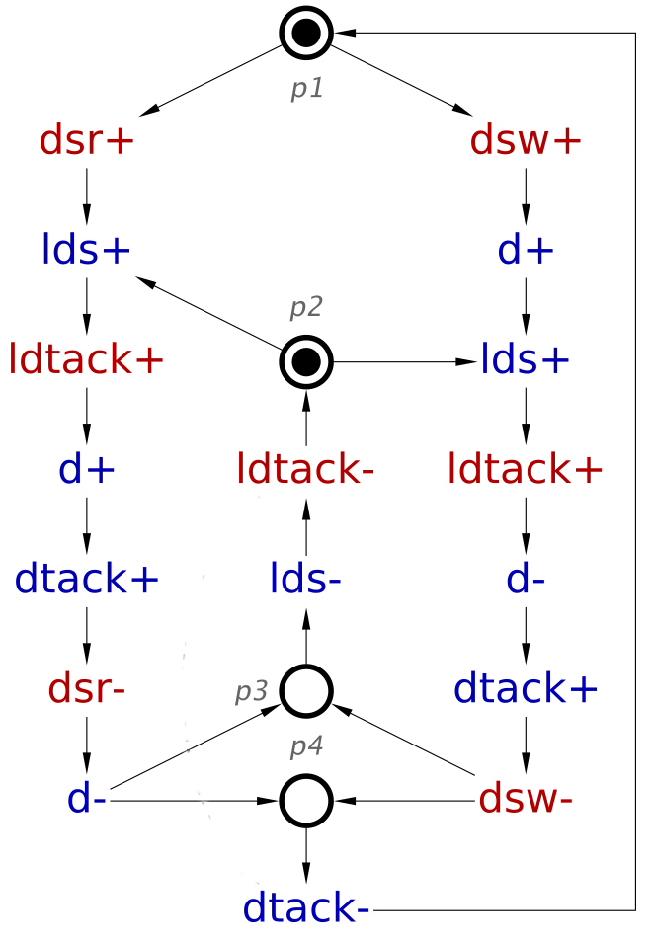
Specification formalisms: STGs
Bus
Data
Transceiver
d
Device
dsr
lds
dsw
VME Bus
Controller
ldtack
dtack

Slide 9
STGs are great !
Any asynchronous behaviour can be specified.
Implementation properties can be easily checked:
  Consistency, output persistence, state encoding.
There is a solid automatic synthesis flow from STGs to circuits (e.g., petrify, MPSAT):
  State encoding
  Logic synthesis for speed-independent circuits
  Logic decomposition and technology mapping

Slide 10
Control specification
Ri+
Ro+
Ri
FIFO
cntrl
Ro
Ao+
Ai+
Ao
Ai
Ri-
Ro-
Ao-
Ai-

Slide 11
Control specification
Ri+
Ro+
Ri
FIFO
cntrl
Ro
Ao+
Ai+
Ao
Ai
Ri-
Ro-
Ao-
Ai-

Slide 12
Control specification
Ri+
Ro+
Ri
FIFO
cntrl
Ro
Ao+
Ai+
Ao
Ai
Ri-
Ro-
Ao-
Ai-

Slide 13
Control specification
Ri+
Ro+
Ri
FIFO
cntrl
Ro
Ao+
Ai+
Ao
Ai
Ri-
Ro-
Ao-
Ai-

Slide 14
Control specification
Ri+
Ro+
Ri
FIFO
cntrl
Ro
Ao+
Ai+
Ao
Ai
Ri-
Ro-
Ao-
Ai-

Slide 15
Control specification
Ri+
Ro+
Ri
FIFO
cntrl
Ro
Ao+
Ai+
Ao
Ai
Ri-
Ro-
Ao-
Ai-

Slide 16
Control specification
Ri+
Ro+
Ri
FIFO
cntrl
Ro
Ao+
Ai+
Ao
Ai
Ri-
Ro-
Ao-
Ai-

Slide 17
Control specification
Ri+
Ro+
Ri
FIFO
cntrl
Ro
Ao+
Ai+
Ao
Ai
Ri-
Ro-
Ao-
Ai-

Slide 18
Control specification
Ri+
Ro+
Ri
FIFO
cntrl
Ro
Ao+
Ai+
Ao
Ai
Ri-
Ro-
Ao-
Ai-

Slide 19
Control specification
Ri+
Ro+
Ri
FIFO
cntrl
Ro
Ao+
Ai+
Ao
Ai
Ri-
Ro-
Ao-
Ai-

Slide 20
Control specification
Ri+
Ro+
Ri
FIFO
cntrl
Ro
Ao+
Ai+
Ao
Ai
Ri-
Ro-
Ao-
Ai-
Ri
C
Ro
Ao
C
Ai

Slide 21

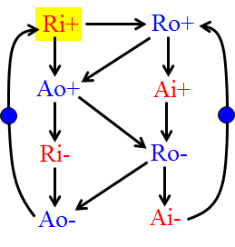

Trying to persuade engineers (the cruel reality)
petri what …?
tokens?
Yeah! Signal Transition Graphs
are extremely useful.
They are based on Petri nets!.
They have places, transitions, and
some tokens that flow, …

Slide 22
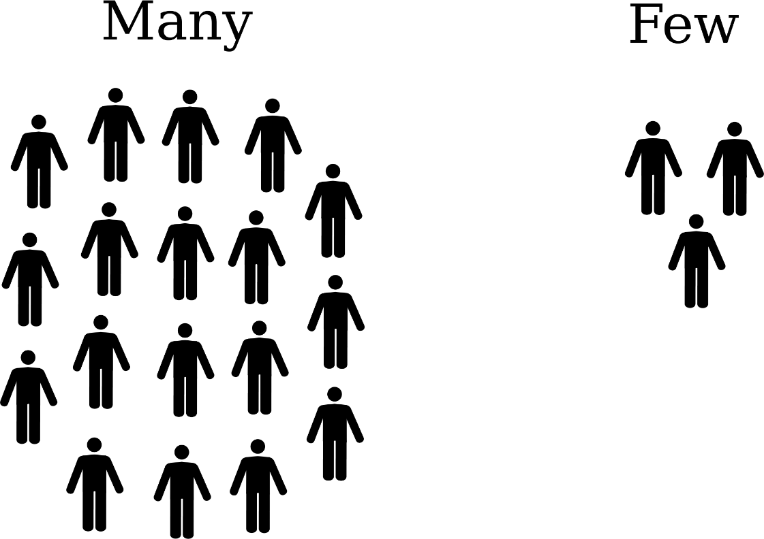
We need a simpler formalism
STGs
STG experts
?
Non-expert engineers

Slide 23
Wish list for the specification model
STGs
Easy adoption.
Powerful
  maybe a little bit less than STGs
  but more than Burst Mode
Efficient: use logic synthesis
(Boolean minimization).
Reuse the existing infrastructure for STGs.
?

Slide 24
Engineers understand waveforms
Source: Xilinx LogiCORE IP FIFO Generator

Slide 25
Multiple waveforms (modes of operation)
Choice

Slide 26
Expressive power
STGs
Causality and concurrency
between events.
Choice (modes of operation):
  AMBA bus: read/write cycle.
Proposal (our sacrifice):
  Concurrency and choice
  mutually exclusive.
?

Slide 27
Expressive power
Not allowed

Slide 28
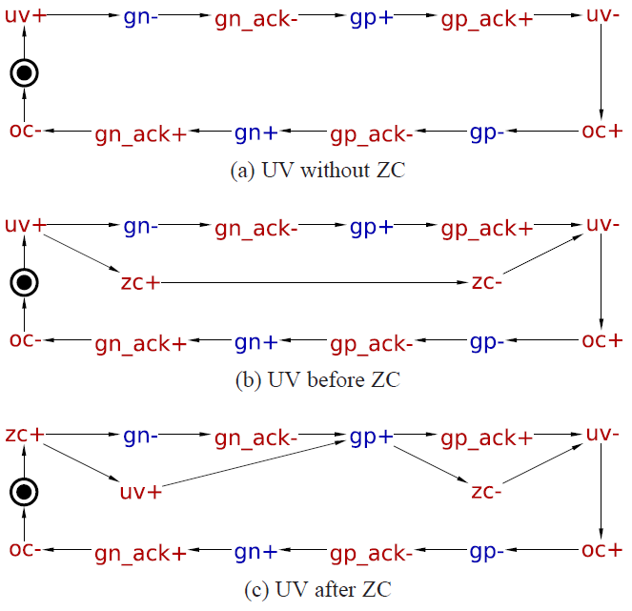
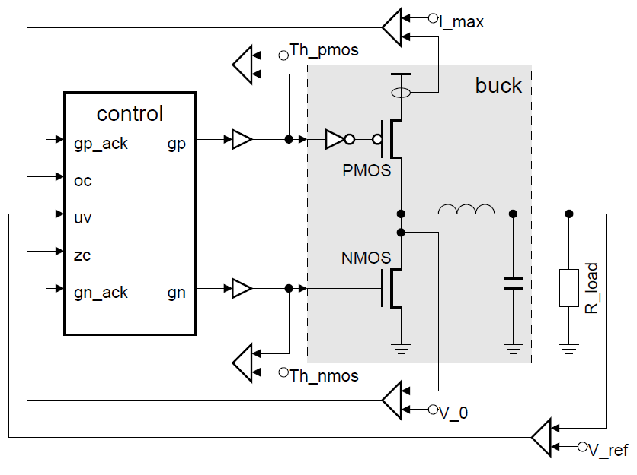
Example: Buck controller

Slide 29
Mode: UV before ZC
zc
uv
oc
gp
gp_ack
gn
gn_ack
no concurrency
no concurrency

Slide 30
Waveform Transition Graph (WTG)
(nodal states)
WF
WF
choice-free & acyclic
WF
WF
WF

Slide 31

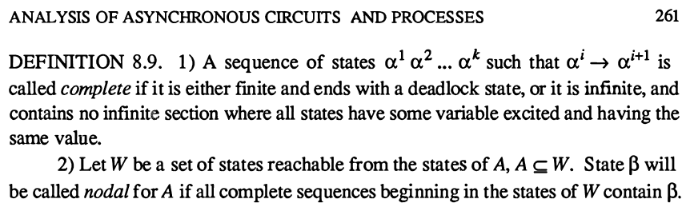
Waveform Transition Graph (WTG)
(nodal states)
WF
WF
choice-free & acyclic
WF
WF
WF

Slide 32
Nodal state in reachability graph
nodal state
(no concurrency)
w
d
x
x
e
e
w
d
z
a
c
b
y
y
b
c
z
Only nodal states can have choice
For timed verification: all counters to zero

Slide 33
Waveform Abstraction
Silent transitions might be acceptable
Causality &
Concurrency
(choice-free)

Slide 34
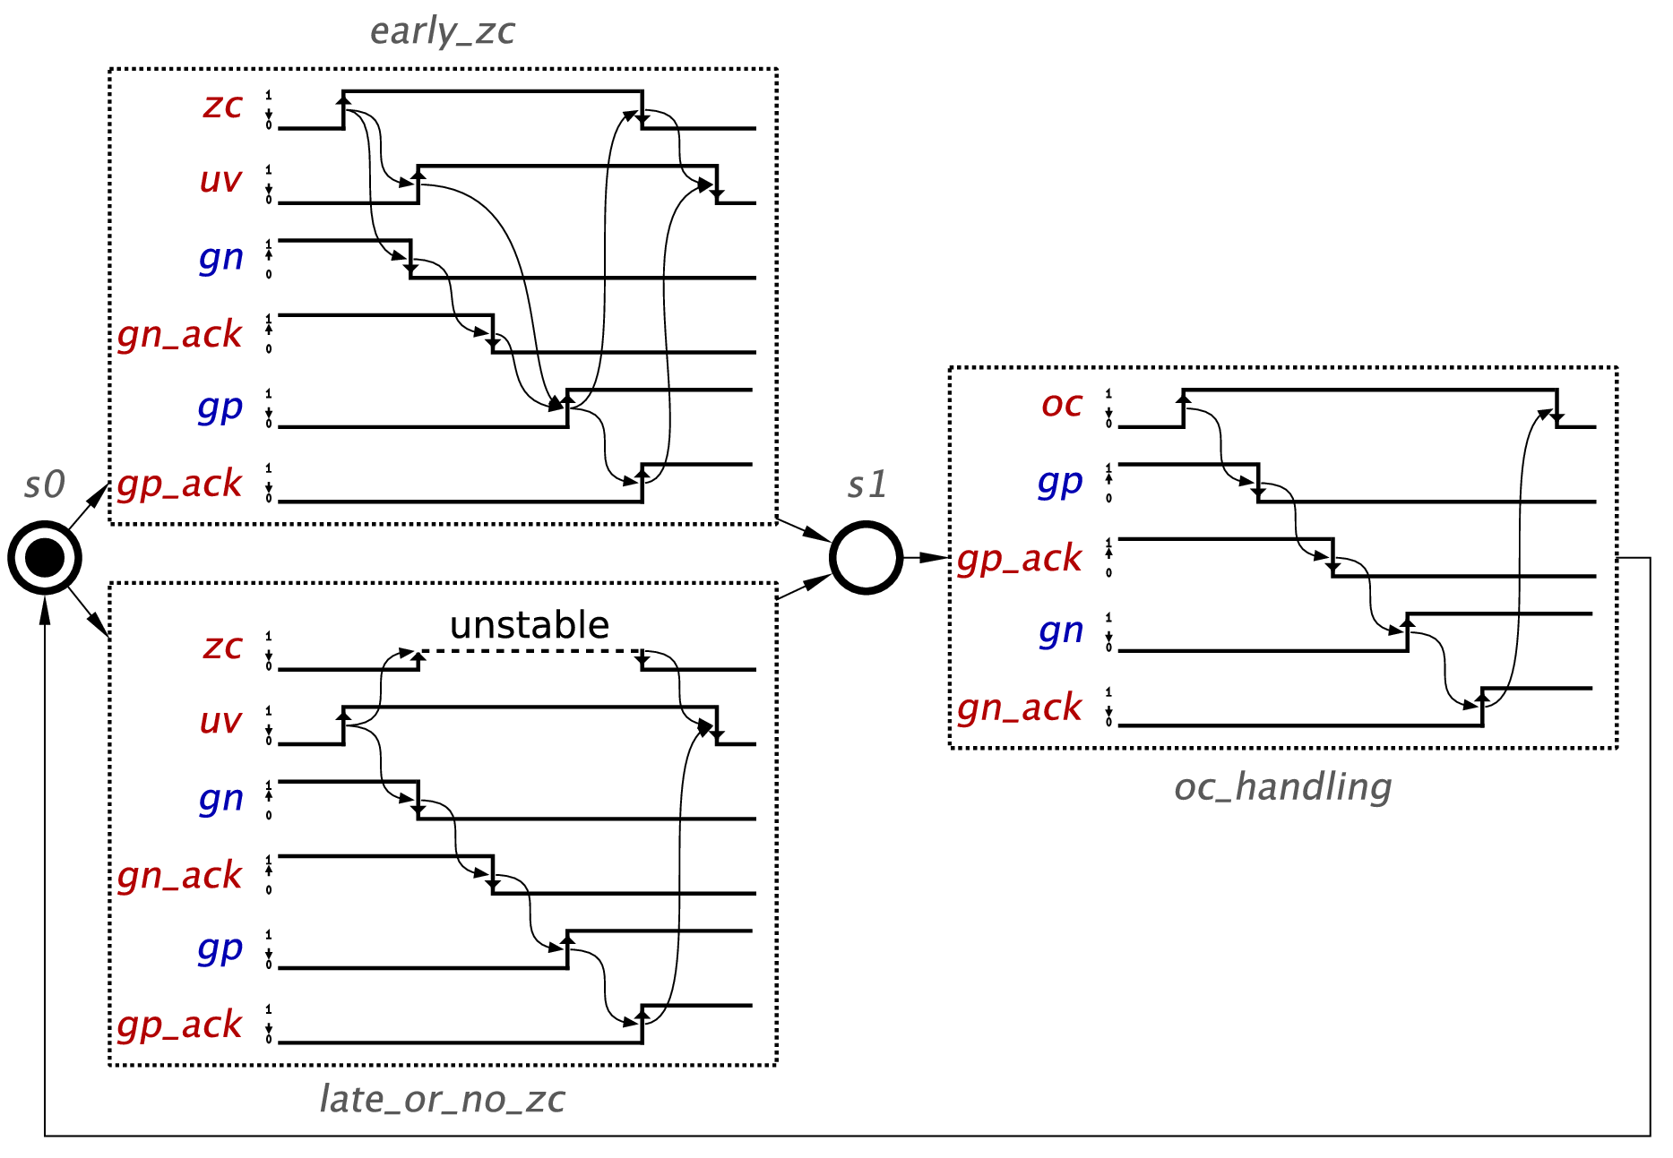
WTG of a buck controller
WF1
WF3
WF2

Slide 35
Concurrency and choice
Bus
Data
Transceiver
D
Device
DSr
LDS
VME Bus
Controller
DSw
LDTACK
DTACK

Slide 36
Concurrency and choice
DSr
Bus
Data
Transceiver
LDS
Device
LDTACK
D
DSr
LDS
VME Bus
Controller
DSw
LDTACK
D
DTACK
DTACK

Slide 37
Concurrency and choice
Bus
Data
Transceiver
D
Device
DSr
LDS
VME Bus
Controller
DSw
LDTACK
DTACK

Slide 38
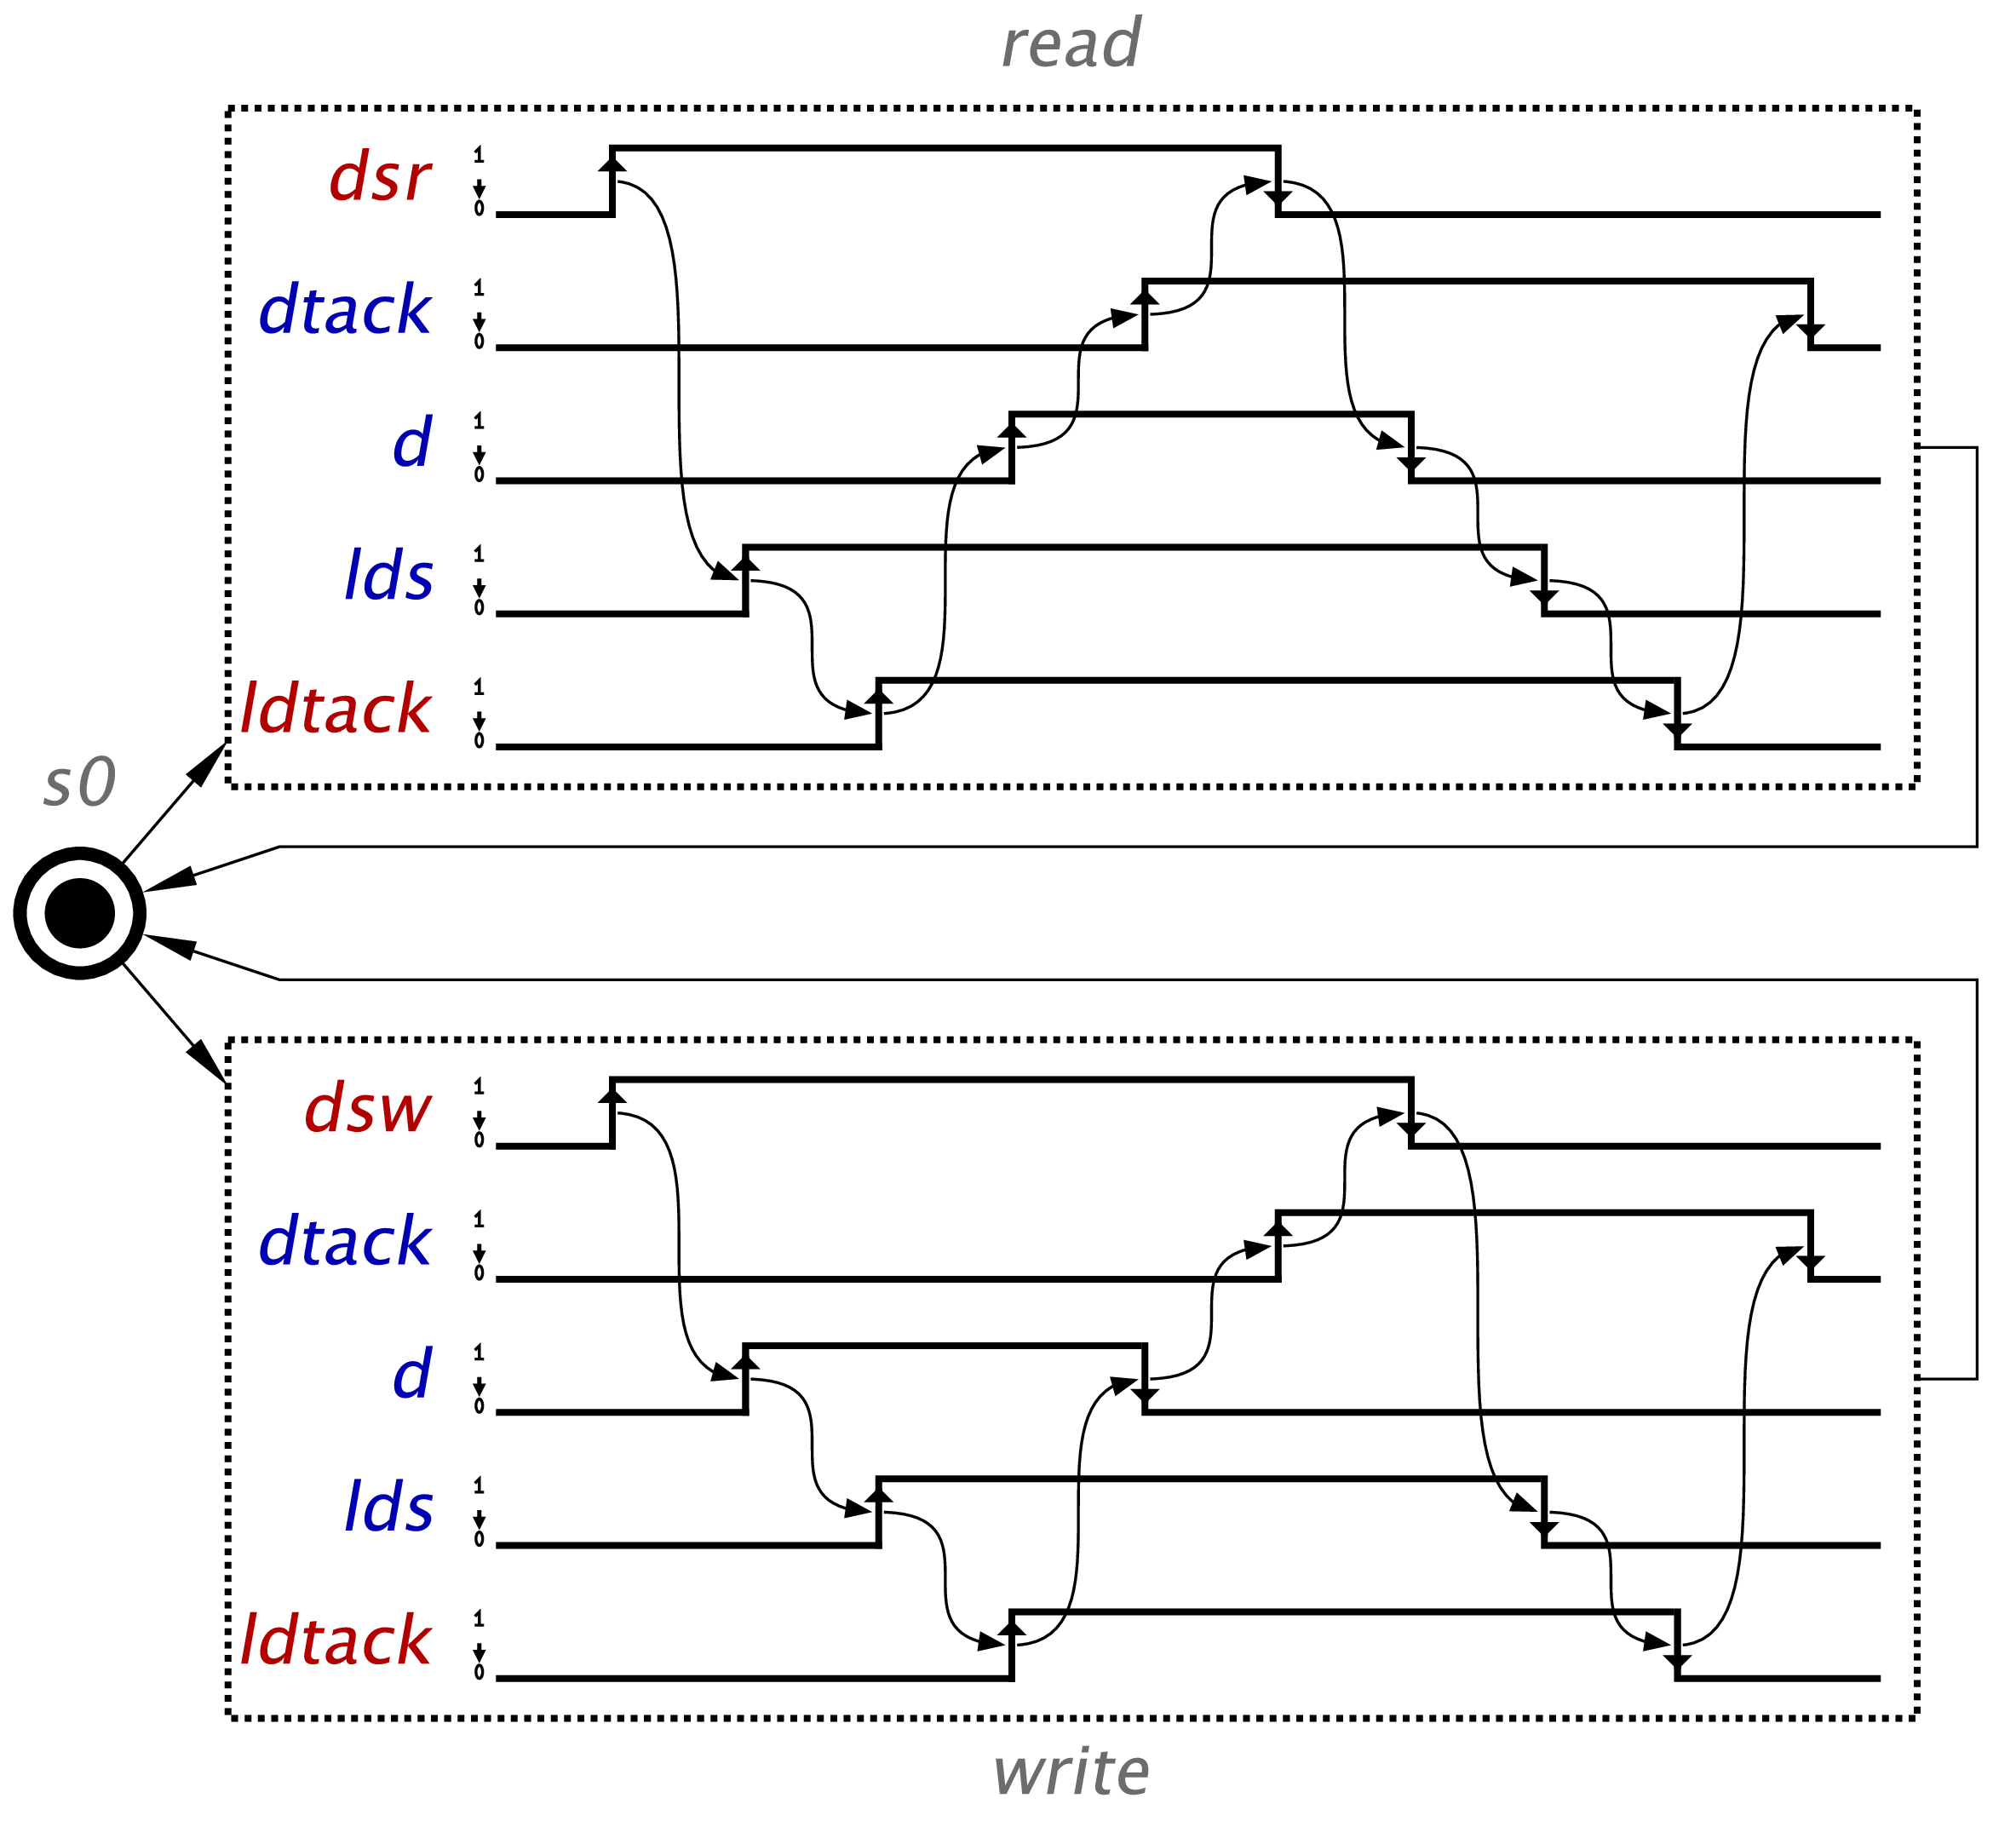
WTG for the VME bus controller
WF read
WF write

Slide 39
WTG: expressive power
STG
WTG
BM

Slide 40
BM vs. WTG vs. STG
STG
BM
WTG
S1
S1
a+,b-/
x-,y+
S2
S2

Slide 41
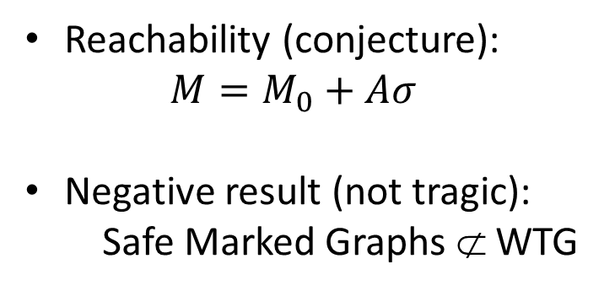
Structural properties of SC WTGs
choice-free & acyclic
WF
WF
WF
WF
Reachability (conjecture):
$M=M_{0}+Aσ$
Negative result (not tragic):
Safe Marked Graphs ⊄ WTG
WF
Live
Safe
Abstraction: one State Machine
Every cycle of the RG contains at least one nodal state
WF
(acyclic)

Slide 42
Not every safe Marked Graph is a WTG
a
x
y
b
b
b
y
y
x
a
a
y
u
v
x
b
b
v
u
y
Every state is at one
side of some diamond
No nodal state

Slide 43
Mining friendly process specifications
Javier de San Pedro and Jordi Cortadella.
Mining structured Petri nets for the visualization of process behavior.
31st ACM Symposium on Applied Computing, April 2016.

Slide 44
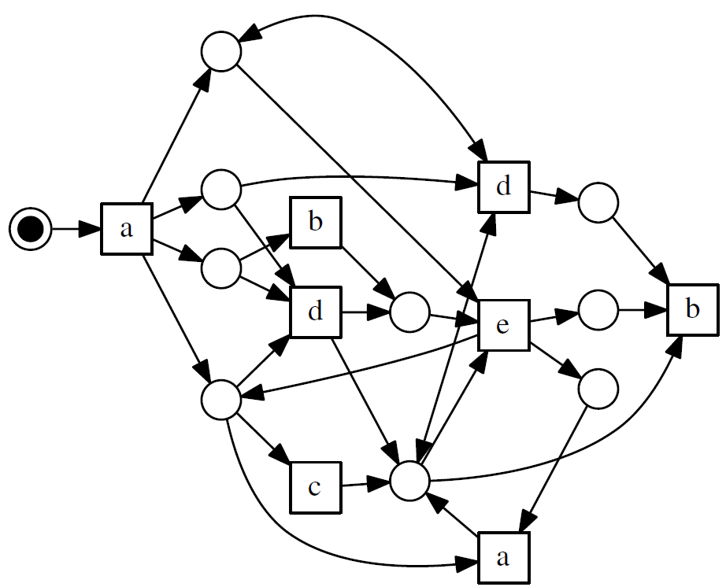
Mining specifications
a
Log:
a b c d e a b
a c d b e c b
a c b d e a b
a b c e a
a d e c
a c b e c
a d e a
b
d
c
c
b
e
d
e
d
b
a
c
a
c
d
e
a
c
b
b

Slide 45
From LTS to Labelled Petri Net
LTS
Spaghetti models
Overfitting vs. Underfitting
LTS
Flower models (≈Σ∗)

Slide 46
Our proposal
Log slice 1
Discovery
Model 1
Log
Slicing
Discovery
Model
Discovery
…
…
Log slice n
Discovery
Model n
Model 1
Model 2
Model 3
Process behavior
Process behavior
Process behavior
Model
Model
Few models, each is low-complexity

Slide 47
Extracting well-structured slices
Slicing
Captures more than 90% of log
Most frequent behavior
Less frequent

Slide 48
Mining specifications
a
Log:
a b c d e a b
a c d b e c b
a c b d e a b
a b c e a
a d e c
a c b e c
a d e a
b
d
c
c
b
e
d
e
d
b
a
c
a
c
d
e
a
c
b
b

Slide 49
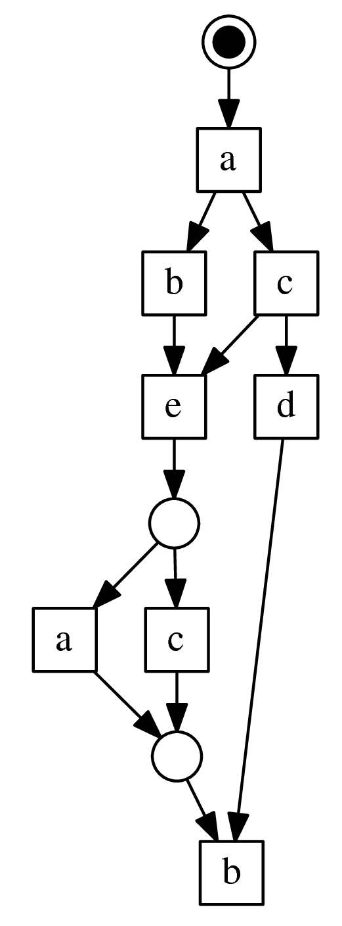
Slicing specifications
a
Log:
a b c d e a b
a c d b e c b
a c b d e a b
a b c e a
a d e c
a c b e c
a d e a
b
d
c
c
b
e
d
e
d
b
a
c
a
c
d
e
SAT
formulation
a
c
b
b
Best and Devillers:
  Characterisation of the state spaces of marked graph Petri nets
  Synthesis of live and bounded persistent systems
Petrify → Synthesis of free-choice Petri nets

Slide 50
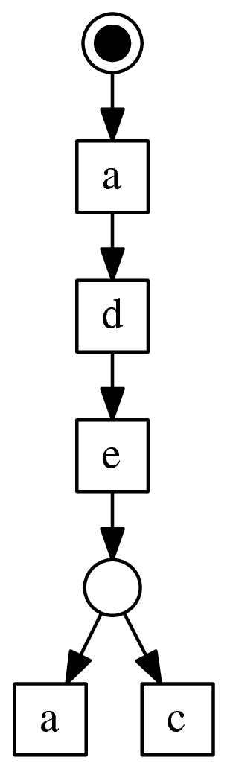
Slicing specifications
a
Log:
a b c d e a b
a c d b e c b
a c b d e a b
a b c e a
a d e c
a c b e c
a d e a
b
d
c
c
b
e
d
e
d
b
a
c
a
c
d
e
a
c
b
b

Slide 51
Slicing specifications
Monolithic Petri net
71%
29%
Log:
a b c d e a b
a c d b e c b
a c b d e a b
a b c e a
a d e c
a c b e c
a d e a

Slide 52



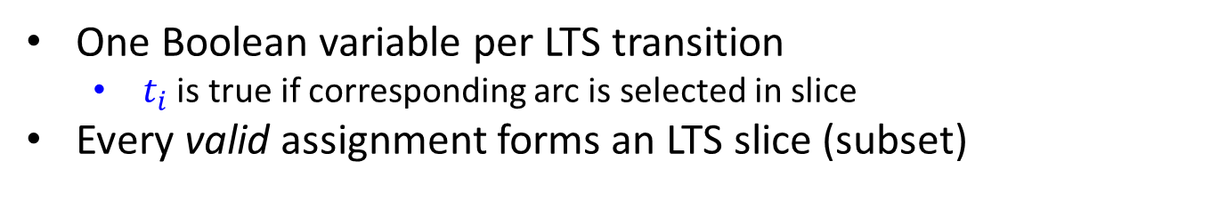













SAT model
Log:
a b c e
a c b e
a d b c e
a
$$t_{1}=0$$
$$t_{1}=1$$
$$t_{2}=0$$
$$t_{2}=1$$
$$t_{7}=0$$
d
b
c
$$t_{3}=0$$
$$t_{8}=0$$
b
c
b
$$t_{9}=0$$
$$t_{4}=1$$
c
$$t_{4}=0$$
$$t_{5}=0$$
c
b
$$t_{10}=0$$
$$t_{11}=0$$
e
$$t_{6}=0$$
$$t_{6}=1$$
$$t_{12}=0$$
e
One Boolean variable per LTS transition
  $t_{i}$ is true if corresponding arc is selected in slice
Every valid assignment forms an LTS slice (subset)

Slide 53



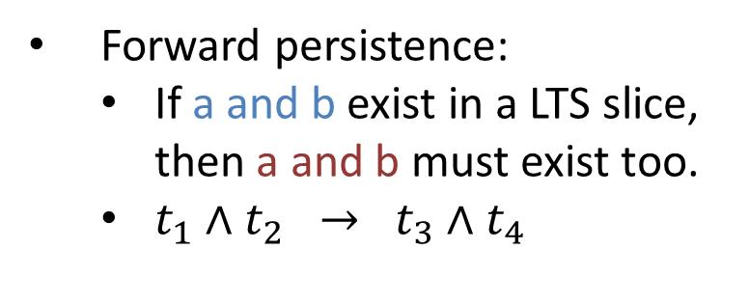




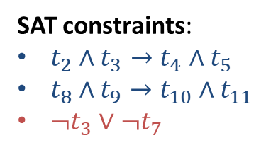









Example: forward persistence
Forward persistence:
  If a and b exist in a LTS slice, then a and b must exist too.
  $t_{1}∧t_{2} → t_{3}∧t_{4}$
a
b
$$t_{2}$$
$$t_{1}$$
a
b
$$t_{4}$$
$$t_{3}$$
Log:
a b c e
a c b e
a d b c e
a
$$t_{1}$$
$$t_{2}$$
$$t_{7}$$
d
b
c
$$t_{3}$$
$$t_{8}$$
SAT constraints:
$t_{2}∧t_{3}→t_{4}∧t_{5}$
$t_{8}∧t_{9}→t_{10}∧t_{11}$
$¬t_{3}∨{¬t}_{7}$
b
c
b
$$t_{9}$$
$$t_{4}$$
c
$$t_{5}$$
c
b
$$t_{10}$$
$$t_{11}$$
e
$$t_{6}$$
$$t_{12}$$
e

Slide 54
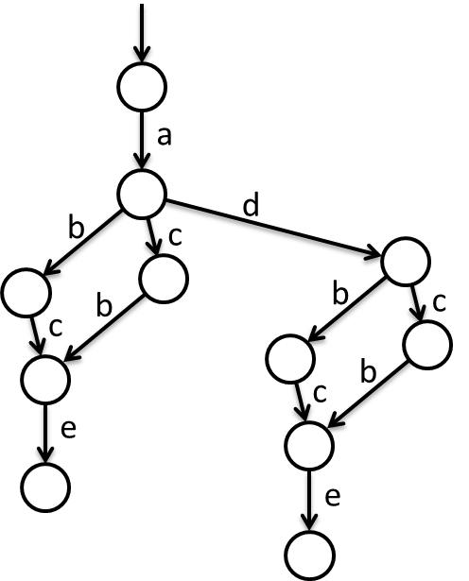
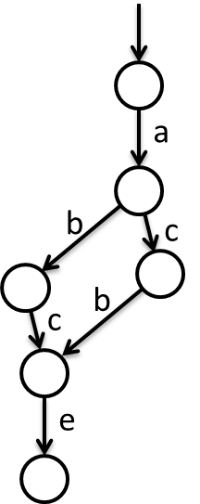
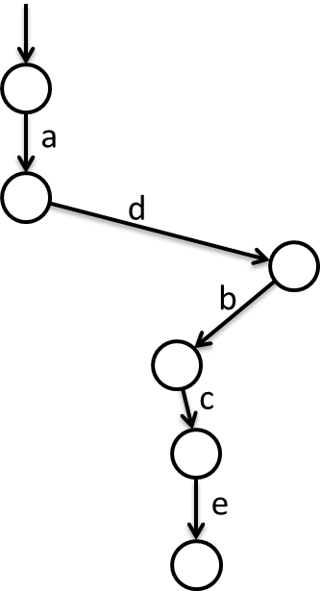
Example: forward persistency
a b c e
a c b e
a d b c e
a b c e
a c b e
a d b c e

Slide 55
Example: incidenttelco
Petri net mined with ILP miner:
448 arcs
9800 crossings
100% fitness

Slide 56
Example: incidenttelco
65 slices required for 100% fitness
However, with the first slice only:
1st slice
15 arcs
Planar (0 cros.)
92.6% fitness
Covers most behaviours
Original
448 arcs
9800 crossings
100% fitness

Slide 57
Other examples
Similar results in other benchmarks
  Only 1-3 slices required for >90% of behaviour
  Every slice is low visual complexity
For >95% of behaviour
Benchmark | # of slices | # of crossings
documentflow | 1 | 0
fhmilu | 1 | 4
fhmn5 | 1 | 1
incidenttelco | 1 | 0
kim | 1 | 0
purchasetopay | 1 | 0
receipt | 1 | 3
tsl | 3 | 3
# of slices | # of crossings
4 | 8
1 | 4
1 | 1
2 | 1
2 | 0
1 | 0
1 | 3
10 | 9

Slide 58
Conclusions
We need to expand the social circle of Petri nets:
  Asynchronous circuits
  Process/Specification mining
  … and many other domains
Simple structures contribute to sympathise with Petri nets:
  For specification (WTG)
  For analysis and visualisation (Petri net slices)
The structural theory of Petri nets is an essential guidance:
  “Nice” commonly means “visually friendly”
  Correlation between structural properties and visualisation

