Slide 1
Graphs: Connectivity
Jordi Cortadella and Jordi Petit
Department of Computer Science

Slide 2
A graph
Source: Wikipedia The network graph formed by Wikipedia editors (edges) contributing to different Wikipedia language versions (vertices) during one month in summer 2013

Slide 3
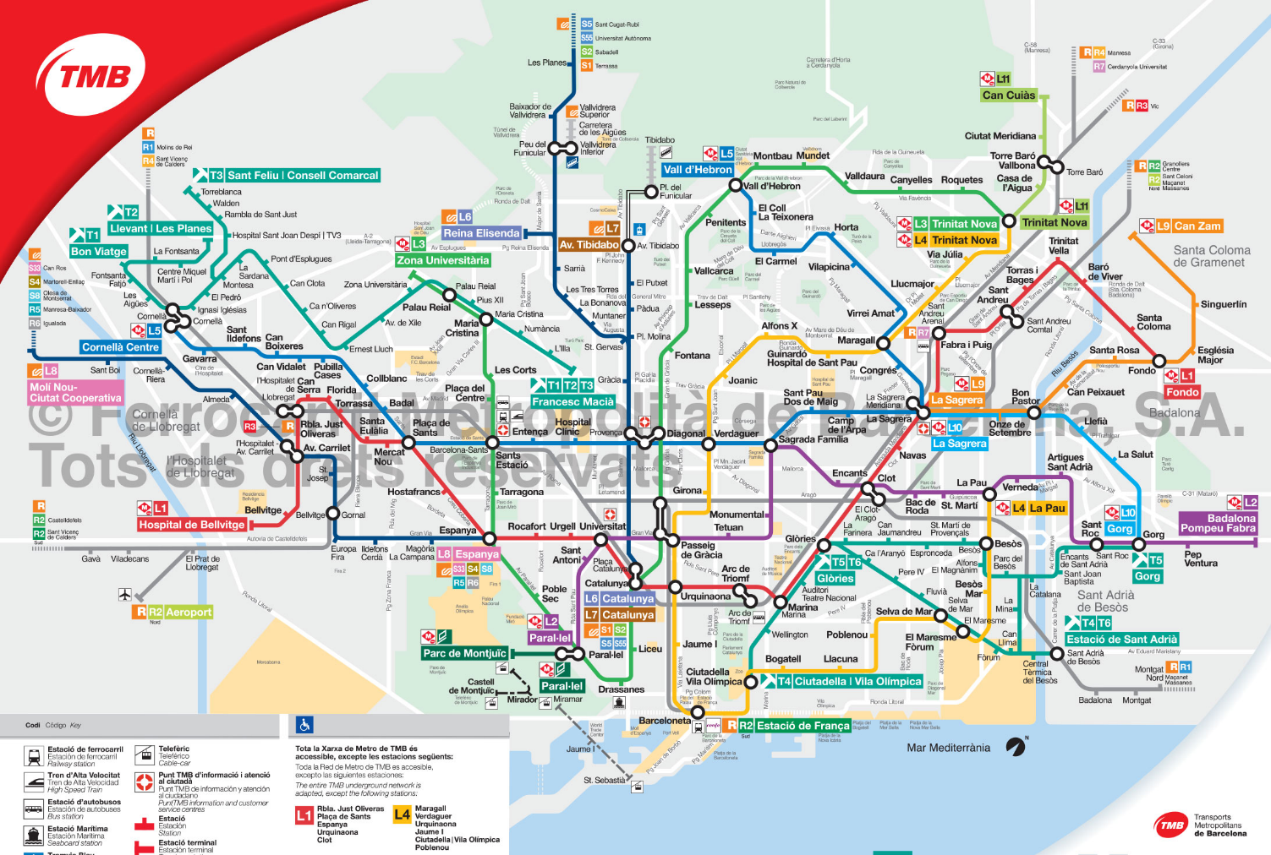
Transportation systems

Slide 4
Social networks

Slide 5
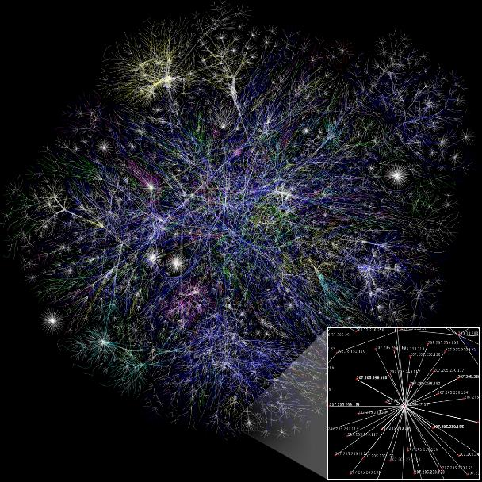
World Wide Web

Slide 6
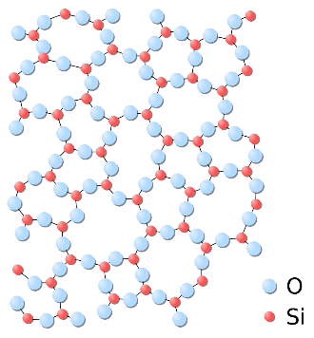
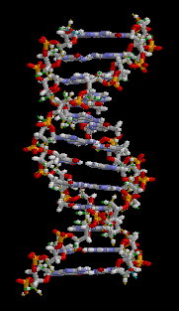
Biology

Slide 7
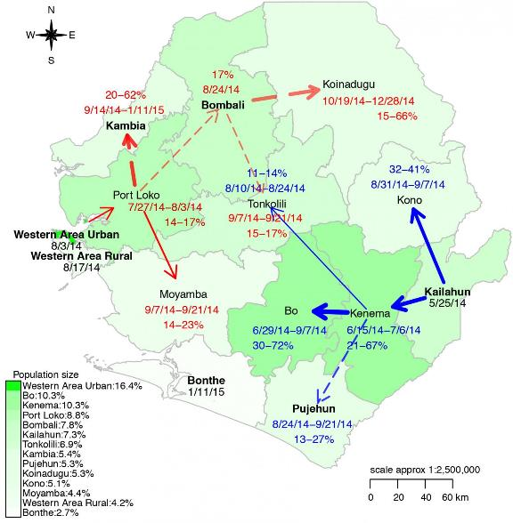
Disease transmission network
https://medicalxpress.com/news/2015-11-reveals-deadly-route-ebola-outbreak.html

Slide 8
Transmission of renewable energy
Topology of regional transmission grid model of continental Europe in 2020
https://blogs.dnvgl.com/energy/integration-of-renewable-energy-in-europe

Slide 9
What would we like to solve on graphs?
Finding paths: which is the shortest route from home to my workplace?
Flow problems: what is the maximum amount of people that can be transported in Barcelona at rush hours?
Constraints: how can we schedule the use of the operating room in a hospital to minimize the length of the waiting list?
Clustering: can we identify groups of friends by analyzing their activity in twitter?

Slide 10
Credits
A significant part of the material used in this chapter has been inspired by the book: Sanjoy Dasgupta, Christos Papadimitriou, Umesh Vazirani, Algorithms, McGraw-Hill, 2008. [DPV2008] (several examples, figures and exercises are taken from the book)

Slide 11
Graph definition
A graph is specified by a set of vertices (or nodes) $V$ and a set of edges $E$.
1
3
$$V=\left\{1,2,3,4,5\right\} \\ E=\{\left(1,2\right), \left(1,3\right), \left(2,4\right), \left(3,4\right),$$ $\left(4,5\right), \left(5,2\right), \left(5,5\right)\}$
2
4
5
Graphs can be directed or undirected. Undirected graphs have a symmetric relation.

Slide 12
Graph representation: adjacency matrix
A graph with $n=|V|$ vertices, $v_{1},⋯,v_{n}$, can be represented by an $n×n$ matrix with:
$$a_{i,j}=\left\{\begin{matrix}1 & \text{if} \text{there} \text{is} \text{an} \text{edge} \text{from} v_{i} \text{to} v_{j} \\ 0 & \text{otherwise} \end{matrix}\right.$$
1
3
$$a=\left[\begin{matrix}0 & 1 & 1 & 0 & 0 \\ 0 & 0 & 0 & 1 & 0 \\ 0 & 0 & 0 & 1 & 0 \\ 0 & 0 & 0 & 0 & 1 \\ 0 & 1 & 0 & 0 & 1\end{matrix}\right]$$
2
4
5
Space: $\text{O}\left(n^{2}\right)$
For undirected graphs, the matrix is symmetric.

Slide 13
Graph representation: adjacency list
A graph can be represented by $\left|V\right|$ lists, one per vertex. The list for vertex $u$ holds the vertices connected to the outgoing edges from $u$.
1
3
1
2
3
The lists can be implemented in different ways (vectors, linked lists, …)
2
4
2
4
3
4
Space: $\text{O}(\left|E\right|)$
4
5
5
5
2
5
Undirected graphs: use bi-directional edges

Slide 14
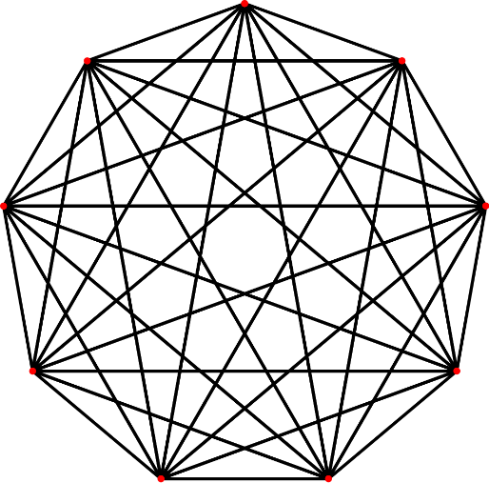
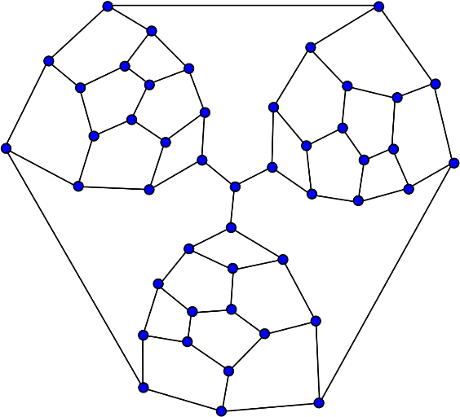
Dense and sparse graphs
A graph with $|V|$ vertices could potentially have up to ${\left|V\right|}^{2}$ edges (all possible edges are possible).
We say that a graph is dense when $|E|$ is close to ${\left|V\right|}^{2}$. We say that a graph is sparse when $|E|$ is close to $|V|$.
How big can a graph be?
Dense graph
Sparse graph

Slide 15
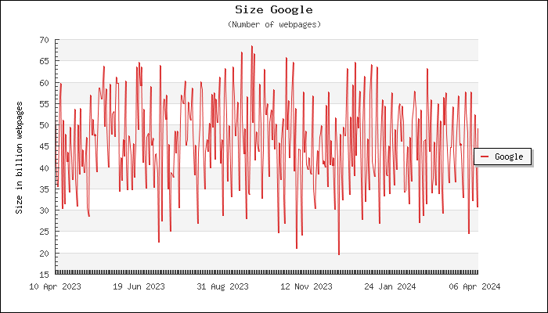
Size of the World Wide Web
www.worldwidewebsize.com
April 2024: 50 billion web pages ($50×{10}^{9}$).
Size of adjacency matrix: $25×{10}^{20}$ elements. (not enough computer memory in the world to store it).
Good news: The web is very sparse. Each web page has about half a dozen hyperlinks to other web pages.

Slide 16
Adjacency matrix vs. adjacency list
Space:
Adjacency matrix is $\text{O}({\left|V\right|}^{2})$
Adjacency list is $\text{O}(\left|E\right|)$
Checking the presence of a particular edge $(u,v)$:
Adjacency matrix: constant time
Adjacency list: traverse $u$’s adjacency list
Which one to use?
For dense graphs → adjacency matrix
For sparse graphs → adjacency list
For many algorithms, traversing the adjacency list is not a problem, since they require to iterate through all neighbors of each vertex. For sparse graphs, the adjacency lists are usually short (can be traversed in constant time)

Slide 17
Graph usage: example
# Create the graph g = Graph()
# Create the vertices g.add_vertex(0) g.add_vertex(1) g.add_vertex(2)
# Create the edges g.addEdge(0, 0) g.addEdge(0 ,1) g.addEdge(1, 2) g.addEdge(2, 1)
# Print all edges of the graph print("Edges:") for u, v in g.edges(): print(u, "->", v)
0
1
2
 | succ | pred
0 | {0,1} | {0}
1 | {2} | {0,2}
2 | {1} | {1}
Edges:
0 -> 0
0 -> 1
1 -> 2
2 -> 1

Slide 18
Graph implementation
class Graph: """Class to represent a simple graph""" _succ: dict[int, set[int]] # forward adjacency list _pred: dict[int, set[int]] # backward adjacency list
def __init__(self): """Graph constructor""" self._succ = {} self._pred = {}
def add_vertex(self, v: int) -> None: """Adds vertex v to the graph""" assert v not in self._succ self._succ[v] = set() self._pred[v] = set()
def vertices(self) -> Iterable[int]: """Returns the set of vertices of the graph""" return self._succ.keys()
 | _succ | _pred
0 | {0,1} | {0}
1 | {2} | {0,2}
2 | {1} | {1}

Slide 19
Graph implementation
def add_edge(self, src: int, dst: int) -> None: """Adds edge src -> dst to the graph""" assert src in self._succ and dst in self._succ self._succ[src].add(dst) self._pred[dst].add(src)
def successors(self, v: int) -> Iterable[int]: # or set[int] """Returns the set of successors of vertex v""" assert v in self._succ return self._succ[v]
def predecessors(self, v: int) -> Iterable[int]: # or set[int] """Returns the set of predecessors of vertex v""" assert v in self._pred return self._pred[v]

Slide 20
Graph implementation
We need a generator to iterate over all edges of the graph, as follows:
print("Edges:") for u, v in g.edges(): print(u, "->", v)
But we only have iterators over successors and predecessors of vertices.
The solution:
def edges(self) -> Iterator[tuple[int, int]]: """Returns a generator for all edges of the graph""" for u in self.vertices(): for v in self.successors(u):
yield (u,v)

Slide 21
Reachability: exploring a maze
L
K
F
H
B
E
C
G
J
I
A
D
D
A
B
E
G
H
C
F
I
J
K
L
Which vertices of the graph are reachable from a given vertex?

Slide 22
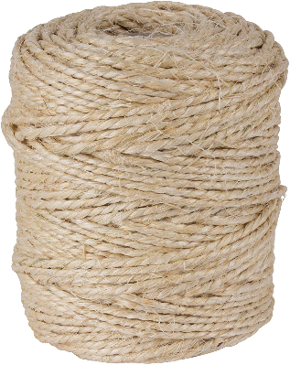
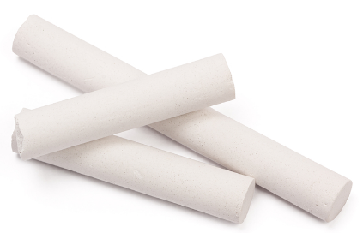
Reachability: exploring a maze
L
K
F
H
B
E
C
G
J
I
A
D
To explore a labyrinth we need a ball of string and a piece of chalk:
The chalk prevents looping, by marking the visited junctions.
The string allows you to go back to the starting place and visit routes that were not previously explored.

Slide 23
Reachability: exploring a maze
L
K
F
H
B
E
C
G
J
I
A
D
How to simulate the string and the chalk with an algorithm?
Chalk: a boolean variable for each vertex (visited).
String: a stack
push vertex to unwind at each junction
pop to rewind and return to the previous junction
Note: the stack can be simulated with recursion.

Slide 24
Finding the nodes reachable from another node
def explore($G$, $v$, visited): """Input: $G=(V,E)$ is a graph Output: visited[$u$] is true for all the nodes reachable from $v$ """
visited[$v$] = True
previsit($v$)
for each edge $\left(v,u\right)∈E$:
if not visited[$u$]: explore($G$, $u$, visited)
postvisit($v$)
Notes:
Initially, visited[$v$] is assumed to be false for every $v∈V$.
pre/postvisit functions are not required now.

Slide 25
Finding the nodes reachable from another node
def explore($G$, $v$, visited): visited[$v$] = True for each edge $\left(v,u\right)∈E$: if not visited[$u$]: explore($G$, $u$, visited)
All visited nodes are reachable because the algorithm only moves to neighbors and cannot jump to an unreachable region.
Does it miss any reachable vertex? No. Proof by contradiction.
Assume that a vertex $u$ is missed.
Take any path from $v$ to $u$ and identify the last vertex that was visited on that path ($z$). Let $w$ be the following node on the same path. Contradiction: $w$ should have also been visited.
$$v$$
$$z$$
$$w$$
$$u$$

Slide 26
Finding the nodes reachable from another node
def explore($G$, $v$, visited): visited[$v$] = True for each edge $\left(v,u\right)∈E$: if not visited[$u$]: explore($G$, $u$, visited)
A
B
D
D
A
B
E
E
F
G
G
H
C
F
I
J
I
C
H
K
L
J
Dotted edges are ignored (back edges): they lead to previously visited vertices.
The solid edges (tree edges) form a tree.

Slide 27
Depth-first search
def dfs($G$) $→$ visited:
for all $v∈V$: visited[$v$] = False
for all $v∈V$: if not visited[$v$]: explore($G$, $v$, visited)
DFS traverses the entire graph.
Complexity:
Each vertex is visited only once (thanks to the chalk marks)
For each vertex:
A fixed amount of work (pre/postvisit)
All adjacent edges are scanned
Running time is $\text{O}(\left|V\right|+\left|E\right|)$. Difficult to improve: reading a graph already takes $\text{O}(\left|V\right|+\left|E\right|)$.

Slide 28
DFS example
Graph
DFS forest
A
C
F
A
B
C
D
B
E
D
E
F
G
H
I
H
I
J
K
L
J
G
L
def dfs($G$) $→$ visited:
for all $v∈V$: visited[$v$] = False
for all $v∈V$: if not visited[$v$]: explore($G$, $v$, visited)
K
The outer loop of DFS calls explore three times (for A, C and F)
Three trees are generated. They constitute a forest.

Slide 29
Connectivity
An undirected graph is connected if there is a path between any pair of vertices.
A disconnected graph has disjoint connected components.
Example: this graph has 3 connected components:
$\left\{A,B,E,I,J\right\} \left\{C,D,G,H,K,L\right\} \left\{F\right\}.$
A
B
C
D
E
F
G
H
I
J
K
L

Slide 30
Connected Components
def explore($G$, $v$, cc, ccnum): """Input: $G=(V,E)$ is a graph, cc is a CC number Output: ccnum[$u$]=cc for each $u$ in the same CC as $v$"""
ccnum[$v$] = cc
for each edge $\left(v,u\right)∈E$:
if ccnum[$u$] == 0: explore($G$, $u$, cc, ccnum)
def connected_components($G$) $→$ ccnum: """Input: $G=(V,E)$ is a graph Output: Every vertex $v$ has a CC number in ccnum[$v$]""" for all $v∈V$: ccnum[$v$] = 0 # Clean cc numbers cc = 1 # Identifier of the first CC for all $v∈V$: if ccnum[$v$] == 0: # A new CC starts explore($G$, $v$, cc, ccnum) cc += 1
Performs a DFS traversal assigning a CC number (starting from 1) to each vertex.
The outer loop of connected_components determines the number of CC’s.
The variable ccnum[$v$] also plays the role of visited[$v$].

Slide 31
Revisiting the explore function
def explore($G$, $v$, visited): visited[$v$] = True
previsit($v$)
for each edge $\left(v,u\right)∈E$:
if not visited[$u$]: explore($G$, $u$, visited)
postvisit($v$)
Let us consider a global variable clock that can determine the occurrence times of previsit and postvisit.
def previsit($v$): pre[$v$] = clock clock = clock + 1 def postvisit($v$): post[$v$] = clock clock = clock + 1
Note: we use clock, pre and post as global variables for convenience. Global variables should never be used.
Every node $v$ will have an interval (pre[$v$], post[$v$]) that will indicate the time the node was first visited (pre) and the time of departure from the exploration (post).
Property: Given two nodes $u$ and $v$, the intervals (pre[$u$], post[$u$]) and (pre[$v$], post[$v$]) are either disjoint or one is contained within the other. The pre/post interval of $u$ is the lifetime of explore($u$) in the stack (LIFO).

Slide 32
Example of pre/postvisit orderings
1,10
11,22
23,24
A
C
F
A
B
C
D
B
E
4,9
12,21
D
E
F
G
H
2,3
I
5,8
H
13,20
I
J
K
L
6,7
J
14,17
G
L
18,19
15,16
K
A
C
F
B
E
D
I
H
Recursion depth
J
G
L
K
1
4
8
12
16
20
24

Slide 33
DFS in directed graphs: types of edges
B
A
C
A
1,16
B
2,11
C
12,15
E
F
D
E
3,10
D
13,14
G
H
4,7
F
H
8,9
5,6
G
back
forward
Tree edges: those in the DFS forest.
Forward edges: lead to a nonchild descendant in the DFS tree.
Back edges: lead to an ancestor in the DFS tree.
Cross edges: lead to neither descendant nor ancestor.
tree
cross

Slide 34
DFS in directed graphs: types of edges
pre/post ordering for $(u,v)$
1,16
A
tree/forward
$$u$$
$$v$$
$$v$$
$$u$$
B
2,11
C
12,15
back
E
3,10
D
13,14
$$v$$
$$u$$
$$u$$
$$v$$
4,7
F
H
8,9
cross
$$v$$
$$v$$
$$u$$
$$u$$
5,6
G
back
forward
Tree edges: those in the DFS forest.
Forward edges: lead to a nonchild descendant in the DFS tree.
Back edges: lead to an ancestor in the DFS tree.
Cross edges: lead to neither descendant nor ancestor.
tree
cross

Slide 35
Cycles in graphs
B
A
C
A cycle is a circular path: $v_{0}→v_{1}→v_{2}→⋯→v_{k}→v_{0}$. Examples: $$B→E→F→B \\ C→D→A→C$$
E
F
D
G
H
Property: A directed graph has a cycle iff its DFS reveals a back edge. Proof: $⇐$ If $(u,v)$ is a back edge, there is a cycle with $(u,v)$ and the path from $v$ to $u$ in the search tree.
$⇒$ Let us consider a cycle $v_{0}→v_{1}→v_{2}→⋯→v_{k}→v_{0}$. Let us assume that $v_{i}$ is the first discovered vertex (lowest pre number). All the other $v_{j}$ on the cycle are reachable from $v_{i}$ and will be its descendants in the DFS tree. The edge $v_{i−1}→v_{i}$ leads from a vertex to its ancestor and is thus a back edge.

Slide 36
Getting dressed: DAG representation
Socks
Underwear
Shirt
Watch
Shoes
Trousers
Tie
Belt
Jacket
A list of tasks that must be executed in a certain order (cannot be executed if it has cycles).
Legal task linearizations (or topological sorts):
Underwear
Socks
Trousers
Shoes
Watch
Shirt
Belt
Tie
Jacket
Watch
Socks
Shirt
Tie
Jacket
Underwear
Trousers
Belt
Shoes

Slide 37
Directed Acyclic Graphs (DAGs)
1,8
2,7
3,4
A
C
E
A DAG is a directed graph without cycles.
DAGs are often used to represent causalities or temporal dependencies, e.g., task A must be completed before task C.
B
D
F
9,12
10,11
5,6
Cyclic graphs cannot be linearized.
All DAGs can be linearized. How?
Decreasing order of the post numbers.
The only edges $(u,v)$ with post[$u$] < post[$v$] are back edges (do not exist in DAGs).
Property: In a DAG, every edge leads to a vertex with a lower post number.
Property: Every DAG has at least one source and at least one sink. (source: highest post number, sink: lowest post number).

Slide 38
Topological sort
def explore($G$, $v$, visited): visited[$v$] = True
previsit($v$)
for each edge $\left(v,u\right)∈E$:
if not visited[$u$]: explore($G$, $u$, visited)
postvisit($v$)
Initially: top_sort = $∅$ (top_sort is a linked list) def postvisit($v$): top_sort.appendleft($v$) # After DFS, top_sort contains # a topological sort
Another algorithm:
Find a source vertex, write it, and delete it (mark) from the graph.
Repeat until the graph is empty.
It can be executed in linear time. How?

Slide 39
Strongly Connected Components
A
B
C
The graph is not strongly connected.
Two nodes $u$ and $v$ of a directed graph are connected if there is a path from $u$ to $v$ and a path from $v$ to $u$.
The connected relation is an equivalence relation and partitions $V$ into disjoint sets of strongly connected components.
D
E
F
G
H
I
J
K
L
Strongly Connected Components
$$\left\{A\right\}$$
$$\{B,E\}$$
$$\{C,F\}$$
$$\{D\}$$
$$\{G,H,I,J,K,L\}$$
This graph is connected (undirected view), but there is no path between any pair of nodes. For example, there is no path $K→⋯→C$ or $E→⋯→A$.

Slide 40
Strongly Connected Components
A
B,E
C,F
A
B
C
D
G,H,I, J,K,L
D
E
F
G
H
Property: every directed graph is a DAG of its strongly connected components.
(Exercise: prove it!)
A directed graph can be seen as a 2-level structure. At the top we have a DAG of SCCs. At the bottom we have the details of the SCCs.
I
J
K
L
Every directed graph can be represented by a meta-graph, where each meta-node represents a strongly connected component.

Slide 41
Properties of DFS and SCCs
Property: If the explore function starts at $u$, it will terminate when all vertices reachable from $u$ have been visited.
If we start from a vertex in a sink SCC, it will retrieve exactly that component.
If we start from a non-sink SCC, it will retrieve the vertices of several components.
Examples:
If we start at $K$ it will retrieve the component $\{G,H,I,J,K,L\}$.
If we start at $B$ it will retrieve all vertices except $A$.
A
B
C
D
E
F
G
H
I
J
K
L

Slide 42
Properties of DFS and SCCs
Intuition for the algorithm:
Find a vertex located in a sink SCC
Extract the SCC
To be solved:
How to find a vertex in a sink SCC?
What to do after extracting the SCC?
Property: If $C$ and $C′$ are SCCs and there is an edge $C→C^{′}$, then the highest post number in $C$ is bigger than the highest post number in $C′$.
Property: The vertex with the highest DFS post number lies in a source SCC.
A
B
C
D
E
F
G
H
I
J
K
L

Slide 43
Properties of DFS and SCCs
A
But we would like executing DFS starting from the sink nodes!
How can we do that?
D
source SCC
C
B
E
A | B | C | D | E
D | B | C | A | E
A
D
B
B
C
highest post-visit numbers
E
A
D
C
E

Slide 44
Reverse graph ($G^{R})$
A
B
C
A
B
C
D
E
F
D
E
F
G
H
G
H
I
I
J
K
J
K
L
L
source
sink
A
B,E
C,F
A
B,E
C,F
D
G,H,I, J,K,L
D
G,H,I, J,K,L
sink
sink
source
source

Slide 45
SCC algorithm
def scc($G$) $→$ ccnum: """Input: $G(V,E)$ a directed graph Output: each $v$ has an SCC number in ccnum[$v$]""" $G^{R}$= reverse($G$) dfs($G^{R}$, post) # calculates post numbers sort($V$, post) # decreasing order of post number ccnum = connected_components($G$)
Runtime complexity:
DFS and connected_components Comp run in linear time $\text{O}(\left|V\right|+\left|E\right|)$.
Can we reverse $G$ in linear time?
Can we sort $V$ by post number in linear time?

Slide 46
Reversing $G$ in linear time
def scc($G$) $→$ ccnum: """Input: $G(V,E)$ a directed graph Output: each $v$ has an SCC number in ccnum[$v$]""" $G^{R}$= reverse($G$) dfs($G^{R}$, post) # calculates post numbers sort($V$, post) # decreasing order of post number ccnum = connected_components($G$)
def reverse($G$) $→G^{R}$: """Input: $G(V,E)$ graph represented by an adjacency list edges[$v$] for each vertex $v$. Output: $G(V,E^{R})$ the reversed graph of $G$, with the adjacency list edgesR[$v$].""" for each $u∈V$: for each $v∈\text{edges}[u]$: edgesR[$v$].add($u$) return $G(V\text{,} \text{edgesR})$

Slide 47
Sorting $V$ in linear time
def scc($G$) $→$ ccnum: """Input: $G(V,E)$ a directed graph Output: each $v$ has an SCC number in ccnum[$v$]""" $G^{R}$= reverse($G$) dfs($G^{R}$, post) # calculates post numbers sort($V$, post) # decreasing order of post number ccnum = connected_components($G$, ccnum)
Use the explore function for topological sort:
Each time a vertex is post-visited, it is inserted at the top of the list.
The list is ordered by decreasing order of post number.
It is executed in linear time.

Slide 48
Sorting $V$ in linear time
A
B
C
DFS tree
1,10
F
D
11,12
J
13,24
D
E
F
2,9
C
14,17
G
18,23
L
G
H
I
3,8
B
15,16
I
19,22
K
J
K
$$G^{R}$$
L
4,5
A
E
6,7
20,21
H
Assume the initial order: $F,A,B,C,D,E,J,G,H,I,K,L$
Vertex:
J | L | K | H | G | I | D | F | C | B | E | A
24 | 23 | 22 | 21 | 17 | 16 | 12 | 10 | 9 | 8 | 7 | 5
Post:

Slide 49
Crawling the Web
Crawling the Web is done using depth-first search strategies.
The graph is unknown and no recursion is used. A stack is used instead containing the nodes that have already been visited.
The stack is not exactly a LIFO. Only the most “interesting” nodes are kept (e.g., page rank).
Crawling is done in parallel (many computers at the same time) but using a central stack.
How do we know that a page has already been visited? Hashing.

Slide 50
Summary
Big data is often organized in big graphs (objects and relations between objects)
Big graphs are usually sparse. Adjacency lists is the most common data structure to represent graphs.
Connectivity can be analyzed in linear time using depth-first search.

Slide 51
exercises

Slide 52
DFS: stack overflow
DFS can be implemented with an elegant recursive algorithm, but it may experiment stack overflow problems. Explain why.
Design an iterative version of DFS.
Challenge: do not to search in

Slide 53
DFS (from [DPV2008])
A
B
A
B
C
H
C
E
D
G
D
F
G
H
F
E
Perform DFS on the two graphs. Whenever there is a choice of vertices, pick the one that is alphabetically first. Classify each edge as a tree edge, forward edge, back edge or cross edge, and give the pre and post number of each vertex.

Slide 54
Topological ordering (from [DPV2008])
A
D
G
C
F
B
E
H
Run the DFS-based topological ordering algorithm on the graph. Whenever there is a choice of vertices to explore, always pick the one that is alphabetically first.
Indicate the pre and post numbers of the nodes.
What are the sources and sinks of the graph?
What topological order is found by the algorithm?
How many topological orderings does this graph have?

Slide 55
SCC (from [DPV2008])
A
C
D
A
B
C
B
E
J
D
E
F
I
G
H
F
G
H
I
Run the SCC algorithm on the two graphs. When doing DFS of $G^{R}$: whenever there is a choice of vertices to explore, always pick the one that is alphabetically first. For each graph, answer the following questions:
In what order are the SCCs found?
Which are source SCCs and which are sink SCCs?
Draw the meta-graph (each meta-node is an SCC of $G$).
What is the minimum number of edges you must add to the graph to make it strongly connected?

Slide 56
Reachability of web pages
The CS department would like to analyze the connectivity of their web pages, under the suspicious that some of them are not reachable. For that purpose, the IT staff proposes to launch a DFS exploration on a list that contains all URLs of the web pages. The pages are symbolically represented as $\{A, B,…,J\}$. The DFS visits the pages following the links contained in each page. When there is more than one link in a page, the links are visited in order of appearance inside the page. The DFS exploration reports the pre- and post-visit numbers associated to each page, which are the following:
The IT staff also knows that the links $C→A$, $D→H$ and $E→D$ are present in the pages because they have explicitly created them.
Draw the DFS forest of the graph. For nodes with a common parent, draw the firstly visited nodes at the left.
Indicate which pages are reachable from $H$, unreachable from $H$ and those for which we do not know whether they are reachable from $H$. Answer the same questions for $B$.
Answer where there is a link between the following pairs of nodes (you can answer YES, NO or I DON'T KNOW): $I→F, F→I, B→C, B→I, G→F, F→E$.
Are $D$ and $G$ in the same SCC? Are $A$ and $C$ in the same SCC?
The IT staff decides to add the link $F→B$ at the end of page $F$ to improve the connectivity of the pages. Draw the DFS forest after executing the DFS algorithm on the same list of pages.
page | A | B | C | D | E | F | G | H | I | J
pre | 14 | 13 | 17 | 4 | 6 | 10 | 2 | 1 | 16 | 3
post | 15 | 20 | 18 | 5 | 7 | 11 | 9 | 12 | 19 | 8

