Slide 1
Linear Containers
Jordi Cortadella and Jordi Petit
Department of Computer Science

Slide 2
Linear containers
Stack (LIFO)
head
tail
add
remove
Queue (FIFO)
head
tail
remove
add
Double-ended Queue
add
head
tail
add
remove
remove

Slide 3
Stack
push
pop
Elements are removed in reversed order of insertion (Last-In-First-Out)
A stack can be simply implemented with an array, vector or list (adding/removing elements to/from the last location)
Typical applications:
Check balanced parenthesis
Backtracking
Activation records (function calls)
Store actions to "undo" them later
top

Slide 4
Evaluation of postfix expressions
This is an infix expression. What’s his value? 42 or 144? 8 ∗ 3 + 10 + 2 ∗ 4
It depends on the operator precedence. For scientific calculators, ∗ has precedence over +.
Postfix (reverse Polish notation) has no ambiguity: 8 3 ∗ 10 + 2 4 ∗ +
Postfix expressions can be evaluated using a stack:
each time an operand is read, it is pushed on the stack
each time an operator is read, the two top values are popped and operated. The result is push onto the stack

Slide 5
Evaluation of postfix expressions: example
6 5 2 3 + 8 ∗ + 3 + ∗
3
8
2
5
5
40
3
5
5
5
5
45
45
48
6
6
6
6
6
6
6
288
push(6) push(5) push(2) push(3)
+
push(8)
*
+
push(3)
+
*

Slide 6
From infix to postfix
a + b ∗ c + ( d ∗ e + f ) ∗ g
a b c ∗ + d e ∗ f + g ∗ +
Algorithm:
When an operand is read, write it to the output.
If we read a right parenthesis, pop the stack writing symbols until we encounter the left parenthesis.
For any other symbol, i.e., + ∗ (, pop entries and write them until we find an entry with lower priority. After popping, push the symbol onto the stack. Exception: ( can only be removed when finding a ).
When the end of the input is reached, all symbols in the stack are popped and written onto the output.

Slide 7
From infix to postfix
a + b ∗ c + ( d ∗ e + f ) ∗ g
Priority ∗ + (
Output
a
+
a
+
a | b

Slide 8
From infix to postfix
a + b ∗ c + ( d ∗ e + f ) ∗ g
Priority ∗ + (
∗ +
a | b
∗ +
a | b | c
+
a | b | c | ∗ | +
+
(
a | b | c | ∗ | +

Slide 9
From infix to postfix
a + b ∗ c + ( d ∗ e + f ) ∗ g
Priority ∗ + (
+
(
a | b | c | ∗ | + | d
∗
+
(
a | b | c | ∗ | + | d
∗
+
(
a | b | c | ∗ | + | d | e
+
+
(
a | b | c | ∗ | + | d | e | ∗

Slide 10
From infix to postfix
a + b ∗ c + ( d ∗ e + f ) ∗ g
Priority ∗ + (
+
+
(
a | b | c | ∗ | + | d | e | ∗ | f
+
a | b | c | ∗ | + | d | e | ∗ | f | +
∗ +
a | b | c | ∗ | + | d | e | ∗ | f | +
∗ +
a | b | c | ∗ | + | d | e | ∗ | f | + | g

Slide 11
From infix to postfix
a + b ∗ c + ( d ∗ e + f ) ∗ g
Priority ∗ + (
a | b | c | ∗ | + | d | e | ∗ | f | + | g | ∗ | +
Complexity: $\text{O}(n)$
Suggested exercise:
Add substraction (same priority as addition) and division (same priority as multiplication).

Slide 12
Queues
Queue (FIFO)
head
tail
remove
add
Double-ended Queue
add
head
tail
add
remove
remove
Queues are usually implemented using references to objects (also called pointers in C/C++). These references allow moving left/right and iterating over the queue.
We will explain a toy implementation of a double-ended queue (deque), with the basic functionality to add/remove elements and iterate over them.

Slide 13
Deque
head
8
5
9
1
3
4
next
prev
Implemented as a circular queue with a reference to the head
Elements can be appended/removed to/from the head or tail
Operations:
len(q), q.append(x), q.appendleft(x), q.pop(), q.popleft()
Access to the i-th element (q[0], q[1],q[-1], q[-2],…)
Iterators: for x in q:

Slide 14
Deque node
head
8
5
9
1
3
4
next
prev
from dataclasses import dataclass, field from typing import TypeVar, Generic, Iterable T = TypeVar('T') # Generic type for the deque @dataclass class Node(Generic[T]): """Internal node of the deque""" data: T # information stored in the node next: 'Node[T]' = field(init=False) # next in the queue prev: 'Node[T]' = field(init=False) # previous in the queue

Slide 15
Deque attributes
head
8
5
9
1
3
4
next
prev
class Deque(Generic[T]): """Class to represent a double-ended queue""" # Attributes of the class _head: Node[T] # reference to the head of the queue _n: int # number of elements in the queue

Slide 16
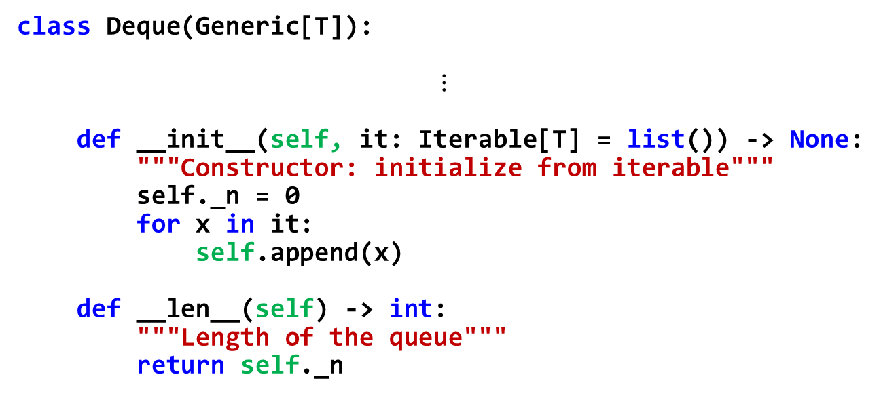
Deque: __init__ and __len__
head
8
5
9
1
3
4
next
prev
class Deque(Generic[T]): $$⋮$$ def __init__(self, it: Iterable[T] = list()) -> None: """Constructor: initialize from iterable""" self._n = 0 for x in it: self.append(x) def __len__(self) -> int: """Length of the queue""" return self._n

Slide 17
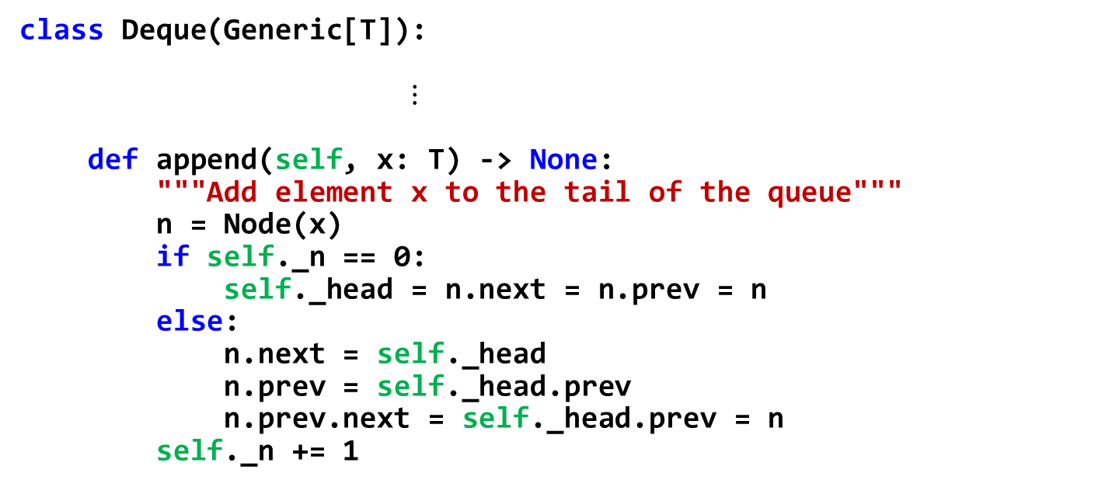
Deque: append
head
n
8
5
9
1
3
4
6
next
prev
class Deque(Generic[T]): $⋮$ def append(self, x: T) -> None: """Add element x to the tail of the queue""" n = Node(x) if self._n == 0: self._head = n.next = n.prev = n else: n.next = self._head n.prev = self._head.prev n.prev.next = self._head.prev = n self._n += 1

Slide 18
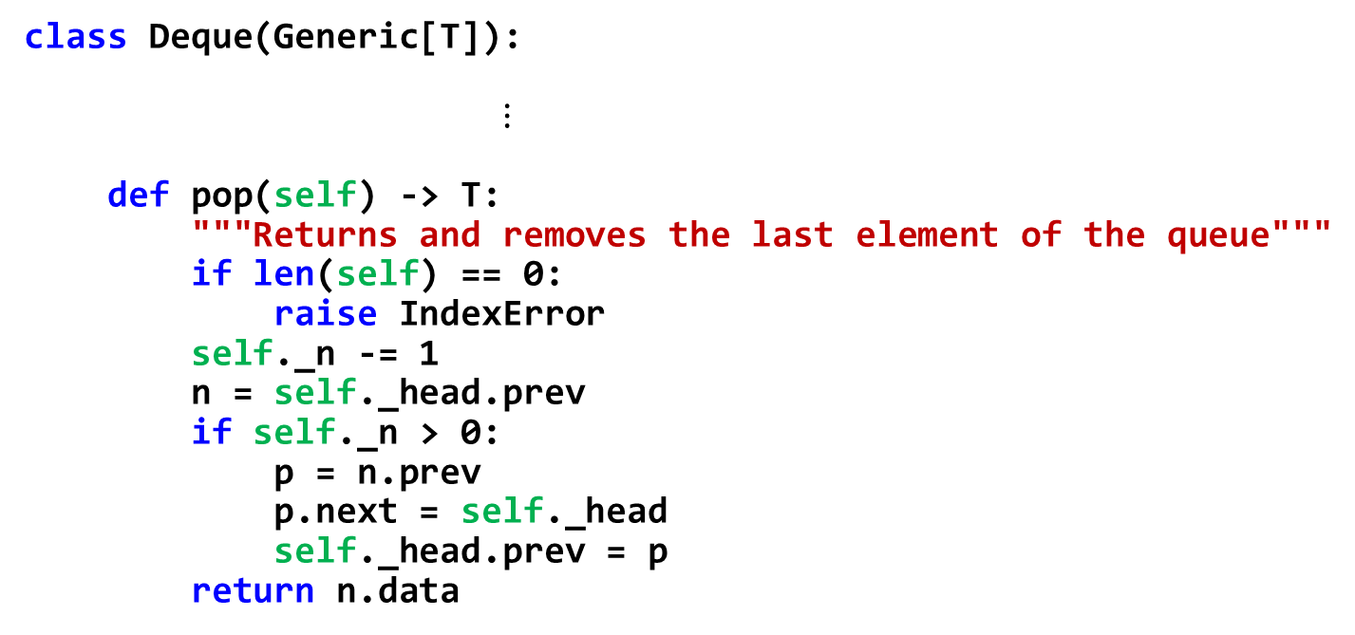
Deque: pop
head
p
n
8
5
9
1
3
4
next
prev
class Deque(Generic[T]): $⋮$ def pop(self) -> T: """Returns and removes the last element of the queue""" if len(self) == 0: raise IndexError self._n -= 1 n = self._head.prev if self._n > 0: p = n.prev p.next = self._head self._head.prev = p return n.data

Slide 19
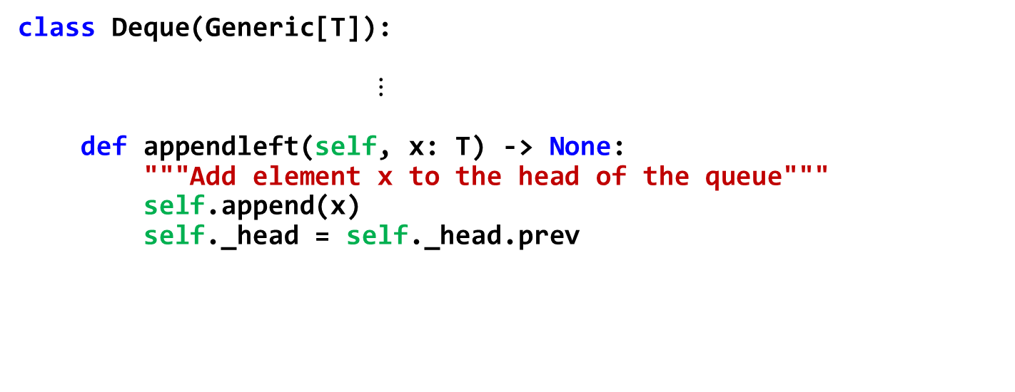
Deque: appendleft
head
8
5
9
1
3
4
6
next
prev
class Deque(Generic[T]): $⋮$ def appendleft(self, x: T) -> None: """Add element x to the head of the queue""" self.append(x) self._head = self._head.prev

Slide 20
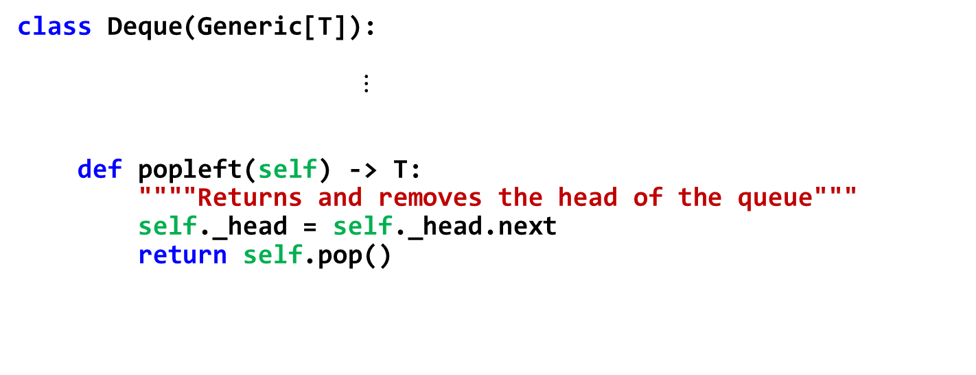
Deque: popleft
head
8
5
9
1
3
4
next
prev
class Deque(Generic[T]): $⋮$ def popleft(self) -> T: """"Returns and removes the head of the queue""" self._head = self._head.next return self.pop()

Slide 21
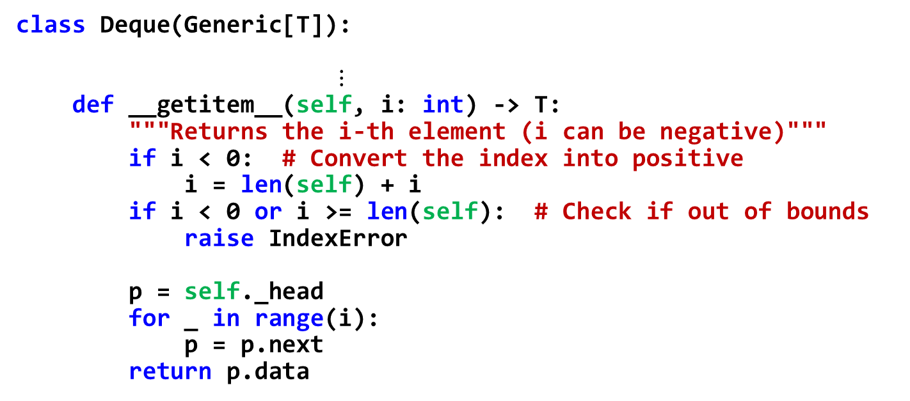
Deque: __getitem__
head
8
5
9
1
3
4
next
prev
class Deque(Generic[T]): $⋮$ def __getitem__(self, i: int) -> T: """Returns the i-th element (i can be negative)""" if i < 0: # Convert the index into positive i = len(self) + i if i < 0 or i >= len(self): # Check if out of bounds raise IndexError p = self._head for _ in range(i): p = p.next return p.data
Can we make it more efficient? How about q[-1] in a queue with ${10}^{6}$ elements?

Slide 22
Deque iterator: how to use it?
q: Deque[int] = Deque([12, 15, 6, -4]) # Visiting the elements of q with an iterator q_iter: DequeIter[int] = iter(q) try: while True: print('', next(q_iter), end='') except StopIteration: print() # Equivalent code with the same functionality for x in q: print('', x, end='') print() # Important: q may have more than one iterator # Iterators are independent from each other q_iter1 = iter(q) q_iter2 = iter(q)

Slide 23
Deque iterator: how to use it?
q: Deque[int] = Deque([12, 15, 6, -4]) q_iter: DequeIter[int] = iter(q) try: while True: print('', next(q_iter), end='') except StopIteration: print()
q.__iter__()
q_iter.__next__()

Slide 24
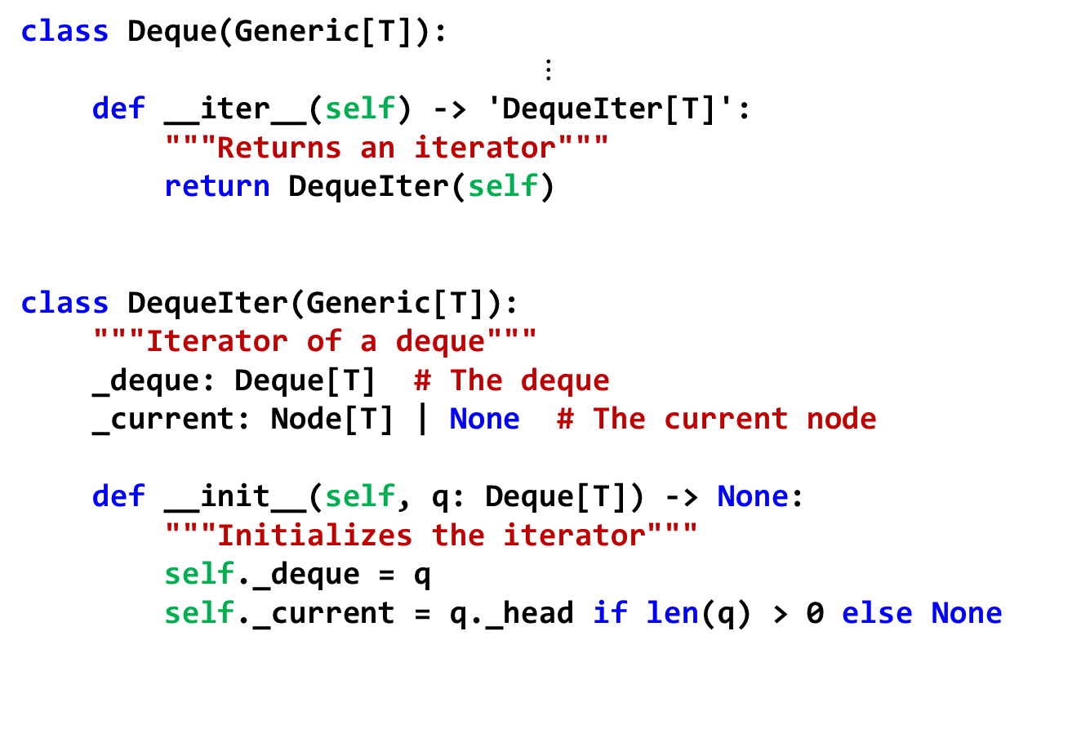
Deque: iterator
class Deque(Generic[T]): $$⋮$$ def __iter__(self) -> 'DequeIter[T]': """Returns an iterator""" return DequeIter(self) class DequeIter(Generic[T]): """Iterator of a deque""" _deque: Deque[T] # The deque _current: Node[T] | None # The current node def __init__(self, q: Deque[T]) -> None: """Initializes the iterator""" self._deque = q self._current = q._head if len(q) > 0 else None
Deque
_head
_n=4

Slide 25
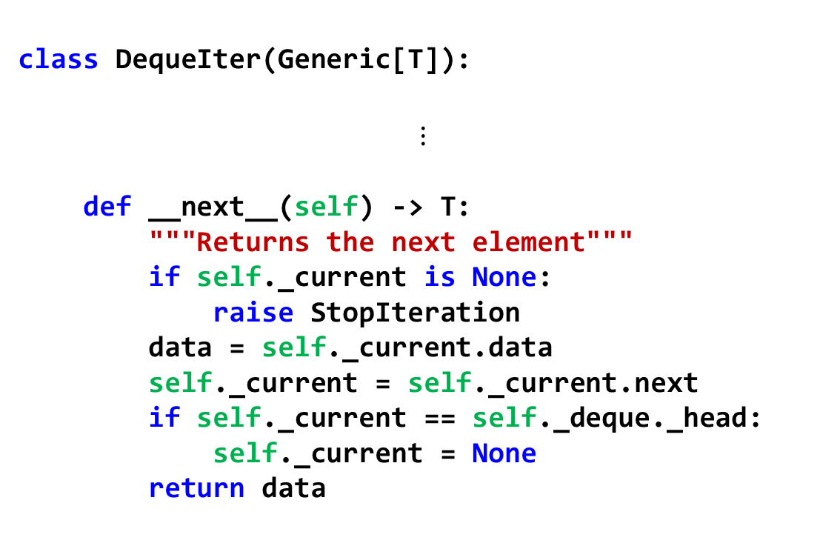
Deque: iterator
self._deque
_head
_n=4
class DequeIter(Generic[T]):
$$⋮$$ def __next__(self) -> T: """Returns the next element""" if self._current is None: raise StopIteration data = self._current.data self._current = self._current.next if self._current == self._deque._head: self._current = None return data
self._current

Slide 26
Using a deque
q: Deque[int] = Deque(range(1,9)) # Initialize with iterable q.appendleft(0)
print("Number of elements:", len(q))
# Using q[i] (__getitem__). Quadratic cost! for i in range(len(q)):
print(" Element", i, " =", q[i])
# Using the iterators (linear cost: much more efficient!) for i, x in enumerate(q): print(" Element", i, " =", x)
print("Removing the last element:", q.pop()) print("Removing the first element:", q.popleft())
print("Remaining elements in the queue:", end='')
for x in q:
print(' ', x, sep='', end='')
print()

Slide 27
Memory management
Programming languages have different strategies for memory management
Typically, there are two structures used for memory management:
Stack, for static memory allocation, associated to functions/methods
Heap, for dynamic memory allocation

Slide 28
Memory management in Python
stack
heap
def square(x): return x*x def find_square(v, x): for idx, val in enumerate(v): if x == square(val): return idx return None a = [3, 5, 9] z = 25 print(find_square(a, z))
1
square x
find_square v x val idx
3
5
9
main a z
25

Slide 29
Heap management
Data structures often have some extra allocated memory to avoid frequent reallocations
A
A
A
A
Needs reallocation!
A.append()
A.append()
A.append()
A.append()
A’s storage
B’s storage
C’s storage
After reallocating A’s storage (e.g., after A.append(…))
B’s storage
A’s storage
C’s storage

Slide 30
Garbage collection
Objects may have multiple references. Each object has a reference count.
Python runs a garbage collector periodically. All objects with zero references are freed.
A ref=1
B ref=3
C ref=0
can be freed!

Slide 31
Efficient memory management
import sys import time t0 = time.time() n = 100000000 s: list[int] = [] # append n elements for i in range(n): s.append(i) if i % 1000 == 0: print(i, sys.getsizeof(s), time.time() - t0) # remove n elements for i in range(n): s.pop() if i % 1000 == 0: print(n+i, sys.getsizeof(s), time.time() - t0)

Slide 32
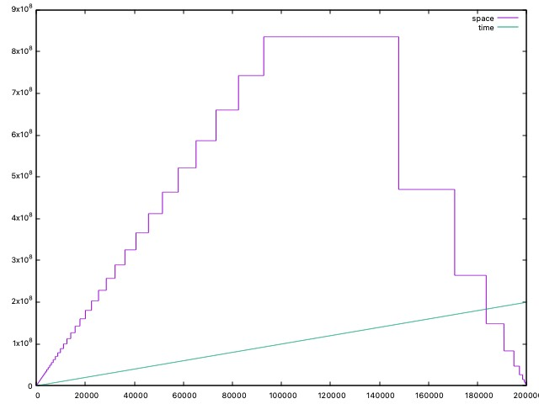
Efficient memory management
Avoid managing memory at every resizing operation
Use extra memory to amortize the effort in allocating/deallocating memory
bytes
$$9×{10}^{8}$$
$$8×{10}^{8}$$
space
$$7×{10}^{8}$$
s.append(i)
s.pop()
$$6×{10}^{8}$$
$$5×{10}^{8}$$
$$4×{10}^{8}$$
$$3×{10}^{8}$$
$$2×{10}^{8}$$
20 secs
time
$$1×{10}^{8}$$
10 secs
$$0$$
0
20000
40000
60000
80000
100000
120000
140000
160000
180000
200000
K ops

Slide 33
Exercises

Slide 34
Stack: Interleaved push/pop operations
Suppose that an intermixed sequence of push and pop operations are performed. The pushes push the integers 0 through 9 in order; the pops print out the return value. Which of the following sequences could not occur?
4 3 2 1 0 9 8 7 6 5
4 6 8 7 5 3 2 9 0 1
2 5 6 7 4 8 9 3 1 0
4 3 2 1 0 5 6 7 8 9
Source: Robert Sedgewick, Computer Science 126, Princeton University.

Slide 35
Middle element of a stack
Design the class MidStack implementing a stack with the following operations:
Push/pop: the usual operations on a stack.
FindMiddle: returns the value of the element in the middle.
DeleteMiddle: deletes the element in the middle.
All the operations must be executed in $\text{O}(1)$ time.
Suggestion: use some of the existing Python containers to implement it.
Note: if the stack has $n$ elements at locations $0..n−1$, where $0$ is the location at the bottom, the middle element is the one at location $\left\lfloor {(n−1)}/2\right\rfloor$.

Slide 36
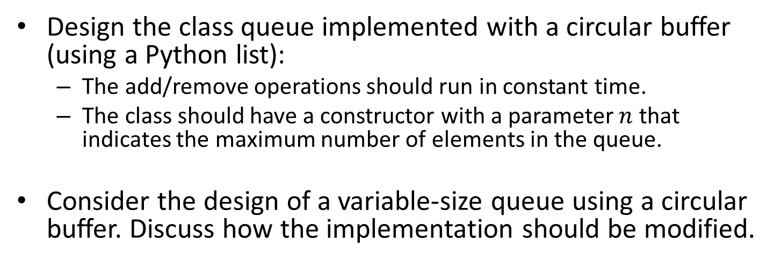
Queues implemented as circular buffers
Design the class queue implemented with a circular buffer (using a Python list):
The add/remove operations should run in constant time.
The class should have a constructor with a parameter $n$ that indicates the maximum number of elements in the queue.
Consider the design of a variable-size queue using a circular buffer. Discuss how the implementation should be modified.
7
0
0
1
2
3
4
5
6
7
6
1
5
2
4
3

Slide 37
Reverse
Design the method reverse() that reverses the contents of a deque:
No auxiliary data structures should be used.
No copies of the elements should be performed.

Slide 38
Rotate and Josephus
Design the method q.rotate(n) that rotates a deque n positions to the right (if positive) or –n positions to the left (if negative). Make the method efficient (e.g., assume that n can be large)
Solve the Josephus problem, for $n$ people and executing every $k$-th person, using a deque: https://en.wikipedia.org/wiki/Josephus_problem
1 | 2 | 3 | 4 | 5 | 6 | 7
q.rotate(-2)
q.rotate(3)
3 | 4 | 5 | 6 | 7 | 1 | 2
5 | 6 | 7 | 1 | 2 | 3 | 4

Slide 39
Merge and quick sort
Design the method q.merge(other: Deque) that merges the deque with another deque, assuming that both are sorted. Assume that a pair of elements can be compared with the operator <. After merging, all the elements must have been transferred to q (other becomes empty).
Design the method q.sort() that sorts the deque according to the < operator. Consider merge sort and quick sort as possible algorithms.

