Slide 1
Exception handling
Jordi Cortadella and Jordi Petit
Department of Computer Science

Slide 2
Quadratic equation
import math def quadratic_equation(file: str) -> None: """Reads three coefficients from a file and computes the real roots of a quadratic equation""" a, b, c = [float(x) for x in open(file).readline().split()] discrim = b*b - 4*a*c if discrim < 0: print('The equation has no real roots!') elif discrim == 0: root = -b / (2*a) print(f'There is a double root at {root}') else: discRoot = math.sqrt(b*b - 4*a*c) root1 = (-b + discRoot) / (2*a) root2 = (-b - discRoot) / (2*a) print(f'The solutions are: {root1}, {root2}')
quadratic_equation('coef.txt')
Source: John Zelle, Python programming: an introduction to Computer Science, Franklin, Beedle & Associates, 2004.

Slide 3
Exception handling
Very often programs are infested with if statements to detect errors and special cases that are produced at runtime.
It is very difficult to predict all the abnormal situations that can occur during the execution of a program.
Exception handling is a mechanism that allows to catch errors without messing up the code of the algorithm.
When an error occurs, and exception is raised, the flow of execution is broken and transferred to an exception handler.
Examples of exceptions: invalid input data, division by zero, square root of a negative number, overflow, file not found, index out-of-bounds, violation of the pre-condition of a function, etc.

Slide 4
Exceptions in Python
try: <body> except <ErrorType>: <handler>
def quadratic_equation(file: str) -> None: """Reads three coefficients from a file and computes the real roots of a quadratic equation""" try: a, b, c = [float(x) for x in open(file).readline().split()] discRoot = math.sqrt(b*b - 4*a*c) root1 = (-b + discRoot) / (2*a) root2 = (-b - discRoot) / (2*a) print(f'The solutions are: {root1}, {root2}') except ValueError: print('No real roots')

Slide 5
Exceptions in Python
What if the exception is not caught?
def quadratic_equation(file: str) -> None: """Reads three coefficients from a file and computes the real roots of a quadratic equation""" a, b, c = [float(x) for x in open(file).readline().split()] discRoot = math.sqrt(b*b - 4*a*c) root1 = (-b + discRoot) / (2*a) root2 = (-b - discRoot) / (2*a) print(f'The solutions are: {root1}, {root2}')
Traceback (innermost last): File "<stdin>", line 1, in ? File "quadratic.py", line 13, in ? discRoot = math.sqrt(b*b - 4*a*c) ValueError: math domain error
Unhandled exceptions are finally caught by the Python interpreter

Slide 6
Exception hierarchy
When an exception is raised, the control is transferred to the innermost try-except statement than handles the exception.
There is an exception hierarchy:
Exception
ArithmeticError
OverflowError
FloatingPointError
LookupError
IndexError
ZeroDivisionError
KeyError
…
…
…

Slide 7
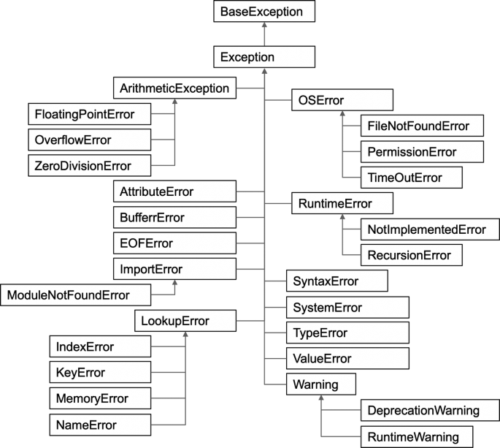
Exception hierarchy

Slide 8
Handling multiple exceptions
def quadratic_equation(file: str) -> None: """Reads three coefficients from a file and computes the real roots of a quadratic equation""" try: a, b, c = [float(x) for x in open(file).readline().split()] discRoot = math.sqrt(b*b - 4*a*c) root1 = (-b + discRoot) / (2*a) root2 = (-b - discRoot) / (2*a) print(f'The solutions are: {root1}, {root2}') except ValueError as error: if str(error) == 'math domain error': print('No real roots.') else: print('Wrong format for coefficients.') except FileNotFoundError: print(f'File {file} could not be found.') except: # something else, e.g., division by zero print('Something went wrong, sorry!')

Slide 9
Raising exceptions
# The program itself can generate exceptions
if x < 0: raise ValueError('No negative numbers allowed') if not isinstance(s, str): raise TypeError('A string is expected')
Python allows user-defined exceptions using classes (not explained here), e.g., class MyError(Exception): …

Slide 10
Assertions
Assertions are sanity checks used to test the program. They are often used to check the pre-conditions of the functions and detect internal errors of the program, e.g.,
def Kelvin2Fahrenheit(temperature: float) -> float: assert temperature >= 0, 'Colder than absolute zero!' return (Temperature-273)*1.8+32
Assertions are not exceptions, but they raise an AssertionError that can be caught by an exception handler.

Slide 11
Conclusions
Use exceptions to maintain clean code and catch abnormal program executions at runtime
Use assertions for internal sanity-checks
Print informative error messages:
Non-informative message: "Unexpected error"
Informative message: "File abc.txt not found"

