Slide 1
Algorithm Analysis (II)
Jordi Cortadella and Jordi Petit
Department of Computer Science

Slide 2
Examples
Selection sort
Insertion sort
The Maximum Subsequence Sum Problem
Convex Hull

Slide 3
Selection Sort
Selection sort uses this invariant:
i-1
i
-7 | -3 | 0 | 1 | 4 | 9 | ? | ? | ? | ? | ? | ?
this is sorted
and contains the i-1
smallest elements
this may not be sorted…
but all elements here are larger than or equal to the elements in the sorted part

Slide 4
Selection Sort
def selection_sort(v: list[T]) -> None: """Sorts v in ascending order""" for i in range(len(v)-1): k = i for j in range(i+1, len(v)): if v[j] < v[k]: k = j v[k], v[i] = v[i], v[k]
Observation: notice that $T\left(n\right)∈Ω(n^{2})$, also. Therefore, $T\left(n\right)∈Θ(n^{2})$.

Slide 5
Insertion Sort
Let us use inductive reasoning:
If we know how to sort arrays of size n-1,
do we know how to sort arrays of size n?
0
n-2
n-1
9 | -7 | 0 | 1 | -3 | 4 | 3 | 8 | -6 | 8 | 6 | 2
-7 | -6 | -3 | 0 | 1 | 3 | 4 | 6 | 8 | 8 | 9 | 2
-7 | -6 | -3 | 0 | 1 | 2 | 3 | 4 | 6 | 8 | 8 | 9

Slide 6
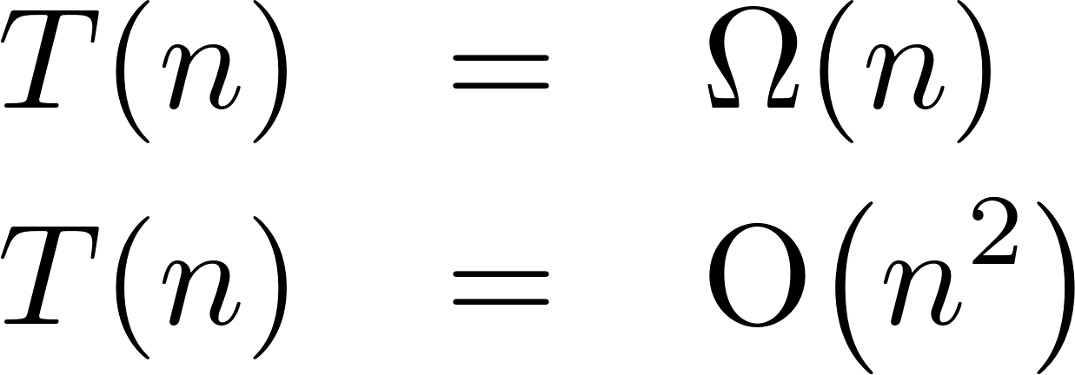
Insertion Sort
def insertion_sort(v: list[T]) -> None: """Sorts v in ascending order""" for i in range(1, len(v)): # n-1 times x = v[i] j = i while j > 0 and v[j - 1] > x: # 0..i times v[j] = v[j - 1] j -= 1 v[j] = x

Slide 7
The Maximum Subsequence Sum Problem
Given (possibly negative) integers $A_{1}, A_{2}, …,A_{n}$, find the maximum value of $\sum_{k=i}^{j}{A_{k}}$. (the max subsequence sum is 0 if all integers are negative).
Example:
Input: -2, 11, -4, 13, -5, -2
Answer: 20 (subsequence 11, -4, 13)
(extracted from M.A. Weiss, Data Structures and Algorithms in C++, Pearson, 2014, 4th edition)

Slide 8
The Maximum Subsequence Sum Problem
def max_sub_sum(a: list[int]) -> int: """Returns the sum of the maximum subsequence of a""" n = len(a) max_sum = 0 # try all possible subsequences for i in range(n): for j in range(i, n): this_sum = 0 for k in range(i, j+1): this_sum += a[k] max_sum = max(max_sum, this_sum) return max_sum
$$T\left(n\right)=\sum_{i=0}^{n−1}{\sum_{j=i}^{n−1}{\sum_{k=i}^{j}{1}}}$$

Slide 9
The Maximum Subsequence Sum Problem
$$T\left(n\right)=\sum_{i=0}^{n−1}{\sum_{j=i}^{n−1}{\sum_{k=i}^{j}{1}}}$$
$$=\sum_{i=0}^{n−1}{\sum_{j=i}^{n−1}{( j−i+1)}}$$
$$=\sum_{i=0}^{n−1}{\frac{(n−i+1)(n−i)}{2}=⋯}$$
$$=\frac{n^{3}+3n^{2}+2n}{6}=Θ(n^{3})$$

Slide 10
The Maximum Subsequence Sum Problem
def max_sub_sum(a: list[int]) -> int: """Returns the sum of the maximum subsequence of a""" n = len(a) max_sum = 0 # try all possible subsequences for i in range(n): this_sum = 0 for j in range(i, n): this_sum += a[j] # reuse computation max_sum = max(max_sum, this_sum) return max_sum
$$T\left(n\right)=\sum_{i=0}^{n−1}{\sum_{j=i}^{n−1}{1}=Θ(n^{2})}$$

Slide 11
Max Subsequence Sum: Divide&Conquer
First half |  |  |  | Second half
4 | -3 | 5 | -2 | -1 | 2 | 6 | -2
The max sum can be in one of three places:
1st half
2nd half
Spanning both halves and crossing the middle
In the 3rd case, two max subsequences must be found starting from the center of the vector (one to the left and the other to the right)

Slide 12
Max Subsequence Sum: Divide&Conquer
def max_sub_sum_rec(a: list[int], left: int, right: int) -> int: """Returns the sum of the maximum subsequence of a[left:right+1]"""
if left == right: # base case return max(a[left], 0)
# Recursive cases: left and right halves center = (left + right)//2 max_left = max_sub_sum_rec(a, left, center) max_right = max_sub_sum_rec(a, center+1, right)
# Subsequence in a[center+1:right+1] max_rcenter, right_sum = 0, 0 for i in range(center+1, right+1): right_sum += a[i] max_rcenter = max(max_rcenter, right_sum)
# Subsequence in a[left:center+1] max_lcenter, left_sum = 0, 0 for i in range(center, left-1, -1): left_sum += a[i] max_lcenter = max(max_lcenter, left_sum)
return max(max_left, max_right, max_lcenter + max_rcenter)
a:
left
center
right

Slide 13
Max Subsequence Sum: Divide&Conquer
$$T\left(1\right)=1 \\ T\left(n\right)=2T\left(n/2\right)+Θ(n)$$
We will see how to solve this equation formally in the next lesson (Master Theorem). Informally:
$$T\left(n\right)=2T\left(n/2\right)+n=2(2T(n/{4)+n/{2)+n}}$$
$$=4T\left(n/4\right)+n+n=8T(n/{8)+n+n+n=⋯}$$
$$=2^{k}T\left(n/{2^{k}}\right)+n+n+⋯+n$$
$$k$$
when $n=2^{k}$, we have that $k=\log_{2}{n}$, hence
$$T\left(n\right)=2^{k}T\left(1\right)+kn=n+n\log_{2}{n}=Θ(n\log{n})$$
But, can we still do it faster?

Slide 14
The Maximum Subsequence Sum Problem
Observations:
If a[i] is negative, it cannot be the start of the optimal subsequence.
Any negative subsequence cannot be the prefix of the optimal subsequence.
Let us consider the inner loop of the $\text{O}\left(n^{2}\right)$ algorithm and assume that all prefixes of a[i..j-1] are positive and a[i..j] is negative:
If p is an index between i+1 and j, then any subsequence from a[p] is not larger than any subsequence from a[i] and including a[p-1].
If a[j] makes the current subsequence negative, we can advance i to j+1.
i
p
j
a:

Slide 15
The Maximum Subsequence Sum Problem
def max_sub_sum(a: list[int]) -> int: """Returns the sum of the maximum subsequence of a""" max_sum, this_sum = 0, 0 for x in a: this_sum += x max_sum = max(max_sum, this_sum) this_sum = max(this_sum, 0) return max_sum
$$T\left(n\right)=Θ(n)$$
a:
4 | -3 | 5 | -4 | -3 | -1 | 5 | -2 | 6 | -3 | 2
4 | 1 | 6 | 2 | 0 | 0 | 5 | 3 | 9 | 6 | 8
4 | 4 | 6 | 6 | 6 | 6 | 6 | 6 | 9 | 9 | 9
this_sum:
max_sum:

Slide 16
Representation of polygons
A polygon can be represented by a sequence of vertices.
Two consecutive vertices represent an edge of the polygon.
The last edge is represented by the first and last vertices of the sequence.
(6,7)
(2,6)
(5,4)
(1,3)
(7,3)
(4,1)
Vertices: (1,3) (4,1) (7,3) (5,4) (6,7) (2,6)
Edges: (1,3)-(4,1)-(7,3)-(5,4)-(6,7)-(2,6)-(1,3)
# A polygon (an ordered set of vertices)
Polygon = list[Point]

Slide 17
Create a polygon from a set of points
Given a set of $n$ points in the plane, connect them in a simple closed path.

Slide 18
Simple polygon
Input: $p_{1},p_{2},…,p_{n}$ (points in the plane).
Output: P (a polygon whose vertices are $p_{1},p_{2},…,p_{n}$ in some order).
Select a point $z$ with the smallest $x$ coordinate (and smallest $y$ in case of a tie in the $x$ coordinate). Assume $z=p_{1}$.
For each ${p_{i}∈\{p}_{2},…,p_{n}\}$, calculate the angle $α_{i}$ between the lines $z−p_{i}$ and the $x$ axis.
Sort the points${ \{p}_{2},…,p_{n}\}$ according to their angles. In case of a tie, use distance to $z$.
$$z$$

Slide 19
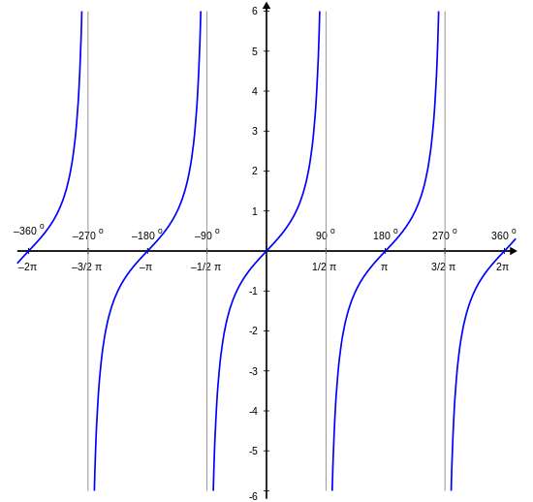
Simple polygon
tan($α)$
$$z$$

Slide 20
Simple polygon
Implementation details:
There is no need to calculate angles (requires arctan). It is enough to calculate slopes (${Δy}/{Δx}).$
There is not need to calculate distances. It is enough to calculate the square of distances (no sqrt required).
Complexity: $\text{O}(n\log{n)}$. The runtime is dominated by the sorting algorithm.
$$z$$

Slide 21
Convex hull
Compute the convex hull of $n$ given points in the plane.

Slide 22
Clockwise and counter-clockwise
How to calculate whether three consecutive vertices are in a clockwise or counter-clockwise turn.
counter-clockwise ($p_{3}$ at the left of $\vec{p_{1}p_{2}}$)
clockwise ($p_{3}$ at the right of $\vec{p_{1}p_{2}}$)
$$p_{3}$$
$$p_{3}$$
$$p_{2}$$
$$β$$
$$α$$
$$β$$
$$p_{2}$$
$$α$$
$$p_{1}$$
$$p_{1}$$
$$α<β$$
$$α>β$$
def left_of($p_{1}:\text{Point}, p_{2}:\text{Point}, p_{3}:\text{Point}$) -> bool: """Returns true if $p_{3}$ is at the left of $\vec{p_{1}p_{2}}$""" return $\left(p_{2}.x−p_{1}.x\right)⋅\left(p_{3}.y−p_{1}.y\right)>\left(p_{2}.y−p_{1}.y\right)⋅(p_{3}.x−p_{1}.x)$

Slide 23
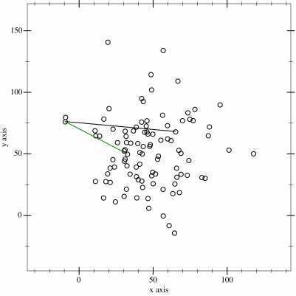
Convex hull: gift wrapping algorithm
https://en.wikipedia.org/wiki/Gift_wrapping_algorithm

Slide 24
Convex hull: gift wrapping algorithm
Input: $p_{1},p_{2},…,p_{n}$ (points in the plane).
Output: P (the convex hull of $p_{1},p_{2},…,p_{n}$).
Initial points: $p_{0}$ with the smallest $x$ coordinate.
Iteration: Assume that a partial path with $k$ points has been built (${ p}_{k}$ is the last point). Pick some arbitrary $p_{k+1}≠p_{k}$. Visit the remaining points. If some point $q$ is at the left of $\vec{p_{k}p_{k+1}}$ redefine $p_{k+1}=q$.
Stop when P is complete (back to point $p_{0}$).
$$p_{k}$$
$$p_{k+1}$$
leftmost point
$$p_{k−1}$$
$$p_{0}$$
Complexity: At each iteration, we calculate $n$ angles. $T\left(n\right)=\text{O}(hn)$, where $h$ is the number of points in the convex hull. In the worst case, $T\left(n\right)=\text{O}\left(n^{2}\right).$

Slide 25
Convex hull: gift wrapping algorithm
def gift_wrapping(pol: Polygon) -> Polygon:
"""Returns the convex-hull of a set of points"""
hull: Polygon = []
# Pick the leftmost point
left = 0
for i, p in enumerate(pol):
if pol[i].x < pol[left].x:
left = i
p = left
while True: # Add points while the polygon is not closed
hull.append(pol[p]) # Add point to the convex hull
q = (p+1)%len(pol) # Pick a point different from p
for i, new_p in enumerate(pol): # Find leftmost point of p->q
if left_of(pol[p], pol[q], new_p):
q = i
p = q # This is the leftmost point
if p == left: # Stop if the point closes the polygon
break
return hull

Slide 26
Convex hull: Graham Scan
https://en.wikipedia.org/wiki/Graham_scan

Slide 27
Convex hull: Graham scan
$$C$$
$$C$$
$$D$$
$$F$$
$$D$$
$$F$$
$$B$$
$$E$$
$$B$$
$$E$$
$$G$$
$$G$$
$$A$$
$$H$$
$$A$$
$$H$$

Slide 28
Convex hull: Graham scan
$$C$$
P:
$$A$$ | $$B$$ | $$C$$ | $$D$$ | $$E$$ | $$F$$ | $$G$$ | $$H$$
$$D$$
$$F$$
$$B$$
$$E$$
$$G$$
Q:
$$A$$ | $$B$$ | $$C$$
$$A$$
$$H$$

Slide 29
Convex hull: Graham scan
$$C$$
P:
$$A$$ | $$B$$ | $$C$$ | $$D$$ | $$E$$ | $$F$$ | $$G$$ | $$H$$
$$D$$
$$F$$
$$B$$
$$E$$
$$G$$
Q:
$$A$$ | $$B$$ | $$C$$ | $$D$$
$$A$$
$$H$$

Slide 30
Convex hull: Graham scan
$$C$$
P:
$$A$$ | $$B$$ | $$C$$ | $$D$$ | $$E$$ | $$F$$ | $$G$$ | $$H$$
$$D$$
$$F$$
$$B$$
$$E$$
$$G$$
Q:
$$A$$ | $$B$$ | $$C$$ | $$D$$ | $$E$$
$$A$$
$$H$$

Slide 31
Convex hull: Graham scan
$$C$$
P:
$$A$$ | $$B$$ | $$C$$ | $$D$$ | $$E$$ | $$F$$ | $$G$$ | $$H$$
$$D$$
$$F$$
$$B$$
$$E$$
$$G$$
Q:
$$A$$ | $$B$$ | $$C$$ | $$D$$
$$A$$
$$H$$

Slide 32
Convex hull: Graham scan
$$C$$
P:
$$A$$ | $$B$$ | $$C$$ | $$D$$ | $$E$$ | $$F$$ | $$G$$ | $$H$$
$$D$$
$$F$$
$$B$$
$$E$$
$$G$$
Q:
$$A$$ | $$B$$ | $$C$$
$$A$$
$$H$$

Slide 33
Convex hull: Graham scan
$$C$$
P:
$$A$$ | $$B$$ | $$C$$ | $$D$$ | $$E$$ | $$F$$ | $$G$$ | $$H$$
$$D$$
$$F$$
$$B$$
$$E$$
$$G$$
Q:
$$A$$ | $$B$$ | $$C$$ | $$F$$
$$A$$
$$H$$

Slide 34
Convex hull: Graham scan
$$C$$
P:
$$A$$ | $$B$$ | $$C$$ | $$D$$ | $$E$$ | $$F$$ | $$G$$ | $$H$$
$$D$$
$$F$$
$$B$$
$$E$$
$$G$$
Q:
$$A$$ | $$B$$ | $$C$$ | $$F$$ | $$G$$
$$A$$
$$H$$

Slide 35
Convex hull: Graham scan
$$C$$
P:
$$A$$ | $$B$$ | $$C$$ | $$D$$ | $$E$$ | $$F$$ | $$G$$ | $$H$$
$$D$$
$$F$$
$$B$$
$$E$$
$$G$$
Q:
$$A$$ | $$B$$ | $$C$$ | $$F$$
$$A$$
$$H$$

Slide 36
Convex hull: Graham scan
$$C$$
P:
$$A$$ | $$B$$ | $$C$$ | $$D$$ | $$E$$ | $$F$$ | $$G$$ | $$H$$
$$D$$
$$F$$
$$B$$
$$E$$
$$G$$
Q:
$$A$$ | $$B$$ | $$C$$ | $$F$$ | $$H$$
$$A$$
$$H$$

Slide 37
Convex hull: Graham scan
$$C$$
P:
$$A$$ | $$B$$ | $$C$$ | $$D$$ | $$E$$ | $$F$$ | $$G$$ | $$H$$
$$F$$
$$B$$
Q:
$$A$$ | $$B$$ | $$C$$ | $$F$$ | $$H$$
$$A$$
$$H$$

Slide 38
Convex hull: Graham scan
$$p_{k}$$
Input: $p_{1},p_{2},…,p_{n}$ (polygon: points in the plane).
Output: $q_{1},q_{2},…,q_{m}$ (the convex hull).
Initially: Create a simple polygon P (complexity $\text{O}(n\log{n})$). Assume the order of the points is $p_{1},p_{2},…,p_{n}$.
$$q_{m−1}$$
$$q_{m}$$
$$q_{1}$$
def graham_scan(pol: Polygon) -> Polygon:
"""Returns the convex hull of a non-convex polygon"""
hull = pol[0:3]
for k in range(3, len(pol)):
while left_of(hull[-2], hull[-1], pol[k]):
hull.pop()
hull.append(pol[k])
return hull
Observation: each point $p_{k}$ can be included in $Q$ and deleted at most once. The main loop of Graham scan has linear cost.
Complexity: dominated by the creation of the simple polygon → $\text{O}(n\log{n)}$.

Slide 39
Exercises

Slide 40
Summations
Prove the following equalities:
$$\sum_{i=1}^{n}{i}=\frac{n(n+1)}{2}$$
$$\sum_{i=1}^{n}{i^{2}}=\frac{n(n+1)(2n+1)}{6}$$
$$\sum_{i=0}^{n}{2^{i}}=2^{n+1}−1$$

Slide 41
For loops: analyze the cost of each code
Calculate the value of variable s at the end of each code
# Code 1 s = 0 for i in range(n): s += 1 # Code 2 s = 0 for i in range(0, n, 2): s += 1 # Code 3 s = 0 for i in range(n): s += 1 for j in range(n): s += 1
# Code 4 s = 0 for i in range(n): for j in range(n): s += 1 # Code 5 s = 0 for i in range(n): for j in range(i): s += 1 # Code 6 s = 0 for i in range(n): for j in range(i, n): s += 1

Slide 42
For loops: analyze the cost of each code
# Code 7 s = 0 for i in range(n): for j in range(n): for k in range(n): s += 1 # Code 8 s = 0 for i in range(n): for j in range(i): for k in range(j): s += 1 # Code 9 s = 0 i = 1 while i <= n: s += 1 i *= 2
# Code 10 s = 0 for i in range(n): j = 1 while j <= n: s += 1 j *= 2
# Code 11 s = 0 for i in range(n): for j in range(i*i): for k in range(n): s += 1 # Code 12 s = 0 for i in range(n): for j in range(i*i): if j%i == 0: for k in range(n): s += 1

Slide 43
$\text{O}$, $Ω$ or $Θ$?
The following statements refer to the insertion sort algorithm and the X’s hide an occurrence of $\text{O}$, $Ω$ or $Θ$. For each statement, find which options for $X∈\{\text{O}, Ω,Θ\}$ make the statement true or false. Justify your answers.
The worst case is $X(n^{2})$
The worst case is $X(n)$
The best case is $X(n^{2})$
The best case is $X(n)$
For every probability distribution, the average case is $X(n^{2})$
For every probability distribution, the average case is $X(n)$
For some probability distribution, the average case is $X(n\log{n})$

Slide 44
Primality
The following algorithms try to determine whether $n≥0$ is prime. Find which ones are correct and analyze their cost as a function of $n$.
def is_prime1(n: int) -> bool: if n <= 1: return False for i in range(2,n): if n%i == 0: return False return True def is_prime2(n: int) -> bool: if n <= 1: return False for i in range(2, int(math.sqrt(n))): if n%i == 0: return False return True def is_prime3(n: int) -> bool: if n <= 1: return False for i in range(2, round(math.sqrt(n))): if n%i == 0: return False return True
def is_prime4(n: int) -> bool: if n <= 1: return False for i in range(2, int(math.sqrt(n))+1): if n%i == 0: return False return True def is_prime5(n: int) -> bool: if n <= 1: return False if n == 2: return True if n%2 == 0: return False for i in range(3, int(math.sqrt(n))+1, 2): if (n%i == 0): return False return True

Slide 45
The Sieve of Eratosthenes
The following program is a version of the Sieve of Eratosthenes. Analyze its complexity.
def primes(n: int) -> list[bool]:
p: list[bool] = [True]*(n+1)
p[0] = p[1] = False
for i in range(2, int(math.sqrt(n))+1):
if p[i]: for j in range(i*i, n+1, i):
p[j] = False
return p
You can use the following equality, where $p≤x$ refers to all primes $p≤x$:
$$\sum_{p≤x}{\frac{1}{p}=\log{\log{x}+\text{O}(1)}}$$

Slide 46
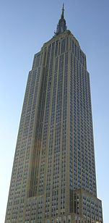
The Cell Phone Dropping Problem
You work for a cell phone company which has just invented a new cell phone protector and wants to advertise that it can be dropped from the $f$^{th} floor without breaking.
If you are given 1 or 2 phones and an $n$ story building, propose an algorithm that minimizes the worst-case number of trial drops to know the highest floor it won’t break.
Assumption: a broken cell phone cannot be used for further trials.
How about if you have $p$ cell phones?
(Source: Wood & Yasskin, Texas A&M University)
$$n$$

