Slide 1
Abstract Data Types (I) (and Object-Oriented Programming)
Jordi Cortadella and Jordi Petit
Department of Computer Science

Slide 2
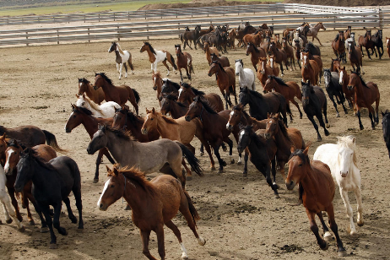
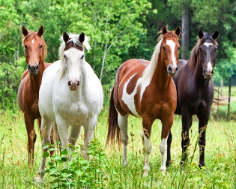
How many horses can you distinguish?

Slide 4
Two examples
# Main loop of binary search while left <= right: i = (left + right)/2 if x < A[i]: right = i–1 elif x > A[i]: left = i+1 else: return i
# Main loop of insertion sort
for i in range(1, len(A)): x = A[i] j = i while j > 0 and A[j-1] > x: A[j] = A[j-1] j -= 1 A[j] = x
Variables used (5): A, x, left, right, i (only 3 modified)
Variables used (4): A, x, i, j

Slide 5
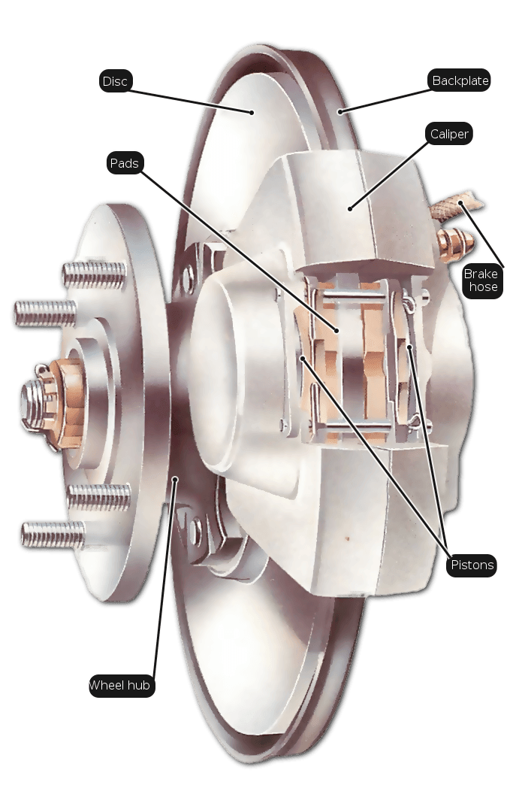
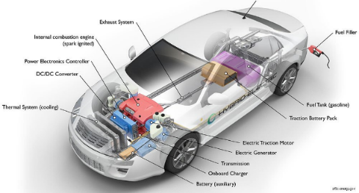
Hiding details: abstractions

Slide 6
Different types of abstractions

Slide 7
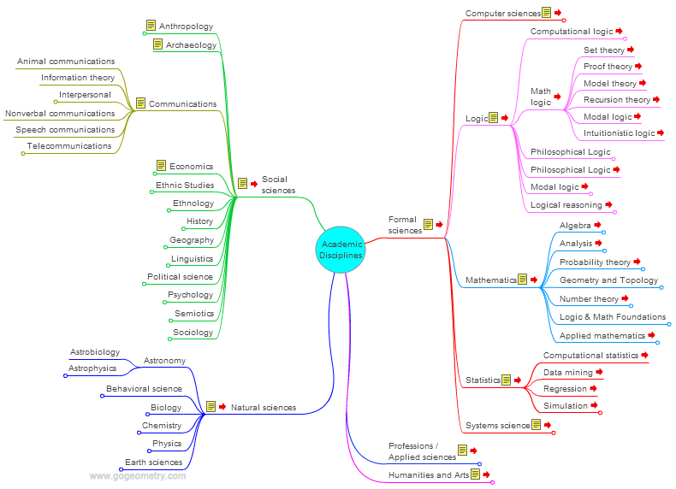
Concept maps are hierarchical: why?
Each level has few items

Slide 8
The computer systems stack
Image Credit: Christopher Batten, Cornell University

Slide 9
The computer systems stack
Image Credit: Christopher Batten, Cornell University

Slide 10
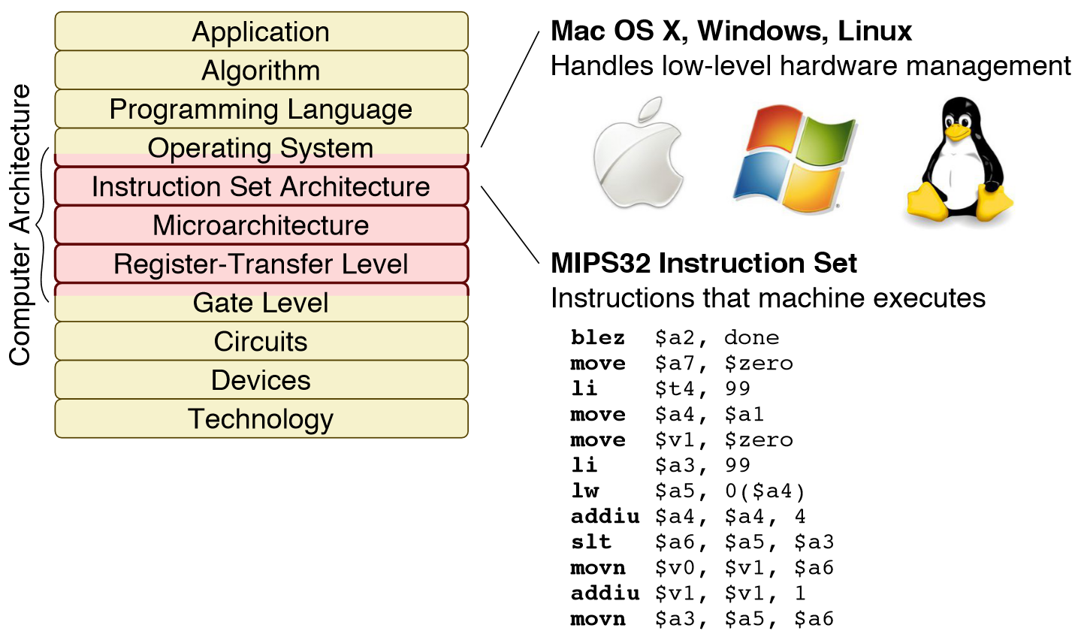
The computer systems stack
Image Credit: Christopher Batten, Cornell University

Slide 11
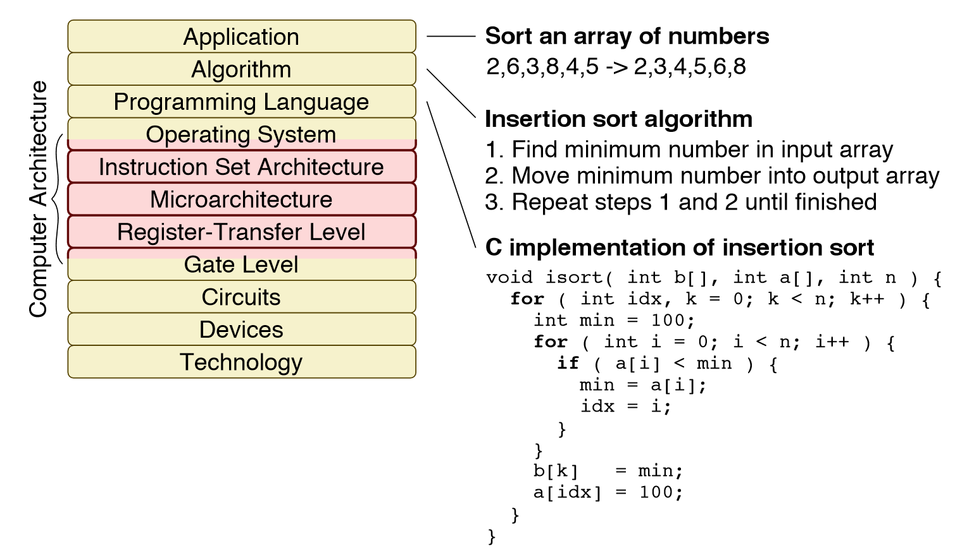
The computer systems stack
Image Credit: Christopher Batten, Cornell University

Slide 12
Our challenge
We need to design large systems and reason about complex algorithms.
Our working memory can only manipulate 4 things at once.
We need to interact with computers using programming languages.
Solution: abstraction
Abstract reasoning.
Programming languages that support abstraction.
We already use a certain level of abstraction: functions. But it is not sufficient. We need much more.

Slide 13
Data types
Programming languages have a set of primitive data types (e.g., int, bool, float, str, …).
Each data type has a set of associated operations:
We can add two integers.
We can concatenate two strings.
We can divide two floats.
But we cannot divide two strings!
Programmers can add new operations to the primitive data types:
gcd(a,b), match(string1, string2), …
The programming languages provide primitives to group data items and create structured collections of data:
C: array, struct.
Python: list, tuple, dictionary.

Slide 14
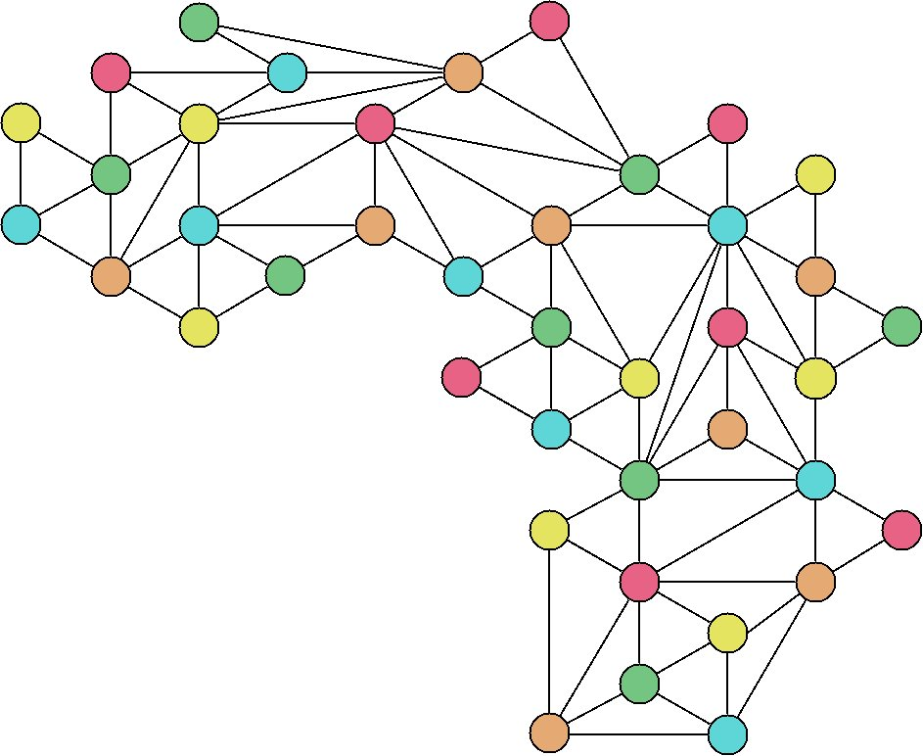
Abstract Data Types (ADTs)
A set of objects and a set of operations to manipulate them
Operations:
Number of vertices
Number of edges
Shortest path
Connected components
Data type: Graph

Slide 15
Abstract Data Types (ADTs)
A set of objects and a set of operations to manipulate them:
Operations:
$P+Q$
$P×Q$
$P/Q$
$gcd⁡(P,Q)$
$P(x)$
$\text{degree}(P)$
$$P\left(x\right)=x^{3}−4x^{2}+5$$
Data type: Polynomial

Slide 16
Abstract Data Types (ADTs)
Separate the notions of specification and implementation:
Specification: “what does an operation do?”
Implementation: “how is it done?”
Benefits:
Simplicity: code is easier to understand
Encapsulation: details are hidden
Modularity: an ADT can be changed without modifying the programs that use it
Reuse: it can be used by other programs

Slide 17
Abstract Data Types (ADTs)
An ADT has two parts:
Public or external: abstract view of the data and operations (methods) that the user can use.
Private or internal: the actual implementation of the data structures and operations.
Operations:
Creation/Destruction
Access
Modification

Slide 18
Abstract Data Types (ADTs)
Internal
Data
Representation
Private Operations
Create
Destruct
Read
User Interface (API)
Write
Modify
$$⋮$$
Invisible
API: Application Programming Interface

Slide 19
Example: a Point
A point can be represented by two coordinates ($x$,$y$).
Several operations can be envisioned:
Get the $x$ and $y$ coordinates.
Calculate distance between two points.
Calculate polar coordinates.
Move the point by $(Δx,Δy)$.
$$x$$
$$r$$
$$y$$
$$θ$$

Slide 20
Example: a Point
# Things that we can do with points p1 = Point(5.0, -3.2) # Create a point (a variable) p2 = Point(2.8, 0) # Create another point
# We now calculate the distance between p1 and p2 dist12 = p1.distance(p2)
# Distance to the origin r = p1.distance()
# Create another point by adding coordinates p3 = p1 + p2
# We get the coordinates of the new point x = p3.x() # x = 7.8 y = p3.y() # y = -3.2

Slide 21
ADTs and Object-Oriented Programming
OOP is a programming paradigm: a program is a set of objects that interact with each other.
An object has:
fields (or attributes) that contain data
functions (or methods) that contain code
Objects (variables) are instances of classes (types). A class is a template for all objects of a certain type.
In OOP, a class is the natural way of implementing an ADT.

Slide 22
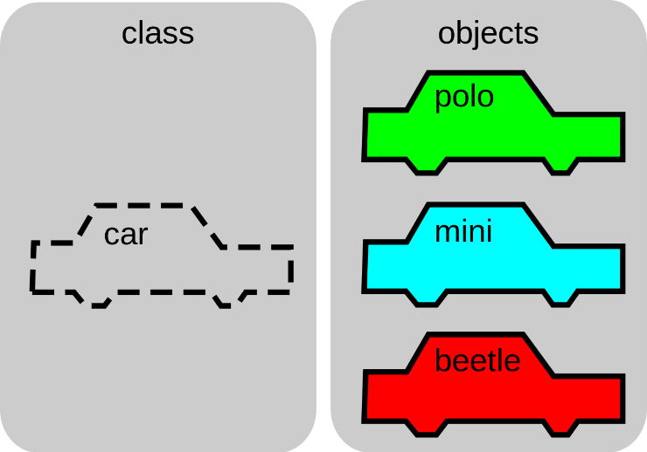
Classes and Objects

Slide 23
Let us design the new type for Point
class Point: """A class to represent and operate with two-dimensional points""" # Declaration of attributes (recommended for type checking)
_x: float # x coordinate
_y: float # y coordinate def __init__(self, x: float = 0, y: float = 0):
"""Constructor with x and y coordinates"""
self._x, self._y = x, y def x(self) -> float:
"""Returns the x coordinate""" return self._x def y(self) -> float:
"""Returns the y coordinate""" return self._y def distance(self, p: Optional['Point']) -> float:
"""Returns the distance to point p (or the distance to the origin if p is None)"""
dx, dy = self.x(), self.y()
if p is not None: dx -= p.x() dy –= p.y()
return math.sqrt(dx*dx + dy*dy)

Slide 24
Let us design the new type for Point
$⋮$
def angle(self) -> float: """Returns the angle of the polar coordinate""" if self.x() == 0 and self.y() == 0: return 0 return math.atan2(self.y()/self.x()) def __add__(self, p: 'Point') -> 'Point': """Returns a new point by adding the coordinates of two points. This is a method associated to the + operator""" return Point(self.x() + p.x(), self.y() + p.y()) def __eq__(self, p: 'Point') -> bool: """Checks whether two points are equal. This is a method associated to the == operator""" return self.x() == p.x() and self.y() == p.y()

Slide 25
How the class methods are invoked
p1 = Point(5.0, -3.2) # __init__(p1, 5.0, -3.2) p2 = Point(2.8) # __init__(p2, 2.8, 0)
dist12 = p1.distance(p2) # distance(p1, p2)
# Distance to the origin r = p1.distance() # distance(p1, None)
# Create another point by adding coordinates p3 = p1 + p2 # Equivalent to p1.__add__(p2)
# We get the coordinates of the new point x = p3.x() # x = 7.8 y = p3.y() # y = -3.2
self

Slide 26
How the class methods are invoked
p1 = Point(5.0, -3.2) p2 = Point(2.8)
dist12 = p1.distance(p2)
r = p1.distance()
p3 = p1 + p2
x = p3.x() y = p3.y()
class Point: def __init__(self, x: float = 0, y: float = 0):
def x(self) -> float:
def y(self) -> float:
def distance(self, p: Optional['Point']) -> float: def angle(self) -> float: def __add__(self, p: 'Point') -> 'Point': def __eq__(self, p: 'Point') -> bool:

Slide 27
Python naming conventions
Type | Examples
Function | distance, dot_product, multiply_by_two
Variable | x, num, num_elements
Class | Point, CityGraph, ParkingLot
Public method | distance, get_angle, shortest_path
Private method | _gcd, _check, _calculate_mean
Magic method | __init__, __add__, __eq__, __str__
Constant | GRAVITY, MIN_DISTANCE, MAX_NUM_PEOPLE
Module | point.py, city_graph.py, parking_lot.py
Package | geometry, citygraph
Recommendation:
use short names for modules and packages
no underscores for package names
Comment: PascalCase, camelCase and snake_case

Slide 28
Magic methods
They are invoked internally to implement certain actions.
They are not supposed to be invoked by the user.
Some examples:
Arithmetic: __add__, __mul__, __div__, __truediv__, __neg__, …
Relational: __eq__, __ne__, __gt__, __ge__, …
Representation: __str__, __repr__, …
Class initialization: __init__, __new__, __del__
and others

Slide 29
Class Point in C++
// The declaration of the class Point
class Point { public: // Constructor Point(double x, double y); // Constructor for (0,0) Point(); // Gets the x coordinate double x() const; // Gets the y coordinate double y() const; // Returns the distance to point p double distance(const Point& p) const; // Returns the distance to the origin double distance() const; // Returns the angle of the polar coordinate double angle() const; // Creates a new point by adding the coordinates of two points Point operator + (const Point& p) const; private: double _x, _y; // Coordinates of the point };

Slide 30
Implementation of the class Point
// The constructor: different implementations Point::Point(double x, double y) { _x = x; _y = y; }
// or also Point::Point(double x, double y) : _x(x), _y(y) {}
// The other constructor Point::Point() : x(0), y(0) {}
They are equivalent, but only one of them should be chosen.
We can have different constructors with different signatures.

Slide 31
Implementation of the class Point
double Point::x() const { return _x; } double Point::y() const { return _y; }
double Point::distance(const Point& p) const { double dx = x() – p.x(); // Better getX() than x double dy = y() – p.y(); return sqrt(dx*dx + dy*dy); }
double Point::distance() const { return sqrt(x()*x() + y()*y()); }
Note: compilers are smart. Small functions are expanded inline.

Slide 32
Implementation of the class Point
double Point::angle() const { if (x() == 0 and y() == 0) return 0; return atan(y()/x()); } Point Point::operator + (const Point& p) const { return Point(x() + p.x(), y() + p.y()); }

Slide 33
Conclusions
The human brain has limitations: 4 things at once.
Modularity and abstraction are for designing large maintainable systems.

